Slide 1

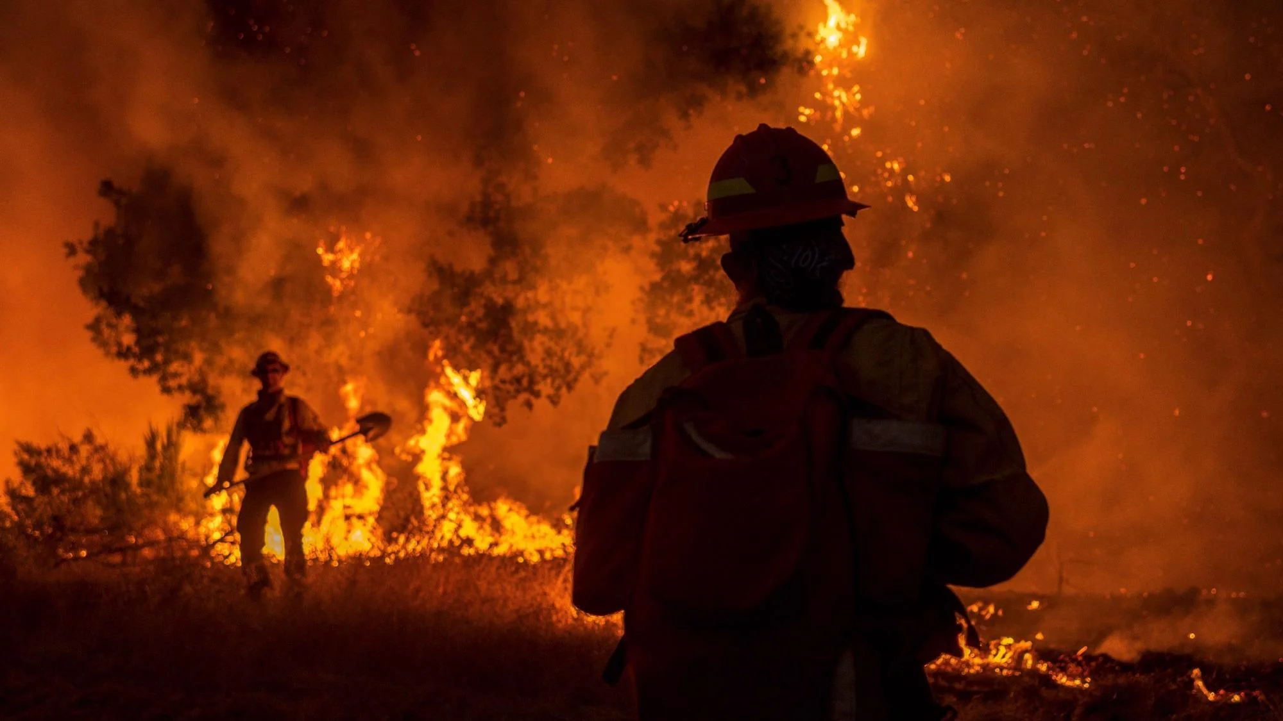
Institute of Engineering & Technology, Lucknow
Detection of Human in flame using HOG & SVM
Presented by
Supervised by
Sumit Kumar Gupta (1805232059)
Piyush Kumar Singh (1900520139002)
Sahil Chaudhary (1805213047)
Prof. Upendra Kumar
Ms. Mudita Sharan
Submitted for the partial fulfillment
of
B.Tech
in
Information Technology
Department of Computer Science & Information Technology
June 2022

Slide 2
Content
Objective
Abstract
Features of Project
Flowcharts
Fire Detection
Human Detection
Tools and technologies
Methodology
Results
Applications
Future Prospects
Requirements
Conclusion
References
Detection of Human in flame using HOG & SVM
June 2022
‹#›

Slide 3
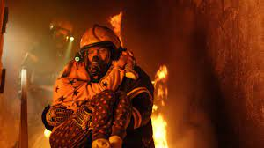
1. Objective
To integrate two independent existing models (Fire Detection model and Human Detection model) so that they can work simultaneously and set the Human priority regions in case of fire emergency.
Detection of Human in flame using HOG & SVM
June 2022
‹#›

Slide 4
2. Abstract
The project helps detect the humans who are stuck in fire by integrating two model one if fire detection and other Human detection.
The project can be broken down into two merging segments - the first is detecting the Fire, and the second is detecting the human.
We integrated both the modules to make them work together.
Detection of Human in flame using HOG & SVM
June 2022
‹#›

Slide 5
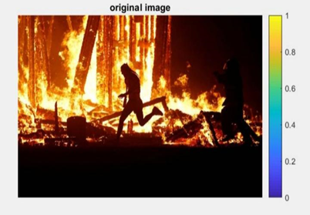
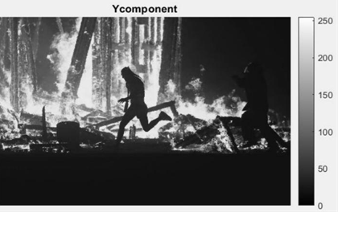
3. Features of Project
This technology replaces the conventional fire detection alarms image processing through computer vision based system.
The fire detection consists of three steps:-
1. Classification of fire pixels
2. segmentation of moving objects
3. analysing candidates region as the algo is based on image processing
Detection of Human in flame using HOG & SVM
June 2022
‹#›

Slide 6
3. Features of project
Moving pixels are detected by applying a background subtraction algorithm along with a frame differencing algorithm.
The moving pixels which are also detected as a fire pixels are further analysed in consecutive frame to raise a fire alarm.
Detection of Human in flame using HOG & SVM
June 2022
‹#›

Slide 7
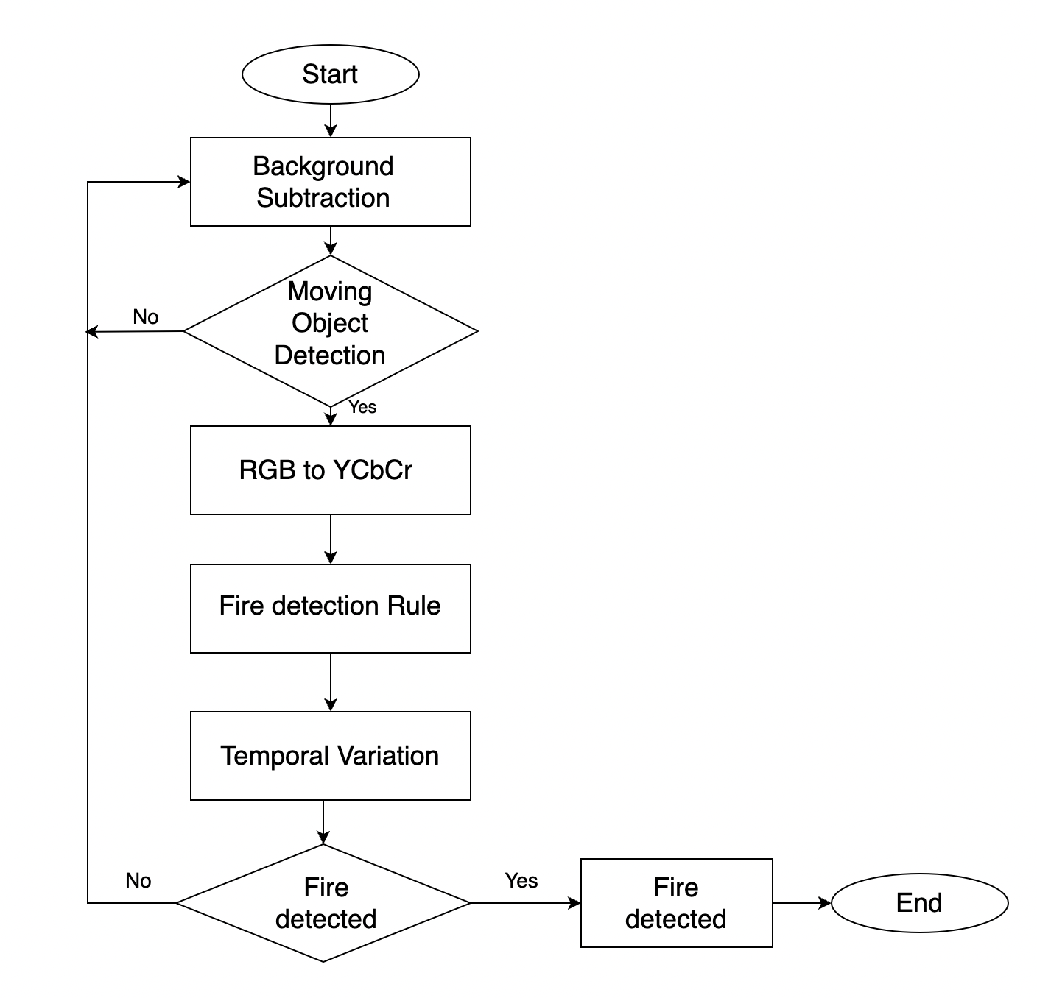
4. Flowcharts
Fire Detection
Detection of Human in flame using HOG & SVM
‹#›
June 2022

Slide 8
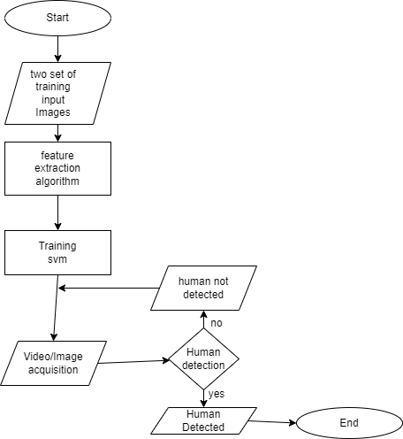
4. Flowcharts
Human Detection
Detection of Human in flame using HOG & SVM
June 2022
‹#›

Slide 9
5. Tools and technologies
OpenCV
Machine learning Algorithms like Histogram of Oriented Gradient(HOG) & Support vector machine(SVM)
Image processing
YCbCr component
Motion detection
Detection of Human in flame using HOG & SVM
June 2022
‹#›

Slide 10
6. Methodology
Fire Detection using YCbCr components
Using Background Subtraction algo for noise removal for clarification
Using Frame Differencing algo to differentiate moving objects
Convert RGB to YCbCr
Detect fire pixels on moving objects using fire detection rules of color thresholding
If detected, go for human detection
If not detected, go for background subtraction
Detection of Human in flame using HOG & SVM
June 2022
13

Slide 11
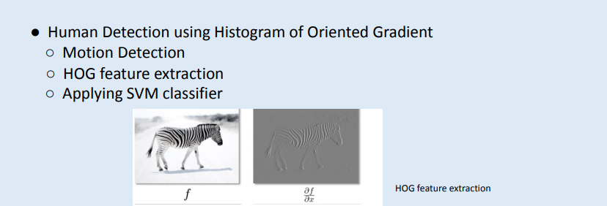
6. Methodology
Detection of Human in flame using HOG & SVM
June 2022
14

Slide 12
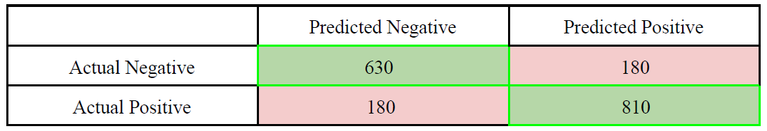
7. Result
For human detection, we used 1800 training images which included positive and negative images.
The accuracy of the algorithm depends upon the training and the classifier.
This project is also performing well with 0.81 F1 Score when trained and tested on bright Images.
Confusion Matrix
Detection of Human in flame using HOG & SVM
June 2022
‹#›

Slide 13
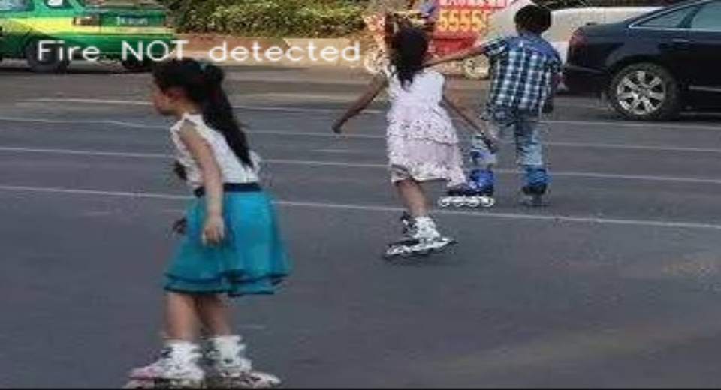
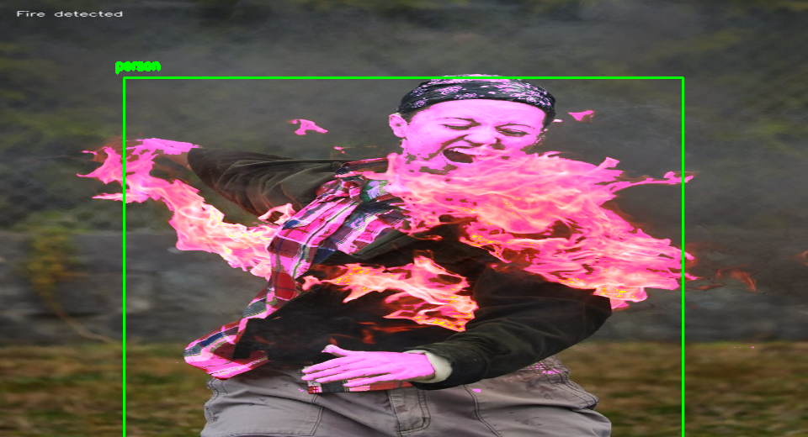
7. Result
Given below are the images of a running video, which has been demonstrated as demo as of how it actually works and the accuracy upto very acute details and as very clearly seen in Fig1, that it does not indicate smoke as fire.Fig2 gives the final output, that is the detection of fire.
Fig1. FIRE NOT DETECTED Fig2. FIRE DETECTED
Detection of Human in flame using HOG & SVM
June 2022
‹#›

Slide 14
8. Applications
This approach can be made better by cultivating this technology in a robot to rescue the humans who are in the fire to avoid destruction.
This can help the Firefighters in rapid planning and serious zones detection.
Implementing the same in the AI by also integrating water pumps suppose, there is a person in flames then the primary task of the pumps will be to extinguish the fire on the person.
The project can also be used separately, that is to say, detecting humans, which I believe can be used in drones for several projects including rescuing, governing and military purposes
Detection of Human in flame using HOG & SVM
June 2022
‹#›

Slide 15
9. Future Prospects
Phase-II (Accuracy)
Further improvement can be made by increasing the accuracy , that is to say by mending limitations . Using thermal images , we can detect the humans in heavy smoke too . By training our model with more data set , detection in very dense and blocked area. eg: forests , And detection of human, given its partial body parts images. eg: hands, legs is also a future possibility.
Phase-III (Integration)
With the knowledge and further help from experts in IOT , this model can be integrated with water pumps and drones.
Detection of Human in flame using HOG & SVM
June 2022
‹#›

Slide 16
10. Requirements for further improvements
Insufficient thermal dataset of human in fire.
Knowledge of IOT.
Hardwares like thermal camera and Infrared camera.
Detection of Human in flame using HOG & SVM
June 2022
‹#›

Slide 17
11. Conclusion
In this fire detection we used image processing in a color space.
YCbCr extracts the luma component from the image and process it further to select the fire pixel and predicts the output.
We have used Histogram of Oriented Gradients and Support Vector Machine classifier to detect humans.
Both algorithms use motion detection to recognize the moving object pixel.
This project is also performing well with F1 Score as 0.81 when compared with projects related to similar subjects.
Detection of Human in flame using HOG & SVM
June 2022
‹#›

Slide 18
12. References
[1.] Dalal, N., Triggs, B., & Schmid, C. (2021, May). Human detection using oriented histograms of flow and appearance. In European conference on computer vision (pp. 428-441). Springer, Berlin, Heidelberg.
[2]. Schalkoff, R. J. (2020). Digital image processing and computer vision (Vol. 286). New York: Wiley.
[3.] J. D. Burnett and M. G. Wing, “A low-cost near-infrared digital camera for fire detection and
monitoring,” International Journal of Remote Sensing, vol. 39, no. 3, pp. 741–753, 2018.
[4.] Viola, P., Jones, M. J., & Snow, D. (2017). Detecting pedestrians using patterns of motion and appearance. International Journal of Computer Vision, 63(2), 153-161.
[5.] Dalal, N., & Triggs, B. (2016, June). Histograms of oriented gradients for human detection.
[6.] Szeliski, R. (2010). Computer vision: algorithms and applications. Springer Science & Business Media.
Detection of Human in flame using HOG & SVM
June 2022
‹#›

Slide 19
12. References
[7.] Çelik, T., Özkaramanlı, H., & Demirel, H. (2017, September). Fire and smoke detection without sensors: Image processing based approach. In 2017 15th European Signal Processing Conference. IEEE.
[8.] Barnouti, N. H., Al-Dabbagh, S. S. M., Matti, W. E., & Naser, M. A. S. (2016). Face Detection and Recognition Using Viola-Jones with PCA-LDA and Square Euclidean Distance. International Journal of Advanced Computer Science and Applications (IJACSA), 7(5), 371-377.
[9.] J. Seebamrungsat, S. Praising, and P. Riyamongkol, “Fire detection in the buildings using image processing,” in Proceedings of the 2014 Third ICT International Student Project Conference (ICT-ISPC), pp. 95–98, IEEE, Bangkok, Thailand, March 2014.
Detection of Human in flame using HOG & SVM
June 2022
20

Slide 20
12. References
Database references:
[1.] https://www.kaggle.com/datasets/megantors/test-images-fire-humans
[2.] https://www.kaggle.com/datasets/phylake1337/fire-dataset
Detection of Human in flame using HOG & SVM
June 2022
20

Slide 21


