Slide 1

INSTITUTE OF ENGINEERING AND TECHNOLOGY, LUCKNOW
CANTEEN AUTOMATION SYSTEM
Presented by:
Pankaj Kumar(1805213035)
Pradeep Verma(1900520139003)
Arvind Kumar Singh(1805213015)
Supervised by :
Prof. MH Khan
Dr. Aditi Sharma

Slide 2
INTRODUCTION
In Colleges having mobile application for canteens is very benifitial for faculty and students respectively.
A virtual Canteen environment ensures to reduce rush on canteen and also simplifies the ordering process for both the customer and the canteen.
In virtual canteen customer can pick their favorite food similar to how they would in a regular canteen and can also compare the rating of different varieties of foods available.
Once an order is placed on the android phone, it is entered into the database and then retrieved, in pretty much real-time, by an application on the canteen’s end.
all items in the order are displayed, along with their equivalent options and supply details, in a summarizing and easy to read manner.

Slide 3
PRE-REQUISITES
Android Studio - Official Integrated Development Environment (IDE) for Android app development, based on IntelliJ IDEA .
Kotlin - Official language for Native Android App Development
XML - Frontend language for Android app.
Firebase - Google-backed application development software for android/web based applications.
Material Design - adaptable system of guidelines, components, and tools that support the best practices of user interface design.
Realtime Database - Cloud-hosted NoSQL database that lets user store and sync data between in realtime.
RazorPay - Neo-banking platform that helps business owners with end-to-end management of their finances.
Sqlite - Android’s internal database management system for mobile applications.
Git - Open source distributed version control system.
Lucid Chart - Open Source tool to create ER Diagram , DFDs , etc.

Slide 4
WHY CANTEEN AUTOMATION SYSTEM?
Automation and Reduction of Human Effort
Encryption - Effecient user data encyption as an aditional layer for user data security.
Use Case Applications - College canteens and Office cafeteria.
Caching - Used SQLite database to store menu data and
reuse it in case of low conectivity.

Slide 5
LITERATURE REVIEW
We went through a lot of different research papers to understand all the previous work done on the project that we have undertaken.
All the previous work in the field of canteen automation system were created using old technologies so we have implemented this project using Kotlin(Officail language for Android Development).
We have taken care of user's security by storing encrypted data into the database.
We have implemented Android’s internal database(Sqlite) to support caching functionality.

Slide 6
METHODOLOGY
Created Splash screen to welcome user which takes user to login screen after the delay of 2 seconds.
Logging, Logout functionality to allow only authenticated user to access in the App.
Simple, intuitive and interactive UI and provide the facility of email verification.
After successfull authentication user will see various categories of food that are currently available with their prize and an add to cart button with checkout option.
User will be redirected to payment gateway once they check out from cart , they can pay through their bank account directly or can choose COD option.
The user can also provide feedback such that canteen owner can improve their services.
Support caching mechanism to store the snapshot of orders to ensure availability of food menu in case of weak internet connectivity.
Supported user data security by encrypting user data before storing it into the databse.
Supported caching mechanism to store the snapshot of orders to support availability of food menu in case of low connectivity.

Slide 7
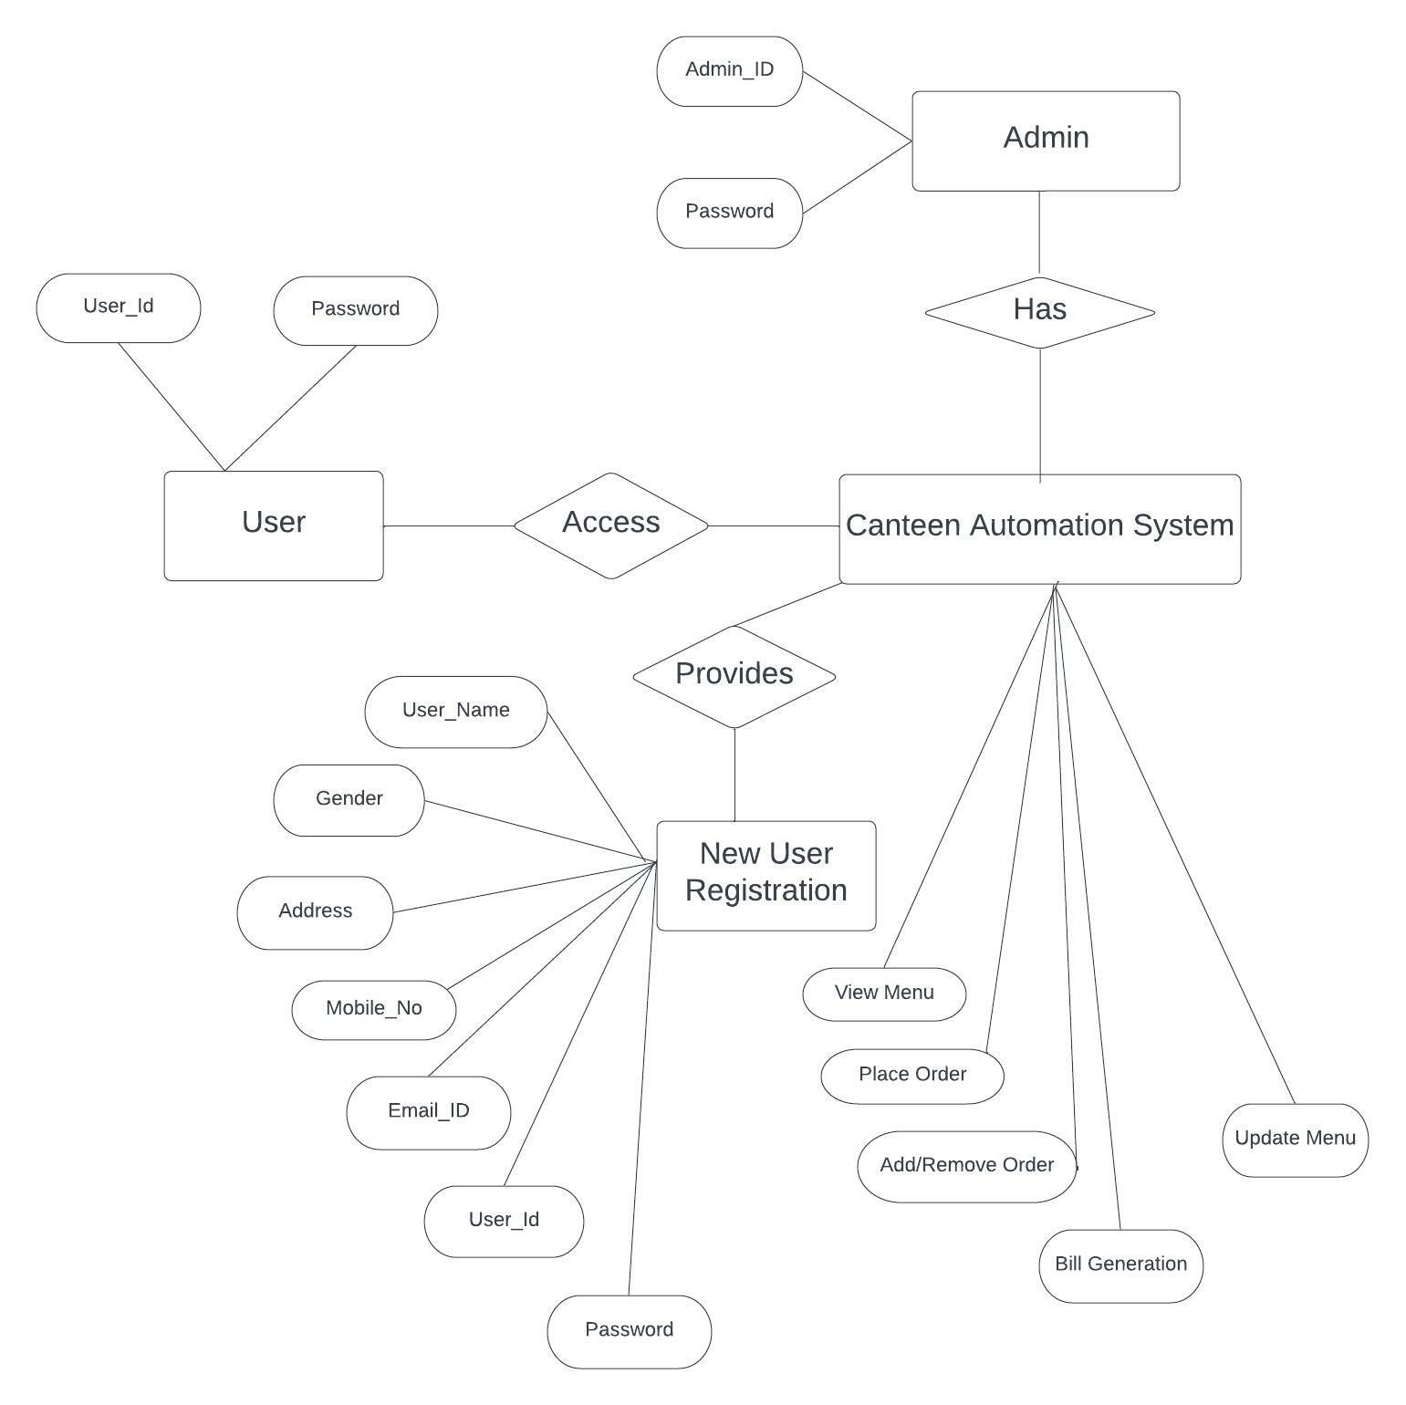
ER Diagram

Slide 8
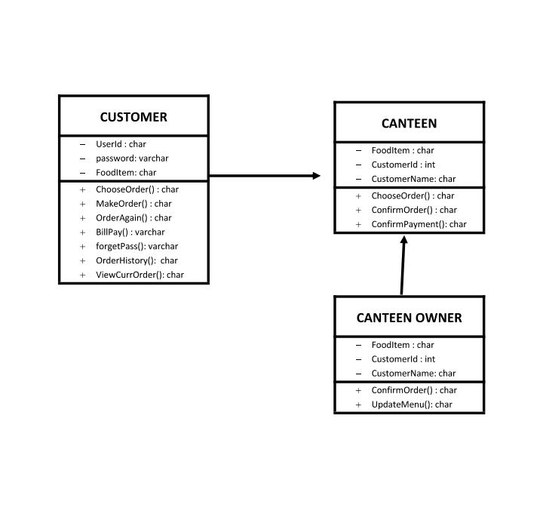
Class Diagram

Slide 9
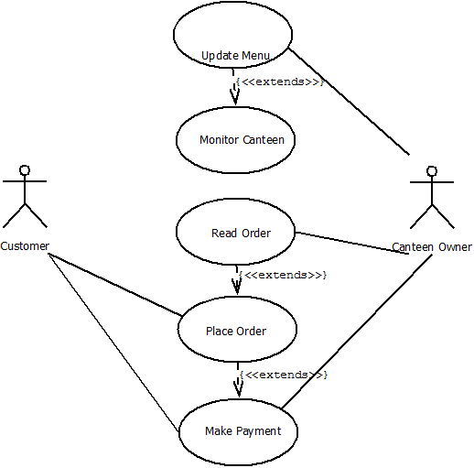
USE CASE DIAGRAM

Slide 10
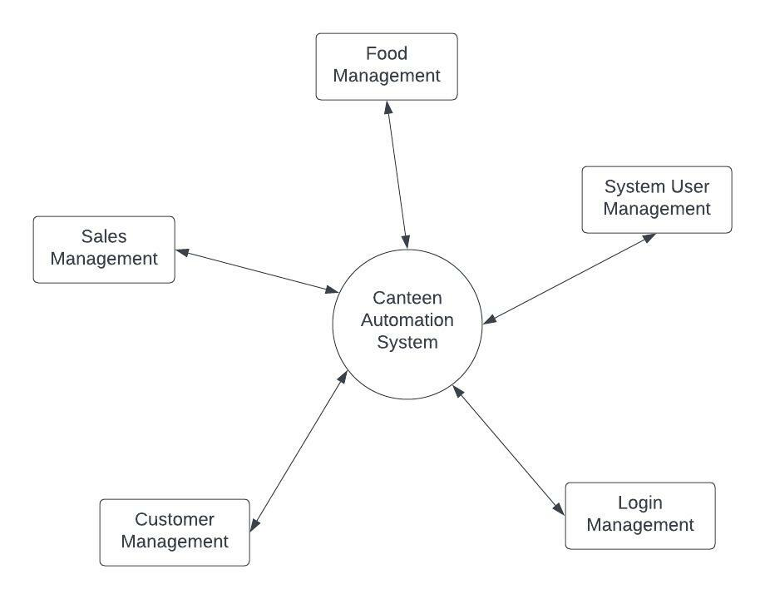
DFD (LEVEL 0)

Slide 11
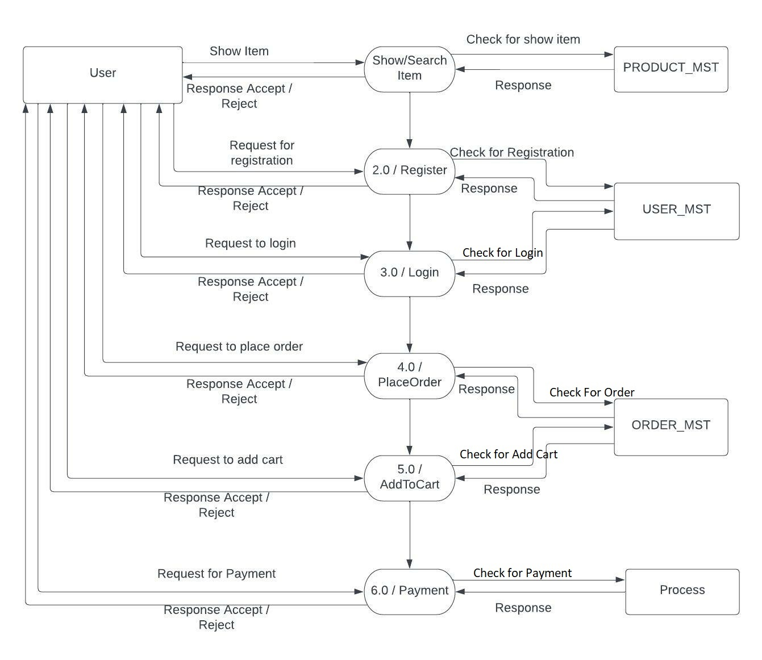
DFD LEVEL 1 (USER)

Slide 12
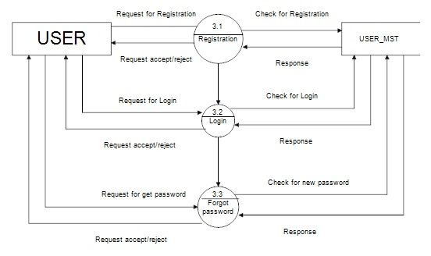
DFD LEVEL1 (AUTHENTICATION)

Slide 13
Onboarding Flow
Sign-up:
To get a user onboard, they have to register on the screen(shown below) first. During the registration/sign-up, we are storing the user information as customer_name, customer_id,
Roll_no, Mobile_no, password and conform password(to be generated), and a file of a College_id_card and all these informations are encrypted before saving into the database.
Sign-in:
After getting registered, one should sign-in at the canteen. For this, they have to verify their
Email-id using a link sent to them , also they will be required to enter the email-id they have used their password they have created while registering.

Slide 14
Sign-up Screen Sign-in Screen

Slide 15
Activities

Slide 16
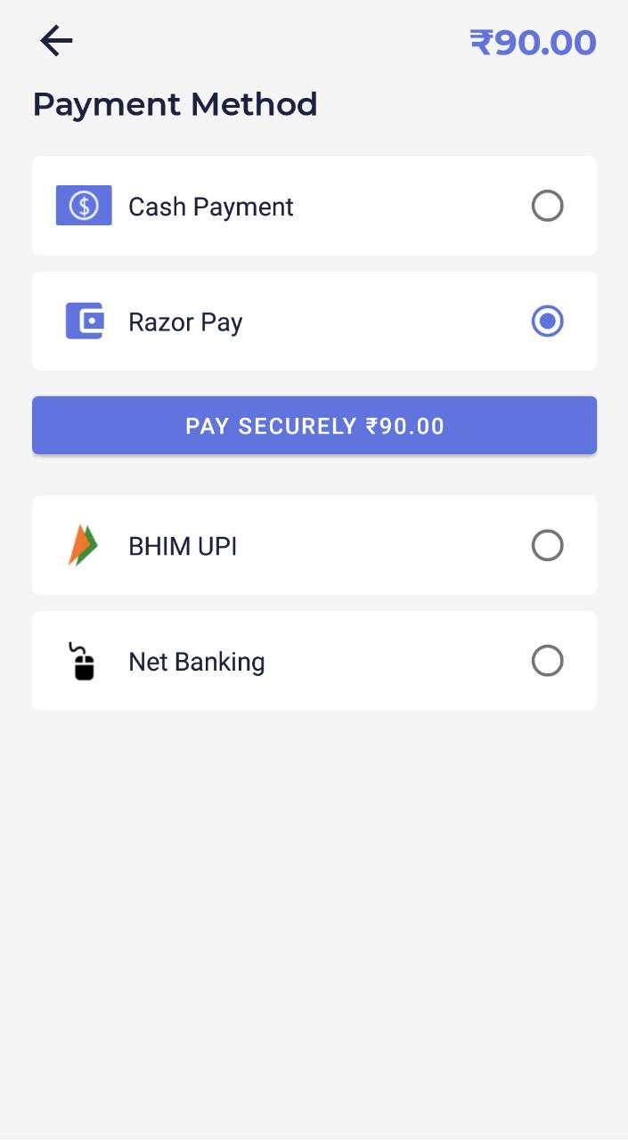
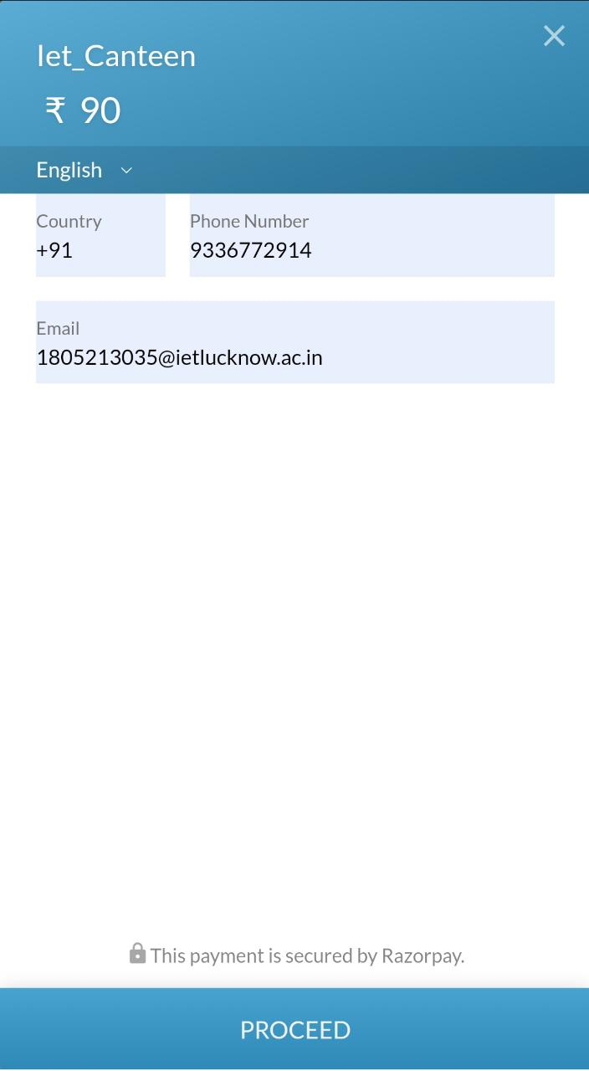
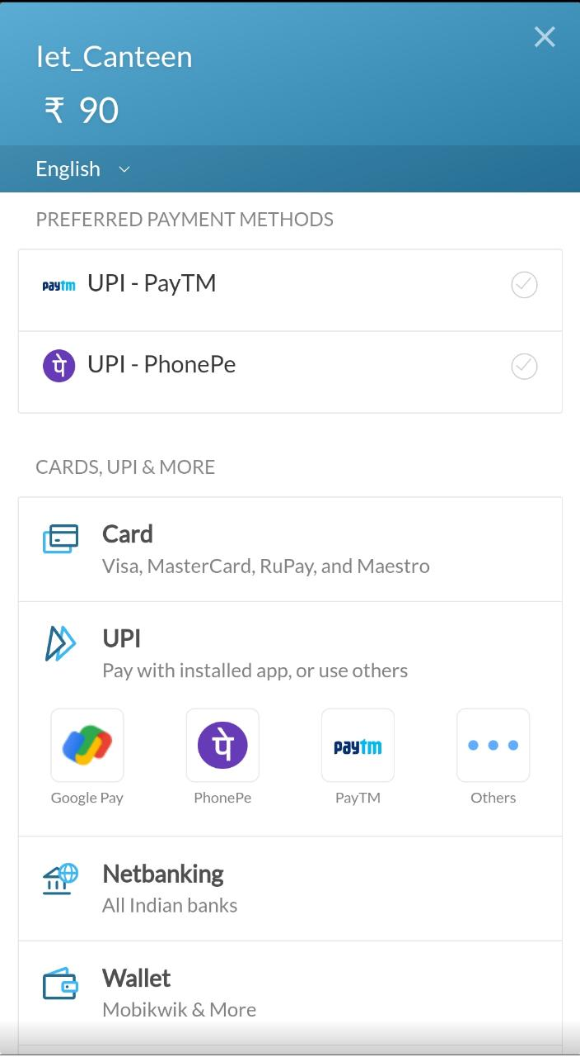
Activities

Slide 17
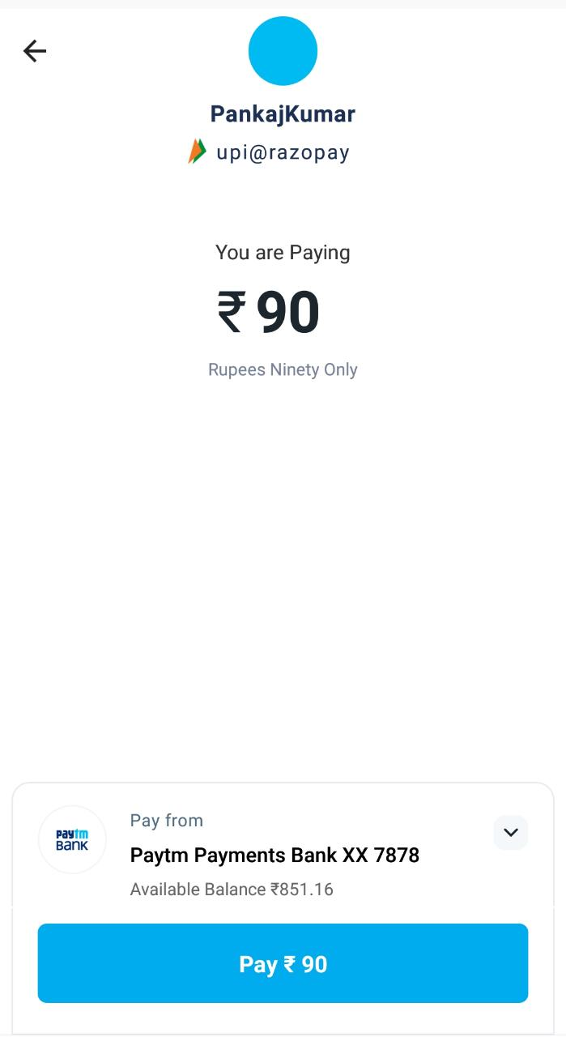
Activities

Slide 18
Activities

Slide 19
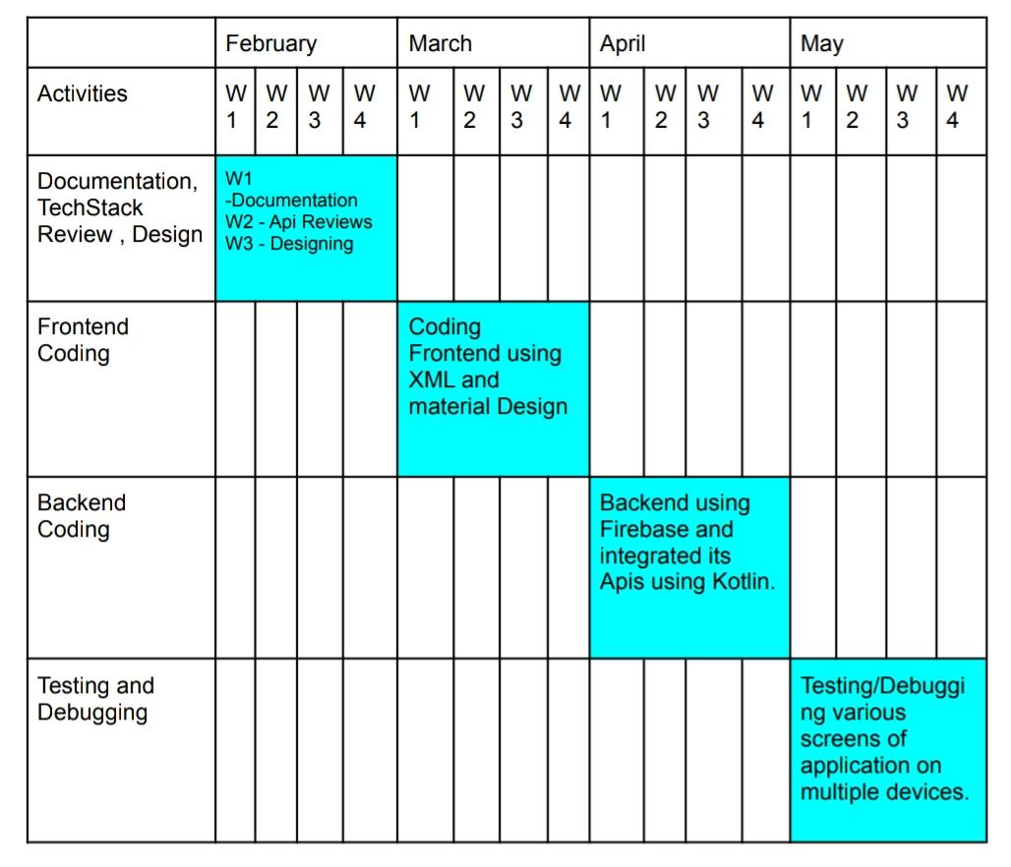
Plan Of Action

Slide 20
Development Requirement:
64-bit Microsoft® Windows® 8/10/11.
x86_64 CPU architecture; 2nd generation Intel Core or newer, or AMD CPU with support for a Windows Hypervisor.
8 GB RAM or more.
8 GB of available disk space minimum (IDE + Android SDK + Android Emulator)
1280 x 800 minimum screen resolution.

Slide 21
Application Requirements
Hareware Requirements
i3 Processor Based Computer or higher
Memory: 1 GB RAM
Hard Drive: 50 GB
Internet Connection
Software Requirements
Windows 7 or higher
Android Development Toolkit(ADT)
Visual Studio 2010
Android 4.0 or higher

Slide 22
Advantages
Completely automated online ordering of food in a canteen.
Reduce crowd and time of canteen and student too.
Order can be placed using personal android phones.
Food ordering pages that look and feel exactly the same as the existing restaurant
website.
Single and individual Admin Panel and login for each Canteen.
Detailed summary of orders placed with option to search orders, update order
status, etc.
Data Encryption is done on user password.

Slide 23
Conclusion
The end result of the mentioned methodology and planned action will be a highly interactive UI with working functionalities of a canteen automation system, which will keep user data secure and will be able to handle low connectivity issue using caching mechanism.
This application aims to aggregate all the activities related to food ordering on a homogeneous ecosystem, which greatly enhance the user experience and streamline user flow.

Slide 24
Reference
N. Durga Swathi & 2 T. Durga , “Online canteen food orering system” , Aegaeum Journal, Issn No : 0776-3808 , Issue 8, 2020
Nikhil Sahani1 , Darshan Kadam2 , “Canteen Automation System using Android ” ,IJIRT ,ISSN: 2349-6002 , issue 1 , 2019.
Yang, T., Lai, I. K. W., Fan, Z. B. “Interactive service quality on the acceptance of self-service ordering systems for the restaurant industry”. Journal of Hospitality and Tourism Technology Vikram. B. Mane – IEEE paper, issue 4 volume 10. August 2018.
B Muniraja , J Rajanikanth - In - Time Billing Process for Canteen Management System - International Journal of Emerging trends in Engineering Research (IJETER), Vol. 3 No.6, Pages : 200 - 203 (2017) .
tutorials on point. (2020). SDLC-agile model-tutorialspoint. Retrieved from tutorials point.com.

