Slide 1

Resume Parser
Presented by :
Rajneesh Gupta (1805213044)
Himanshu Pandey (1805213024)
Deependra Kumar (1805213019)
Supervised by:
Dr. Upendra Kumar Sir
Mr. Ajit Shukla Sir

Slide 2
Introduction
Resume parsing refers to the analysis of job resumes.
Resume parsing software provides to companies an efficient way to identify keywords and skills,
Used to sort through large quantities of applications to identify the best applicants

Slide 3
Motivation
Corporate companies and recruitment agencies process numerous resumes daily.
An automated intelligent system is required which can take out all the vital information from the unstructured resumes.
Transform all of them to a common structured format which can then be ranked for a specific job position.

Slide 4
Technologies Used
Python
Flask (Framework)
NLTK
MongoDB
Bootstrap
RestFul Api
JavaScript

Slide 5
How It Works?
First we collect all the resumes in pdf format.
Extract text from pdf files.
Convert these unstructured text into structured text using punkt, averaged_perceptron_tagger,
maxent_ne_chunker.
Getting all stopwords and eliminate these from text.
Generate bigrams and trigrams to look into our skill set Data Base.
Calculate the percentage of match and store it in database.
Select best matched results.

Slide 6
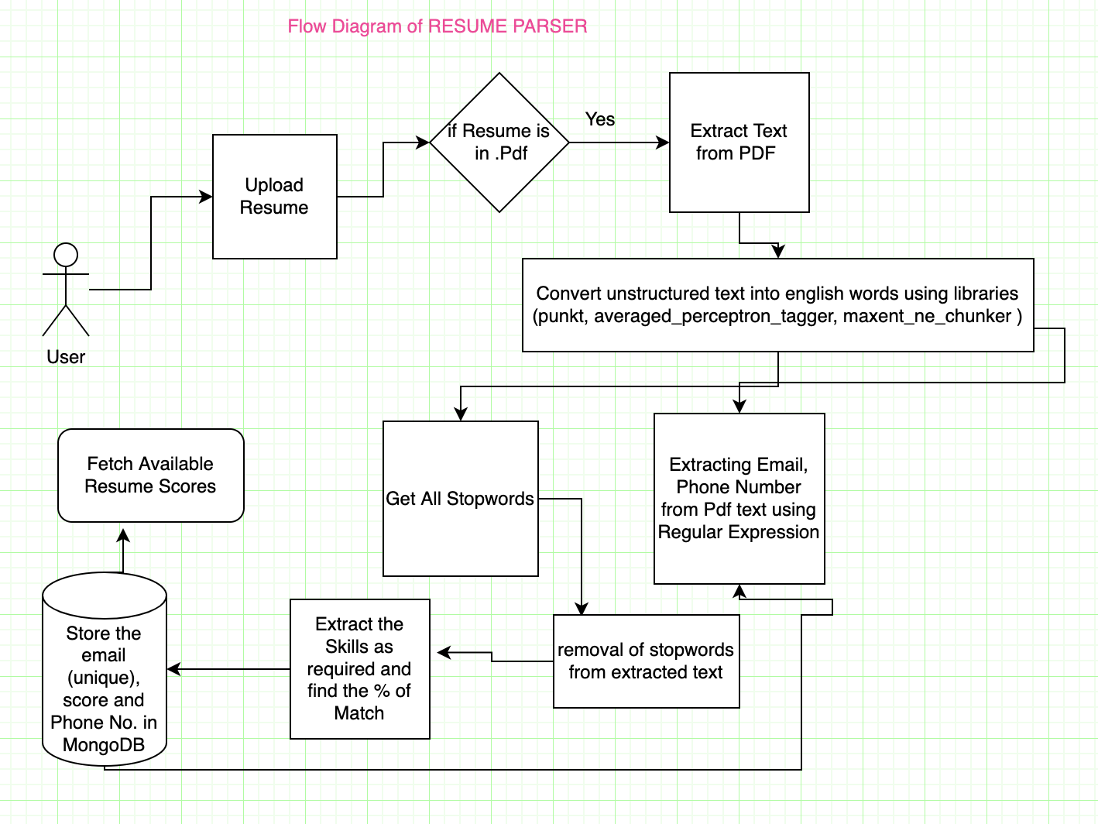

Slide 7
Details about Libraries used
1- Pdfminer.six : It is a Python tool which is used to extracting information from pdf documents.It focuses on getting and analyzing the text data.
2-NLTK (Natural language toolkit): NLTK is a toolkit build for working with NLP in python. It provides us various text processing libraries.

Slide 8
3- Stopwords : it is a NLTK library , which is used to get all possible commonly used word(such as “the”, “a”,”in”) , and then remove these words from our text because these are unnecessary for us. 4- Tokenization : it is the process of tokenizing or splitting a string, text into a list of tokens. Like a word is a token in a sentence and a sentence is a token in a paragraph.

Slide 9
Punkt
Averaged_perceptron_tagger
Maxent_ne_chunker
Flask :
It is python lightweight python framework that provide useful tools and features that help in making server and backend part.

Slide 10
MongoDB:
It’s a nosql database used for storing resume data.
Here we store the data in documents rather than relational tables.
Restful APIs:
It stands for Representational State Application Programming Interface, It’s a principle of writing APIs in backend.
Formula Used = ( number of skills matched / number of input skills) * 100

Slide 11
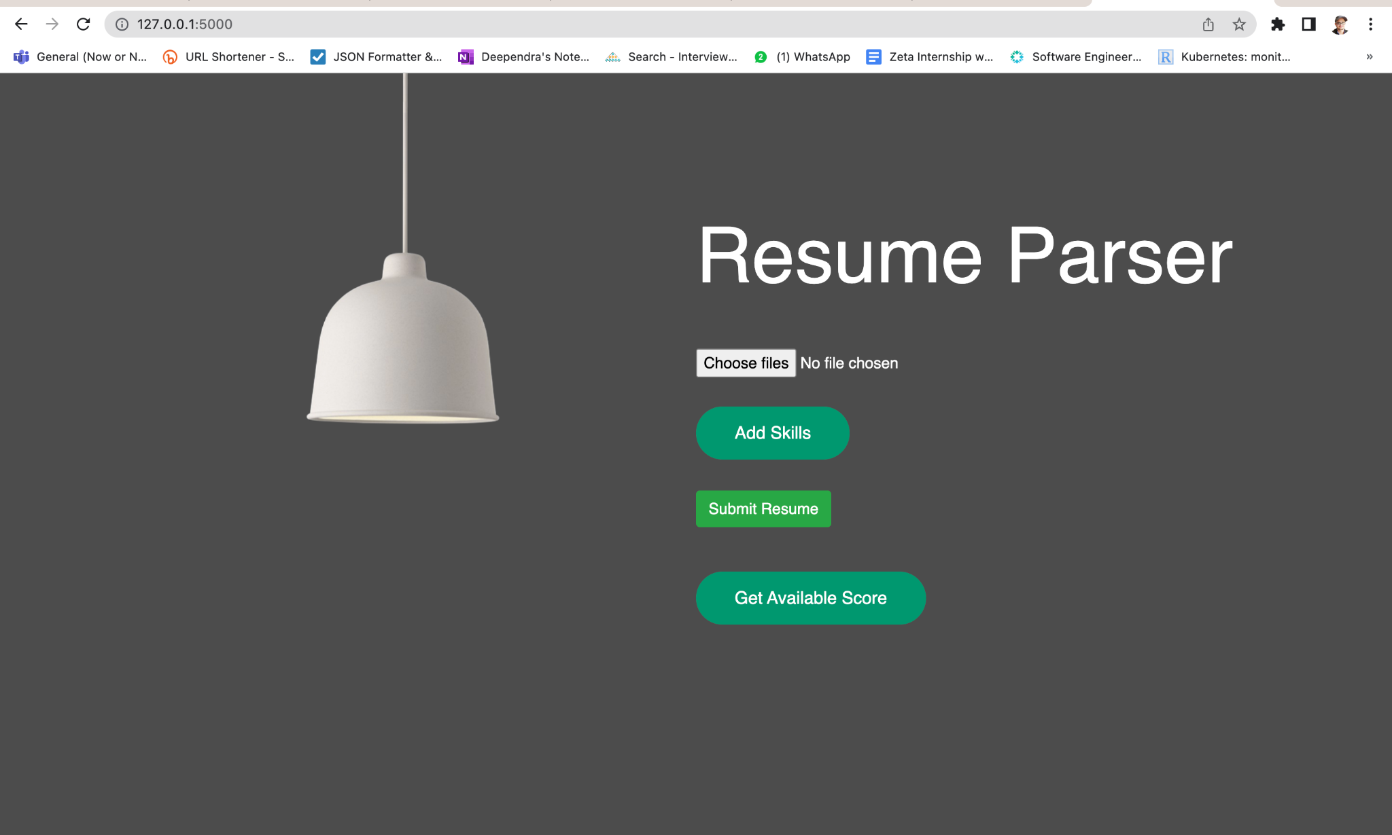

Slide 12
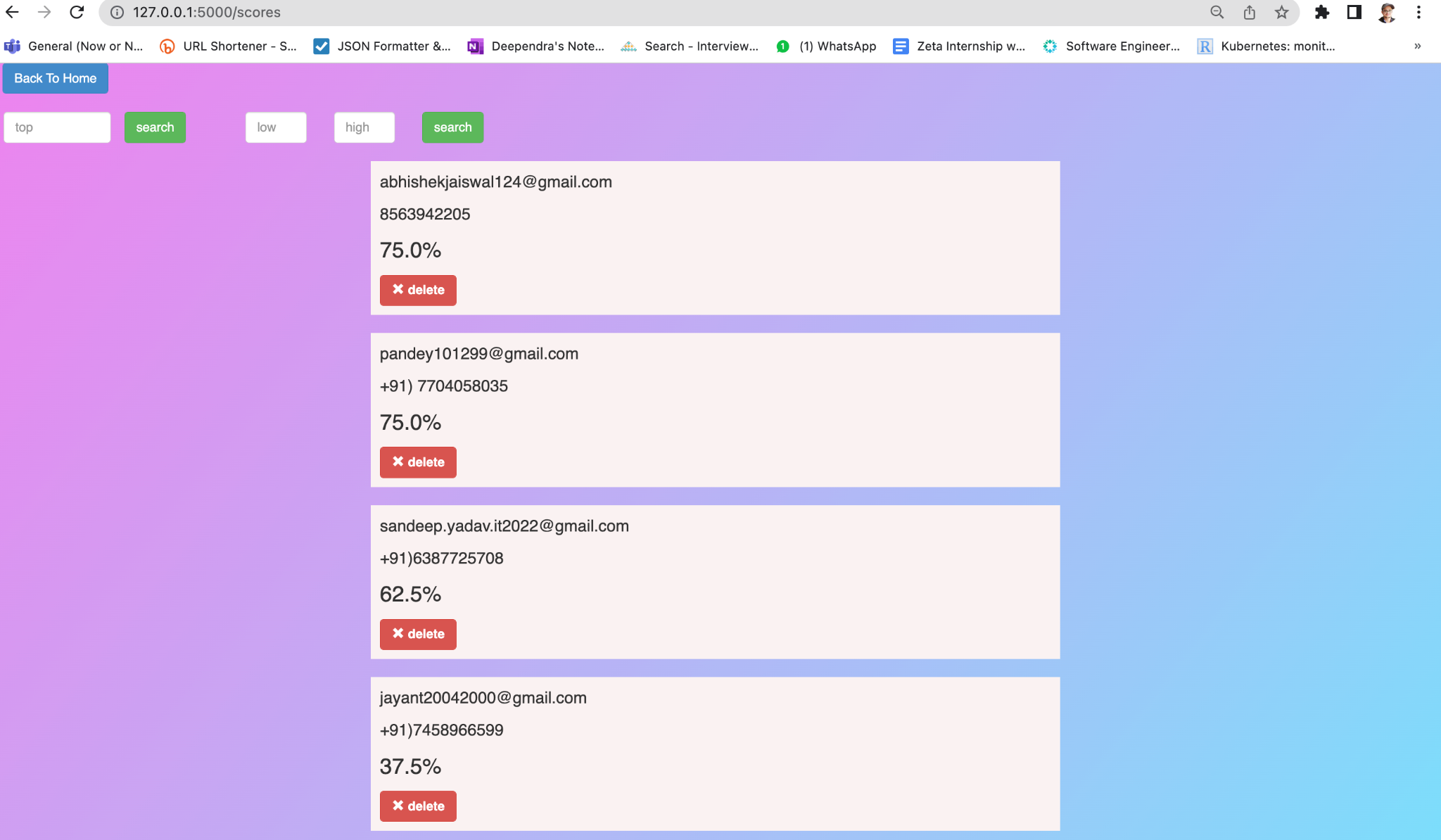

Slide 13
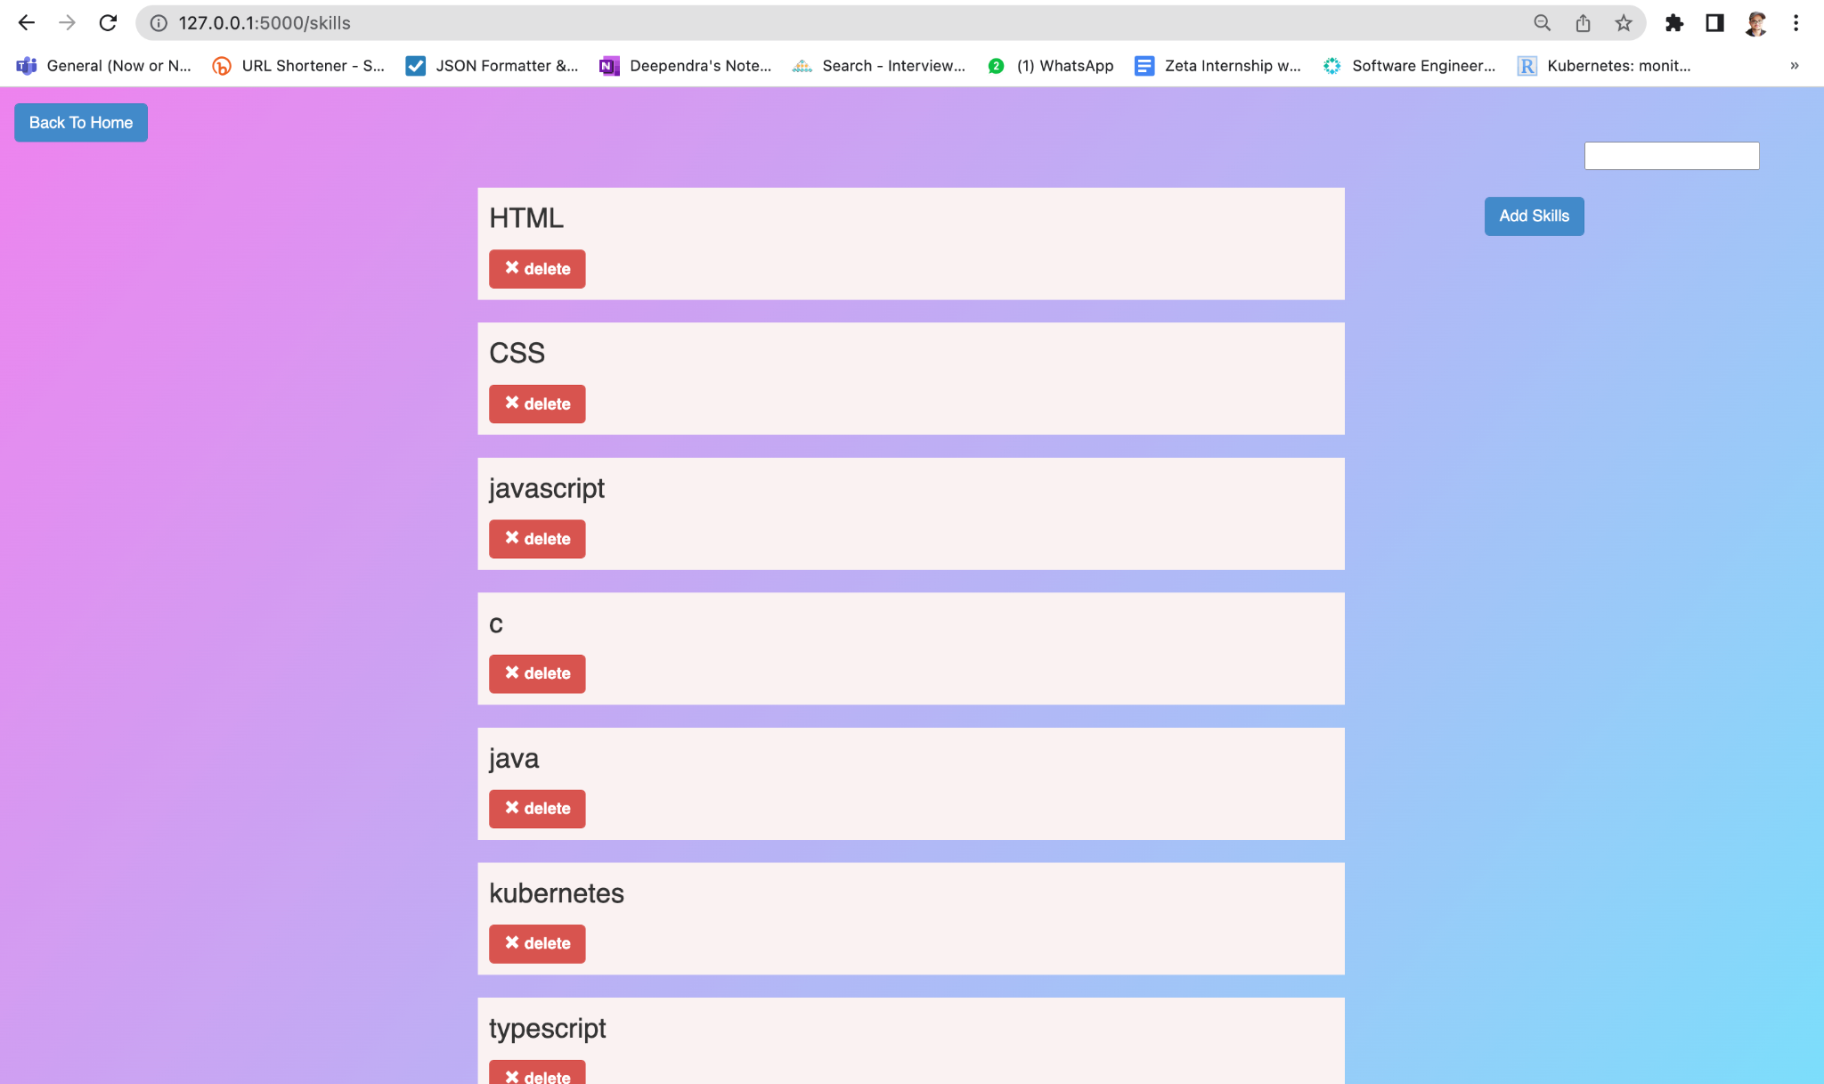

Slide 14
CONCLUSION
Our approach is to make the work of companies and candidates easier and effective. Basically our aim is to ease the recruitment process. The process will provide the quality of applicants for the companies. The unfair and discriminatory practice in the process will be dampened. Based on the information in the form of skills the resumes will be ranked in order.

Slide 15
Future Scope
Will be able to parse multiple types of resume like .doc , .docx files etc.
Will be able to parse Resume in different languages.
Will try to extract names of individuals whose resume we are processing.

Slide 16
THANK YOU

