Slide 1



PlagScan Character Based Extrinsic Plagiarism Detector
Supervisors:
Dr. Parul Yadav
Er. Mudita Sharan
Submitted By:
Ritik Kumar Gupta
Ritik Kumar
Shubham Kumar

Slide 2

Table of Content
Introduction
Need
Objective
Features
Action plan
Working Model
Methodology
Snapshots
Technologies Used
How we are better?
Target
Experimental Results
What’s Next?
Problems Still Unsolved
References

Slide 3

INTRODUCTION
Plagiarism is widely acknowledged to be a significant and increasing problem for higher education institutions .A wide range of solutions, including several commercial systems, have been proposed to assist the educator in the task of identifying plagiarized work, or even to detect them automatically but the story does not end up here because as new tools are created , new ways of plagiarism also developed.
Detecting plagiarism is an active area of research; the task is non-trivial and the differences between paraphrased answers and original work are often not so obvious even by existing tools.

Slide 4
NEED
As we are moving towards a more of digital era, many things have changed , mostly after pandemic of 2020. Virtual Classrooms and online classes are a must for todays world and hence the chances for plagiarism also increases between students as it is a natural human tendency to move to a low burden zone.
But it is crystal clear that it will make any economy weak no matter how powerful they were in the past.
Our PlagScan is an all-in-one solution to it which utilise latest algorithms to create itself as a barrier in front of cheaters.

Slide 5
OBJECTIVE
The aim of the project is to provide institutions a minimum cost full pipelined model to conduct their exams free from any malpractices involved in minimum processing time.

Slide 6
FEATURES
Provides the class labels for plagiarism as either 0 or 1. Useful for writing original pieces within a short time. Helps in staying within the regulatory and ethical limits.
Able to provide graphical insights to output.
OS compatible and able to scan loads of data in a single click.
Less processing time with low costs.

Slide 7
Dataset collection + Initial Development
Notebook 2
Testing + Deployment
Dec
Jan
Feb
Mar
Apr-May
Notebook 1
Notebook 3

Slide 8
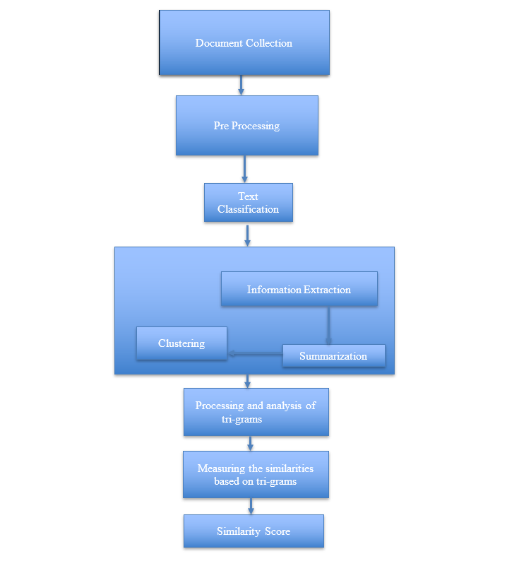
WORKING MODEL

Slide 9
METHODOLOGY
This project will be broken down into three main notebooks:
Notebook 1: Data Exploration
Load in the corpus of plagiarism text data.
Explore the existing data features and the data distribution.
Notebook 2: Feature Engineering
Clean and pre-process the text data.
Define features for comparing the similarity of an answer text and a source text, and

Slide 10
METHODOLOGY
extract similarity features.
Select "good" features, by analysing the correlations between different features.
Create train/test .csv files that hold the relevant features and class labels for train/test data points.
Notebook 3: Train and Deploy Your Model in SageMaker
Uploading train/test feature dataset to S3.
Define a binary classification model and a training script.
Use SVM Classification Model (Pytorch can be alternative)
Deleting endpoints

Slide 11
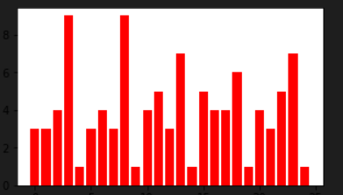
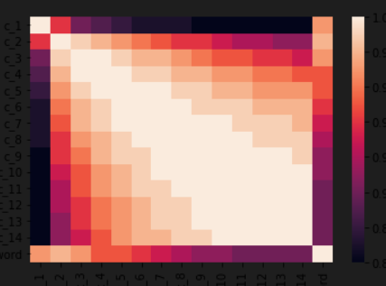
SNAPSHOTS
Bar plot between category type and associated task
Co-matrix seaborn plot between n-gram containment values

Slide 12
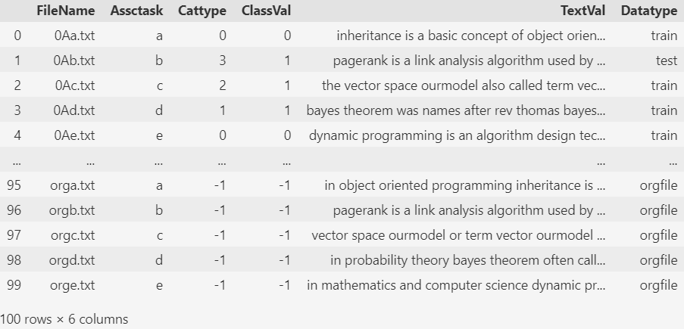
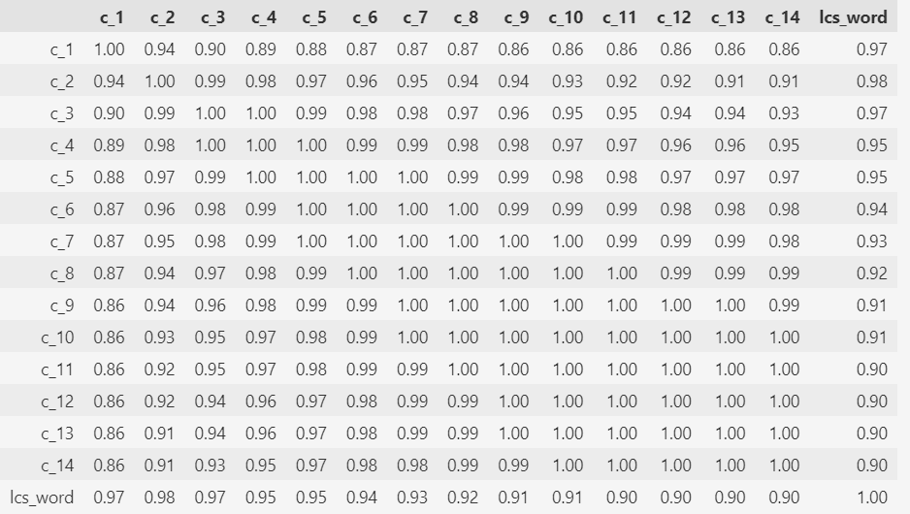
SNAPSHOTS

Slide 13

TECHNOLOGIES USED
Programming Environment – REPL
IDE– Jupyter Notebook (v.4.6)
Browser – Chrome (v.97.0)
OS – Windows (64 bit)
Deployment – AWS Sagemaker
EC2 instance – ml.t2.medium (6 IPv6 private addresses on port 80)
Block Storage – S3
Programming Language – Python (v.3.9.0)
Libraries – numpy, pandas, matplotlib, seaborn etc
Classification – Sklearn
Sampling – Stratified Sampling
Similarity Features – n-gram, LCS
Server – Tornado
Others – PyCharm, VS Code
Processor – Intel Scalable (3.3 Ghz)

Slide 14

HOW WE ARE BETTER THAN OUR COMPETITORS IN MARKET?
Competitors – Grammarly | Plagiarism checker X | CopyScape |Turnitin
Techniques they generally used - Jaccard Coefficient | Cosine Coefficient | Overlap Coefficient | Levenshtein Distance | Hamming distance | Dice Coefficient.
Our game changing players – Containment (n-gram) & LCS features.
How?
Achieving minimum detection run length | maximum stitch distance | minimum post stitch run rate | minimum cosine score , which leads to minimum recall value | maximum precision value | maximum granularity, which leads to a overall minimum PAN score. (CLEF, 2022)

Slide 15
TARGET
Processing total of 10 minutes for entire PAN 100 dataset (7500 x 7500) using ml.t2.medium EC2 on one virtual core with max to max memory load increase of 3 Gigabytes and maximum network bandwidth of 300 Mbit/sec at minimum cost of $0.0464/hr (4 Rs/hr).

Slide 16
Experimental Results
On deploying PlagScan on AWS Sagemaker (us-east-1 region) with notable instance of ml.t3.medium along with estimator instance of ml.c4.xlarge and deployer instance of ml.t2.medium on al1-v-1 platform identifier of elastic inference ml.eia1.medium in 5GB of “Any” S3 bucket storage without VPC, we get following measurements on Sklearn:-
Uploading - Uploading generated training model
Completed - Training job completed
Training seconds: 36
Billable seconds: 36
CPU times: user 343 ms, sys: 23.3 ms, total: 366 ms
Wall time: 2min 41s

Slide 17
Experimental Results
The accuracy ,precision, recall and f1-score we get in output is as follows:-
Recall: 1.000
Precision: 1.000
Accuracy: 1.000
The billing cost for our 3735 PUT,COPY,POST requests and 585 GET requests of 105 dataset files having 0.031Gb-mo of Notebook Instance ML Storage and 0.006 Gb-mo Training ML Storage on Gp2 EBS with 0.135 hours of hosting ml.t2.medium and 0.143 hours of training ml.c4.xlarge on us-east-1 region zone is as follows:-
$0.06 (4.68 INR ac 11-05-22)

Slide 18
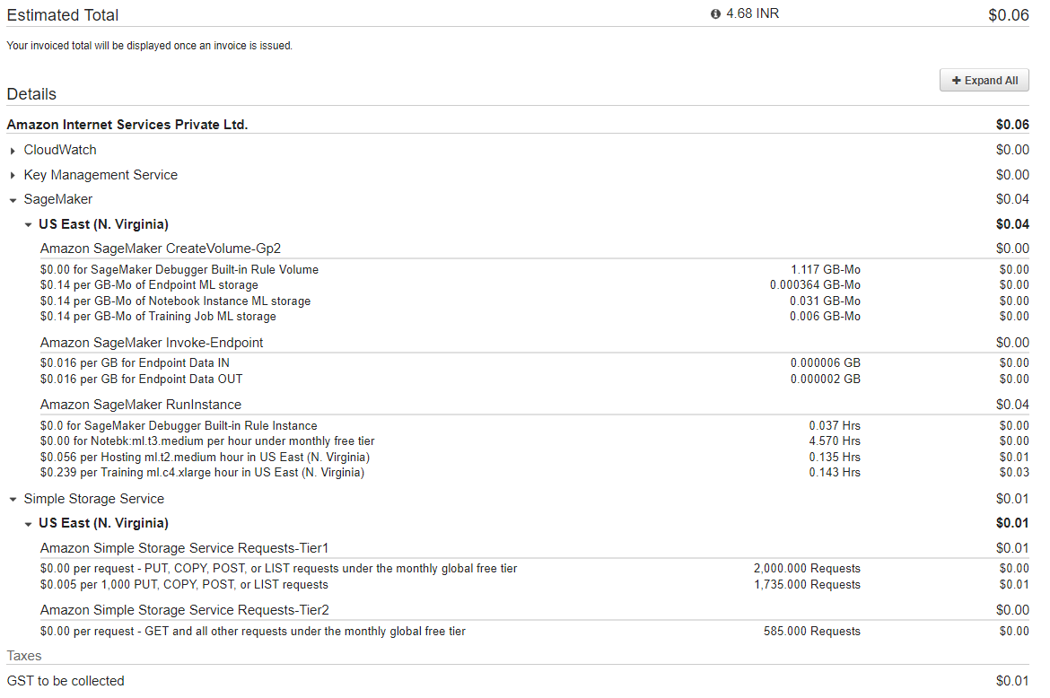

Slide 19
WHAT NEXT?
To integrate cross lingual detection algorithms.
To integrate Citation based, Grammar based and Structure based methods to enhance and extend the productivity.
To use not only Extrinsic but Intrinsic methods too for plagiarism check.
To use every possible file format like Adobe PDF, Microsoft Word, RTF, ODT and HTML.
Connect to Google search API to extend database.
Creating GUI and deploy on hosted website.

Slide 20
PROBLEMS STILL UNSOLVED
A detection method that ensures proof of completeness and correctness is missing.
A proximity measure that guarantees detection of plagiarized text segment in both intrinsic and extrinsic detection framework with high accuracy,
Developing a cross-lingual plagiarism checking tool that can perform without external references but ensures high accuracy is a challenging task.
Tension between being able to process the data quickly, and performing well within finite time.
We can clearly improve our production processes and filtering approach but the benefits of these improvements outweigh the costs of development is another problem that we cannot yet solved.
Using a larger database and handling related ssh and http traffic.

Slide 21
References
Clough, P. and Stevenson, M. Developing A Corpus of Plagiarised Short Answers, Language Resources and Evaluation: Special Issue on Plagiarism and Authorship Analysis, In Press
J. Yeung, S. Wong, A. Tam and J. So, "Integrating Machine Learning Technology to Data Analytics for E-Commerce on Cloud," 2021 Third World Conference on Smart Trends in Systems Security and Sustainablity (WorldS4), 2021, pp. 105-109, doi: 10.1109/WorldS4.2019.8904026.
Clough, P., Stevenson, M. Developing a corpus of plagiarised short answers, Language Resources and Evaluation, 45 (1), pp. 5-24

Slide 22
THANK YOU

