Slide 1
Summary
Tristie White
Learning chunking: The point of data chunking is to break down huge amounts of data into smaller versions of its self and make it easier and faster to manage

Slide 2
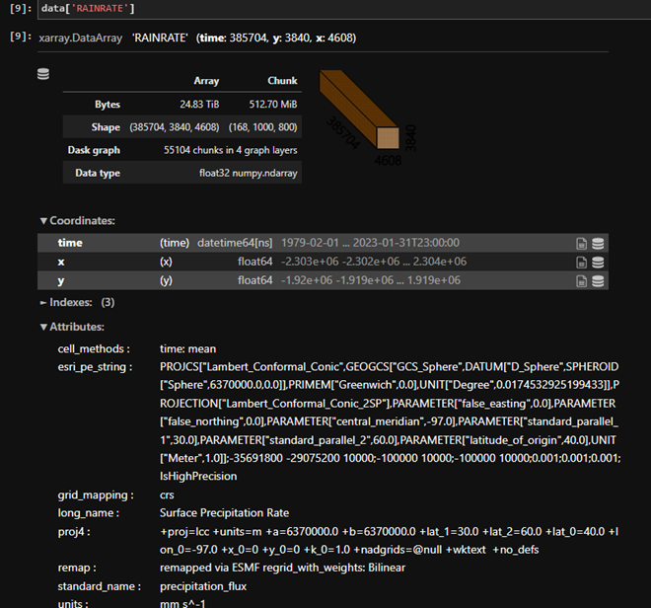
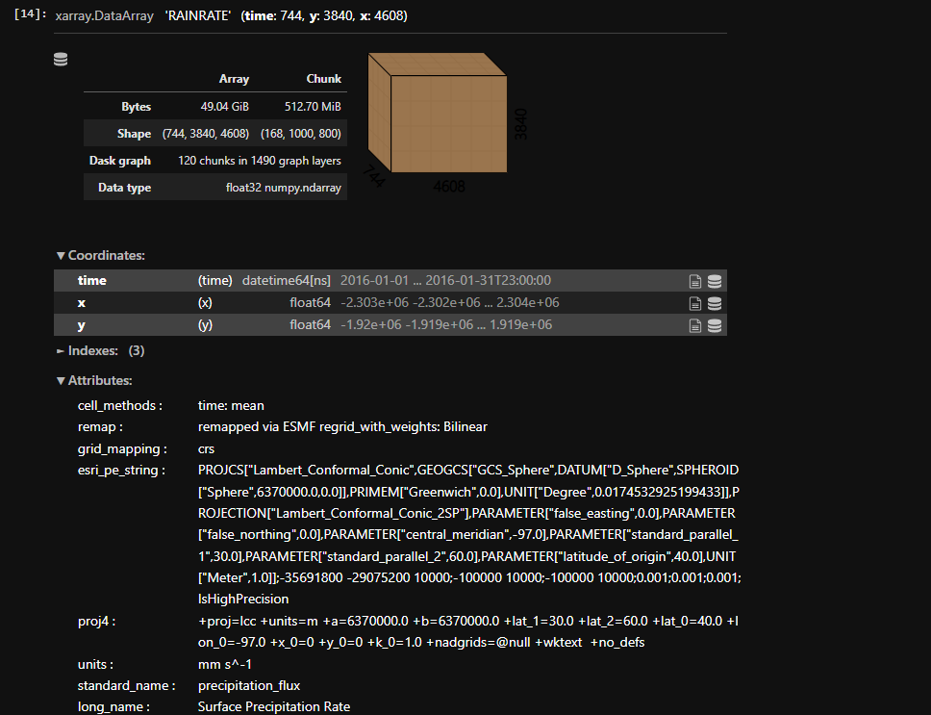
Learning
During the research experience we learned about data set, how to chunk them and compare the data. Using the data from the aws is smaller and faster than using it on the local storage
Data set that was from the aws cloud
Data set from local storage

