Slide 1
Kip kop network
Ocskó Gábor, Jelenovics Milán, Kómár Attila

Slide 2
IP address allocation (VLSM)
Ocskó Gábor

Slide 3
What was the task?
• Network identifier - both in binary and decimal form
• Scatter address - both in binary and decimal form
• First assignable IP address - in both binary and decimal form
• Last assignable IP address (If the network contains switches, they will receive the last assignable IP address) - in both binary and decimal form
• Second assignable IP address (If the network contains servers, they will receive the second assignable IP address) - in both binary and decimal form
• Subnet masks - binary, decimal and prefix
• Total cost of all IP addresses to be purchased

Slide 4
Implementation
-create an empty vlsm table
-put the ip addresses in the right place
-arrange to be transparent (optional)
-Use the DEC.BIN command to convert what was needed to binary
calculate how bad the forint is, that is, calculate how much it will cost

Slide 5
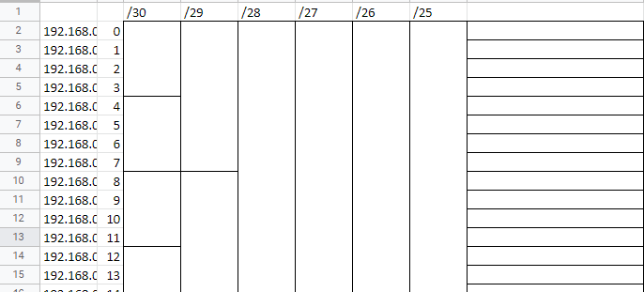
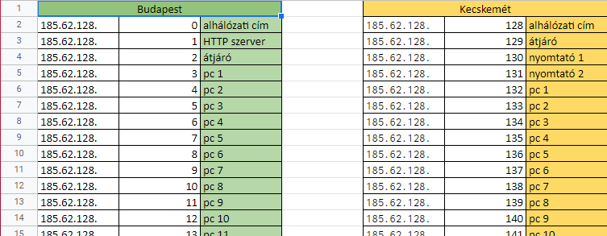


Slide 6
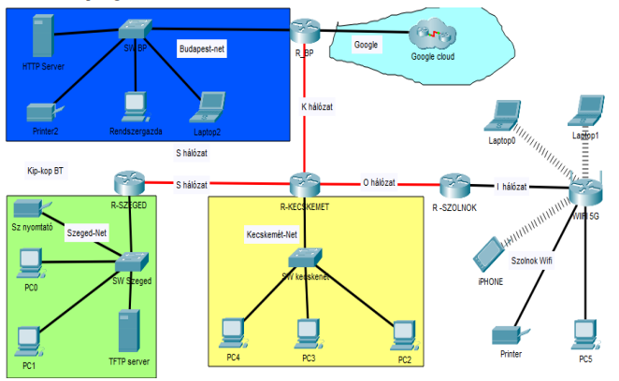
Creating the network topology
By Jelenovits Milán

Slide 7
Routers, Switches
Router(2911): Adding network cards (HWIC-1GE-SFP) for Gigabit Ethernet ports (GLC-LH-SMD)
Switch(PT-Empty): Adding Gigabit Ethernet ports(NM-1CGE)

Slide 8
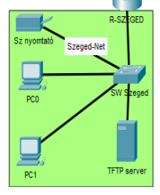
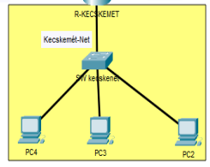
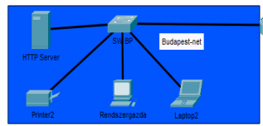
Computers, printers
Replacing network cards from Fast Ethernet (100 Mbps) to Gigabit Ethernet cards

Slide 9
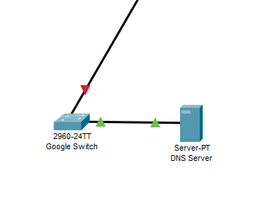
Google Cloud
1 Switch (2960), 1 DNS Server

Slide 10
Google network and DNS configuration
Kómár Attila

Slide 11
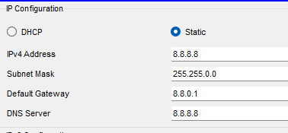
Server IP configuration
IP address: 8.8.8.8
Mask: /16 (255.255.0.0)
Default gateway: 8.8.0.1
DNS Server’s IP is itself

Slide 12
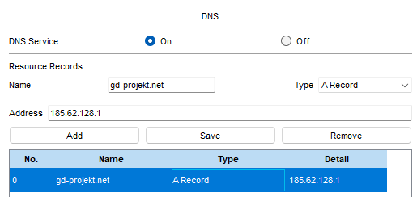
DNS (Domain Name System)
Turn the DNS Service on
Website’s name: gdprojekt.net
Address: 185.62.128.1

Slide 13
R_BP Router configuration
enable
configure terminal
ip route 0.0.0.0 0.0.0.0 GigabitEthernet0/0
interface GigabitEthernet0/0
ip address 8.8.0.1 255.255.0.0
no shutdown
exit

Slide 14
Budapest-net network configuration
Ocskó Gábor

Slide 15
What did you have to do?
On the switch:
-set password in privileged EXEC mode
-add a username and password
-remote access with telnet
-set login message
-config to the tftp server
On the router:
-set password in privileged EXEC mode
-enter username with password
-remote access with ssh

Slide 16
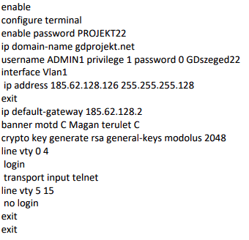
Implementation the commands on the switch

Slide 17
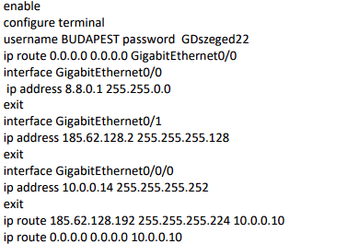
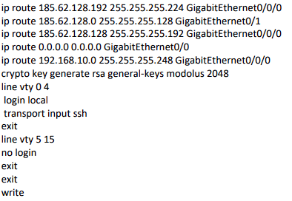
Implementation the commands on the router

Slide 18
Webpage
By Jelenovits Milán

Slide 19
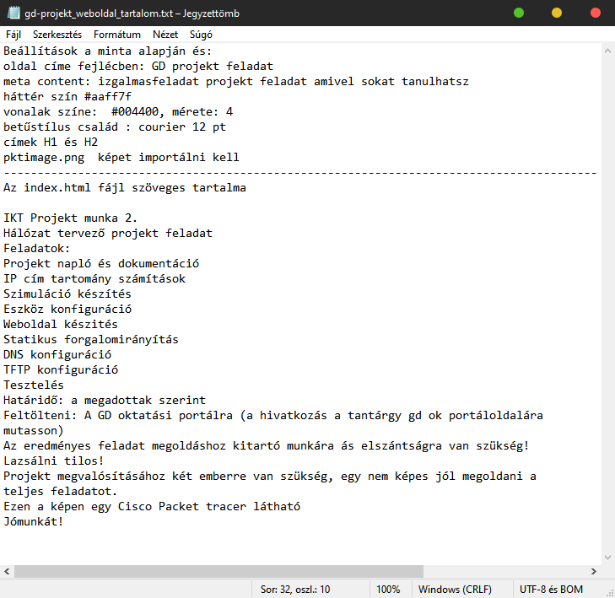
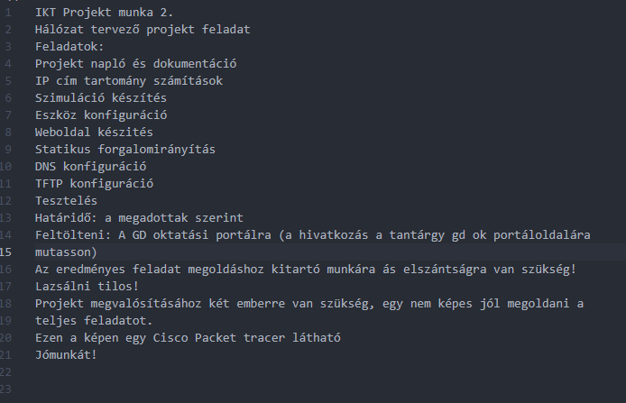

Copying source

Slide 20
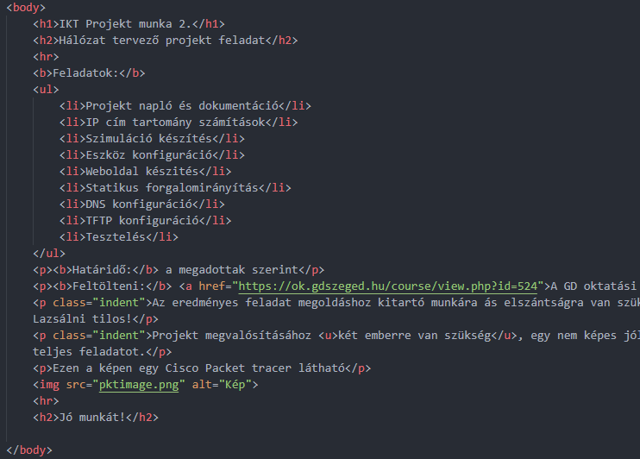
Text layout
Arrangements of paragraphs, lists and links
List
Link
Paragraph

Slide 21
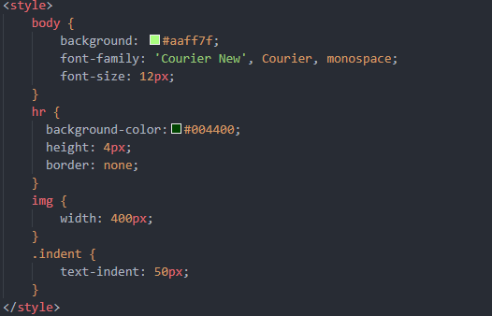
Style
Background, Resizing image, Text indent and font size

Slide 22
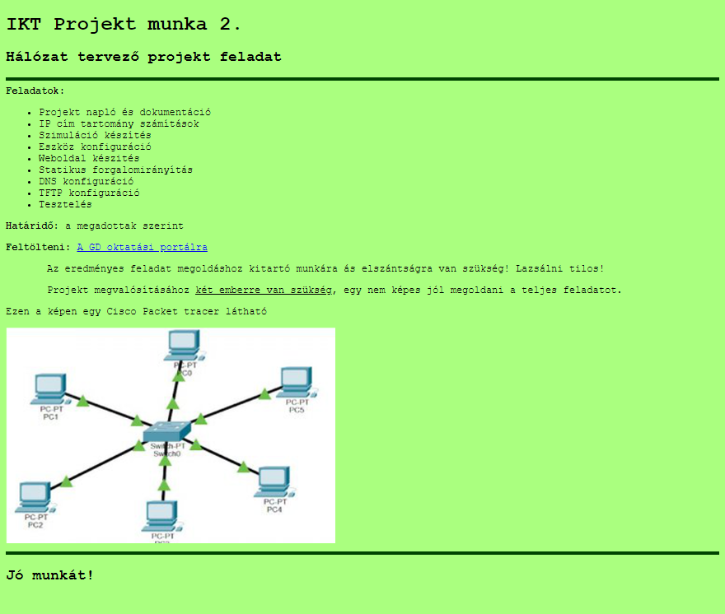

Slide 23
Kecskemét-net network
By Jelenovits Milán

Slide 24
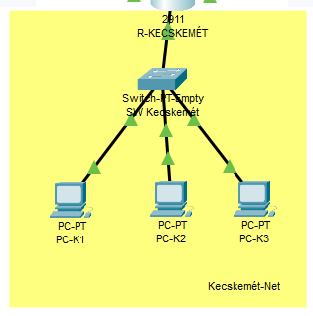
Topology

Slide 25
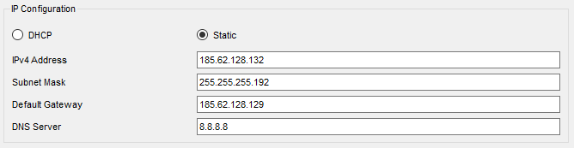
IP addresses
PC-K1: 185.62.128.132
PC-K2: 185.62.128.133
PC-K3: 185.62.128.134

Slide 26
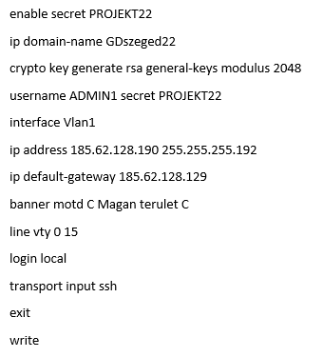
SW Kecskemét configuration

Slide 27
Szolnok Wifi subnet configuration
Kómár Attila

Slide 28
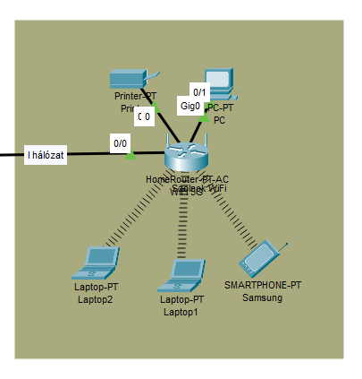
Topology

Slide 29
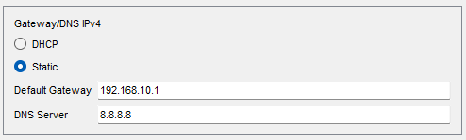
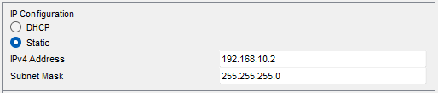
IP addresses
Printer: 192.168.10.2
PC: 192.168.10.3

Slide 30
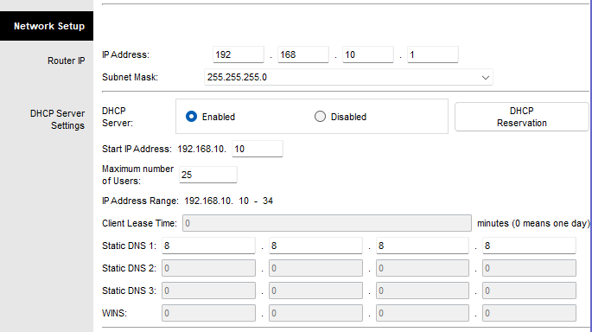
Wifi Setup

Slide 31
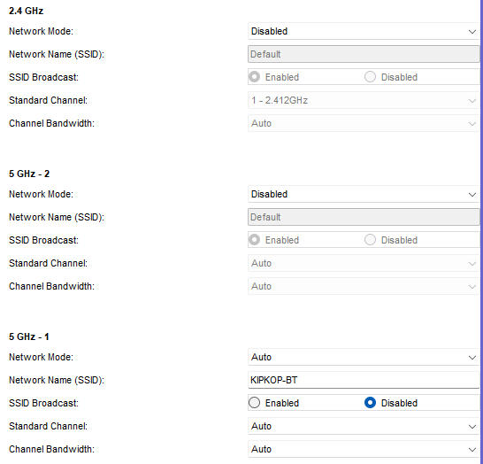
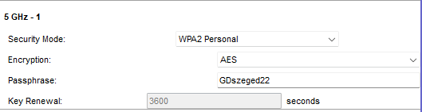
Wifi Wireless

Slide 32
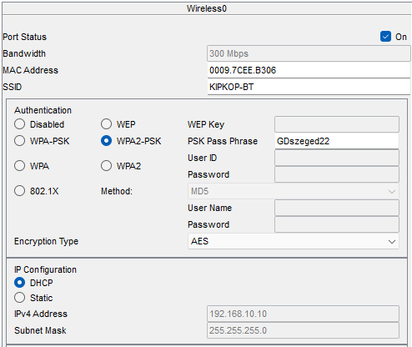
Wireless devices

Slide 33
I, K, S and O networks
Ocskó Gábor

Slide 34
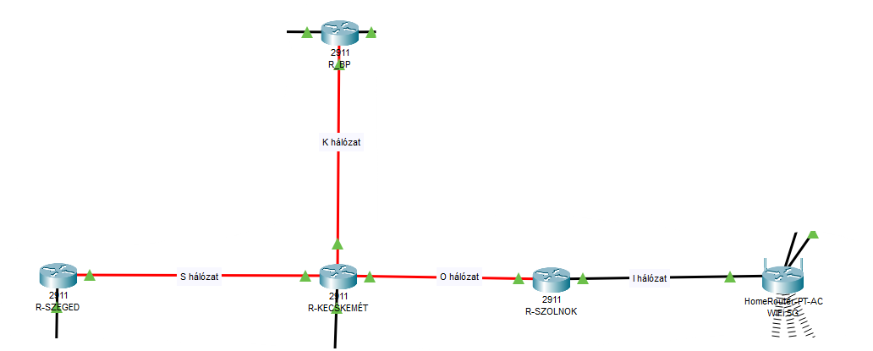
The topology

Slide 35
What was the task?
-To set the ip addresses of R-SZOLNOK
-Set a password and set a message of the day
-Save config to tftp server

Slide 36
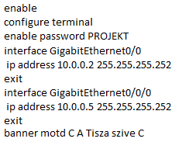
R-SZOLNOK
To set the ip address and the other stuff listed, you needed these:

Slide 37
Checking the network
P A I N

Slide 38
What was the task?
-Check with the courier
-To ping
-Is the Gdprojekt.net page available?
-Ssh and telnet

Slide 39
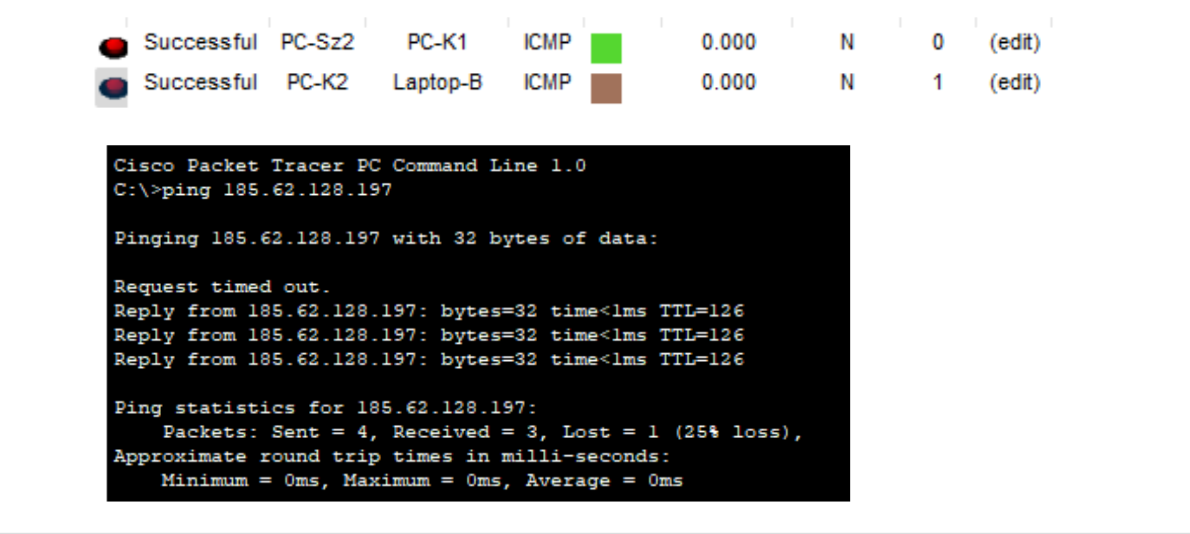
Mail and ping

Slide 40
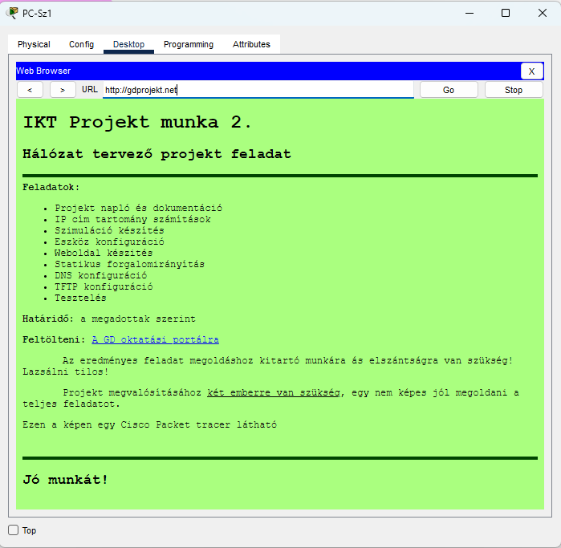
gdszeged.net from the szeged pc

Slide 41
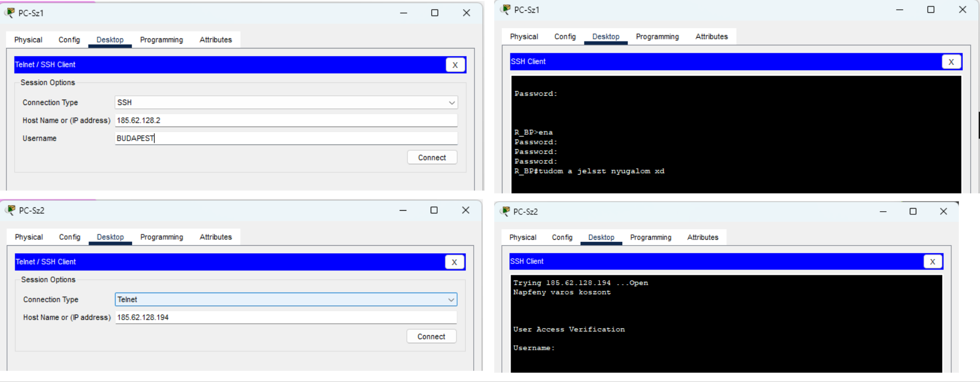
SSH and Telnet
ssh also requires a user, but telnet only requires an ip address

Slide 42
Thank you for your attention!

