Slide 1
Kip kop network
Ocskó Gábor, Jelenovics Milán, Kómár Attila

Slide 2
IP address allocation (VLSM)
Ocskó Gábor

Slide 3
What was the task?
• Network identifier - both in binary and decimal form
• Scatter address - both in binary and decimal form
• First assignable IP address - in both binary and decimal form
• Last assignable IP address (If the network contains switches, they will receive the last assignable IP address) - in both binary and decimal form
• Second assignable IP address (If the network contains servers, they will receive the second assignable IP address) - in both binary and decimal form
• Subnet masks - binary, decimal and prefix
• Total cost of all IP addresses to be purchased

Slide 4
Implementation
-create an empty vlsm table
-put the ip addresses in the right place
-arrange to be transparent (optional)
-Use the DEC.BIN command to convert what was needed to binary
calculate how bad the forint is, that is, calculate how much it will cost

Slide 5
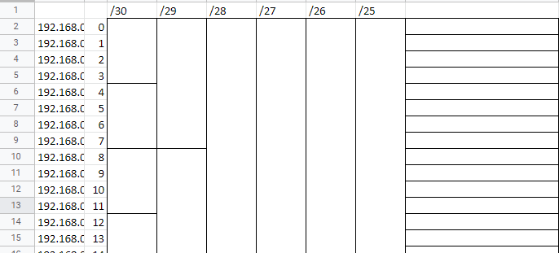
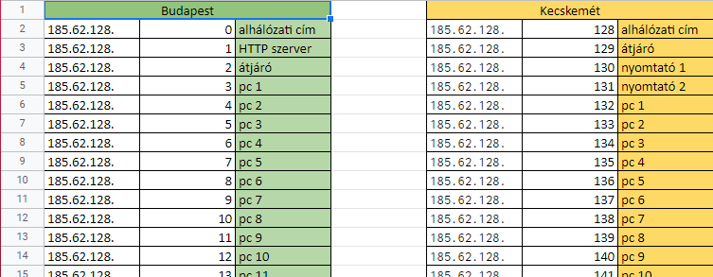


Slide 6
Budapest-net network configuration
Ocskó Gábor

Slide 7
What did you have to do?
On the switch:
-set password in privileged EXEC mode
-add a username and password
-remote access with telnet
-set login message
-config to the tftp server
On the router:
-set password in privileged EXEC mode
-enter username with password
-remote access with ssh

Slide 8
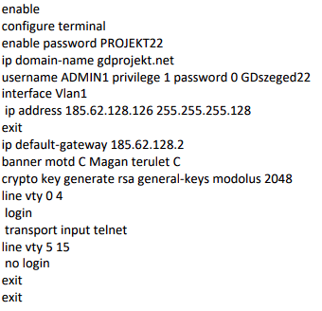
Implementation the commands on the switch

Slide 9
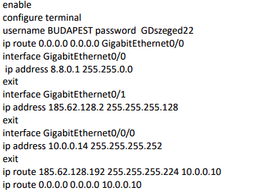
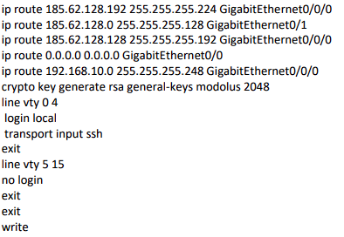
Implementation the commands on the router

Slide 10
I, K, S és O network
Ocskó Gábor

Slide 11
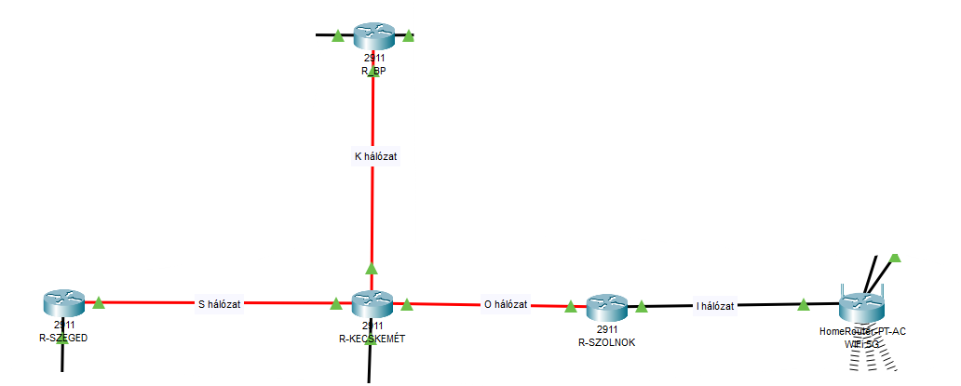
The topology

Slide 12
What was the task?
-To set the ip addresses of R-SZOLNOK
-Set a password and set a message of the day
-Save config to tftp server

Slide 13
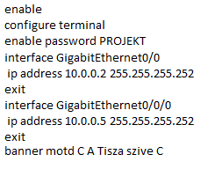
R-SZOLNOK
To set the ip address and the other stuff listed, you needed these:

Slide 14
Checking the network
P A I N

Slide 15
What was the task?
-Check with the courier
-To ping
-Is the Gdprojekt.net page available?
-Ssh and telnet

Slide 16
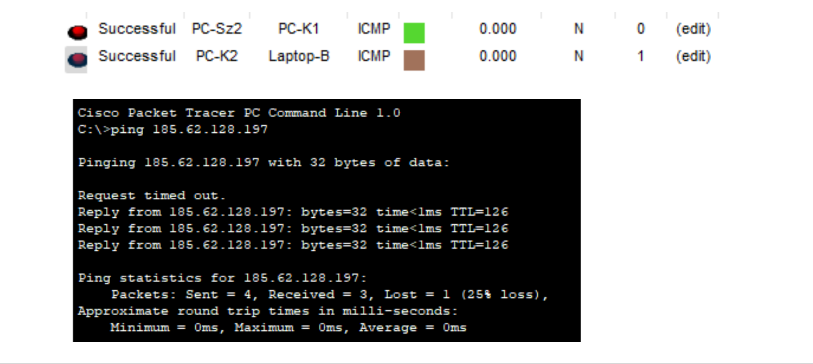
Mail and ping

Slide 17
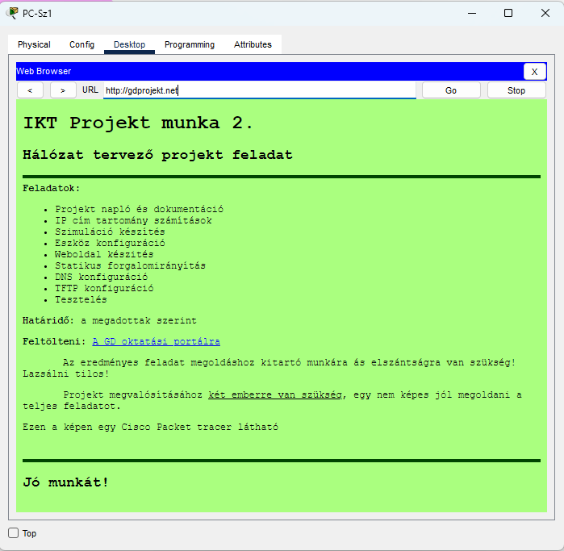
gdszeged.net from the szeged pc

Slide 18
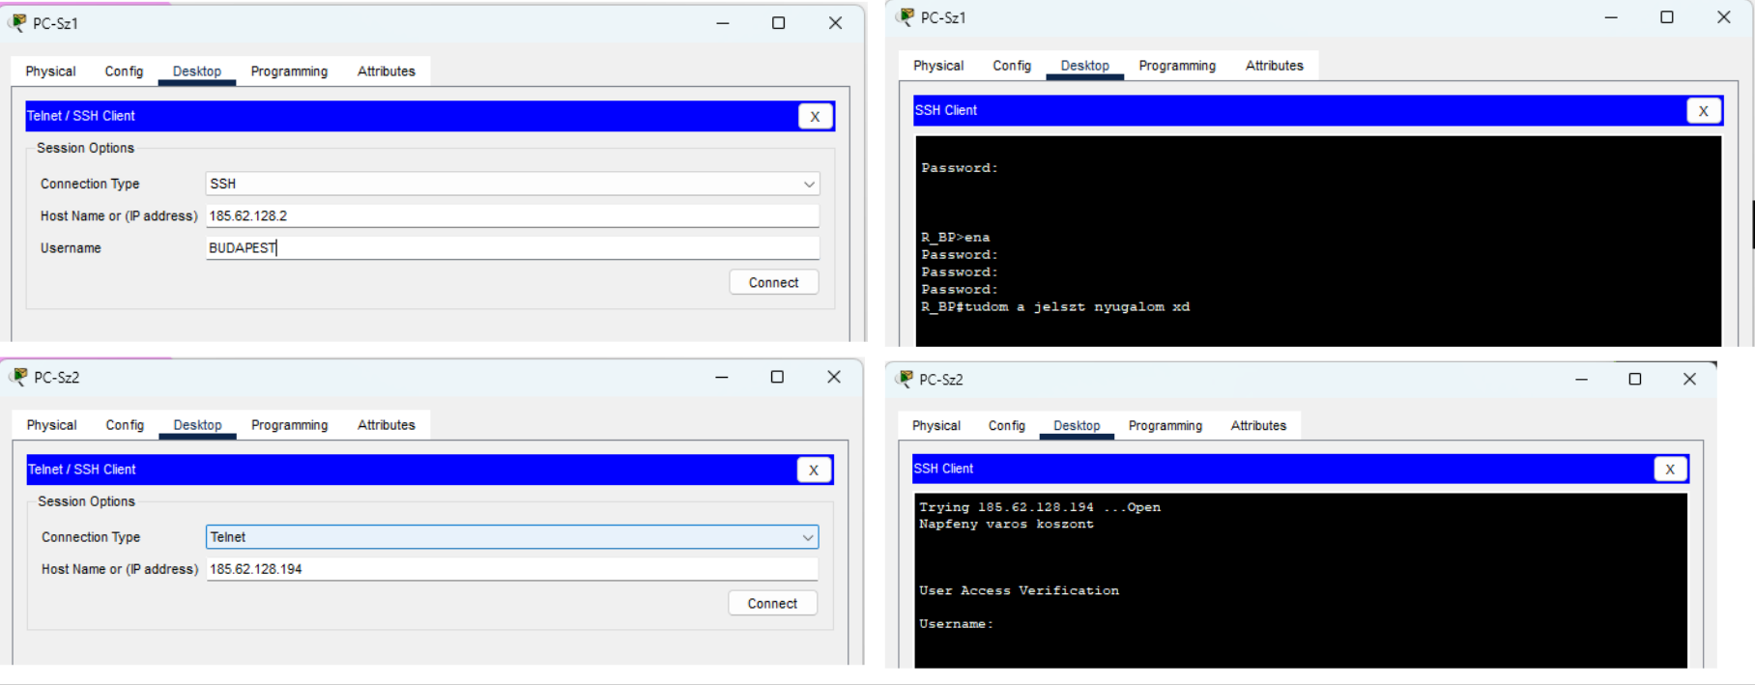
SSH and Telnet
ssh also requires a user, but telnet only requires an ip address

Slide 19
Thanks for your attention!

