Slide 1
Kip kop network
Ocskó Gábor, Jelenovics Milán, Kómár Attila

Slide 2
IP address allocation (VLSM)
Ocskó Gábor

Slide 3
What was the task?
• Network identifier - both in binary and decimal form
• Scatter address - both in binary and decimal form
• First assignable IP address - in both binary and decimal form
• Last assignable IP address (If the network contains switches, they will receive the last assignable IP address) - in both binary and decimal form
• Second assignable IP address (If the network contains servers, they will receive the second assignable IP address) - in both binary and decimal form
• Subnet masks - binary, decimal and prefix
• Total cost of all IP addresses to be purchased

Slide 4
Implementation
-create an empty vlsm table
-put the ip addresses in the right place
-arrange to be transparent (optional)
-Use the DEC.BIN command to convert what was needed to binary
calculate how bad the forint is, that is, calculate how much it will cost

Slide 5
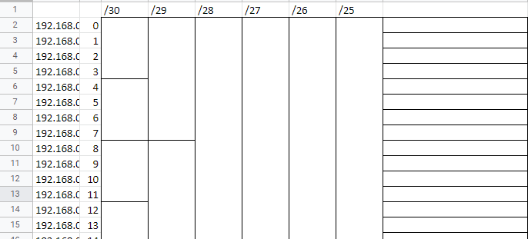
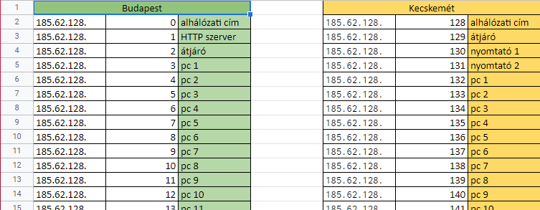


Slide 6
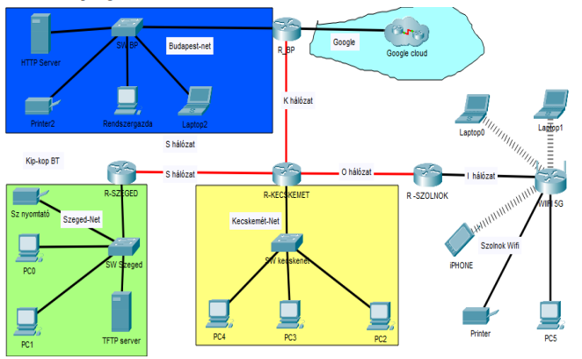
Creating the network topology
byJelenovits Milán

Slide 7
Routers, Switches
Router(2911): Adding network cards (HWIC-1GE-SFP) for Gigabit Ethernet ports (GLC-LH-SMD)
Switch(PT-Empty): Adding Gigabit Ethernet ports(NM-1CGE)

Slide 8
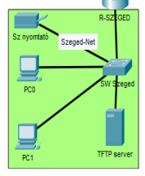
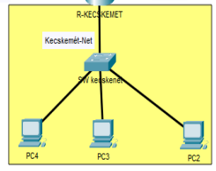
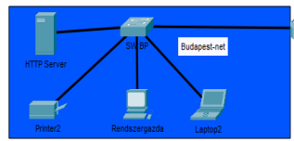
Computers, printers
Replacing network cards from Fast Ethernet (100 Mbps) to Gigabit Ethernet cards

Slide 9
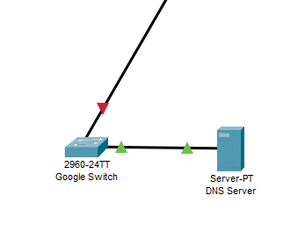
Google Cloud
1 Switch (2960), 1 DNS Server

Slide 10
Budapest-net network configuration
Ocskó Gábor

Slide 11
What did you have to do?
On the switch:
-set password in privileged EXEC mode
-add a username and password
-remote access with telnet
-set login message
-config to the tftp server
On the router:
-set password in privileged EXEC mode
-enter username with password
-remote access with ssh

Slide 12
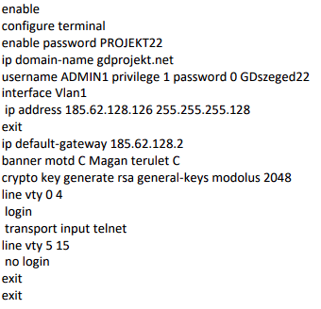
Implementation the commands on the switch

Slide 13
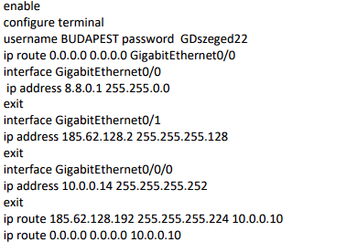
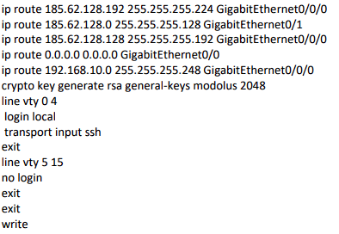
Implementation the commands on the router

Slide 14
Webpage
By Jelenovits Milán

Slide 15
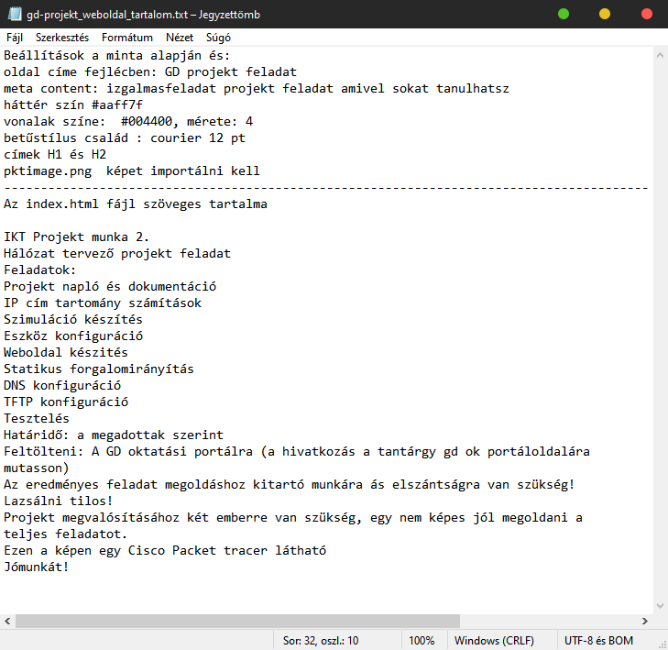
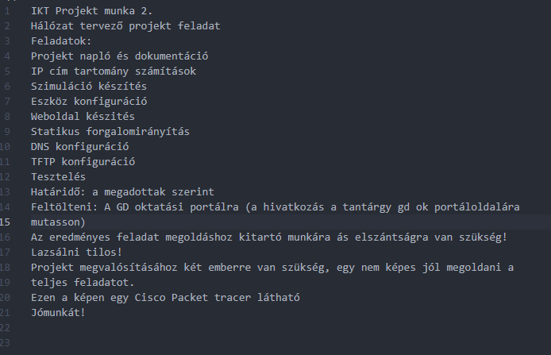

Copying source

Slide 16
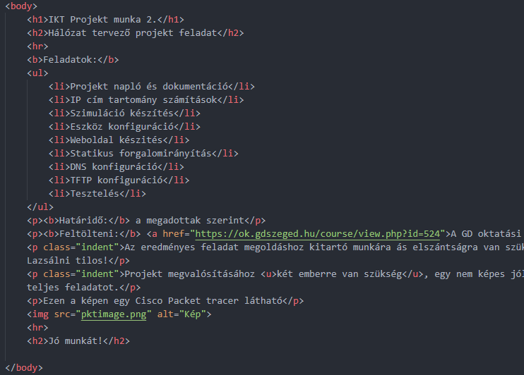
Text layout
Arrangements of paragraphs, lists and links
List
Link
Paragraph

Slide 17
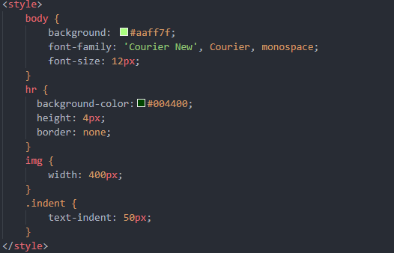
Style
Background, Resizing image, Text indent and font size

Slide 18
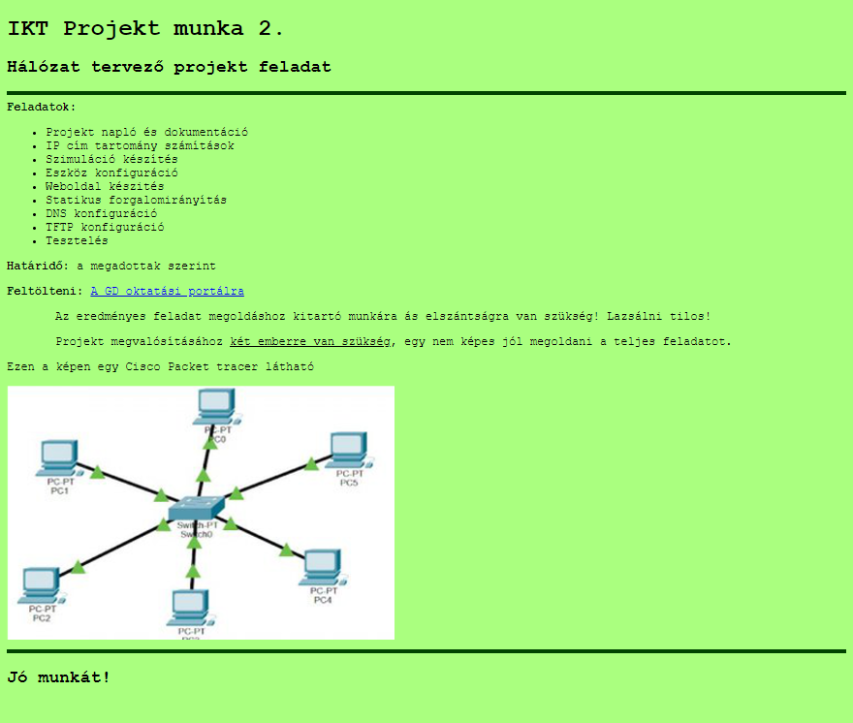

Slide 19
Kecskemét-net network
By Jelenovits Milán

Slide 20
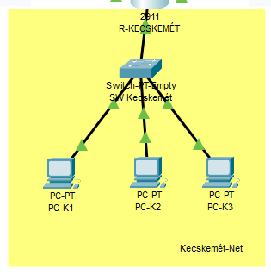
Topology

Slide 21
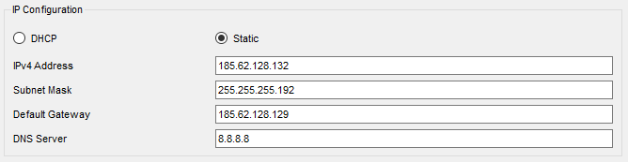
IP addresses
PC-K1: 185.62.128.132
PC-K2: 185.62.128.133
PC-K3: 185.62.128.134

Slide 22
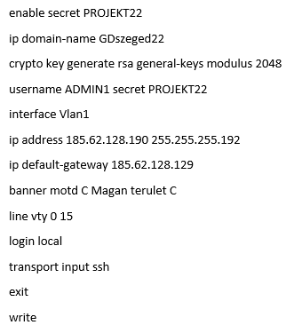
SW Kecskemét configuration

Slide 23
I, K, S és O network
Ocskó Gábor

Slide 24
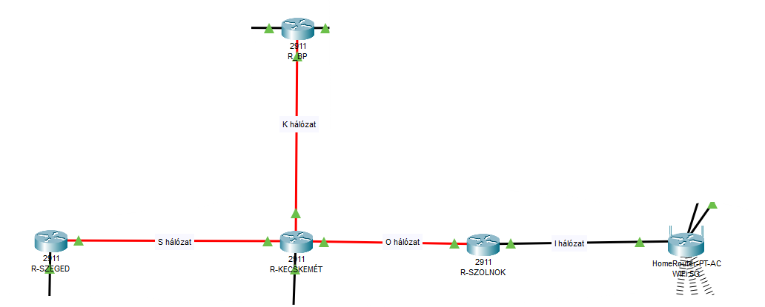
The topology

Slide 25
What was the task?
-To set the ip addresses of R-SZOLNOK
-Set a password and set a message of the day
-Save config to tftp server

Slide 26
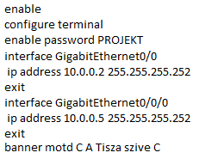
R-SZOLNOK
To set the ip address and the other stuff listed, you needed these:

Slide 27
Checking the network
P A I N

Slide 28
What was the task?
-Check with the courier
-To ping
-Is the Gdprojekt.net page available?
-Ssh and telnet

Slide 29
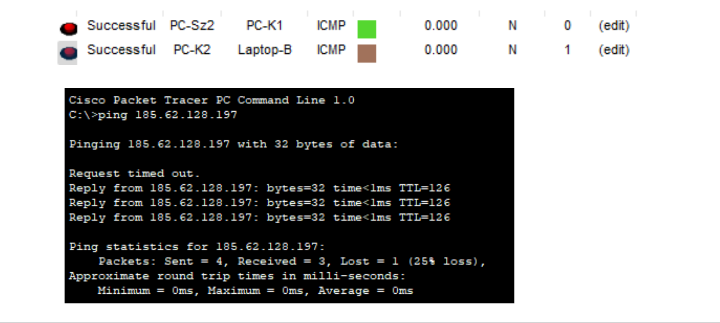
Mail and ping

Slide 30
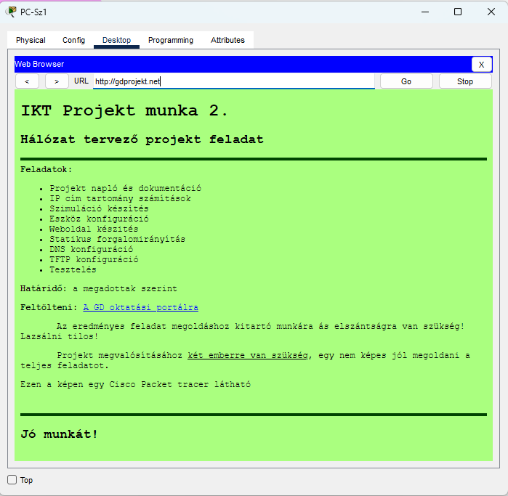
gdszeged.net from the szeged pc

Slide 31
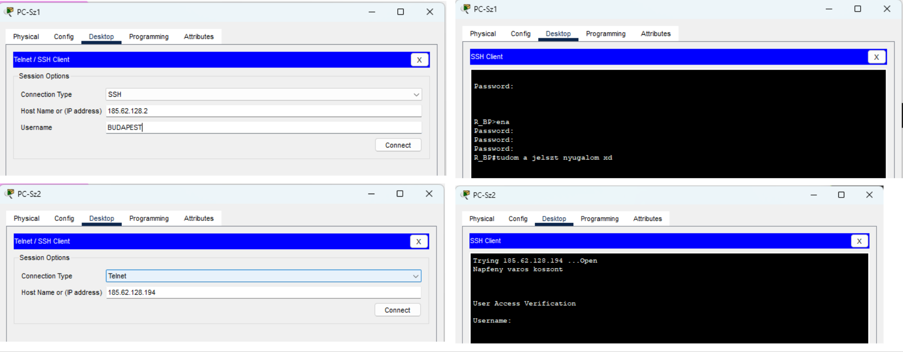
SSH and Telnet
ssh also requires a user, but telnet only requires an ip address

Slide 32
Thank you for watching!

