Slide 1
Kip kop network
Ocskó Gábor, Jelenovics Milán, Kómár Attila

Slide 2
IP address allocation (VLSM)
Ocskó Gábor

Slide 3
What was the task?
• Network identifier - both in binary and decimal form
• Scatter address - both in binary and decimal form
• First assignable IP address - in both binary and decimal form
• Last assignable IP address (If the network contains switches, they will receive the last assignable IP address) - in both binary and decimal form
• Second assignable IP address (If the network contains servers, they will receive the second assignable IP address) - in both binary and decimal form
• Subnet masks - binary, decimal and prefix
• Total cost of all IP addresses to be purchased

Slide 4
Implementation
-create an empty vlsm table
-put the ip addresses in the right place
-arrange to be transparent (optional)
-Use the DEC.BIN command to convert what was needed to binary
calculate how bad the forint is, that is, calculate how much it will cost

Slide 5
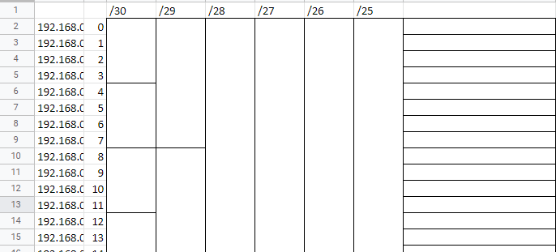
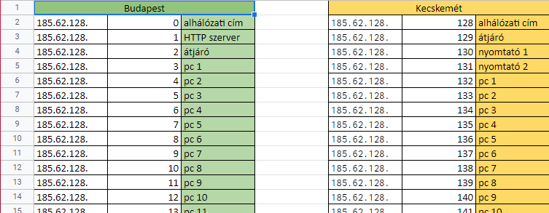


Slide 6
Budapest-net network configuration
Ocskó Gábor

Slide 7
What did you have to do?
On the switch:
-set password in privileged EXEC mode
-add a username and password
-remote access with telnet
-set login message
-config to the tftp server
On the router:
-set password in privileged EXEC mode
-enter username with password
-remote access with ssh

Slide 8
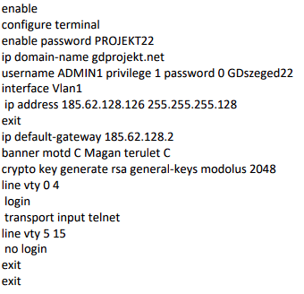
Implementation the commands on the switch

Slide 9
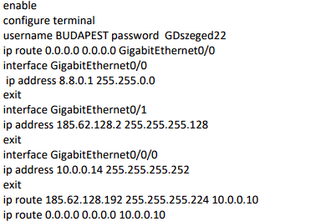
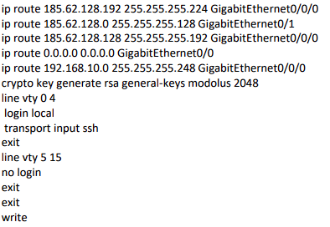
Implementation the commands on the router

Slide 10
Kecskemét-net config
Jelenovics Milán

Slide 11
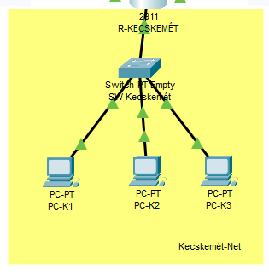
Topológia

Slide 12
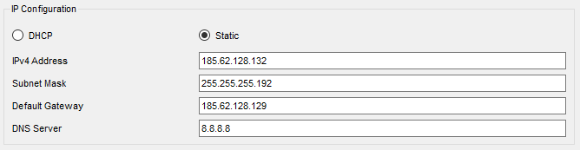
Ip address on computers
PC-K1: 185.62.128.132
PC-K2: 185.62.128.133
PC-K3: 185.62.128.134

Slide 13
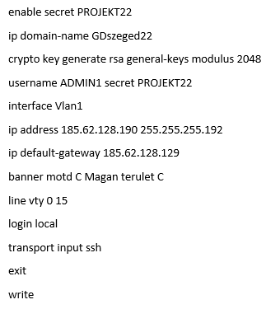
SW Kecskemét configuration

Slide 14
Szeged-net config
Ocskó Gábor

Slide 15
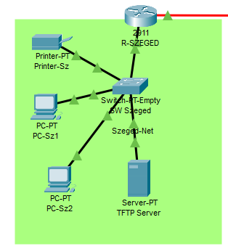
Topology

Slide 16
What was the task?
For devices, ip address and dns to google
Set password and telnet on switch
Set an IP address, gateway and login message on the router
To set the message of the day
Save the configuration to the TFTP server

Slide 17
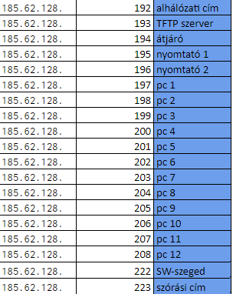
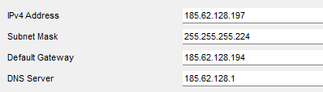
implementation
Az eszközök ip címét kinézni az ipcim.xlsx-ből és beállítani az adott eszközön

Slide 18
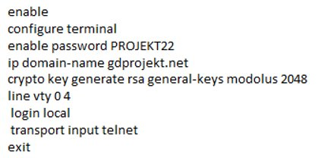
On the switch
Switch password and telnet setting

Slide 19
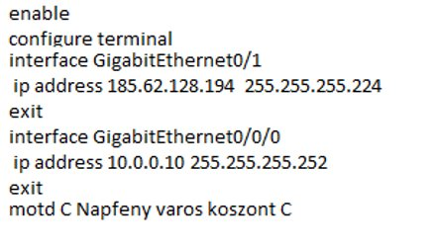
On the router
Ip address, gateway and login message on the router

Slide 20
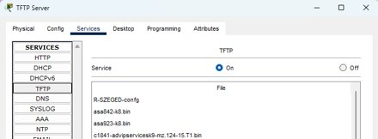
And finally saving to the tftp server
This command was used to save the config:
copy startup-config tftp:

Slide 21
I, K, S és O network
Ocskó Gábor

Slide 22
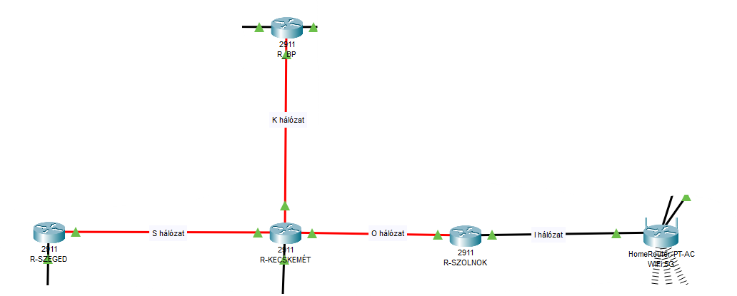
The topology

Slide 23
What was the task?
-To set the ip addresses of R-SZOLNOK
-Set a password and set a message of the day
-Save config to tftp server

Slide 24
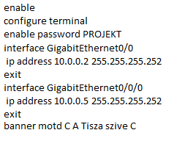
R-SZOLNOK
To set the ip address and the other stuff listed, you needed these:

Slide 25
Checking the network
P A I N

Slide 26
What was the task?
-Check with the courier
-To ping
-Is the Gdprojekt.net page available?
-Ssh and telnet

Slide 27
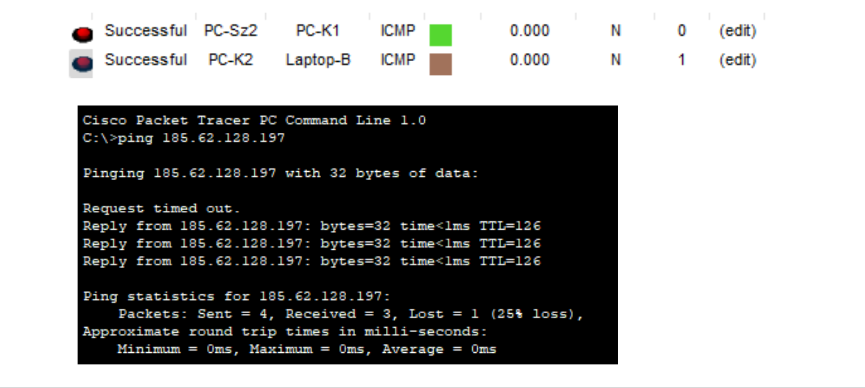
Mail and ping

Slide 28
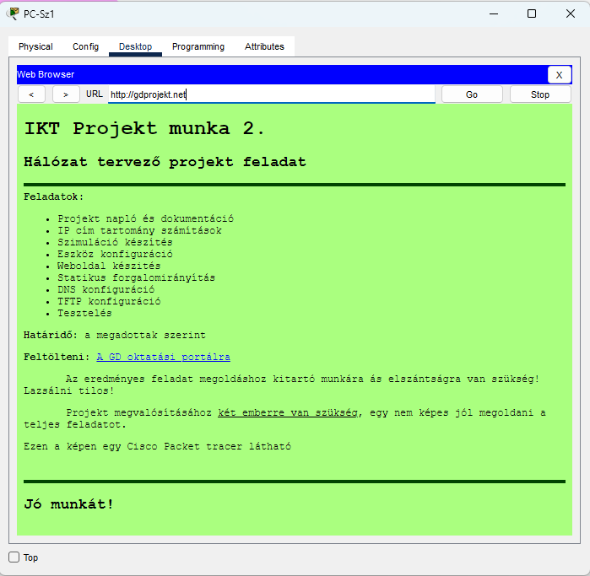
gdszeged.net from the szeged pc

Slide 29
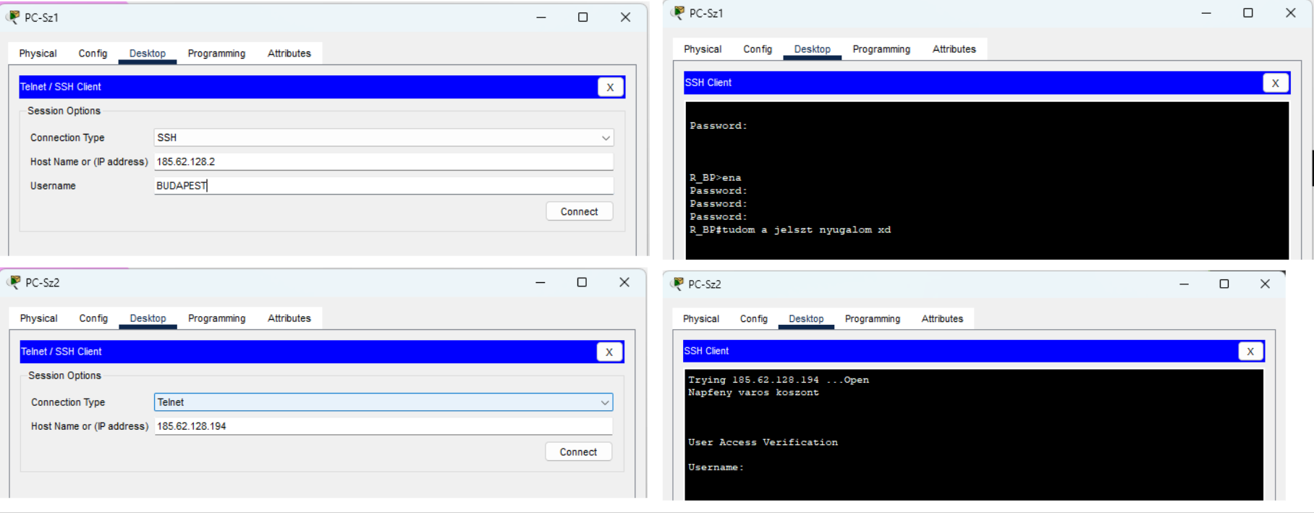
SSH and Telnet
ssh also requires a user, but telnet only requires an ip address

Slide 30
Thanks for your attention!

