Slide 1

Team Details
Team name – Pixel Pioneers
Team leader name – Parth Aggarwal
Team members – Aryan Bansal , Kundan Sahil
Problem Statement - Educational campuses experience significant energy inefficiencies due to the absence of real-time monitoring, predictive insights, and cost-effective optimization tools.

Slide 2


AMD SLINGSHOT HACKATHON
ENERGY
GUARDIAN
AI-Powered Campus Energy Monitoring

Slide 3



THE PROBLEM
40%
30%
0
of global energy
consumed by buildings
wasted due to
poor monitoring
real-time visibility
in most campuses
Campuses are flying blind. Energy bills spike. Nobody knows why.

Slide 4




THE IDEA
One dashboard.
Every watt.
Every zone.
In real-time.
Live demand curves & forecasting
Solar / Grid / Battery mix tracking
AI chatbot for instant answers
Smart alerts before things go wrong

Slide 5




OPPURTUNITIES
BLIND SPOTS
CLOUD TRAP
No real-time zone-level visibility on campuses
Expensive, cloud-dependent & reactive systems
WASTED WATTS
NO 3-IN-1
Lights on in empty rooms, AC running after hours
Zero affordable live monitoring + 3D + AI solution
Campuses hemorrhage energy — invisible, unchecked, and costly.

Slide 6
HOW IS IT DIFFERENT?
Predictive · Affordable · Privacy-First
❌ Existing Solutions
✅ Energy Guardian
Cloud-based analytics
Fully on-device (AMD AI PC)
Reactive reporting only
Predictive AI demand forecasting
High deployment cost
Zero additional infrastructure
Text-only dashboards
Interactive 3D WebGL campus map
No conversational interface
Built-in AI energy chatbot
Limited transparency
Explainable zone-level recommendations
One platform. On-device. No cloud. No compromise.

Slide 7






FEATURES
3D Campus Map
Live Grid Status
Solar PV
WebGL interactive
building visualization
Voltage, frequency
& power quality
Rooftop array
& MPPT monitoring
Alert Engine
AI Chatbot
Analytics
Instant anomaly
detection & alerts
Natural language
energy intelligence
Weekly reports &
sustainability tracking

Slide 8




PROCESS FLOW DIAGRAM
01
02
03
04
›
›
›
Sensors
Ingest
AI Engine
Dashboard
Campus IoT
sensors collect data
Real-time data
streaming & parsing
Anomaly detect
& forecasting
Live visualisation
& alerts
Everything automated. Zero config. Just plug it in.

Slide 9
WIREFRAMES/MOCK DIAGRAMS
Screen 1
4 Key Screens
9 Functional Tabs
1 Single-File Platform
Overview Dashboard
Screen 2
3D Campus Map
Full working prototype available — single-file HTML application (index.html) with 9 tabs, Three.js 3D campus, live SVG charts, and AI chatbot.
Screen 3
Alerts Management
Screen 4
AI Energy Chatbot

Slide 10
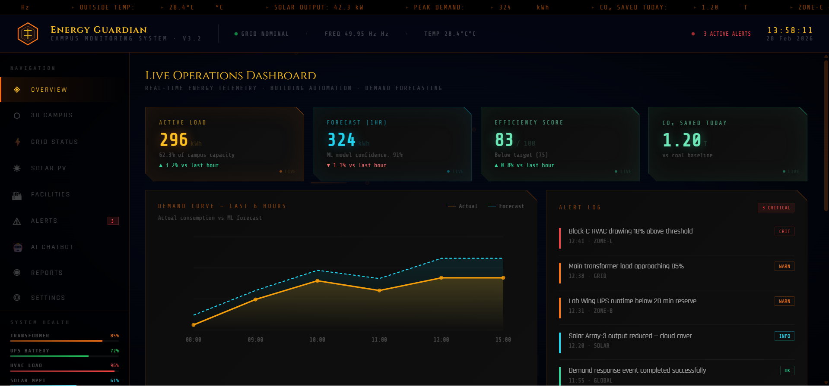
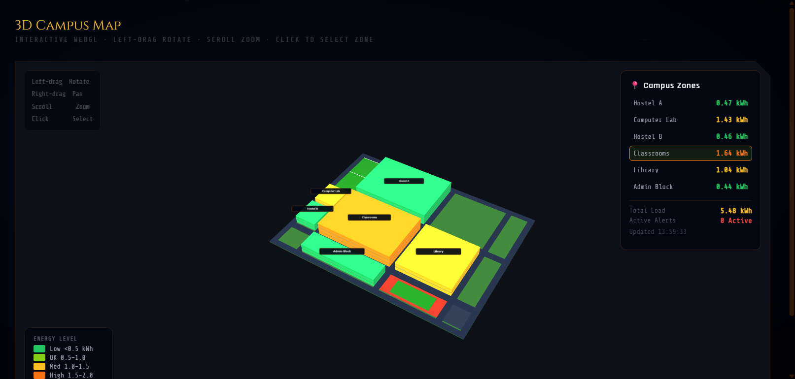
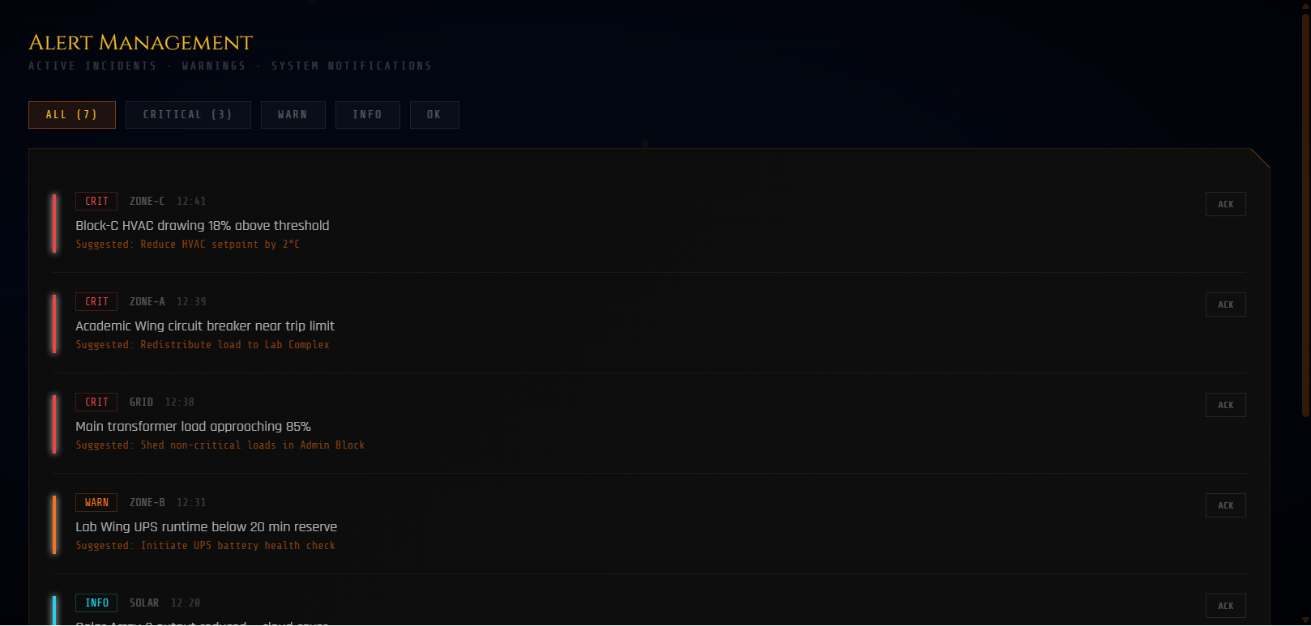
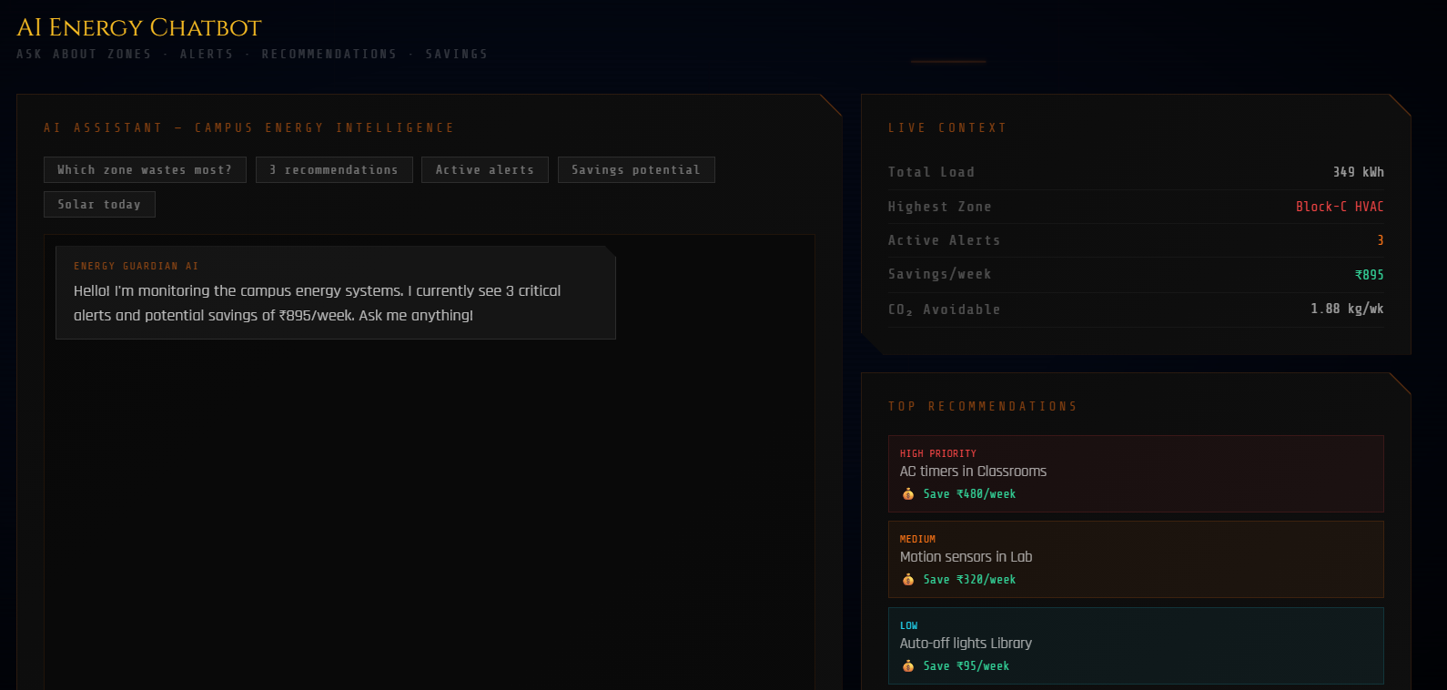

Slide 11
ARCHITECTURE
DATA SOURCES
IoT Sensors · Smart Meters · Solar Inverters · BMS
▼
INGESTION LAYER
Real-time Stream · Data Parser · Normalization
▼
INTELLIGENCE
AI/ML Models · Anomaly Detection · Demand Forecasting
▼
PRESENTATION
WebGL Dashboard · Alert Engine · AI Chatbot · Reports

Slide 12






TECH STACK
Frontend
Visualisation
HTML5 · CSS3 · Vanilla JS · Three.js (WebGL)
Canvas API · Chart.js · CSS Animations
AI / ML
AMD Products
Bell-curve demand modelling · ONNX Runtime · Anthropic Claude API (chatbot)
AMD Ryzen AI PC · Radeon GPU (DirectML) · NPU (VitisAI / ONNX Runtime)
Deployment
Data Layer
Python 3 · CustomTkinter · http.server (local) · Offline-first, zero cloud
Local JSON · SQLite · ReportLab (PDF) · 5-second live refresh cycle

Slide 13

AMD INTEGRATION
Powered by AMD
Energy Guardian leverages the full AMD AI PC architecture — CPU for orchestration and rule logic, Radeon GPU (DirectML) for 3D WebGL rendering and dashboard animations, and Ryzen AI NPU (VitisAI/ONNX) for on-device demand forecasting and anomaly detection. No energy data ever leaves the campus network.
AMD Hardware
AMD Software
Performance
AMD Ryzen AI PC (CPU + GPU + NPU)
ONNX Runtime (VitisAI + DirectML) · ROCm · Anthropic Claude API
100% on-device · ₹46,540/yr savings · Zero cloud latency

Slide 14

IMPLEMENTATION COST
Cloud Infrastructure
₹0 /mo
AI/ML API Costs
₹0 /mo
Hardware (Sensors)
₹1,00,000 - ₹2,50,000
Development
₹2,00,000 - ₹5,50,000
Total Estimated Cost:
₹3,00,000 - ₹8,00,000

Slide 15



PROTOTYPE ASSETS
GitHub Repository
Demo Video
github.com/I-Parth-Aggarwal-I/AI_Campus_Energy_Guardian
youtu.be/-DBfs5aHK_8
Public · Open Source · All assets included
3 min walkthrough · All features shown
Prototype
https://i-parth-aggarwal-i.github.io/AI_Campus_Energy_Guardian/
Overview · 3D Campus · AI Chatbot

Slide 16


