Slide 1

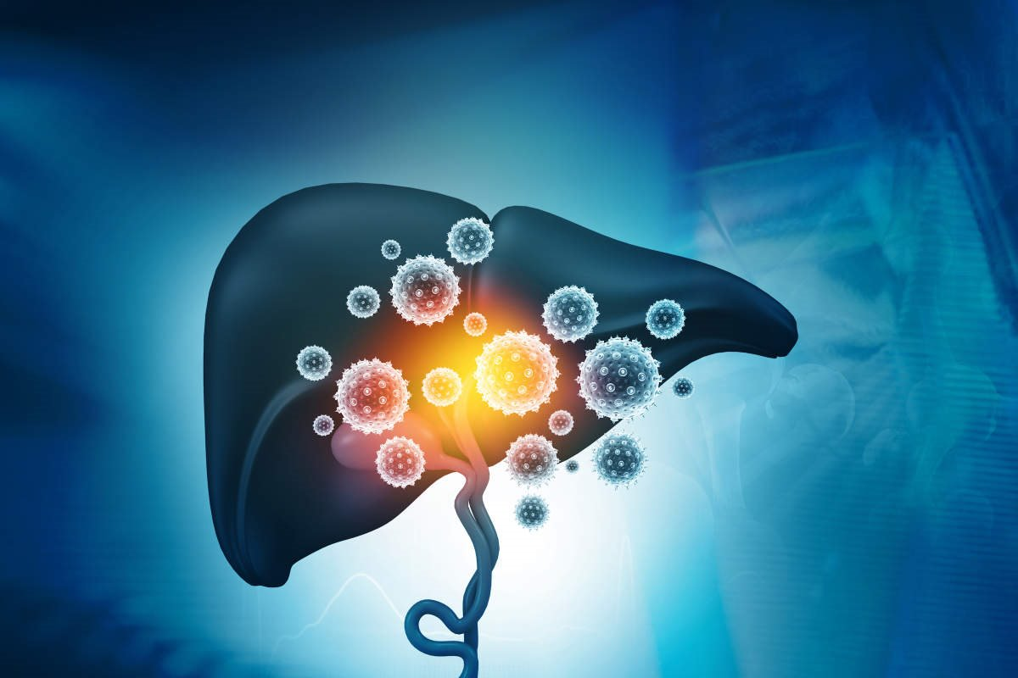
CLASSIFICATION OF HEPATITIS DISEASE USING EXPLAINABLE ARTIFICIAL INTELLIGENCE
Presented by
ROSHAN KUMAR
(12021002026027)
ESHA MISHRA
(12021002001046)
SNEHASISH BHAKAT
(12021002001136)
Guided by
Prof. (Dr) TAPAS SI

Slide 2
OBJECTIVES
To construct a Machine Learning model to classify the presence of a hepatitis disease.
To identify key clinical parameters responsible for the disease.
To implement Explainable AI techniques to explain and interpret the prediction.
4. To generate valuable insights through visualizations and thorough analysis.

Slide 3
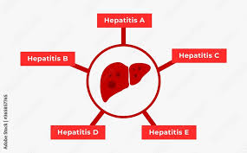
INTRODUCTION TO HEPATITIS DISEASE
Hepatitis is an inflammation of the liver that can cause serious health problems. It is usually caused by a viral infection, but there are other possible causes, such as alcohol, toxins, or autoimmune disorders.
According to the World Health Organization, about 354 million people worldwide live with hepatitis B or C, and many of them are unaware of their infection.
There are five main types of viral hepatitis: A, B, C, D, and E. Each type has different modes of transmission, symptoms, treatments, and prevention methods.
Hepatitis B and C are the most common causes of chronic liver disease, cirrhosis, and liver cancer.

Slide 4
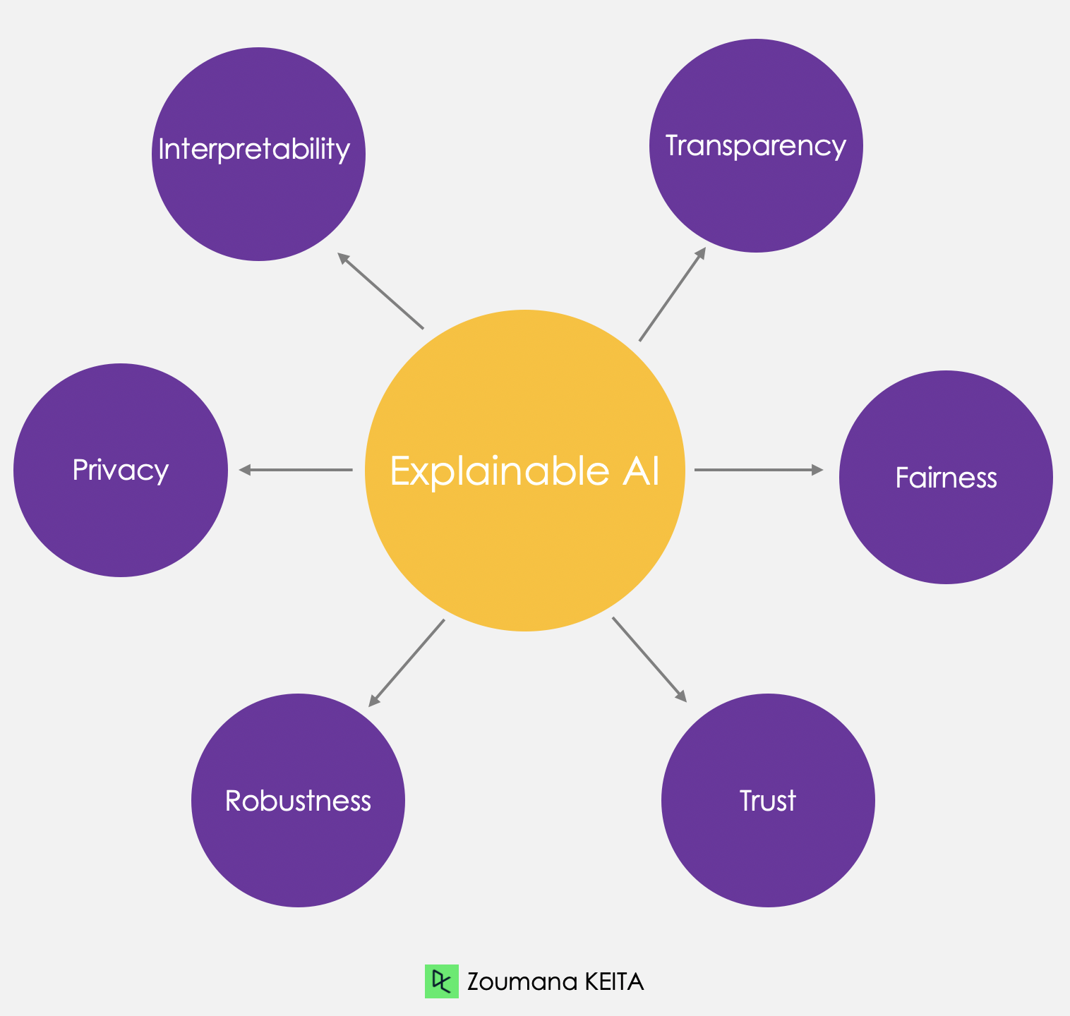
EXPLAINABLE ARTIFICIAL INTELLIGENCE (XAI)
Benefits of Using XAI for Hepatitis
Classification
1
Identify Key Factors
2
Fosters Trust
XAI uncovers the key features influencing hepatitis classification, aiding in insightful decision-making.
Building trust by explaining decisions and improving the model transparency in the medical domain.

Slide 5
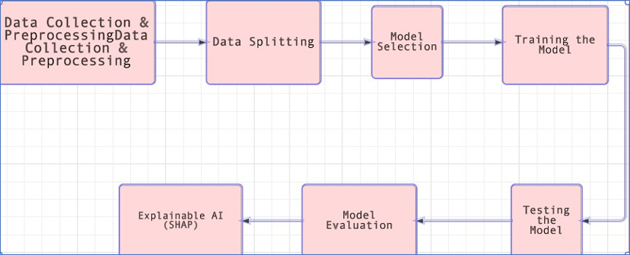
Proposed Model

Slide 6

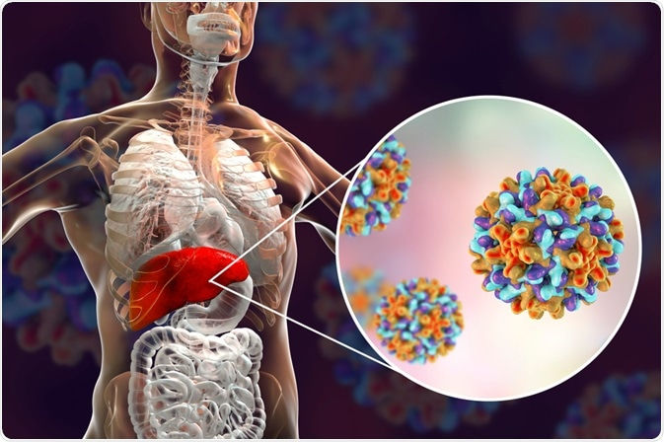
EXPERIMENTAL SETUP
Machine learning model implemented in Python.
Libraries used: NumPy, matplotlib, pandas, scikit-learn.
SHAP values computed using SHAP library.
Local instance-specific explanations generated using LIME library.

Slide 7
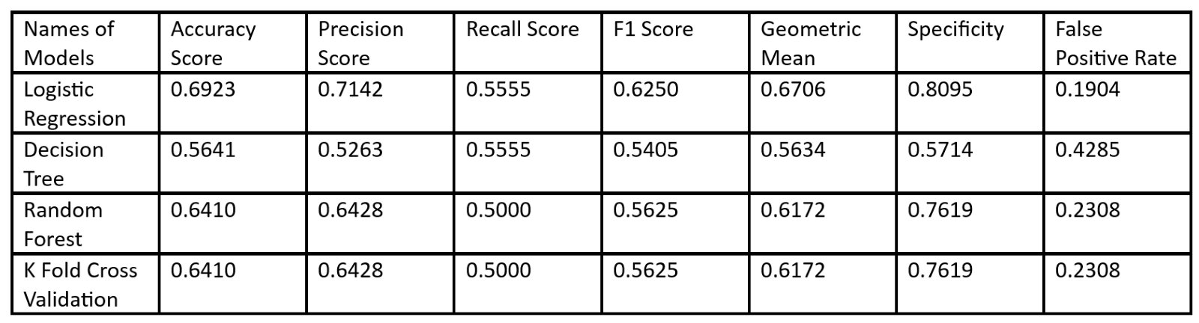
RESULT AND DISCUSSIONS

Slide 8

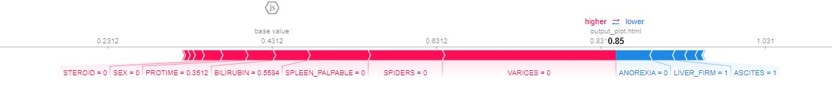
CLASSIFICATION OF HEPATITIS DISEASE USING EXPLAINABLE ARTIFICIAL INTELLIGENCE
ANALYSIS
Presented by
Guided by
ROSHAN KUMAR
(12021002026027)
ESHA MISHRA
(12021002001046)
SNEHASISH BHAKAT
(12021002001136)
FORCE PLOT – EXPLANATION USING SHAP

Slide 9
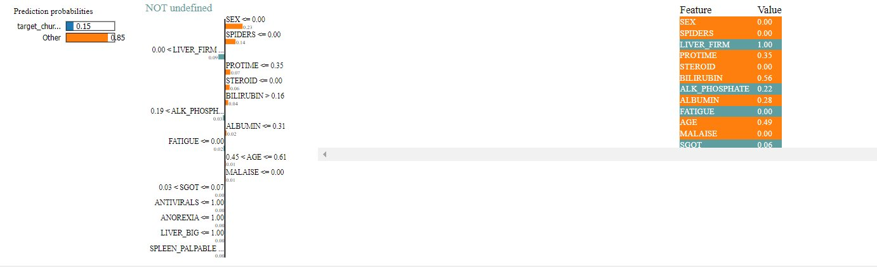
EXPLANATION USING LIME

Slide 10
Parameters with highest feature importance
Spider Nevi
Esophageal Varices
Ascites
Firm Liver

Slide 11
LITERATURE REVIEW
Sr. No | Author & Year | Models/Algorithm | Findings/Remark
1. | Anto and Chandramathi [1] | Hybrid GA-SA and SVM for hepatitis prediction. | Achieved 87% accuracy on UCI hepatitis dataset.
2. | Bhargav et al. [2] | Applied LR, DT, SVM, NB for hepatitis classification using UCI dataset. | LR provided highest accuracy: 87.17%.
3. | Nivaan and Emanuel [3] | Proposed LR model for hepatitis prediction on UCI dataset | Obtained 83.33% accuracy
4. | Alfyani and Muljono [4] | Compared NB and KNN classifiers for hepatitis classification on UCI dataset. | NB outperformed KNN with 74.19% accuracy
5. | Hassan and Shah [5] | Compared LR, DT, NB, KNN, SVM, RF for hepatitis classification on UCI dataset. | Random Forest achieved highest accuracy: 85%.

Slide 12
CLASSIFICATION OF HEPATITIS DISEASE USING EXPLAINABLE ARTIFICIAL INTELLIGENCE
CONCLUSION
Presented by
Utilized SHAP and LIME for better understanding of ML model predictions, especially in Hepatitis prediction.
SHAP's Force Plot highlighted key factors like Spider Nevi and Ascites, predicting Hepatitis with 0.85 probability.
LIME explained feature impacts, aiding decision insights.
Integration of SHAP and LIME improved interpretability, trust, and applicability in medical diagnosis, particularly for Hepatitis.
Overall, SHAP and LIME integration enhanced interpretability and trustworthiness, crucial for real-world medical diagnosis like Hepatitis prediction.
Guided by
ROSHAN KUMAR
(12021002026027)
ESHA MISHRA
(12021002001046)
SNEHASISH BHAKAT
(12021002001136)

Slide 13
FUTURE SCOPE
Explore other Explainable AI techniques for better model interpretability.
Investigate ensemble methods to enhance accuracy.
Apply the approach to other medical datasets for broader use.
Collaborate with medical experts to validate predictions and improve clinical relevance.

Slide 14
CLASSIFICATION OF HEPATITIS DISEASE USING EXPLAINABLE ARTIFICIAL INTELLIGENCE
REFERENCES
[1] K. Polat and S. G¨unes¸, “Prediction of hepatitis disease based on principal component analysis and artificial immune recognition system,” Applied Mathematics and Computation, vol. 189, no. 2, pp. 1282–1291, 2007.
[2] E. Dogantekin, A. Dogantekin, and D. Avci, “Automatic hepatitis diagnosis system based on linear discriminant analysis and adaptive network based on fuzzy inference system,” Expert Systems with Applications, vol. 36, no. 8, pp. 11282–11286, 2009.
[3] An Integrated Model to Evaluate the Transparency in Predicting Chronic Kidney Disease using a Trio-embedded Explainable Model- Read the Research paper and got the idea about how to do.
[4] Interpretable AI-BUILDING EXPLAINABLE MACHINE LEARNING SYSTEMS By AJAY THAMPI ©2022 by Manning Publications Co. All rights reserved.
[5] Classification assessment methods- Alaa Tharwat Faculty of Computer Science and Engineering, Frankfurt University of Applied Sciences, Frankfurt, Germany.
[6] Explainable AI for Practitioners by Michael Munn and David Pitman Copyright © 2023 Michael Munn, David Pitman, and O’Reilly Media, Inc. All rights reserved. Printed in the United States of America. Published by O’Reilly Media, Inc., 1005 Gravenstein Highway North, Sebastopol, CA 95472.
[7] Explainable AI Recipes: Implement Solutions to Model Explainability and Interpretability with Python ISBN-13 (pbk): 978-1-4842-9028-6 ISBN-13 (electronic): 978-1-4842-9029-3 https://doi.org/10.1007/978-1-4842-9029-3 Copyright © 2023 by Pradeepta Mishra
Presented by
Guided by
ROSHAN KUMAR
(12021002026027)
ESHA MISHRA
(12021002001046)
SNEHASISH BHAKAT
(12021002001136)

Slide 15
ACKNOWLEDGMENT
We extend our sincere gratitude to the University of Engineering and Management, Jaipur, for their unwavering support and resources that were instrumental in the successful completion of this project. Special thanks to Professor Tapas Si for his invaluable mentorship, expert guidance, and continuous encouragement, which significantly enriched our project's quality and depth. Additionally, we appreciate the contributions from our team members for their assistance throughout this endeavor. Lastly, our heartfelt thanks to our colleagues for their support and understanding.

Slide 16
THANK YOU

