Slide 1
I-SYST BluePyro
BLE Services & Data Format

Slide 2
Bluetooth Services & Characteristics
UART Base UUID = 00000000-287c-11e4-ab74-0002a5d5c51b
 | UUID (hex) | Description | Data format
UART service | 00000101-287C-11E4-AB74-0002A5D5C51B | Sensor’s raw data service
UART_RX characteristic | 00000102-287C-11E4-AB74-0002A5D5C51B | Send sensor’s raw data to BLE | A text string
BluePyro Base UUID = a0080000-01fb-4109-8a0a-1816898a6725
 | Values (hex) | Description | Data format
BluePyro service | A008FFE0-01FB-4109-8A0A-1816898A6725 | BluePyro’s configuration and DFU service
BLEPYRO_CFG characteristic | A008FFE1-01FB-4109-8A0A-1816898A6725 | Read/Write configuration characteristic | See data structure next slide
BLEPYRO_DFU characteristic | A008FFE2-01FB-4109-8A0A-1816898A6725 | DFU mode

Slide 3
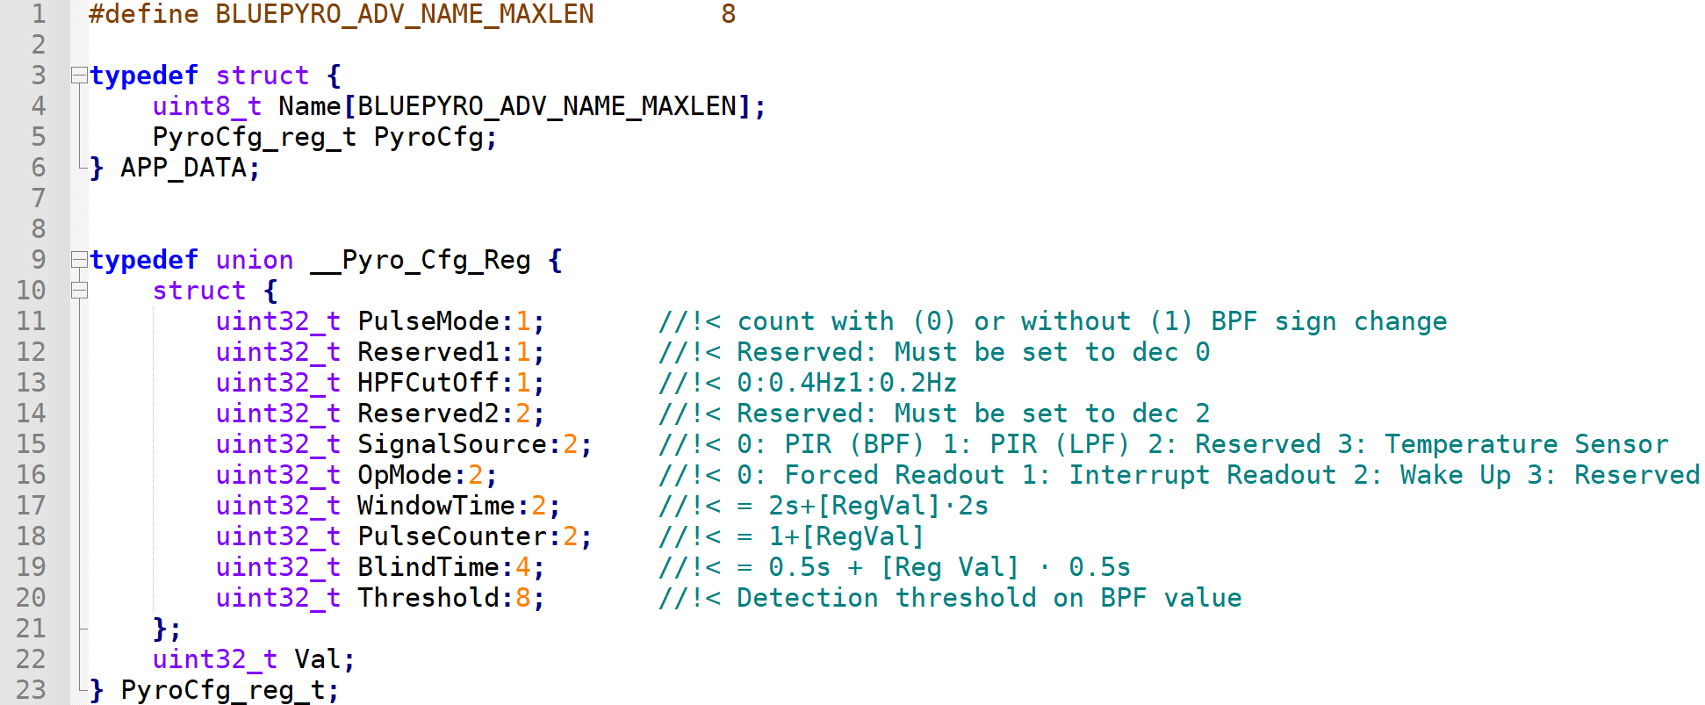
BLEPYRO_CFG Characteristic Data Format

Slide 4
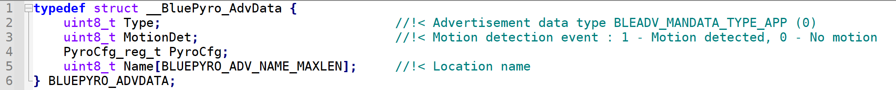
BluePyro BLE Advertising Data
PyroCfg_reg_t and BLUEPYRO_ADV_NAME_MAXLEN are defined in the previous slide

