Slide 1


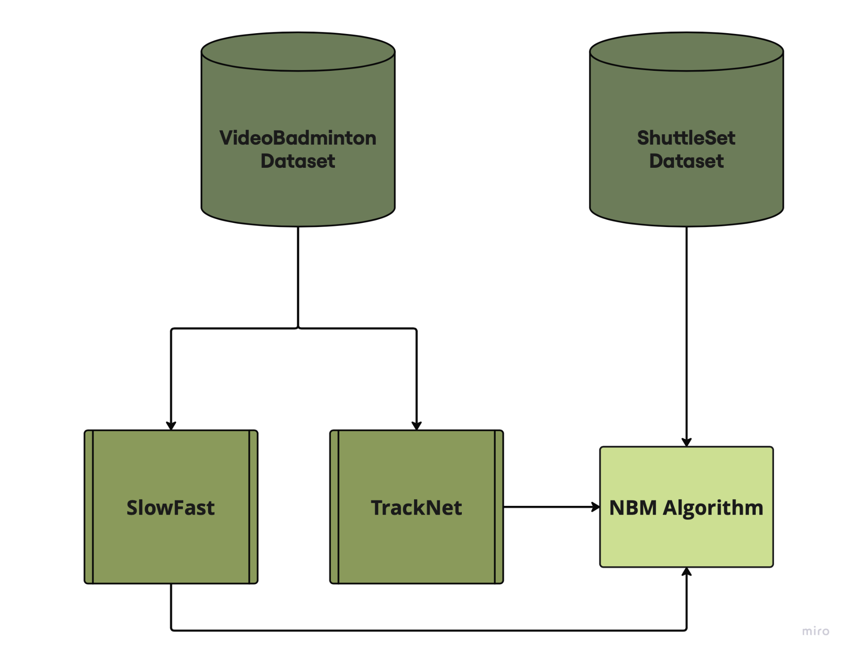
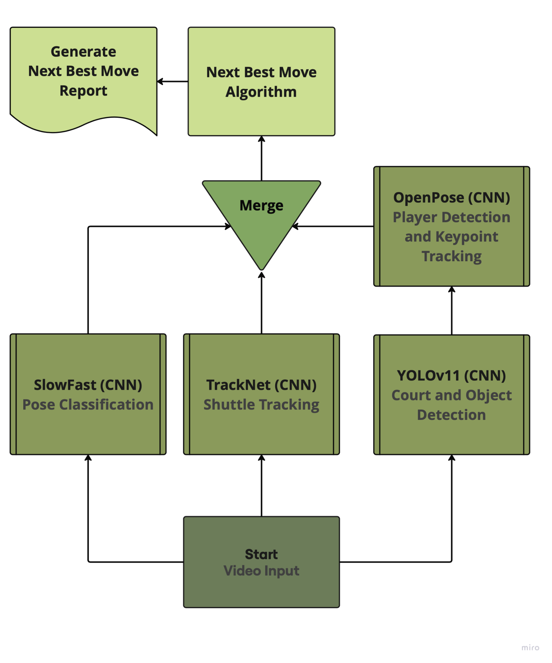
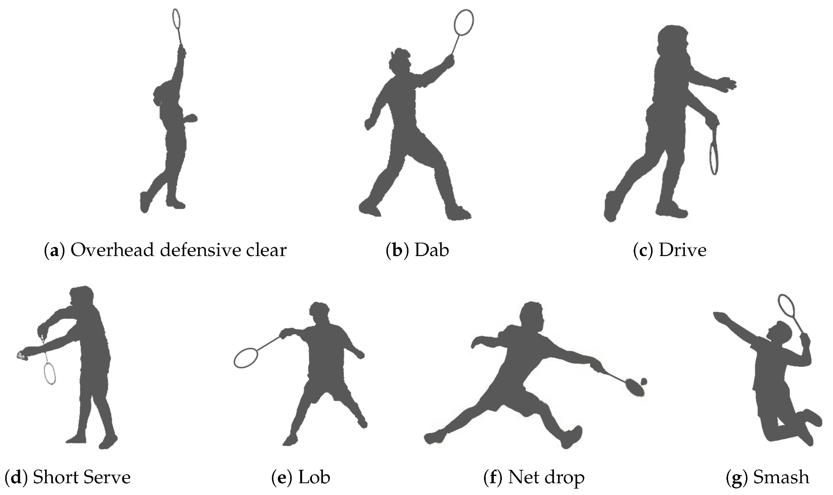
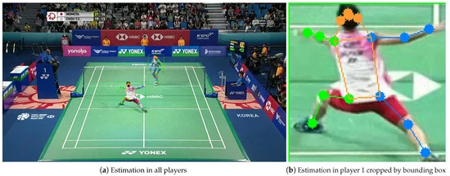
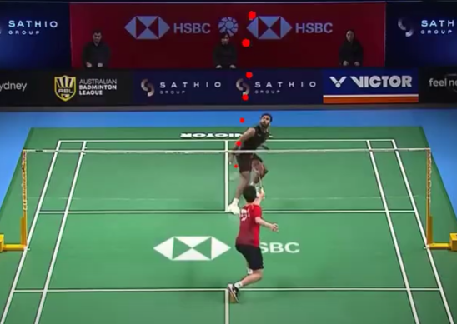
Introduction
Model
Badminton isn’t very popular in the US, and finding places to play or afford coaching can be tough, especially for lower income athletes. With few dedicated facilities and coaching costs as high as $50–100 per hour, many players struggle to get proper training. To make badminton more accessible, we created an AI powered app that uses computer-vision and machine learning techniques to analyze game strategy and give personalized feedback. This will allow players to improve their skills through video analysis without relying on expensive in-person coaching.
AI Approach to Coaching Badminton Strategy with Mobile App
OpenPose and TrackNet are used to track players and the shuttle in real-time. OpenPose detects and players’ keypoints (Figure 4) and the court in each frame, while TrackNet follows the shuttle's trajectory (Figure 5). The VideoBadminton dataset is used to train the TrackNet model and a SlowFast model that detects player strokes throughout the match (Figure 2). The model temporally segments the input video and feeds it to the Next Best Move Algorithm. The Next Best Move Algorithm is trained on the ShuttleSet Dataset, which includes stroke-level records from top ranking singles matches. NBM predicts the best moves for a player based on positions, strokes, and scores, helping build game sense and improve performance.
Computer Systems Lab
2024-2025
İpek Sayar, Jacob Dipasupil
Figure 2. Flowchart of Training
Figure 3. Flowchart of Procedure
Figure 4. Player Tracking
Figure 5. TrackNet
Figure 1. Core Badminton Strokes
Results
Badminton uses a combination of core strokes (Figure 1) throughout the game. The overhead clear sends the shuttle high and deep to push opponents back, while the drive is a fast, straight shot to keep rallies quick. The smash is the strongest attack, hitting the shuttle down sharply to score points. At the net, the net drop places the shuttle just over the net to force a weak return, while the dab is a quick push used in doubles for control. The lob is a high, defensive shot to reset the rally. The serve starts each point, with different types like the high serve, low serve, flick serve, and drive serve. While learning these strokes should be the among the first few techniques to learn when training badminton, it’s equally important to gain an intuition for when to use each one, so we developed SmartRally.
System Architecture
Every input video to the app is processed through a series of AI models: a SlowFast model trained on the VideoBadminton dataset for pose detection, a TrackNet model for shuttle trajectory tracking, and a YOLOv11 OpenPose model for player localization (Figure 3). The system then predicts the Next Best Move (NBM) using a custom 1-3-1 neural network trained on the ShuttleSet dataset, which analyzes real-time player movement data to determine the optimal sequence of actions during gameplay. Using OpenCV, the system overlays annotations on the video, showing what move the player should have performed and where they should have aimed on the court to maximize their chances of scoring against their opponent at each point in the match. This information is presented through an interactive app, where the user can view separate video clips for each move, navigate between them, and receive detailed feedback. Users can also save the generated videos under custom names in an archive, allowing them to easily access the same feedback later.
In 737 rallies and 7,298 strokes for 27 of the top-ranking singles players in matches from 2018 to 2021, the Next Best Move Algorithm achieved an accuracy of approximately 70%. The SmartRally advice is not absolute, and there are hundreds of way to win a match. However, SmartRally gives the stroke with the most consistent results. With the use of SmartRally, users can gain an intuitive understanding of the types of strokes to use depending on the shuttle trajectory and player positions. Of course, to elevate skill, players should seek proper training by a professional, however SmartRally serves as an accessible resource for those who want to learn, but don’t have the resources to start.
Notes:
Nexshot
SmartRally

