Slide 1

ModelGuard AI
Security & Operations Presentation
Protecting AI models from extraction attacks — in real time
Threat Analysis · Top Risks · OE Dashboard

Slide 2



WHY THIS PRODUCT?
API Access
Zero Visibility
Real-Time
All an attacker needs
Without ModelGuard
Detection + Audit
No breach, no stolen weights — just systematic queries to rebuild your model.
Most organisations have no signal when extraction is in progress.
ModelGuard scores every query, flags patterns, and writes a tamper-evident trail.
AI models are expensive to build and trivial to steal — ModelGuard closes that gap.

Slide 3
TOP 3 SECURITY RISKS
Threat Analysis — ModelGuard AI
01
CRITICAL
Forges admin tokens — entire auth boundary collapses instantly with zero exploitation effort.
JWT Secret in Public Repo
Admin token forgery · No brute force needed · Permanent access
02
CRITICAL
Exposes model weights, audit logs, and attack reports — the three assets ModelGuard exists to protect.
Default MinIO Credentials
Steal model artifacts · Erase audit trail · Silent deletion
03
HIGH
Any authenticated user can overwrite any model. Backdoored artifacts replace legitimate ones silently.
Model Upload — No Ownership Check
Cross-tenant overwrite · No versioning recovery · Undetected

Slide 4
RISK 1 · CRITICAL
JWT Signing Secret Committed to Public Repo
WHAT
BLAST RADIUS
The JWT secret "modelguard-dev-secret-change-in-production"
is hardcoded in main.py
and committed to the public repository.
Forge admin token from public repo — instant access
Read & delete audit logs — erase evidence of extraction
WHY IT'S #1
Access attack reports — see what ModelGuard has detected
Auth is the only security boundary between the public internet and admin operations. A single line of source code enables an attacker to forge a permanent admin token — no password, no brute-force, no exploit required.
Upload malicious model artifacts to any model ID
All other controls collapse — this is the master key
FIX: Rotate secret immediately. Load from environment variable only.

Slide 5
RISK 2 · CRITICAL
Default MinIO Credentials Hardcoded in docker-compose.yml
WHAT
WHAT ATTACKERS CAN DO
minioadmin / minioadmin is hardcoded in docker-compose.yml and mirrored in the backend environment. MinIO ports 9000 and 9001 are bound to 0.0.0.0 — publicly reachable.
Download model weights
Steal core IP instantly
Delete all audit logs
Erase evidence — no trace remains
WHY IT'S #2
Read all attack reports
See every detection alert
MinIO holds the three things ModelGuard is built to protect. Default credentials on a public port hand attackers direct file-system access — no token needed. There is no object locking, so deletion is silent and irreversible.
Overwrite model artifacts
Inject backdoored binaries
No object locking
Deletion is permanent and silent
FIX: Rotate credentials, load from secrets manager, restrict port binding.

Slide 6
RISK 3 · HIGH
Model Artifact Overwrite — No Ownership Validation
WHAT
ATTACK SCENARIO
POST /models/{model_id}/upload has no ownership check. Any authenticated customer can upload to any model_id with any filename — silently overwriting another tenant's artifact.
1
Attacker registers a legitimate account
2
Discovers a competitor's model_id via API
3
Uploads a backdoored binary with the same filename
WHY IT'S #3
4
Competitor's clean model is silently replaced
Model artifacts are the core IP ModelGuard is built to protect. A malicious tenant can silently replace a competitor's binary with a backdoored version. No error is returned, there is no versioning to recover from, and the audit trail only records that an upload occurred.
5
Audit log shows only 'upload occurred' — no ownership alert
6
No version rollback possible without manual intervention
FIX: Validate ownership on every upload. Add object versioning.

Slide 7

OE DASHBOARD · Built with Streamlit
System Health
Statistics
Audit Logs
Attack Reports
Instant four-indicator view: Frontend, API, MinIO, Detector. First stop for every on-call engineer.
Registered model count, detection engine status, and MinIO health in a single dashboard.
Query tamper-evident records by model ID and date. 140 records found for sentiment-v1 in demo.
92 HIGH/CRITICAL reports for sentiment-v1. Feature vectors reveal extraction patterns in real time.
In production: First 60s on-call triage → security event spike detection → escalation to token revocation

Slide 8
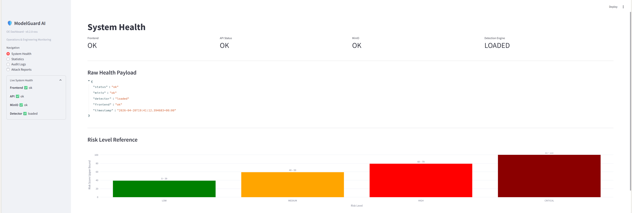
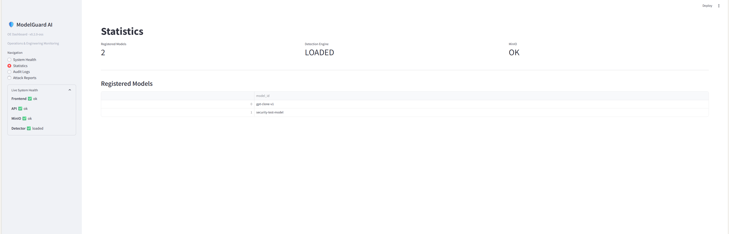
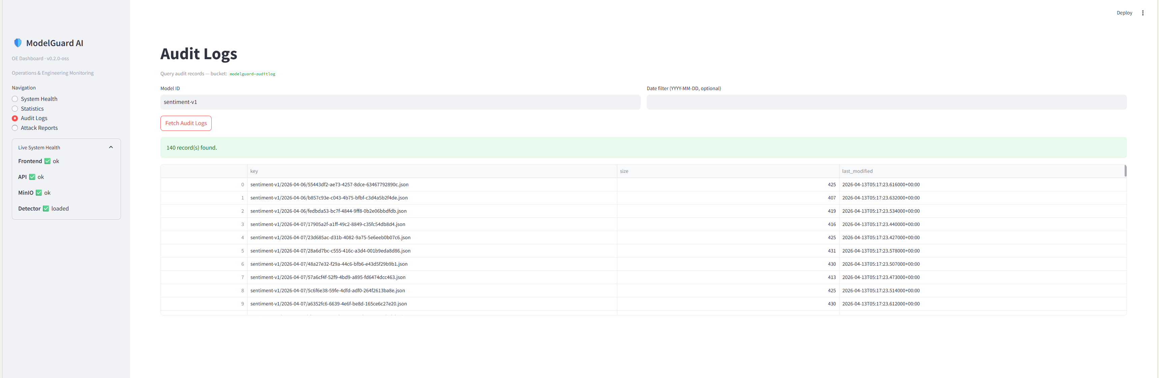
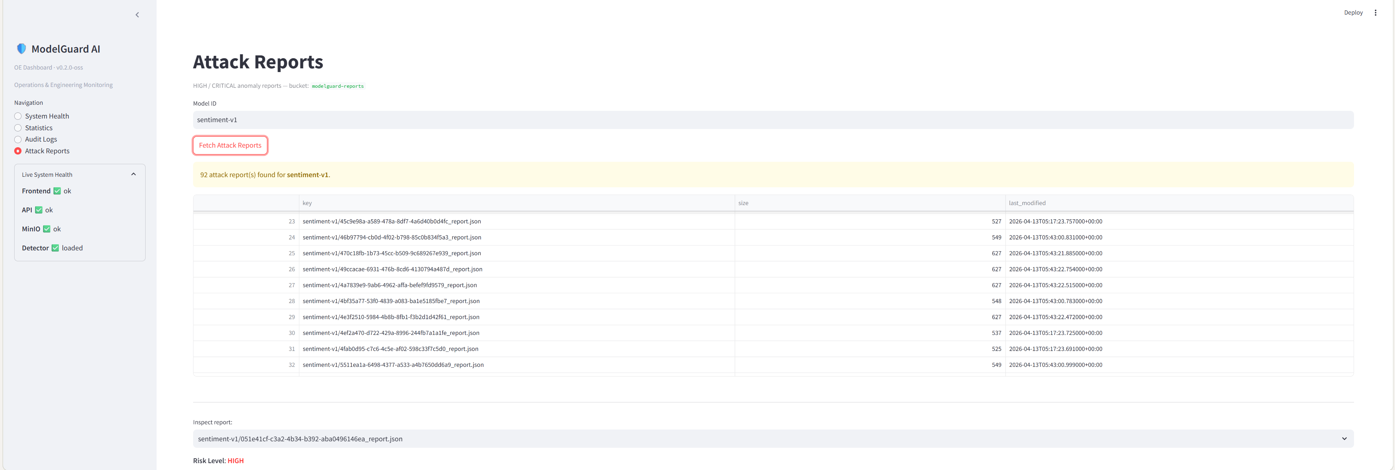
OE DASHBOARD · Live Screenshots
System Health
Statistics
Audit Logs
Attack Reports
ModelGuard AI · OE Dashboard v0.2.0-oss · Operations & Engineering Monitoring

Slide 9
Summary
Product
Real-time model extraction detection with tamper-evident audit trail
Risk 1
JWT secret in public repo — admin impersonation, zero effort
Risk 2
Default MinIO creds — model weights and audit logs exposed
Risk 3
No upload ownership check — silent cross-tenant model overwrite
OE Dashboard
Streamlit-based ops view for health, auditing, and attack triage
ModelGuard AI — Security closes the gap between building models and protecting them.

