Slide 1
Smart Analyzer
Team No: 5

Slide 2
Objective

Slide 3
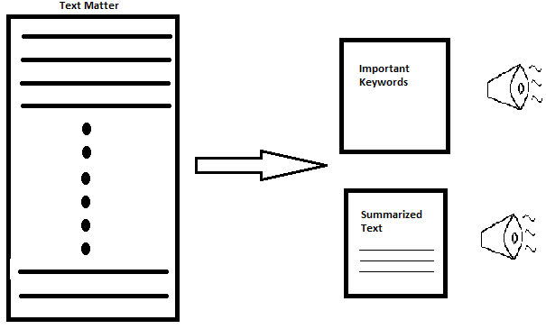
Flow Diagram
Important
Keywords
Summarized Text

