Slide 1


Slide 2
Privacy Eye
Privacy Intrusion Detection
Theme: Social Skills
Team #6 – Rita, Sajal, Sandeep, Nitish, Venkat

Slide 3
Team 6 Composition
Name | Profession | Info
Rita Anjana | Working Professional | Without disability
Sajal Arora | Working Professional | Low Vision
Sandeep Kanabar | Working Professional | Hearing impaired. Relies entirely on lip-reading
Nitish Tuteja | Fresher | Low Vision
Venkat Suprabath Bitra | Student | Without Disability

Slide 4
Privacy Intrusion Detection
WHAT, WHY and HOW?

Slide 5
What is PRIVACY EYE?
Empowers people with or without disabilities by giving them more control over their privacy.
It gives people an EYE over their privacy and hence the name PRIVACY EYE.

Slide 6
Why the need for privacy?
With social connection being the order of the day, it makes more sense to ensure that people’s privacy is not intruded upon.

Slide 7
The need for privacy
If a person with low vision is accessing sensitive information/website and someone shoulder surfs him, it becomes a privacy concern.
If a person who’s totally deaf and his world is silent – is accessing private information and someone comes and stands behind him discreetly.
Bottomline – warn a user if his privacy is being intruded upon.

Slide 8
How are we detecting intrusion?
Using OpenCV: https://github.com/opencv/opencv for Face Detection and then Face Recognition to classify if face is intrusion or not.

Slide 9
How are we detecting intrusion
Face Detected
YES
Face Classification
YES
Matches Similar
NO
Intrusion Detected
Warn

Slide 10
Face detection to identify if intrusion happened.
Once Face is detected, then Face is recognized using machine learning models and then classified to see if it matches SIMILAR Faces on pre-trained models. If a match is found, it does NOT Alert.
If match is NOT found, raises intrusion alert.

Slide 11
Future Plans:
Extend this idea to mobile devices and can be added as an accessibility feature on mobile phones.
If a user’s location is detected in public zone or user is continuously moving (e.g. in bus), alert him if he would like to be monitored.
When user is entering password / sensitive field, this can be used to alert the user.

Slide 12
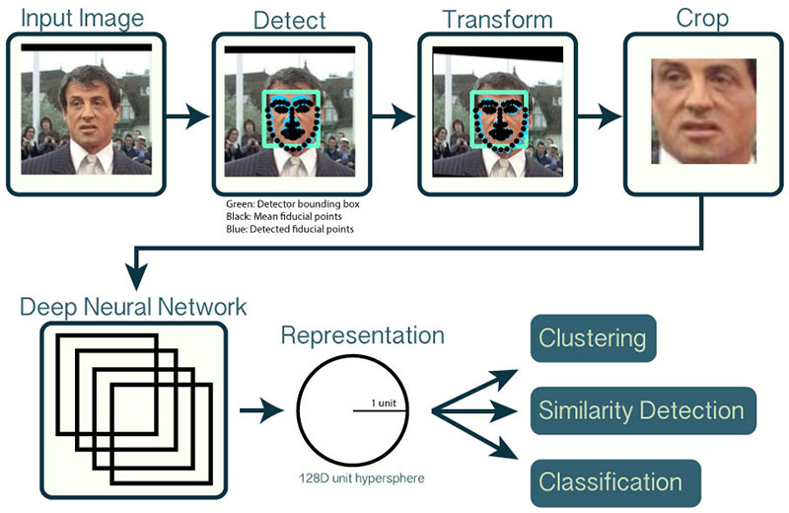
Model Architecture
https://www.pyimagesearch.com/2018/09/24/opencv-face-recognition/

