Slide 1
Online INDEN-LE meeting on Evaluation of ⁷Be system
Vivian Dimitriou
Nuclear Data Section
IAEA

Slide 2
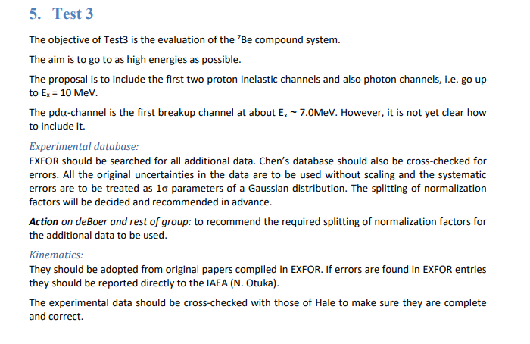
R-matrix Codes for charged-particle reactions in the RRR (4), 27-29 August 2018, INDC(NDS)-0767

Slide 3
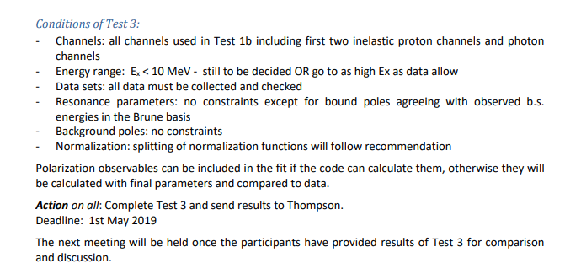
Cont’d

Slide 4
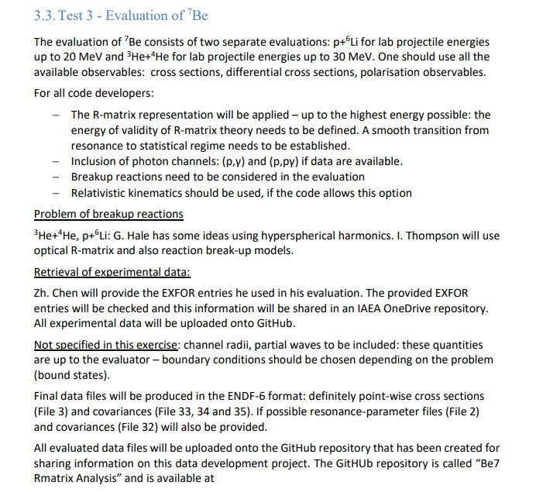
R-matrix Codes for charged-particle reactions in the RRR (5), 13-14 May 2019, INDC(NDS)-0787

Slide 5
Some results
Zhenpeng Chen and Yeying Sun
“A Global Fitting Method with the R-matrix code RAC”
INDC(NDS)-0791, December 2019
-evaluation of ⁷Be up to 30 MeV; included all channels with available experimental data; generalized least-squares fit; reduced R-matrix model; chi2<1

Slide 6
R-matrix codes for charged-particle reactions in the RRR, 15-16 March 2021, virtual, INDC(NDS)-0827
Preliminary results of ⁷Be* evaluation up to 20 MeV CM from I. Thompson
NCSM provided spin/parity input for levels above known ones
Generalized Reich Moore damping was used

Slide 7
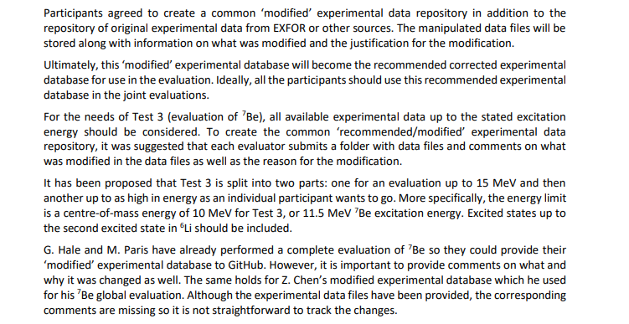
R-matrix codes for charged-particle reactions in the RRR, 15-16 March 2021, virtual, INDC(NDS)-0827

Slide 8
INDEN-LE (4), 20-23 June 2022, INDC(NDS)-0853
Test 3 – Full evaluation of ⁷Be compound system
[Summary of discussions of the follow-up meeting held on 01-09-2022. Present: P. Dimitriou, H. Leeb, M. Pigni, I. Thompson]
Specifications for the final evaluation for discussion at the next INDEN-LE meeting and consideration for ENDF/B-8.1:
Three incident channels will be considered according to the experimental data available in EXFOR:
p+⁶Li, E_{x} = 11.5 MeV at least (Ep ≈ 7 MeV (lab));
³He+⁴He, E_{x} = 11.5 MeV at least (E_{3He} ≈ 23 MeV (lab));
⁴He+³He, E_{x} = 11.5 MeV at least (E_{4He} ≈ 17 MeV (lab)).
All outgoing channels including gamma channels should be considered if possible.

Slide 9
Cont’d
Experimental data
All EXFOR data files (and others) compiled by I. Thompson and available on GitHub and on Shared OneDrive will be used. A csv file with metadata is also available (dataprop.csv).
Additionally, data files provided by James deBoer and Zhenpeng Chen (also available on GitHub and Shared OneDrive), should also be consulted and used.
Note: deBoer data files do not contain any metadata (units, type of data, etc.)
Input resonance energies, widths, spins and parities
This information will be taken from TUNL website, and if additional data are needed in the higher excitation energies, theoretical values will be used. Ian Thompson will provide shell-model calculations.
Output data (to be provided by evaluators)
Chi2/dof
Resonance parameter (RP) files
Reconstructed cross-section files
Use Legendre expansions for elastic scattering charged-particle angular distributions - if possible
Covariances of RP and/or reconstructed cross sections (ENDF6 specifications)
List of data normalizations
Experimental data - metadata (whatever modifications have been implemented)

Slide 10
Requirement for participation in INDEN evaluation
To provide all output listed in (c) by agreed deadlines
Actions and Deadlines
January 2023 online meeting: present evaluations; obtain feedback.
[Sec. note: an online poll resulted in the following dates for the online meeting: 13-16 February 2023]
Provide all output data listed in (c) – evaluators could use this information to improve their own evaluation (at or immediately after February meeting)

Slide 11
Questions for the final discussion session
Is the sole purpose of this evaluation (⁷Be) a submission to CSEWG (and ENDF/B-8.1)?
Deadlines depend on the answer to 1)
Is there a point in discussing a joint evaluation? – regardless of CSEWG and ENDF/B-8.1?
and what do we mean by joint in this case?

Slide 12
Thank you!
Notes:
Thank you!

