Slide 1



TEAM CODELANDERS
THE BIG IDEA
RADICAL EMPATHY.

Slide 2



ABOUT US
At The Big Idea, the broken model of workplace training is being redefined. For too long, unconscious bias and microaggressions have gone unaddressed.
Through our AI-driven immersive platform, realistic workplace scenarios are simulated. Continuous feedback is provided and an accountability score is maintained so that real progress can be ensured. Human oversight is guaranteed by a unique self-complaint mechanism, allowing workplace culture to be strengthened through constant learning.
It is our mission for awareness to be moved into action, so that workplaces are built where fairness is treated as a reflex, not an afterthought.
02

Slide 3

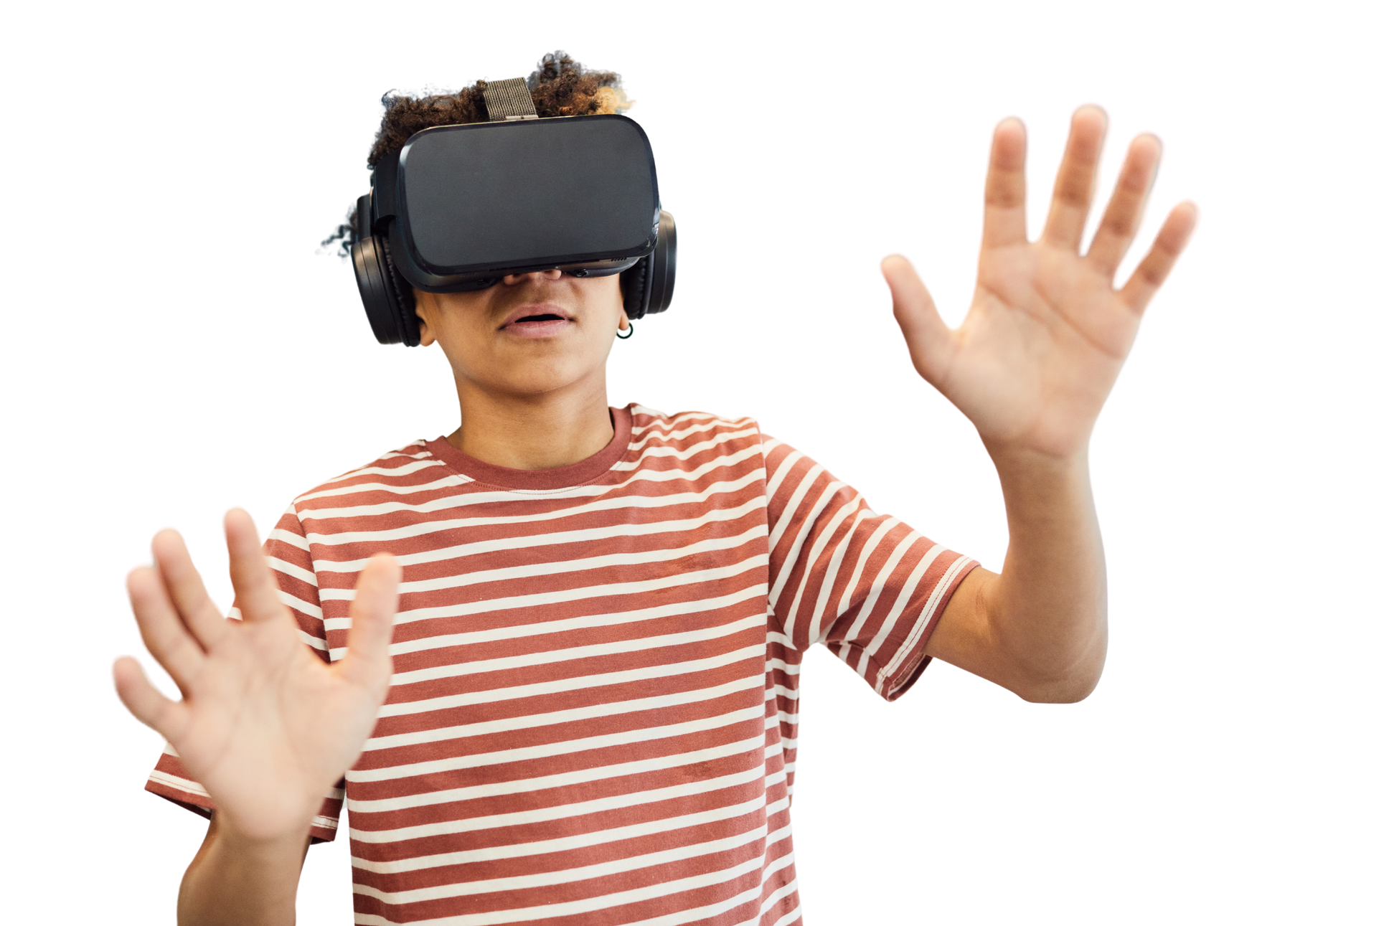
Problem
Statement
Workplace discrimination, unconscious bias, and microaggressions are often subtle, making them difficult to detect and address. Employees and employers may have awareness or empathy gaps, and conventional training methods frequently fail to create lasting behavior change or deep emotional understanding. There is a need for immersive learning solutions that simulate real-world workplace dynamics, foster empathy, and cultivate inclusive organizational cultures.
03

Slide 4
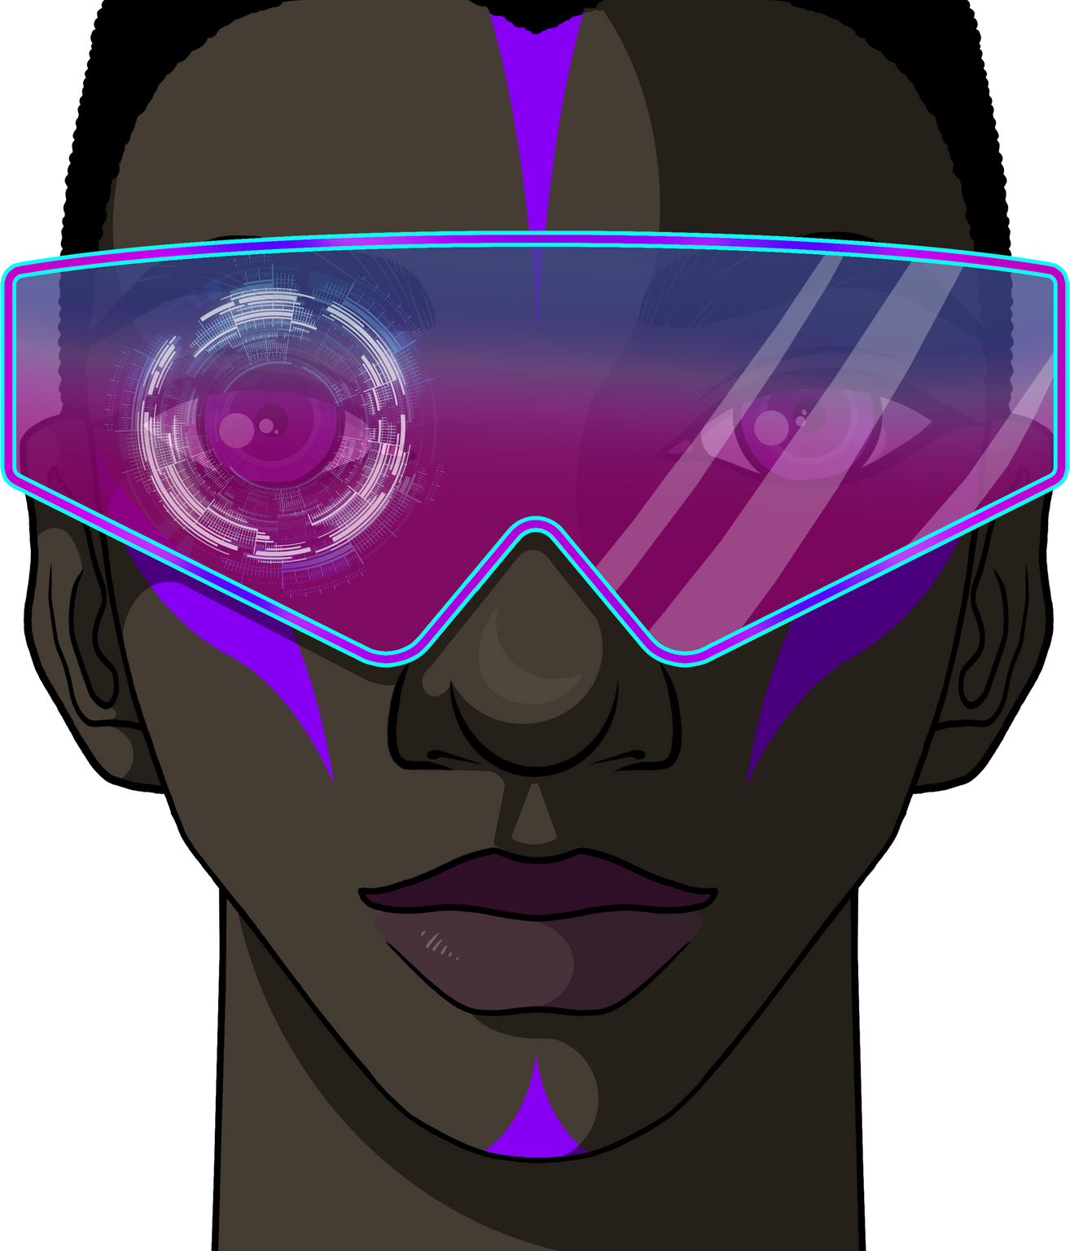
INTRODUCTION
Conventional training methods are considered ineffective, as long-term behavioral change is rarely achieved.
An AI-driven immersive solution has been proposed so that real-world scenarios can be simulated and awareness can be increased.
An annual review reports that track all bias-related memos raised against an employee, along with how many have been effectively resolved to promote accountability and improvement.”
A track record score is maintained for employees and employers so that accountability is ensured.
04

Slide 5
INTRODUCTION
An AI-powered real-time facial analyzer that identifies participation imbalances and potential bias triggers during interactions. By mapping visibility and engagement patterns, it provides organizations with actionable insights to foster fairness and inclusivity
The Mood analyzer interprets facial cues to assess emotional states in real time, enabling early detection of stress, discomfort, or positivity during interactions.
A self-complaint mechanism is integrated, enabling concerns to be raised when an incident is not recognized by AI.
05

Slide 6








TECH STACK
06

Slide 7
07
FLOWCHART
THE BIG IDEA
SERVICES
PRODUCTS
Real time analyser
Mood analyser
Self-help station
Query desk
Website
FAIRSIGHT
Situation analyser
Realtime training for bias
VR personal assistant
Record maintanance

Slide 8

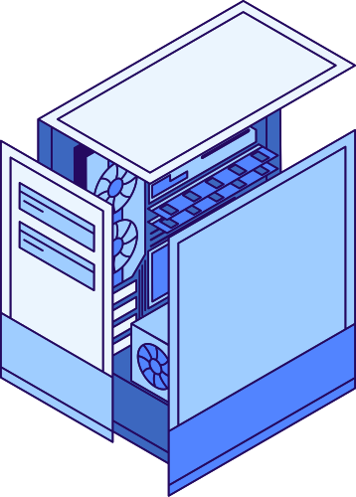
MOOD ANALYSER USING GOOGLE API
Our project uses a mood analysis tool that leverages Google’s Image processing API to detect emotions from visual input. By analyzing facial expressions, the system identifies whether the mood expressed is positive, negative, or neutral. The results are displayed in real time, providing users with clear feedback on emotional patterns. This tool can be applied in workplace settings to enhance self-awareness, communication, and emotional intelligence.
08

Slide 9
REALTIME ANALYSER USING AI-ML MODELS
The real-time analyzer is built using an AI/ML pipeline that combines speech-to-text transcription, NLP-based sentiment and interruption detection, and facial expression analysis. The system captures live audio and video through the FairSight device (camera + mic + Arduino interface), processes it with ML models trained on workplace interaction datasets, and runs behavioral analysis in real time. The website dashboard visualizes mood analysis, interaction scores, and memo reviews. Together, this creates a seamless feedback loop that transforms raw interactions into insights for inclusive growth.
09

Slide 10

SELF-HELP AND QUERY DESK
We created a self-help and query desk system powered by NLP and machine learning models, with Pandas handling data processing and analytics. The platform allows employees to ask workplace-related questions in natural language, and the system provides instant, context-aware answers. It also analyzes past queries and feedback to continuously improve its responses and suggest relevant resources.
By combining NLP for intent detection, ML models for prediction and personalization, and Pandas for insights from employee data, the solution works like an intelligent virtual HR assistant—reducing response times, improving accessibility, and empowering employees with self-help tools.
10

Slide 11
FAIRSIGHT
FairSight is a smart in-house device designed to capture and analyze workplace interactions in real time. Built with an integrated camera and microphone, Arduino as the mediator, ESP-32WIFI as the transcriber and model hoster, it records conversations and passes the data to AI/ML models for transcription, sentiment analysis, and bias detection. By linking with Unity + XR, FairSight enables employees to replay situations for deeper reflection, while the connected web dashboard offers mood analysis, interaction history, and progress tracking. It acts as a bridge between raw human interaction and meaningful, bias-aware feedback.
11

Slide 12
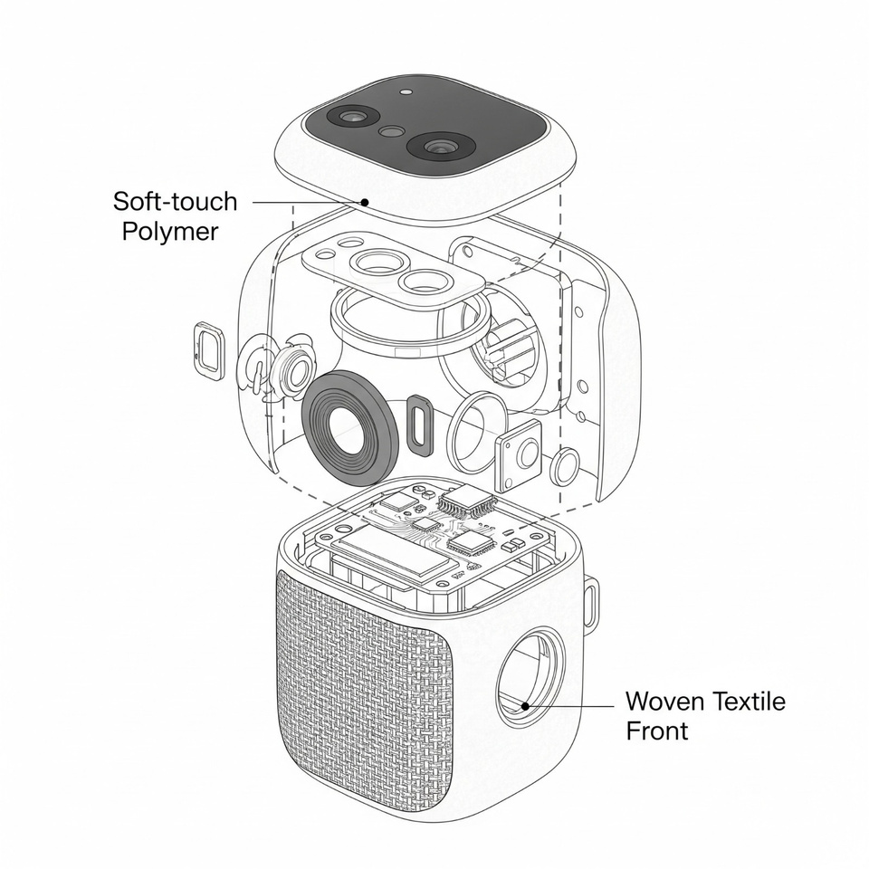
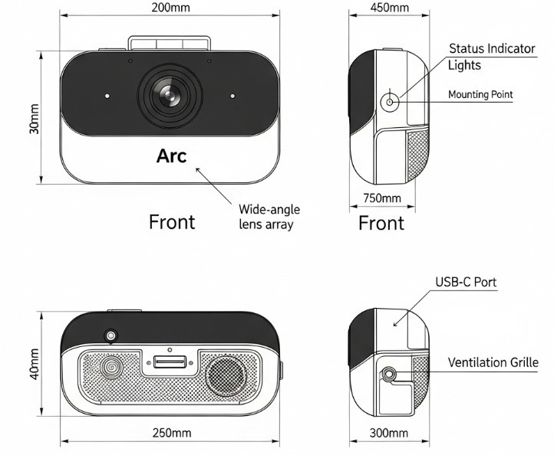
DESIGN CONCEPTS- FairSight

Slide 13
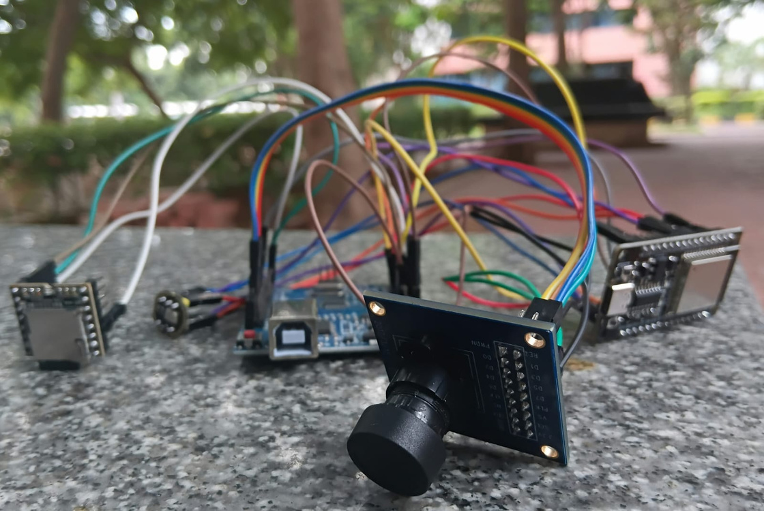
DESIGN CONCEPTS- FairSight
ESP-32 WIF
ARDUINO UNO
O76 7O CAMERA
INMP 441 MIC
DFP PLAYER MINI

Slide 14
14
WEBSITE
Our team has desinged a website prototype using Figma that serves as the central hub for our immersive workplace bias training ecosystem. The site integrates features like VR system access and regeneration, record maintenance for tracking employee progress, realtime facial analyser and a mood analyzer that gauges user sentiment during training.
The platform acts as a one-stop interface where HR Managers can monitor records and improvements, and the mood analyzer provides insights into emotional responses, helping personalize the training journey. This ensures that bias awareness is not just trained, but also measured, tracked, and continuously improved through a sleek, intuitive web experience.

Slide 15

BUDGET ALLOCATION & PRODUCTION COST
In-house Mood Analyser (Soft-touch Polymer Casing)
Hardware (25%) – ₹12,000
Microcontroller, sensors, display, connectivity
Casing (15%) – ₹8,000
Soft-touch polymer casing, internal housing
Software/API (45%) – ₹22,000
Google NLP API, in-house development & testing
Miscellaneous (15%) – ₹6,000
Testing, power, packaging
➡ Estimated Total (Prototype): ₹48,000 – ₹50,000
15

Slide 16
Meet The
Code Landers
CHITTESH D- 25BRS1255
ANAMITHRA GOVINDARAJAN- 25BRS1291
RAMYASHRI S- 25BRS1144
MOHAMED FAHEEM- 25BRS1326
S NAVYASHRE- 25BRS1398

