Slide 1
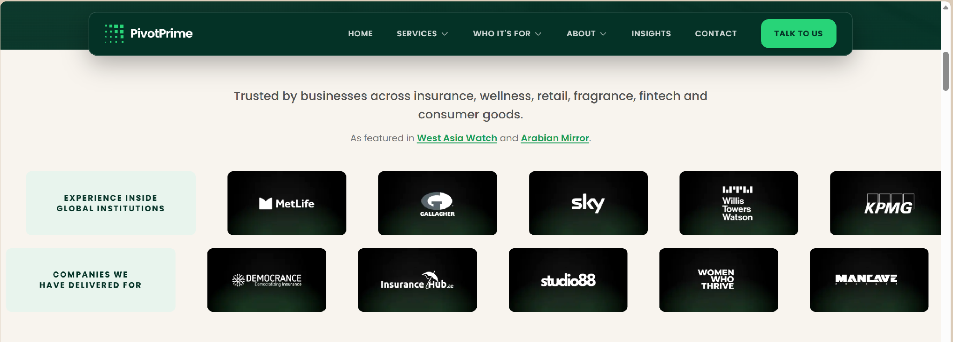
STATUS 30 SEP: NOT DONE YET
The institutions strip still shows MetLife, Gallagher, Sky, Willis Towers Watson, KPMG and AIG. Ford, Dubizzle and OSN are missing.
The "Companies we have delivered for" strip has none of Cinnacare, Nurture UAE, Scentmatic or BookMeetings yet.

Slide 2
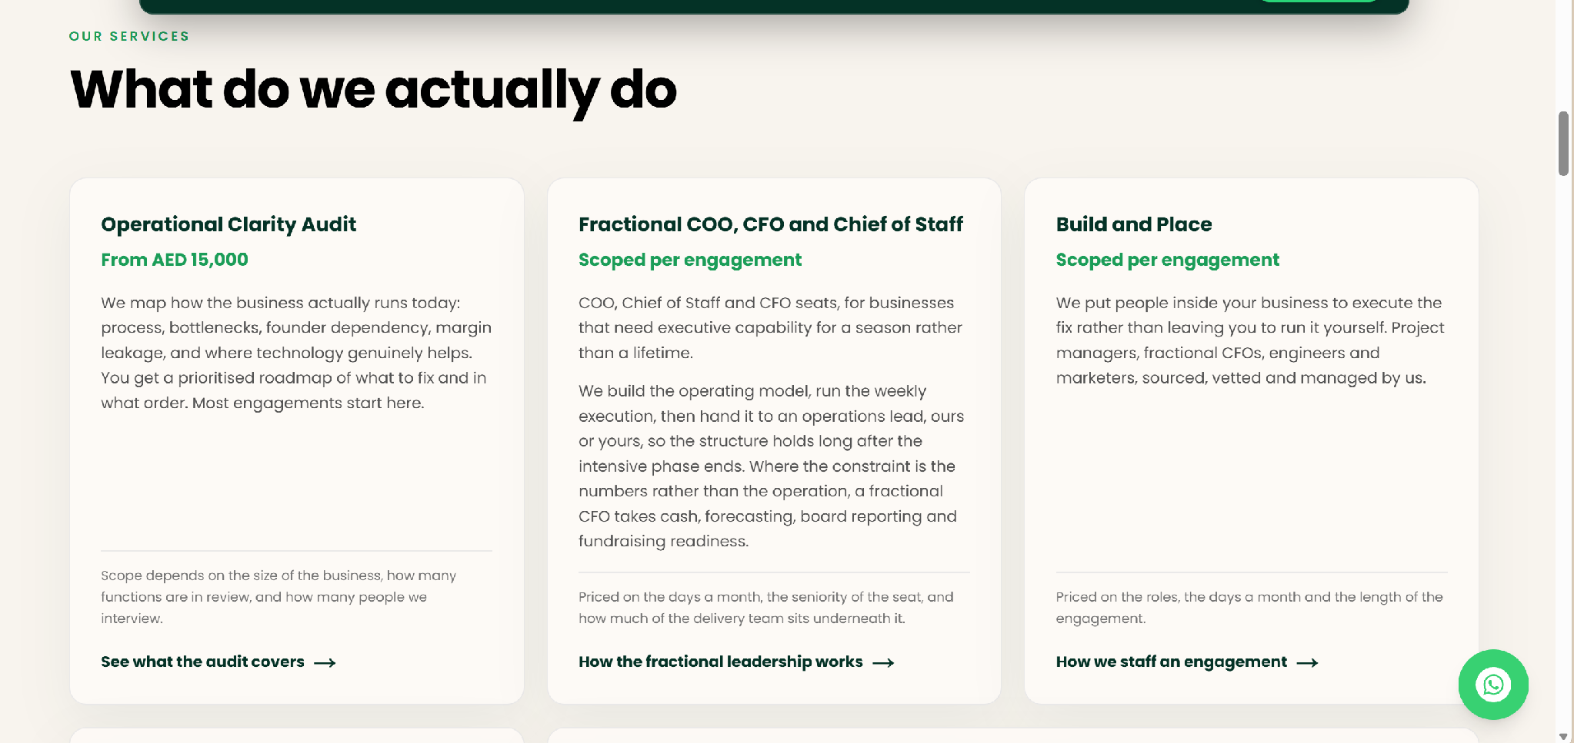
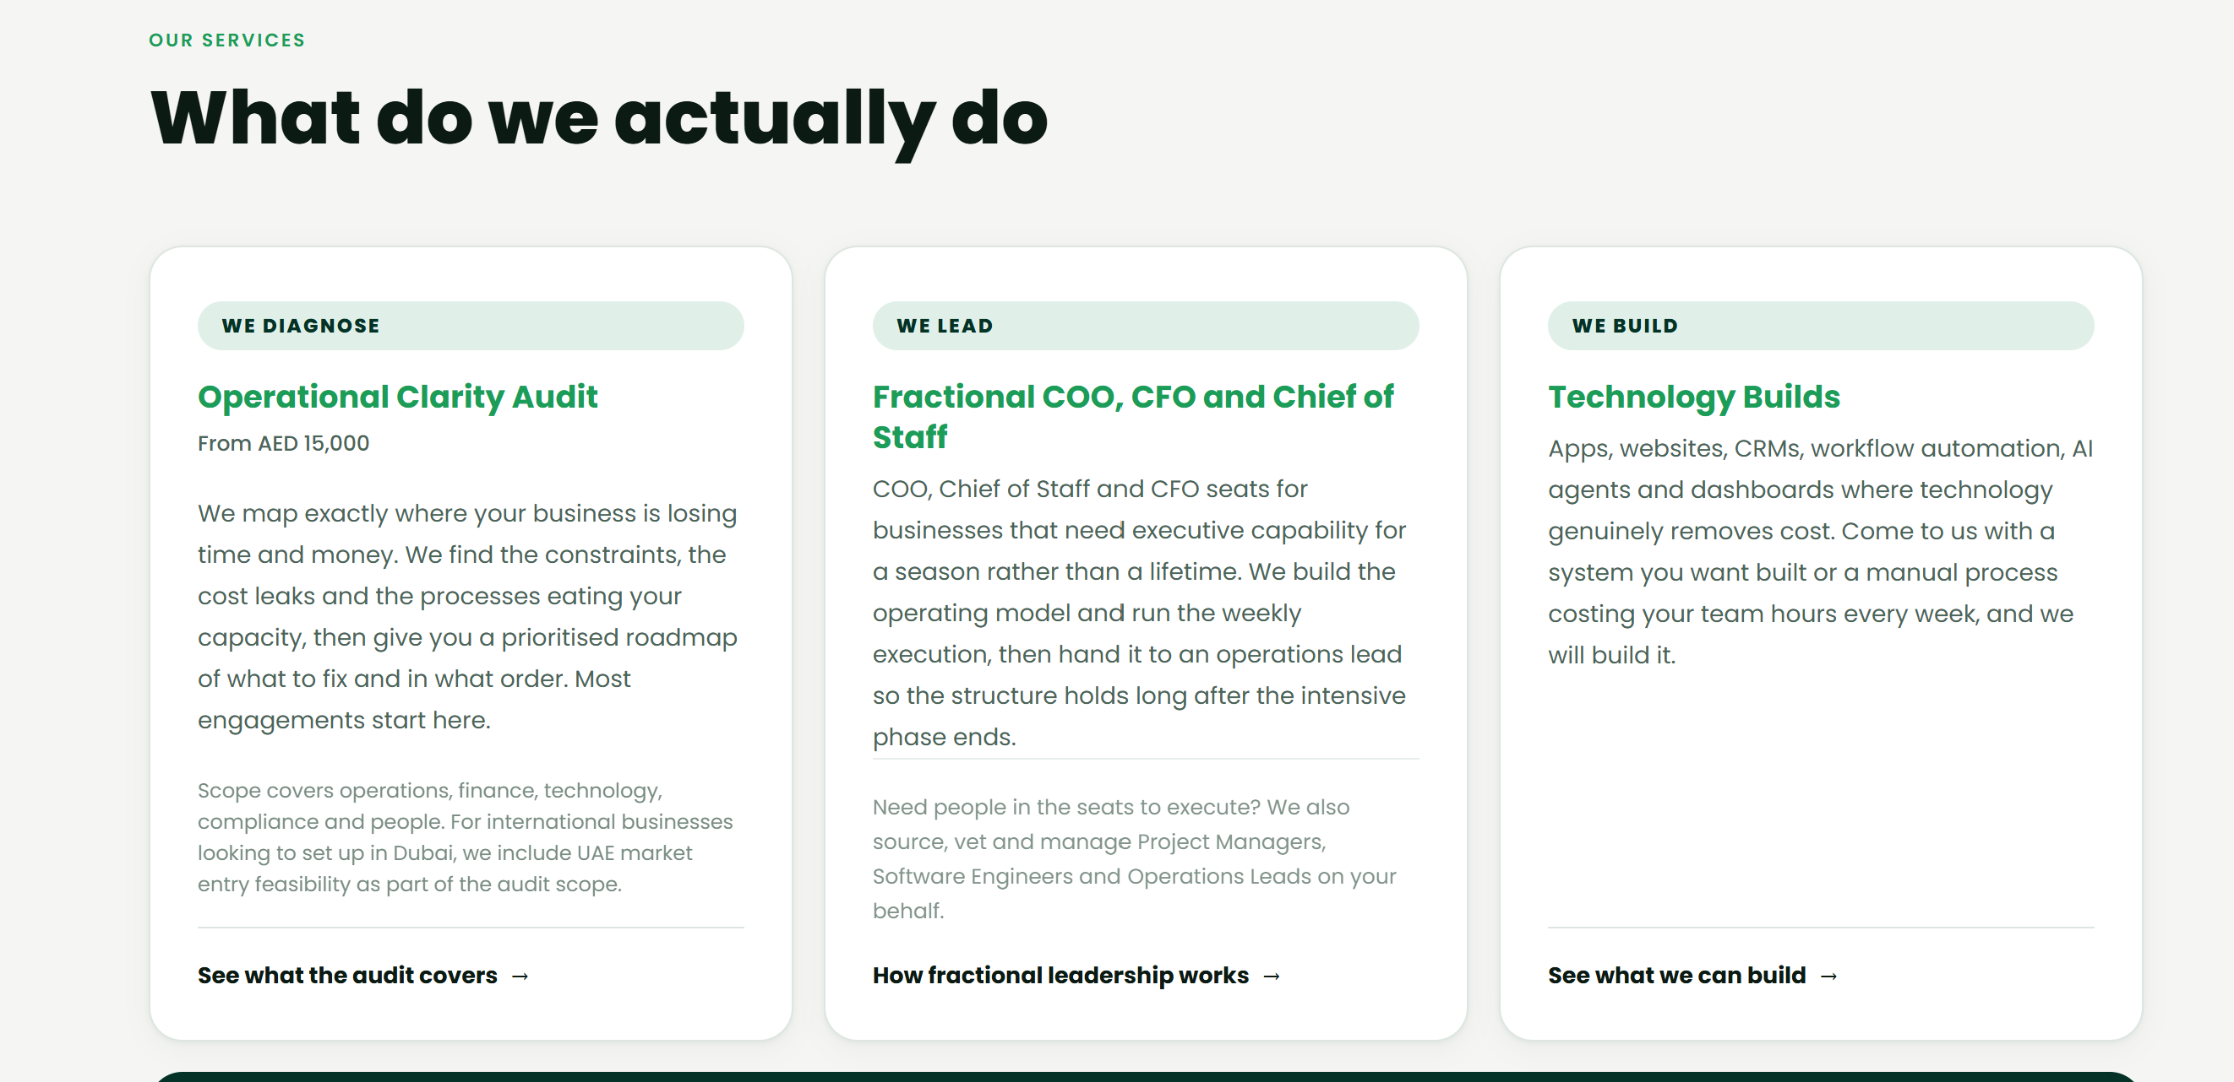
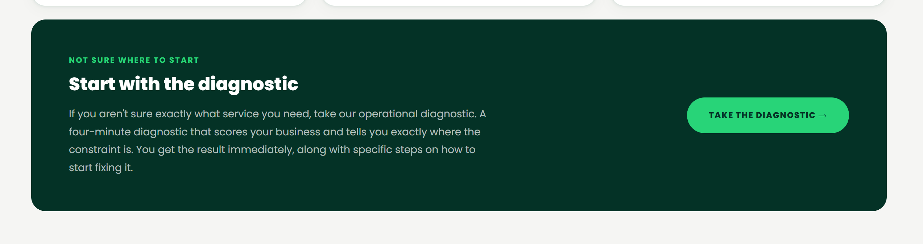
DEVELOPER NOTES
[1] Have refined it so it reads as 3 cards under diagnose, lead and build.
And only 3 offers now, see the html for this here - https://claude.ai/code/artifact/eeb21f42-35a9-4dce-ac61-a9c22f2faa19
STATUS 30 SEP: PARTLY DONE
Done: the three cards (Diagnose, Lead, Build).
Still to do: Build and Place is still a full offer inside the Lead card, and UAE Market Entry is still a full offer inside the Build card. Fold both into short notes as in the mock-up, so there are only 3 offers.
The Services page still says "which of the five you actually need". Change it to three.

Slide 3
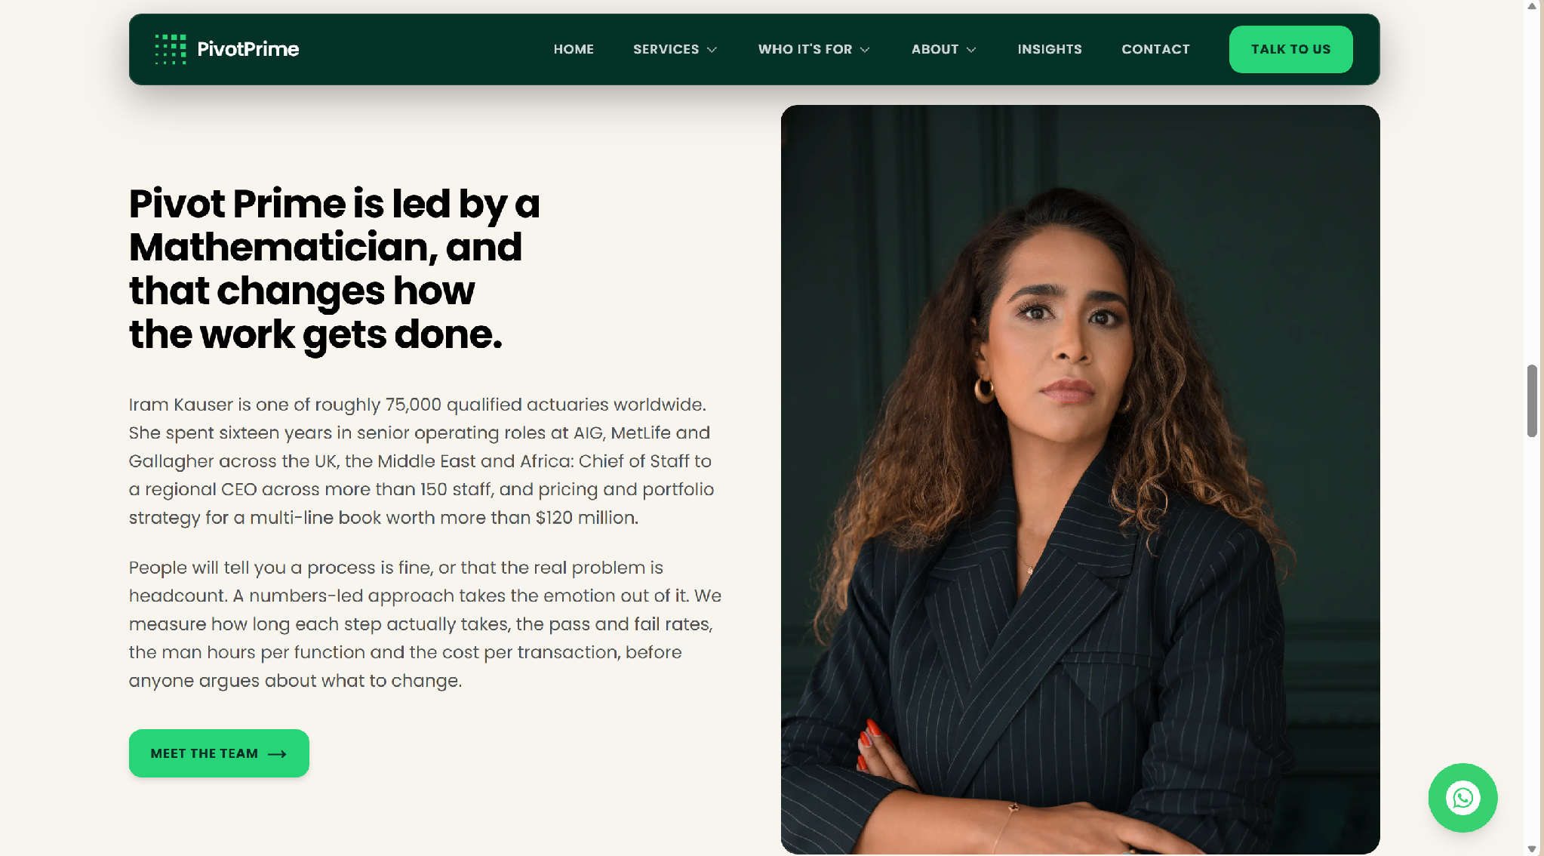
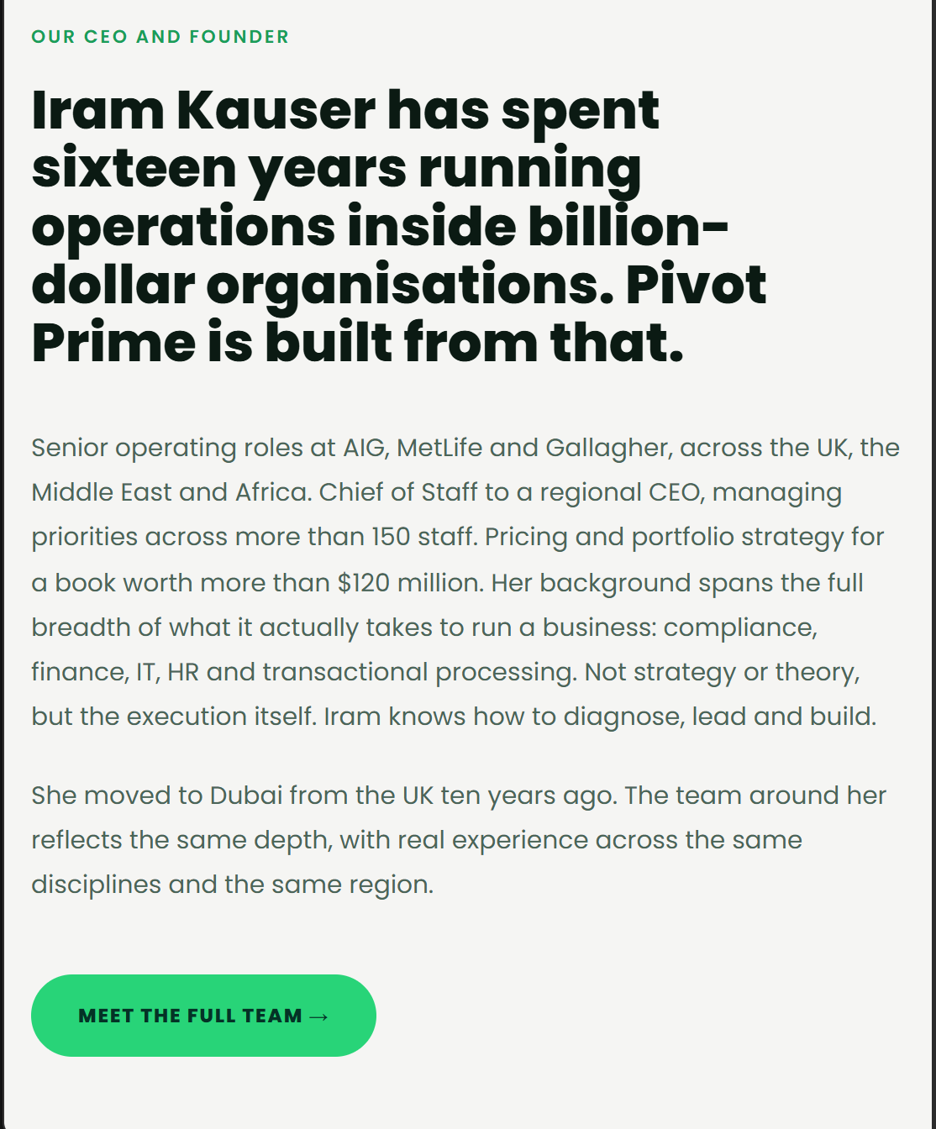
DEVELOPER NOTES
[1] Eyebrow heading - Meet the CEO & Founder, then as per second pic here, but keep my photo of course
[2] – Use right hand side text and heading please.
[3) reminder buttons to remain rectangular as currently is
STATUS 30 SEP: NOT DONE YET
There is no "Meet the CEO & Founder" eyebrow yet.
The homepage still uses the old heading and text ("Pivot Prime is led by a Mathematician..."). Replace them with the heading and text in the right-hand picture, keeping my photo.
Button shape is correct, keep it.

Slide 4
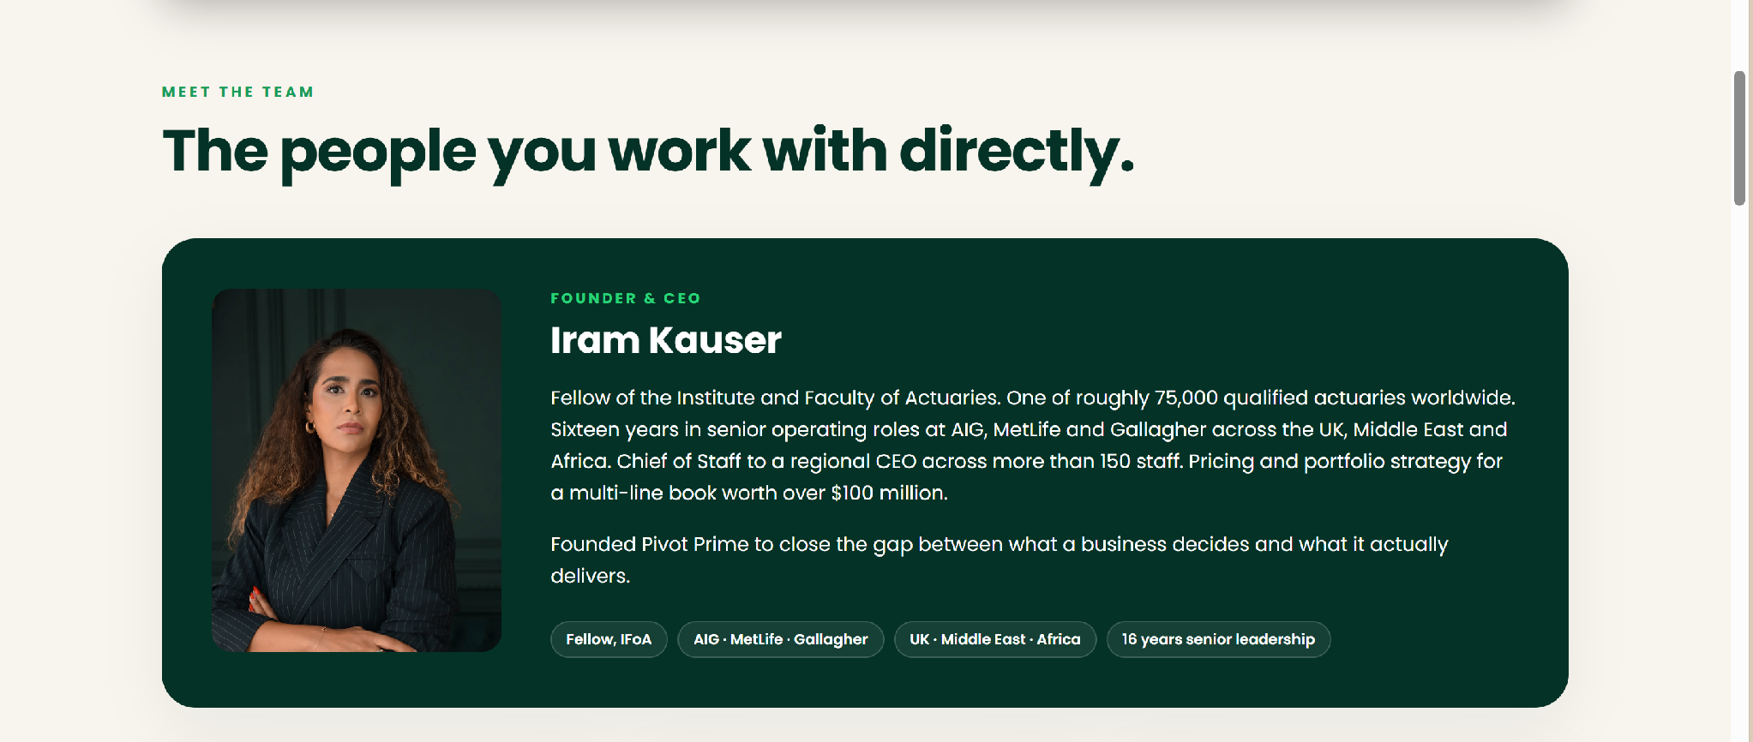
DEVELOPER NOTES
[1] Below add my linked in page, and say connect with Iram on Linkedin, do this for all staff.
[2] Under the heading of my name, the text will be:
Iram has held the roles that Pivot Prime now provides for its clients.
Chief of Staff to the CEO of AIG GCCNA. Head of Operations at Gallagher's Middle East brokerage, with full accountability for compliance, finance, IT, HR, claims and offshore delivery. Head of Pricing and Portfolio Management for a $120M book spanning the Middle East, Africa and Israel. She has not studied these functions from the outside. She has run them.
Over sixteen years at AIG, MetLife and Gallagher, she built operating models from scratch, led enterprise transformation aligned with DFSA standards, scaled delivery capability across borders, and closed major commercial partnerships in the region. She has been based in Dubai for ten years and understands the market the way only someone who has operated inside it does.
She is a Fellow of the Institute and Faculty of Actuaries,and holds an MSc in Mathematics with Distinction from the University of Birmingham.
She founded Pivot Prime on one conviction: the people best placed to fix a business are those who have run one.
Tags: Fellow, IFoA · Gallagher · AIG · MetLife · UK · Middle East · Africa · 16 years senior leadership.
STATUS 30 SEP: PARTLY DONE
Done: my new bio text and tags are live on the About page.
Still to do: add "Connect with Iram on LinkedIn" with my LinkedIn link under my bio, and the same for Justin, Saif and Khushi. See also next page.

Slide 5
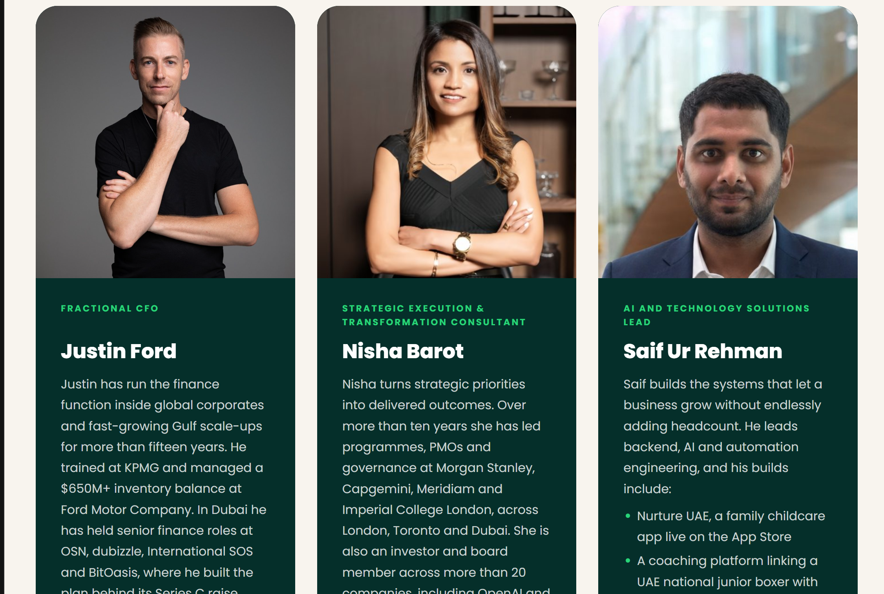
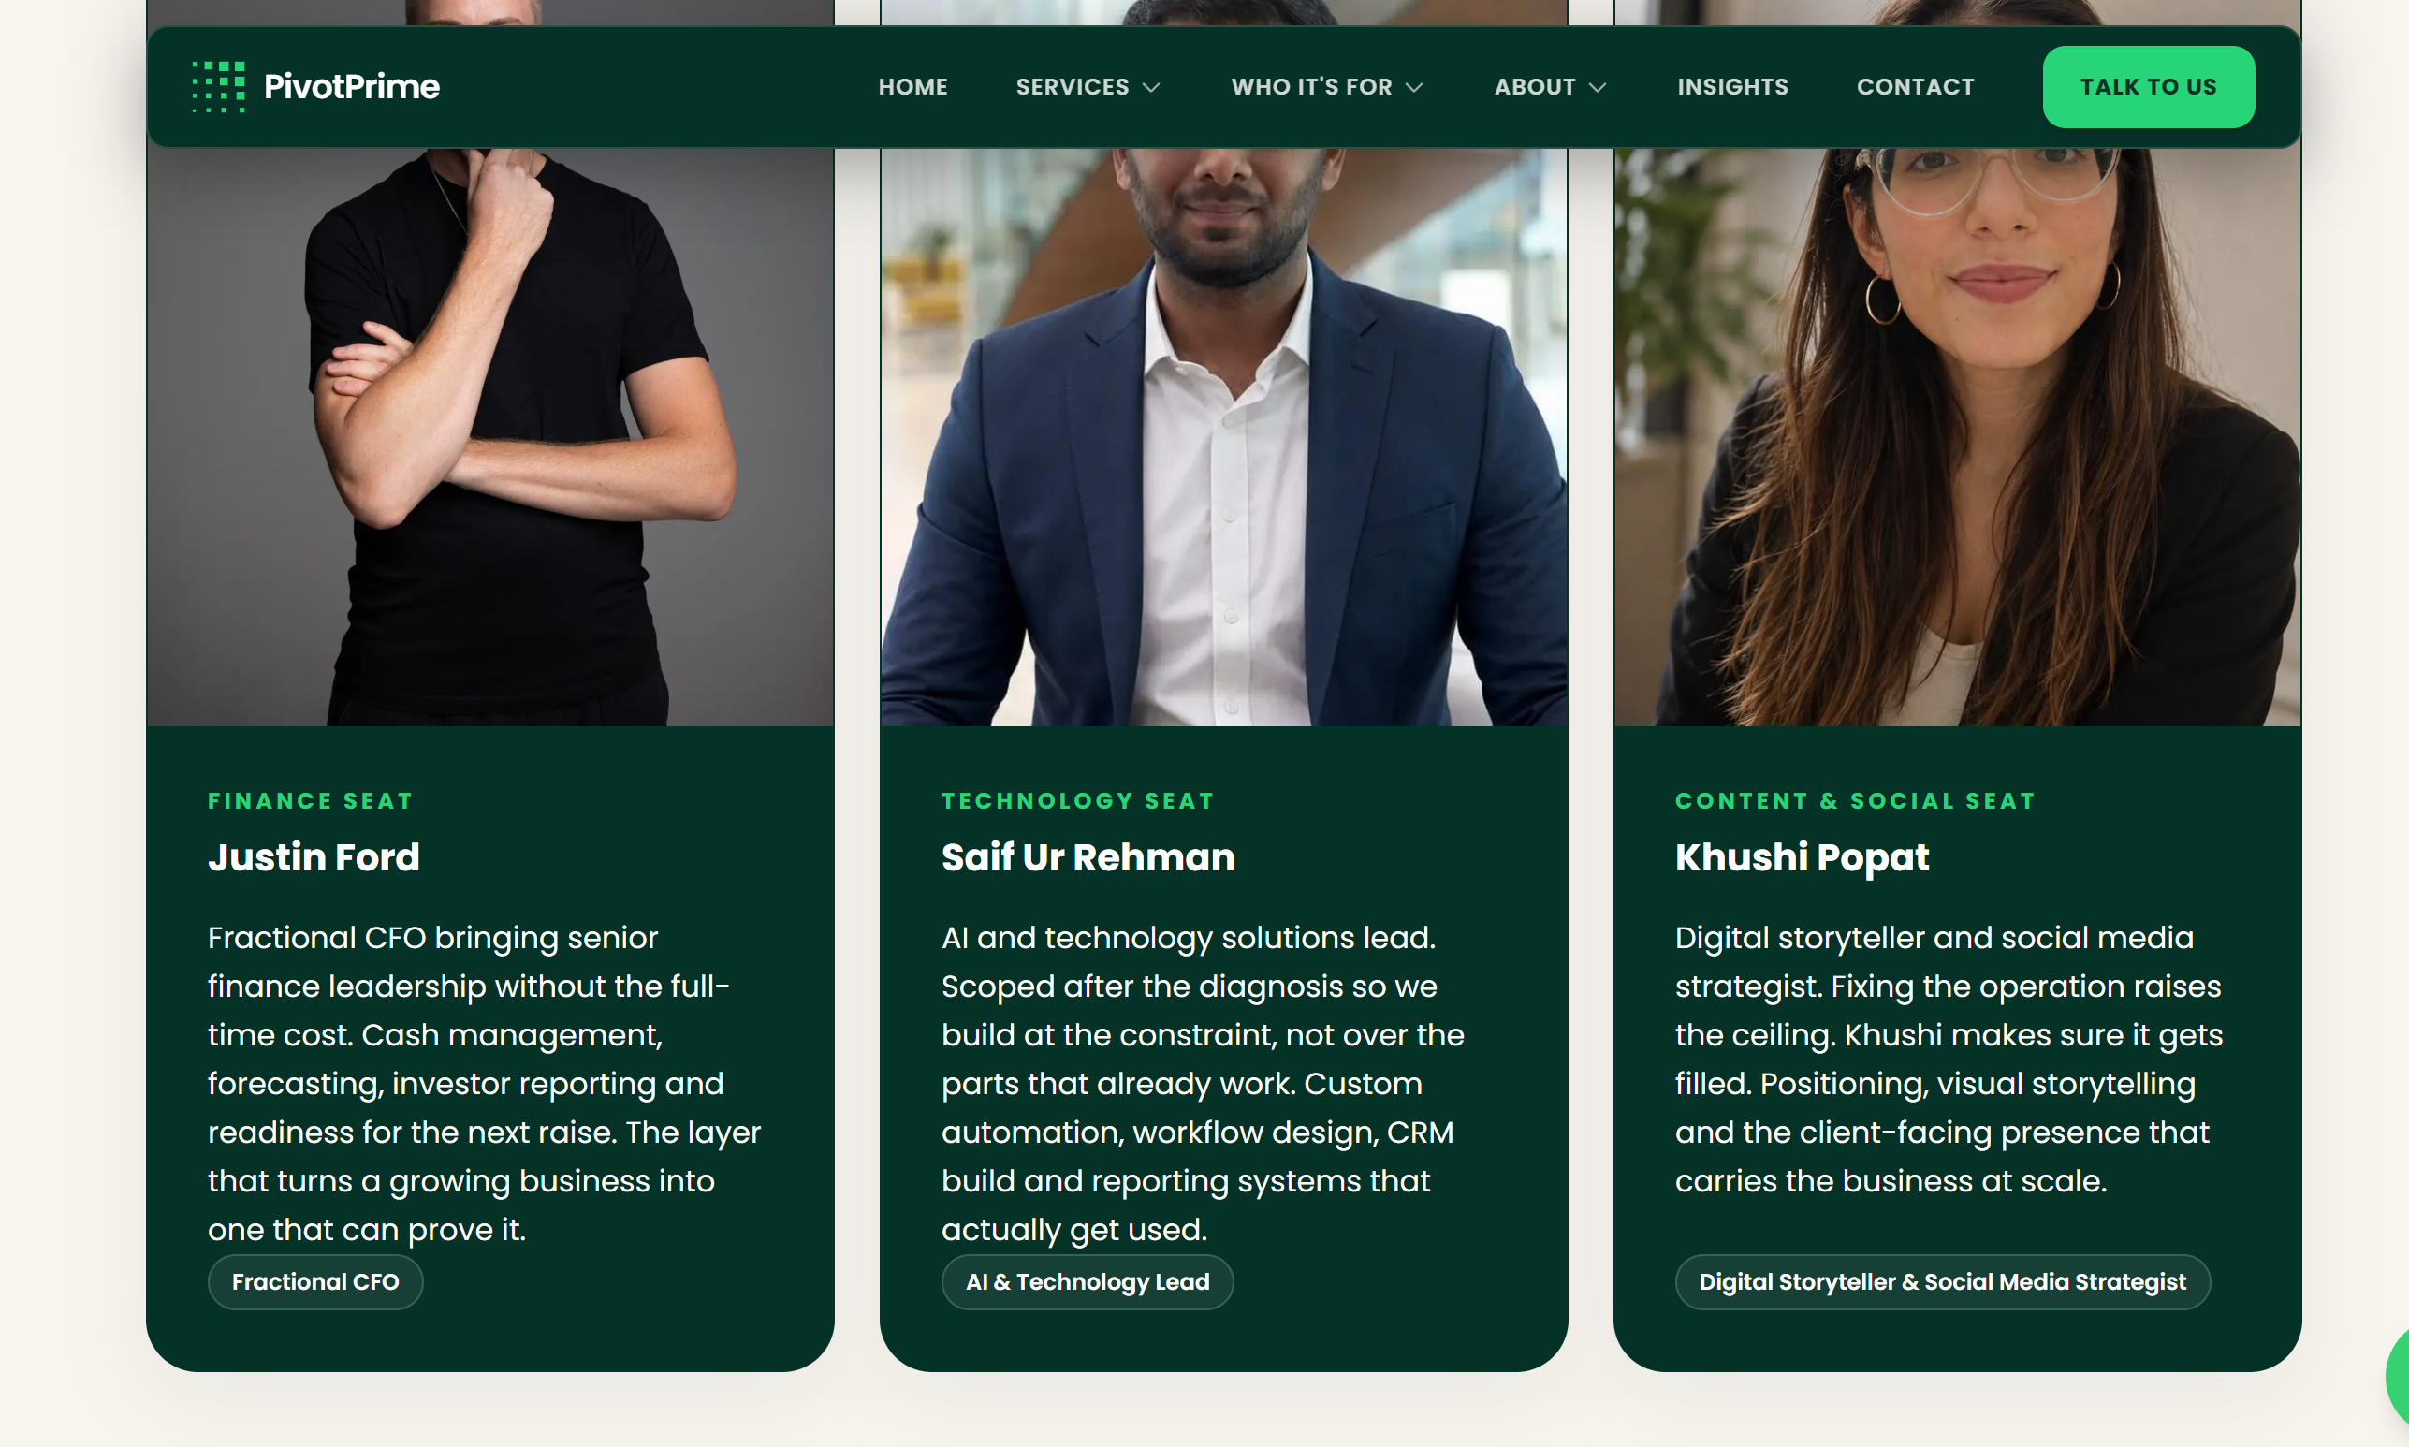
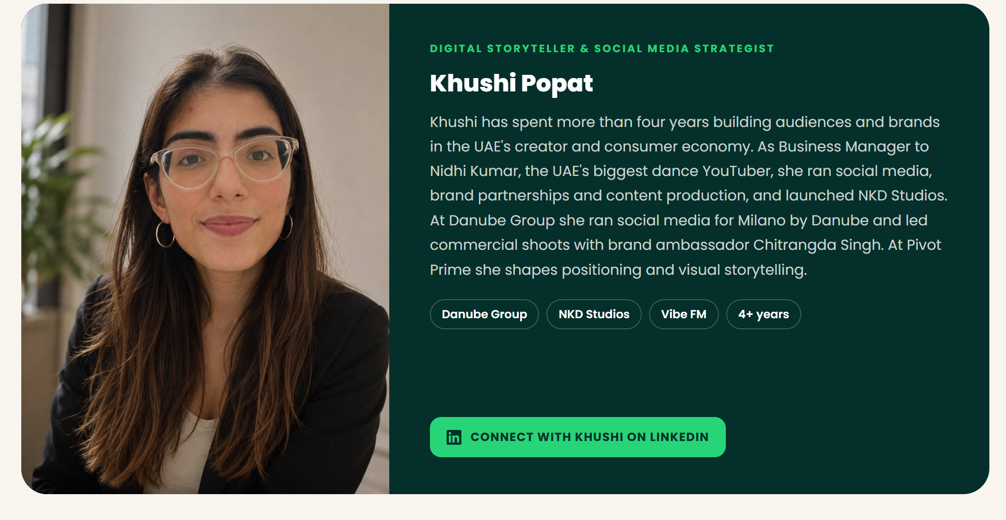
STATUS 30 SEP: NEW ADDITION
We have to add Nisha to the website – her bio and details are attached
Everyones bio sections to be updated a bit see attached html
Add everyone’s linked in to the bottom of their bios

Slide 6
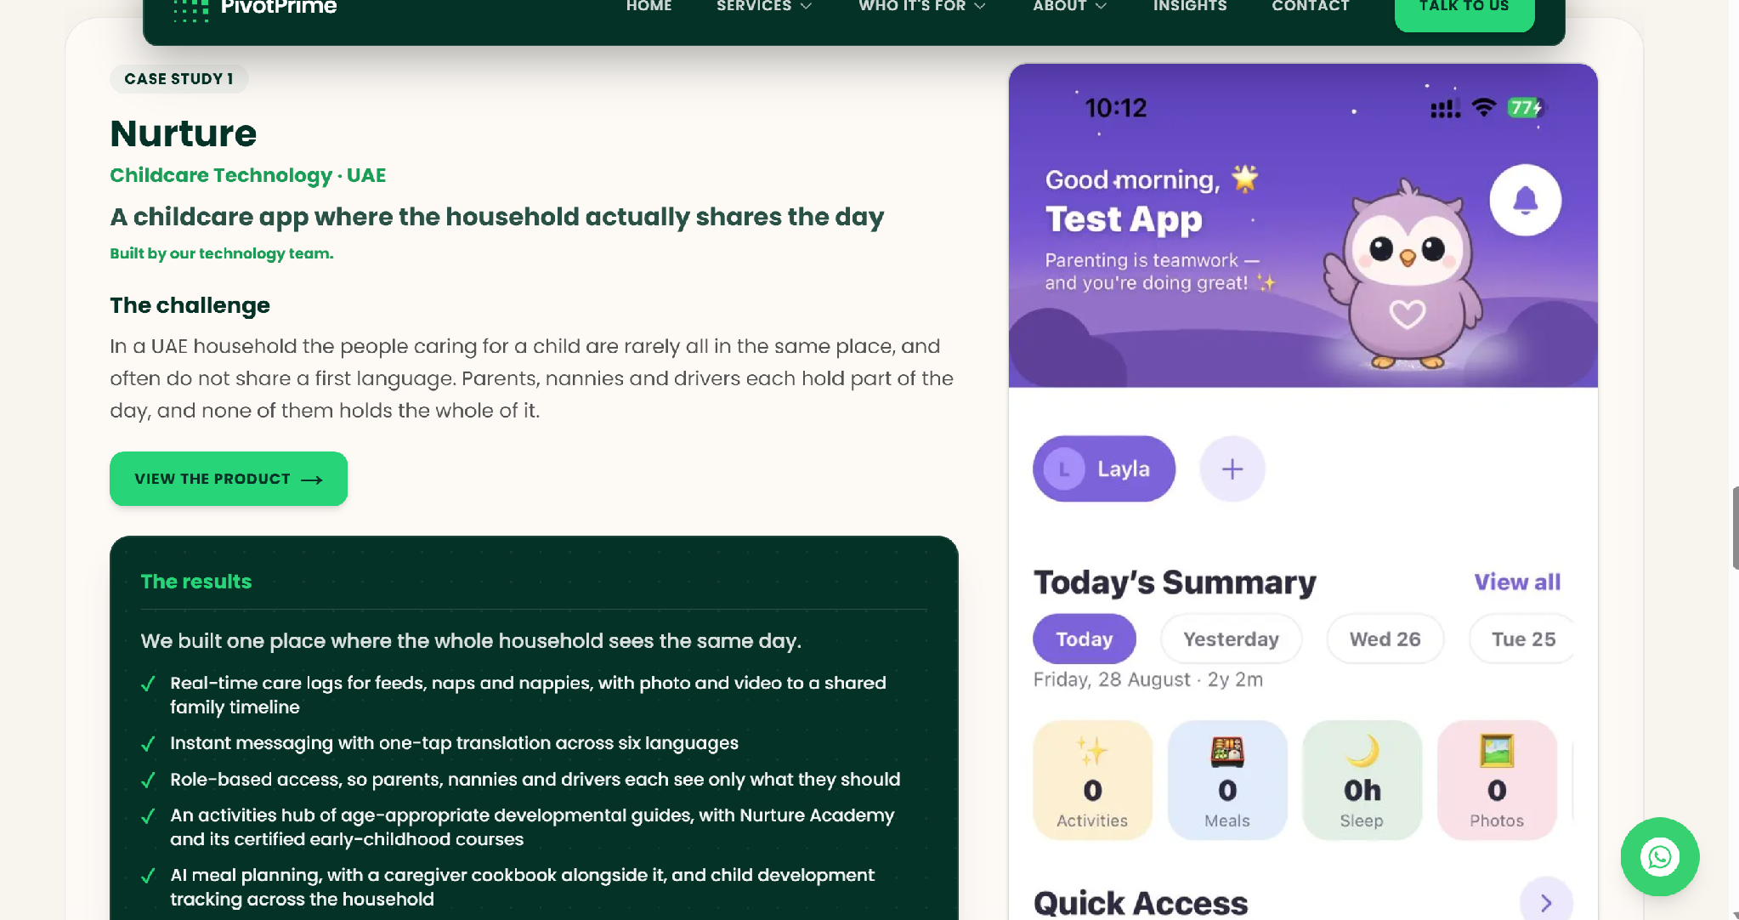
STATUS 30 SEP: PARTLY DONE
Still to do: the Nurture screenshot still says "Good morning, Test App". Replace it with a live screenshot showing a real name.

Slide 7
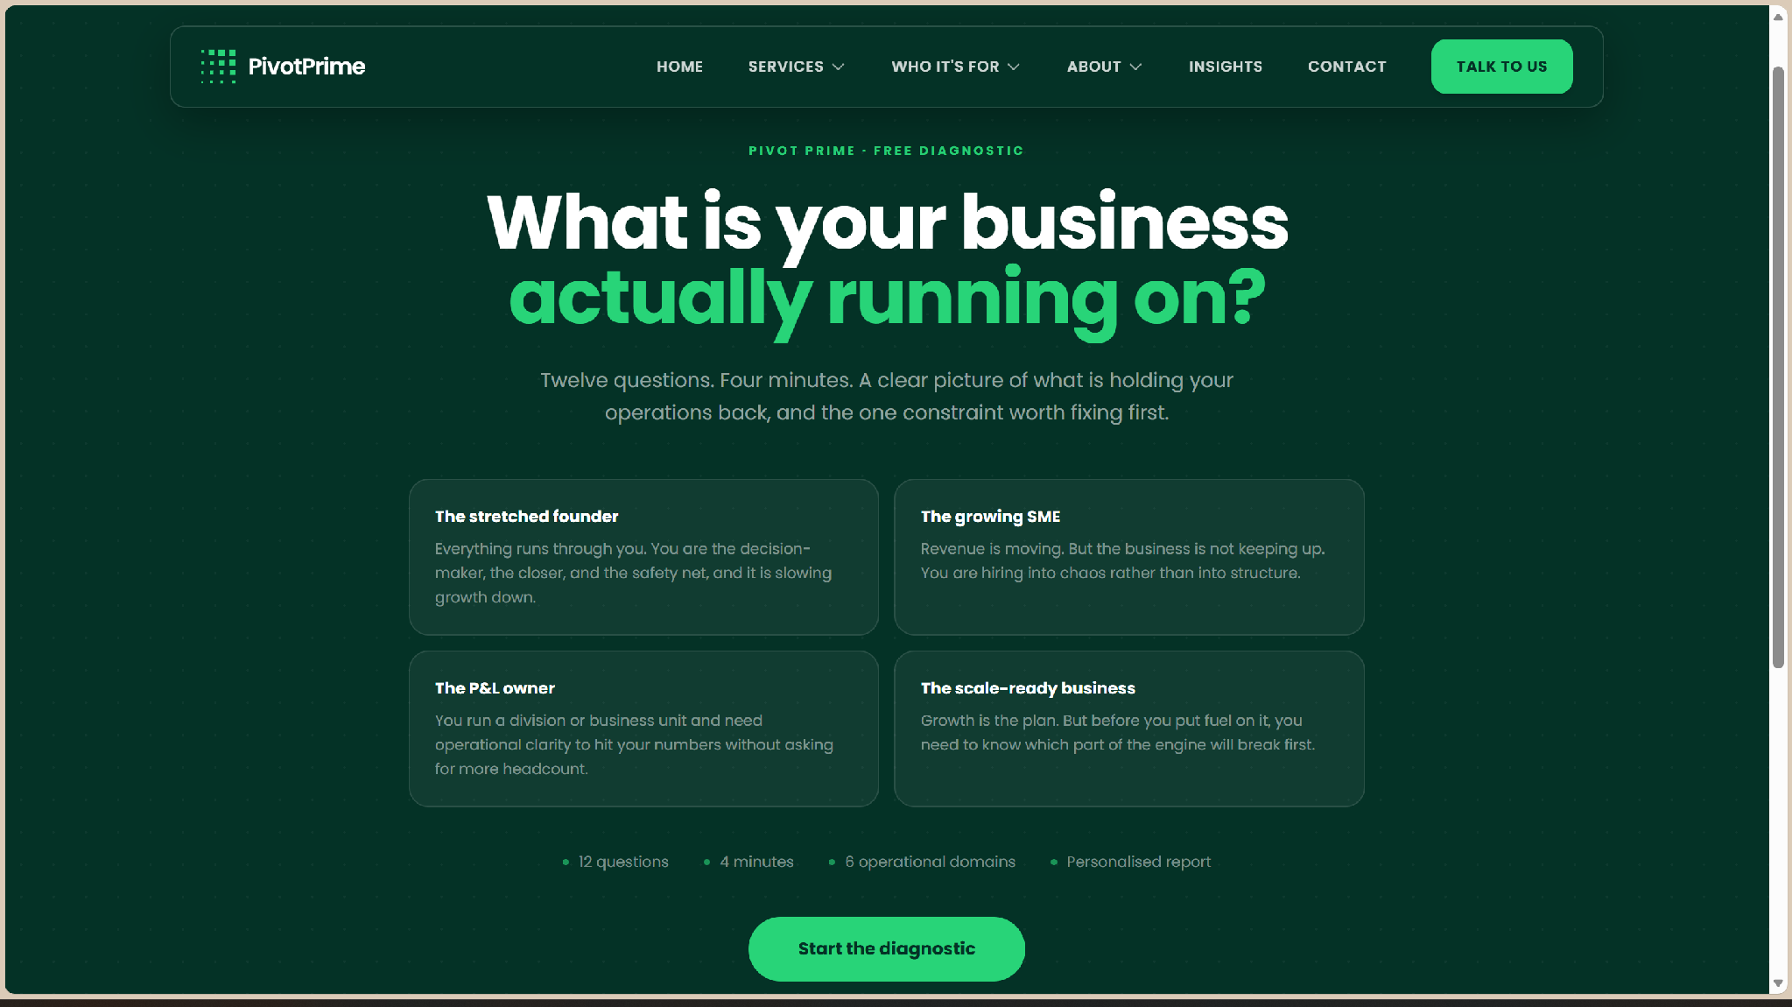
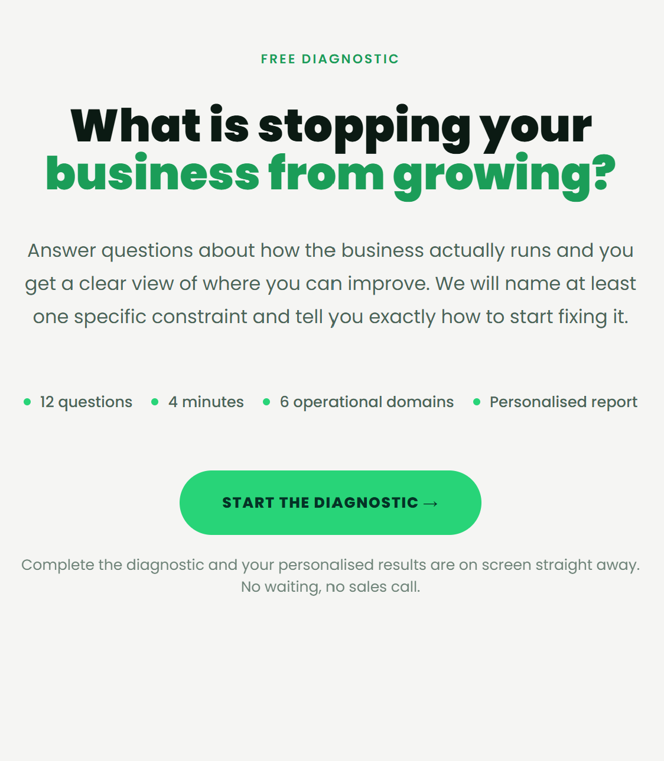

DEVELOPER NOTES
[1] FREE DIAGNOSTIC, SLIGHTLY BIGGER, OR HIGHLIGHTED,
[2] Main page to look like second pic shown here, remove all the stretched founder stuff etc, and have the lighter background similar to most of the website.
Keep wording as shown in this picture
[3], start the diagnostic button to be rectangular like all other buttons and example shown below
STATUS 30 SEP: NOT DONE YET
The "Free diagnostic" label is still small. Make it bigger or highlighted.
The page is still dark green with the old headline. Use the lighter background and the wording in the second picture.
"Start the diagnostic" is still a round pill. Make it rectangular like the other buttons.

Slide 8
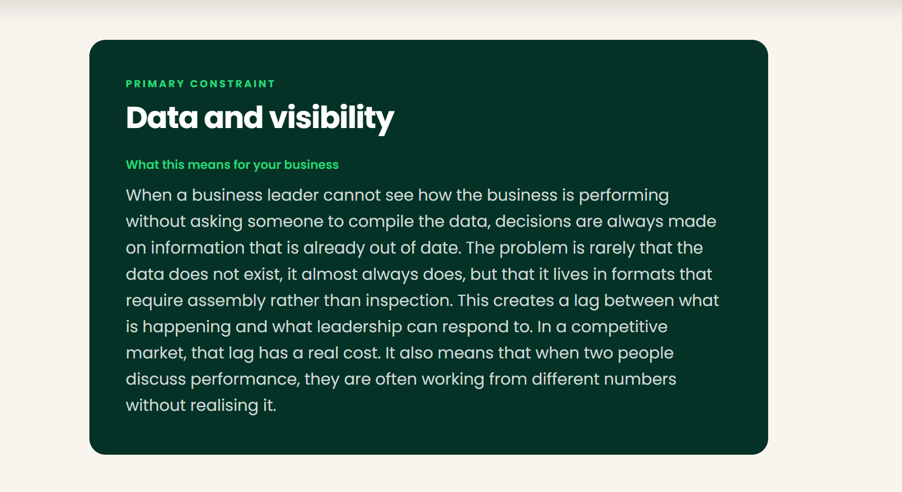
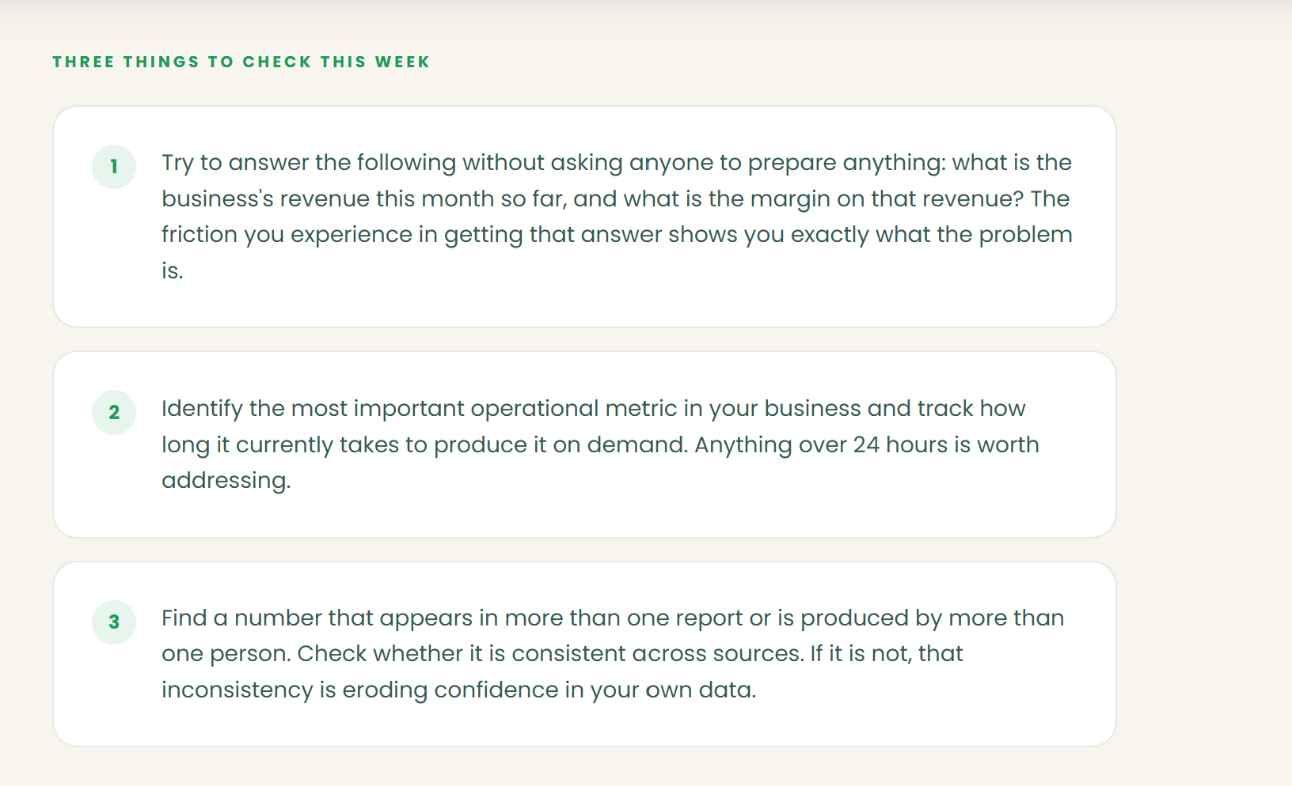
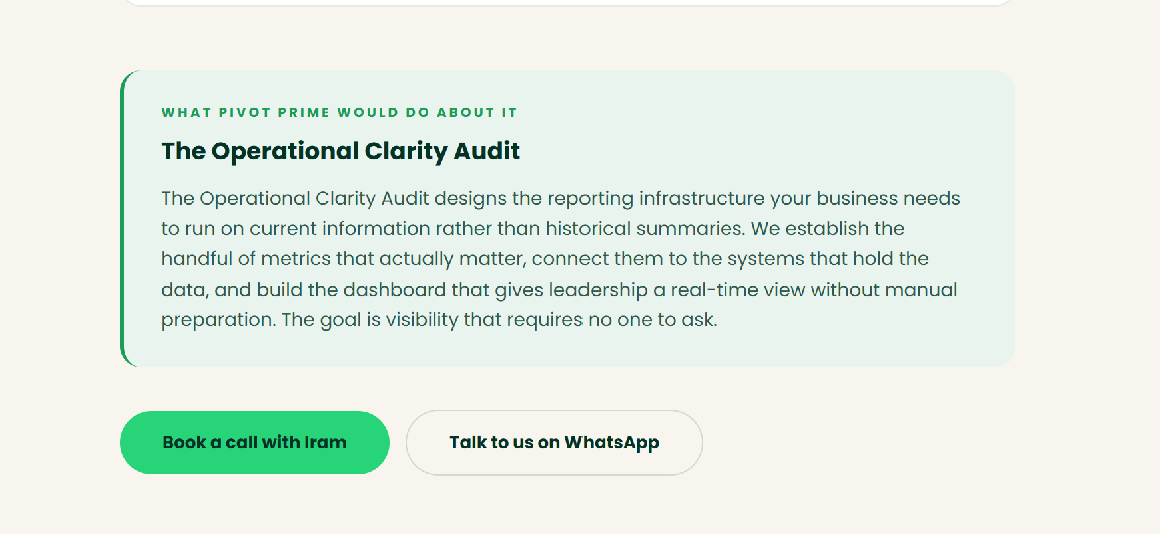
DEVELOPER NOTES
[1] I have to read all the different versions of advice we give, can you share
The data all shown here, it will all pop up on screen when they enter their email address in, and look basically like this - https://claude.ai/code/artifact/e38bc4c5-1a88-4015-bed0-0016d663ae84
STATUS 30 SEP: TO CONFIRM
Please send me all the versions of the advice text.
The "Unlock my score" button is still a round pill. Make it rectangular.

Slide 9
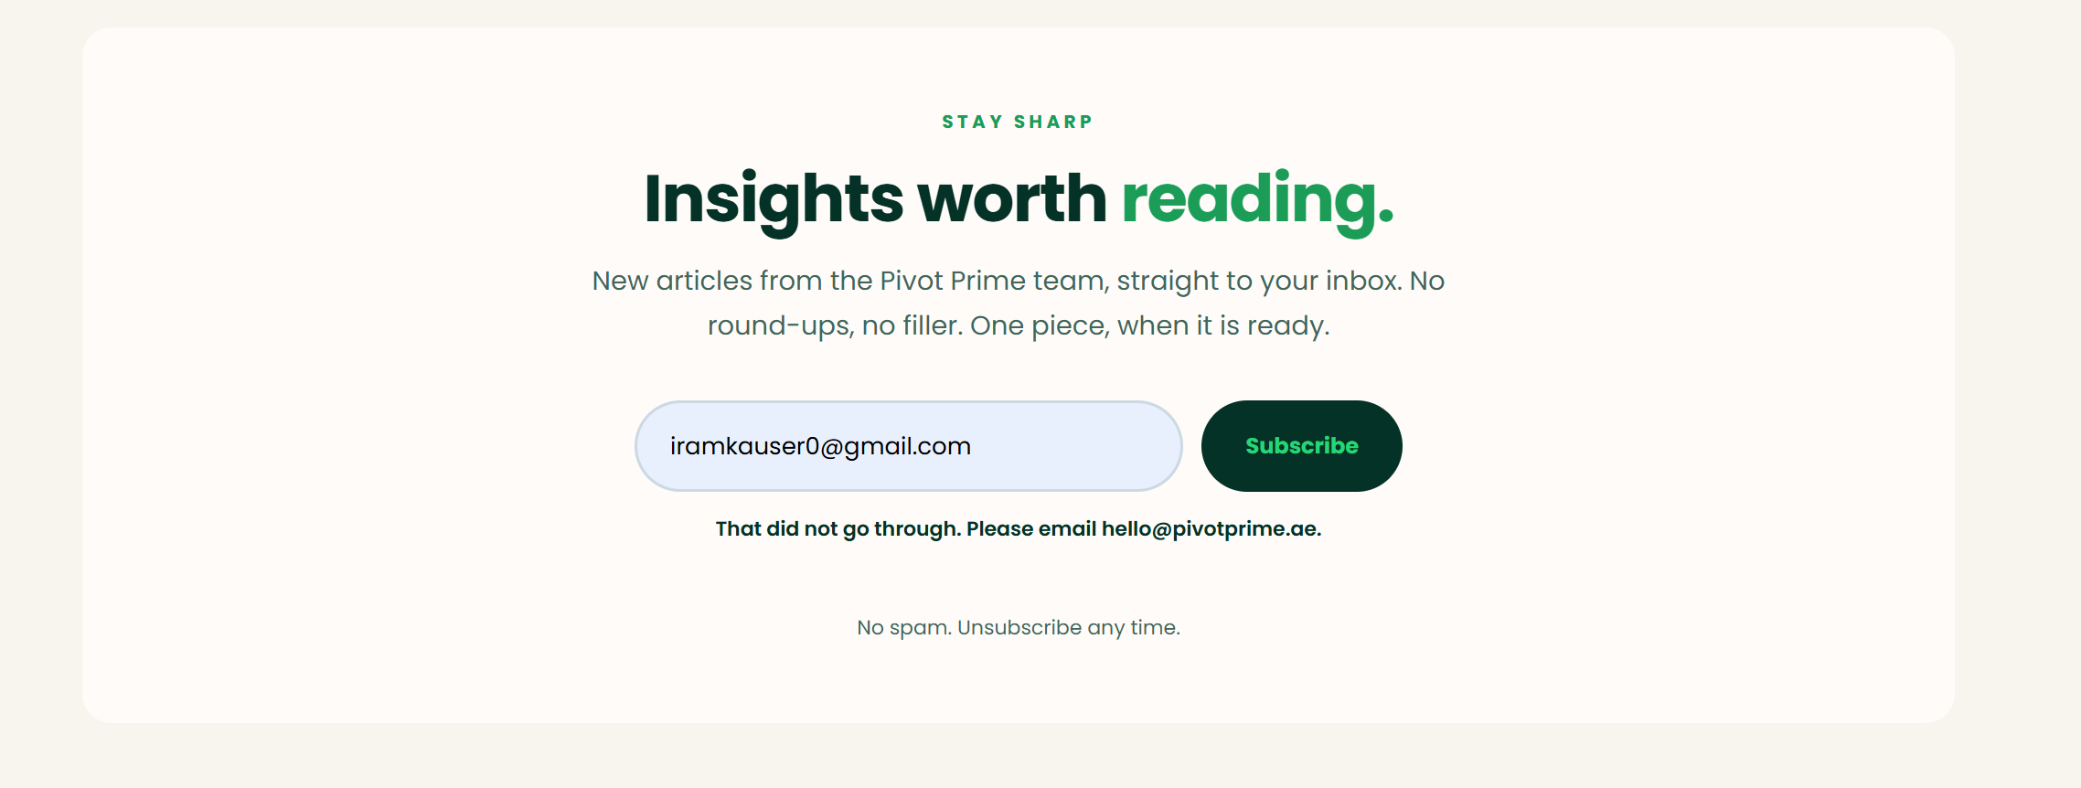
DEVELOPER NOTES
[1] Fix this, it doesn’t work when we subscribe
[2] fix the button here to be rectangular
STATUS 30 SEP: SIGNUP FIXED, ONE TEST LEFT
Subscribing now works and the button is rectangular.
When the next article is published, test that subscribers receive the email and that its link opens the article.

Slide 10
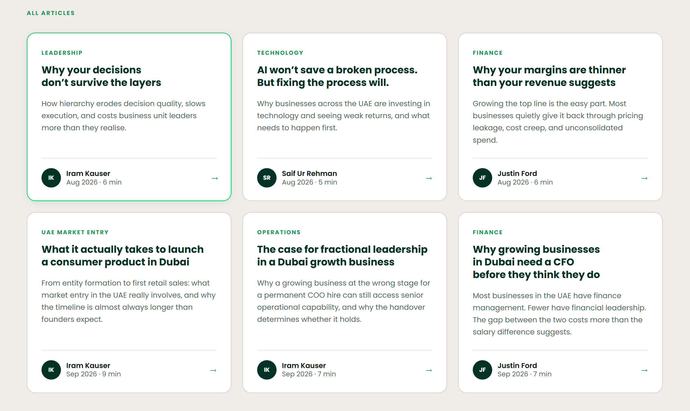
DEVELOPER NOTES
[1] Add the three articles shown below, for September – find full articles at –
https://claude.ai/code/artifact/374a7554-969c-4e4f-bb74-a4056085bd13
STATUS 30 SEP: NOT DONE YET
Insights still shows only the four August articles.
Add the three September articles: UAE market entry, fractional staffing and fractional CFO (by Justin Ford).

Slide 11
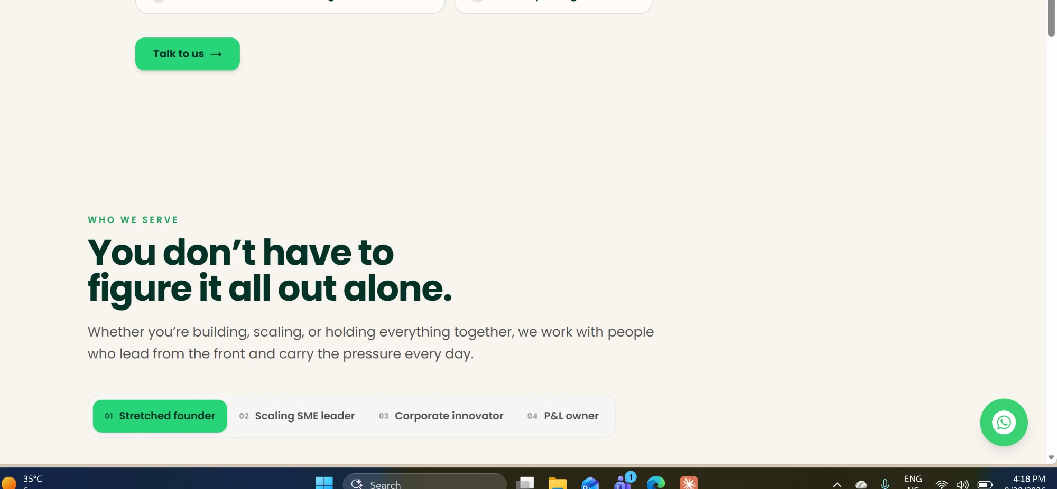
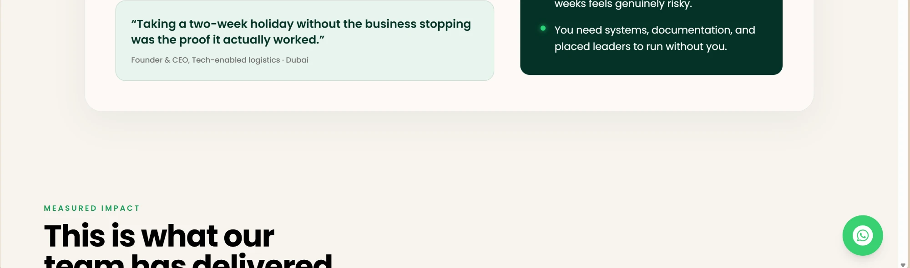
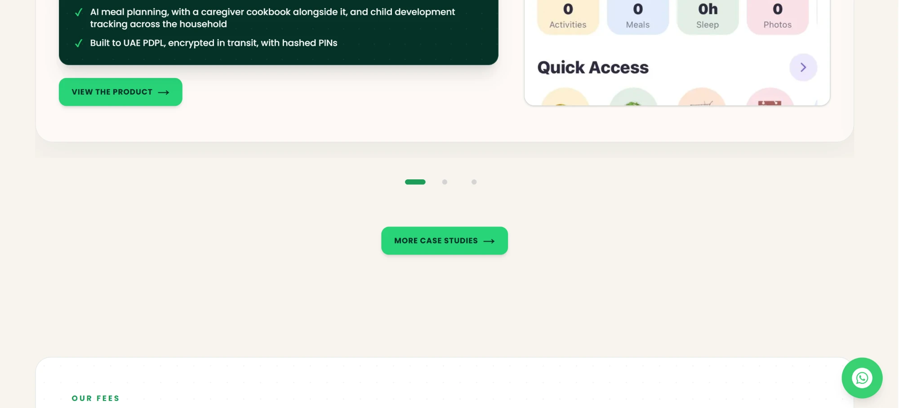
Red lines: Who we serve sits in a white box on one edge, Measured Impact starts on another
Red lines: pain accordion ends on one left edge, Who we serve starts on another
Red boxes: case studies box is off-white, Our fees box is pure white, and a grey band shows under the case studies box
STATUS 30 SEP: NEW ADDITION
The homepage does not read as one page. Each section has its own width and left edge, so you can see where one section ends and the next begins (red lines above show the two different edges in each screenshot).
Please use one content width for every section, so all headings, cards and buttons start on the same left edge.
Use the same spacing between every section, and remove the thin divider line above Who we serve.
Use one background colour for boxed sections. The case studies box is off-white (#FEF9F6) while the Our fees box is pure white (#FFFFFF), and a grey band (#EFEEE7) shows under the case studies box. Pick one colour for all boxes and remove the band.
The aim is for the page to scroll as one continuous flow rather than separate blocks.

