Slide 1
A General Approach to Network
Configuration Verification
Ryan Beckett
with
Aarti Gupta, Ratul Mahajan, David Walker
Notes:
Today I’m going to be talking about a project I have been working on with … for verifying network control planes.
And when I say network control planes, what I mean is … BGP, OSPF as opposed to P4, OpenFlow

Slide 2
Misconfigurations are common
Notes:
misconfigurations in enterprise networks are quite common. For example, last year Southwest… led to grounding of 8000 flights, and there seem to be outages that wind up as top line news items every few months or so.

Slide 3
Misconfigurations are expensive
$
$
Notes:
In addition to being common, configurations are also expensive. Numerous studies that have looked at the problem have concluded that network outages caused by misconfiguration cost hundreds of thousands of dollars for every hour of downtime.

Slide 4
Why control-plane configuration is hard
Complexity
Low-level
Complex
-BGP, OSPF, RIP
-Route redistribution
-Protocol preference
-Metric conversions
-Protocol parameters
-Interface metrics
-Route maps
-Access control lists
Low-level
Distributed
Failures
Distributed
Failures
-Device configurations
-100,000s of lines
-Link failures common
-Router failures possible
Bugs
Notes:
A natural question then is:

Slide 5
Current Approach: Simulation
Control Plane
Data Plane
Simulate
Traceroute
Inspect FIB
Data plane verification
Example: Batfish [Fogel et al, 2015]
Notes:
Traditional operators don’t use verification
That may be changing with new tools like HSA, Veriflow
Still, there is simulation in the mix, because the control plane will be simulated

Slide 6
Pure Simulation: Limitations
Often test for
particular packet(s)
Must use a single,
fixed environment
Must use a single,
message ordering
???
???
2
1
???
???
???
Must use a single,
fixed set of failures
Notes:
Also, simulation is expensive, can typically only enumerate any 1 failure

Slide 7

Current Approach: Heuristics
Configurations
String Matching
ospf interface int2_1
metric 1
interface int2_10 10.0.0.1/24
Potential Issues
ospf redistribute connected metric 10
redistribute connected
prefix-list PL_C 10.0.0.0/24
Example: rcc [Feamster et al, 2005]
Notes:
Look for the presence or absence of certain strings

Slide 8
Heuristics: Limitations
Unsound: can miss many bugs
String Matching
ospf interface int2_1
metric 1
Incomplete: can report false positives
interface int2_10 10.0.0.1/24
ospf redistribute connected metric 10
redistribute connected
Hard to test behavioral properties
prefix-list PL_C 10.0.0.0/24

Slide 9
Verification Goal
‘‘
We would like a scalable way to verify network properties for all possible data planes (packets, message orderings, environments, and k-failures)
’’

Slide 10
Verification Challenges
Generality: directives are diverse and have complex interactions
Scalability: message ordering in the control plane matters
3
1
R1
R2
R1
R2
≠
1
3
2
2
R3
R3

Slide 11
Contributions
We build a tool called Minesweeper that:
Encodes the network as a combinational circuit
Uses an SMT solver to check properties for
all possible stable data planes.
in1
out1
in2
out2
Can model most control-plane features
and can verify a rich collection of properties
Can scale to networks with hundreds of routers
using domain-specific optimizations that improve
performance over 460x
Notes:
Use this as a “rest of the talk” slide

Slide 12
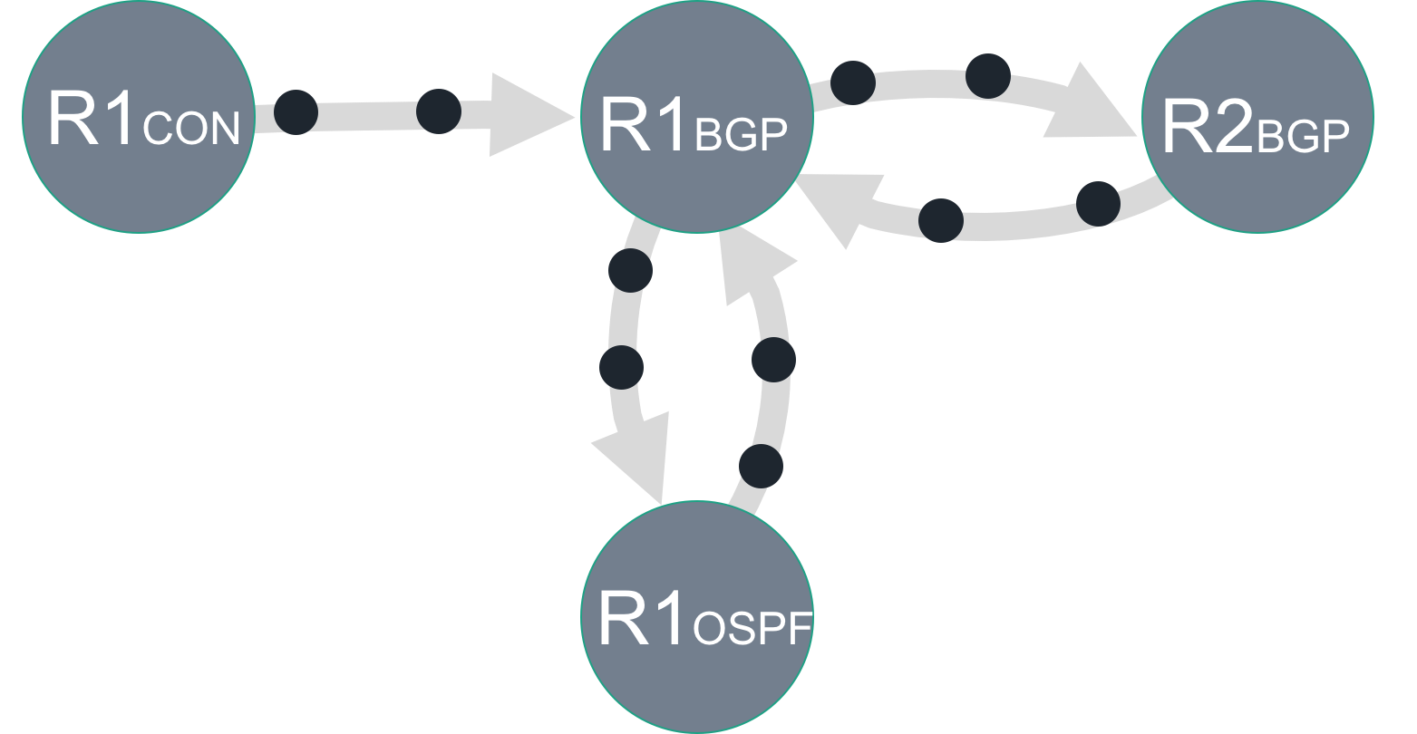
Minesweeper Architecture
1.
Vendor-Specific Configs
2.
Vendor-Independent Format
Cisco
Arista
Interfaces: {
Ethernet0/0: {
InterfaceCost: 1,
importPolicy: “PEER_IN”,
…
}
}
Juniper
Parse
Encode
3.
Combinational Circuit
4.
Property Violation
Query
ENV
Notes:
Sucks in configs, generates formulas that represent stable solutions:
Mention easy to represent all environments here, just another input
Mention optimizations here

Slide 13
Encoding Overview
‘‘
’’
Does P hold in the network?
N1
N2
N3
Network Encoding: N
S1
R1
R2
S2
⋀
Network Property: ¬ P
R3
Satisfiable: Property Violation
S3
Unsatisfiable: Holds for all stable data planes

Slide 14
Network Representation
Control Plane Routing Record
Data Plane Packet
prefix
[0,2³²)
dstIp
[0,2³²)
prefixLen
[0,2⁵)
srcIp
[0,2⁵)
adminDist
[0,2⁸)
dstPort
[0,2⁸)
localPref
[0,2³²)
srcPort
[0,2³²)
metric
[0,2¹⁶)
protocol
[0,2¹⁶)
med
[0,2³²)
Decision Process / Topology
ospfType
[0,2²)
controlFwd_{x,y}
1 bit
origin
[0,3)
dataFwd_{x,y}
1 bit
routerId
[0,2³²)
failed_{x,y}
[0,1]
Notes:
Can a “routing record“ reach this point in a stable solution Define term
Say that we are using either IDL or LIA

Slide 15
Running Example
Data plane packet
1
N1
N2
N3
Symbolic Packet
{
}
dstIp
[0,2³²)
S1
R1
R2
S2
srcIp:
[0,2³²)
dstPort
[0,2¹⁶)
???
???
srcPort
[0,2¹⁶)
R3
protocol
[0,2⁸)
S3
Notes:
At the end of the day, we care about how a packet is forwarded through the network.

Slide 16
Running Example
Protocol Interactions
2
N1
N2
N3
N1
N2
N3
Protocol
View
R1
R2
R1
R2
BGP
BGP
S1
S2
S1
CON
OSPF
OSPF
CON
S2
R3
R3
OSPF
CON
S3
S3

Slide 17
Running Example
Protocol Interactions
2
N1BGP
N1
N2
N3
Redistribution
From CON to BGP
e1
Circuit
View for R1
in1
e2
R1
R2
out2
BGP
BGP
S1
e7
in7
out3
e3
CON
OSPF
OSPF
CON
S2
R1CON
R1BGP
R2BGP
R3
out6
in4
e4
OSPF
e6
in5
CON
After R2
export filter
e5
S3
R1OSPF
After R1
import filter
Notes:
Can a “routing record“ reach this point in a stable solution Define term. Black dots are routing records.
“Convert view on left to circuit view. What it does is process routing records that can reach a particular point in the network in a stable solution.
For example, there is a routing record

Slide 18
Running Example
Control Plane Info
3
N1BGP
Symbolic Record
e1
valid:
1 bit
in1
e2
{
}
prefix:
[0,2³²)
out2
out3
e3
prefixLen:
[0,2⁵)
e7
in7
R1CON
R1BGP
adminDist:
[0,2⁸)
localPref:
[0,2³²)
out6
in4
e4
metric:
[0,2³²)
e6
in5
[0,2³²)
med:
e5
ospfType
[0,2²)
R1OSPF

Slide 19
Running Example
R1 BGP import filter from R2
Import FIlters
4
ip prefix_list L deny 192.168.0.0/16 le 32
ip prefix_list L allow
route-map R1_Import_From_R2 10
match ip address prefix-list L
set local-preference 120
N1BGP
SMT constraint
e1
in1
e2
out2
If message sent from R2
if e4.valid ∧ failedR1,R2 = 0 then if ¬ (FBM(e4.prefix, 192.168.0.0, 16) ∧
16 ≤ e4.prefixLen ≤ 32) then
in4.valid = true in4.lp = 120 in4.prefix = e4 .prefix
in4.metric = e4.metric
in4.prefixLen = e4 .prefixLen
…
else in4.valid = false
else in4 .valid = false
e7
in7
out3
e3
R1CON
If it passes the import filter
R1BGP
R2BGP
out6
in4
e4
Then R1 receives a message
with local-pref 120
e6
in5
e5
R1OSPF
Otherwise, R1 does not
receive a message

Slide 20
Running Example
Decision Process
5
R1-BGP-BEST = Min(in1, in4, in5, in7)
N1BGP
R1-BEST = Min(R1-BGP-BEST
R1-OSPF-BEST
e1
R1-CON-BEST)
in1
e2
out2
e7
in7
out3
e3
R1CON
R1BGP
R2BGP
Protocol Specific
Lexicographic Comparison (≤)
out6
in4
e4
e6
in5
(R1-BGP-Best.prefixLen < in1.prefixLen) ⋁
(R1-BGP-Best.prefixLen = in1.prefixLen ⋀
(R1-BGP-Best.localPref > in1.localPref) ⋁
(R1-BGP-Best.localPref = in1.localPref) ⋀
…
e5
R1OSPF

Slide 21
Running Example
Decision Process
5
N1BGP
Does R1 forward to R2 in the control plane?
e1
controlfwd_{R1,R2} = (in4 = R1-Best)
in1
e2
out2
e7
in7
out3
e3
R1CON
R1BGP
R2BGP
Does R1 forward to R2 in the data plane?
out6
in4
e4
datafwd_{R1,R2} = controlfwd_{R1,R2} ⋀ ¬ ACL(R1,R2)
e6
in5
e5
R1OSPF

Slide 22
Supported Features
Features
Implemented
Continued…
OSPF Intra-area
iBGP
OSPF Inter-area
Route Reflectors
eBGP Local-pref
Static Routes
eBGP Communities
Route Redistribution
eBGP MEDs
Multipath Routing
eBGP Path Prepending
Access Control Lists
eBGP Aggregation
IPV6

Slide 23
Property: Reachability / Isolation
‘‘
’’
Can router R3 (not) reach subnet S2?
N1
N2
N3
canReach_{R2} ⇔ datafwd_{R2,S2}
canReach_{R1} ⇔
(datafwd_{R1,R2} ⋀ canReach_{R2}) ⋁
(datafwd_{R1,R3} ⋀ canReach_{R3})
S1
R1
R2
S2
canReach_{R3} ⇔
(datafwd_{R3,R1} ⋀ canReach_{R1})
R3
Property: canReach_{R3}
S3
Notes:
Remind what the datafwd variable is here

Slide 24
Property: Equal / Bounded Path Length
‘‘
’’
Do all routers in a pod have equal length paths to a destination port?
‘‘
’’
Is the path length no more than 4?
datafwd_{R1,R3} ⇒ length_{R1} = length_{R3} + 1
datafwd_{R2,R3} ⇒ length_{R2} = length_{R3} + 1
…
R3
Property: length_{R1} = length_{R2}
R1
R2
Property: length_{R1} ≤ 4

Slide 25
Property: Routing Loops
‘‘
’’
Can my network ever have loops?
through_{R1,R1} ⇔
(datafwd_{R1,R2} ⋀ through_{R2,R1}) ⋁
(datafwd_{R1,R3} ⋀ through_{R3,R1}) ⋁
…
R2
through_{R3,R1} ⇔
(datafwd_{R3,R1}) ⋁
(datafwd_{R3,R2} ⋀ through_{R2,R1}) ⋁
R1
R3
Property: ¬through_{R1,R1}

Slide 26
Property: Black Holes
‘‘
’’
Does router R1 ever black hole traffic?
R4
R5
R1
Property:
(dataFwd_{R4,R1} ⋁ dataFwd_{R5,R1} ⋁ …) ⋀
¬(dataFwd_{R1,R2} ⋁ dataFwd_{R1,R3} ⋁ …)
R2
R3

Slide 27
Property: Multipath Consistency
‘‘
’’
Are multiple paths treated equally?
R6
Property:
canReach_{R3} ⇒
(controlfwd_{R3,R4} ⇒
datafwd_{R3,R4} ⋀
canReach_{R3})
⋀
(controlfwd_{R3,R5} ⇒
datafwd_{R3,R5} ⋀
canReach_{R5})
…
R4
R5
R2
R3
R1

Slide 28
Properties
‘‘
’’
Do two routers serve equal roles?
env1
env2
env3
env4
Property:
(env1 = env2) ⋀ (env3 = env4) ⇒
(datafwd_{R1,R} = datafwd_{R2,R})
⋀
R1
R2
R

Slide 29
Properties
‘‘
’’
Is peer P1 preferred over P2 over P3?
P2
P1
P2
env2
env1
env3
Property:
env1.valid ⇒ datafwd_{R1,P1}
¬ env1.valid ⋀ env2.valid ⇒ datafwd_{R1,P2}
R1
R3
R2

Slide 30
Properties
‘‘
’’
Does P hold after k link failures?
R1
Constraint: ∑_{x,y} failed_{x,y} ≤ k
R3
R2
Notes:
Other properties such as path preferences, disjoint paths, load balancing, network equivalence

Slide 31
Optimizations: Prefix Hoisting
Symbolic Record
FBM(r.prefix, 192.4.0.0, 16) ⋀
16 ≤ r.prefixLen ≤ 32
valid:
1 bit
{
}
=
prefix:
[0,2³²)
prefixLen:
[0,2⁵)
FBM(dstIp, 192.4.0.0, 16) ⋀
16 ≤ r.prefixLen ≤ 32
adminDist:
[0,2⁸)
localPref:
[0,2³²)
=
metric:
[0,2³²)
med:
[0,2³²)
(192.4.0.0 ≤ dstIp ≤ 192.4.0.0 + 2³²⁻¹⁶) ⋀
16 ≤ r.prefixLen ≤ 32
ospfType
[0,2²)
Integer Difference Logic!
Notes:
Set up mental model of what costs (prefix is a bitvector for every route record) (N representations of the control plane)

Slide 32
Optimizations: Slicing
Symbolic Record
{
valid:
1 bit
}
Statically analyze the configs to
determine when certain attributes
are irrelevant
prefixLen:
[0,2⁵)
adminDist:
[0,2⁸)
localPref:
[0,2³²)
[0,2³²)
Example: if the local preference
is never explicitly set, then it can
not influence the decision process
metric:
med:
[0,2³²)
ospfType
[0,2²)

Slide 33
Optimizations: Slicing
Maintain a single copy of export
variables when the export policy
is uniform to all peers
N1BGP
N1BGP
e2
e2
out2
Merge the import and export
records when the default import
policy is used
out3
e3
out3
R1BGP
R2BGP
R1BGP
R2BGP

Slide 34
Evaluation
Can Minesweeper find real bugs?
Run on a collection of 152 legacy networks
1—23K lines of configuration
How well does Minesweeper scale?
Test on a collection of synthetic data center benchmarks
Compare verification time across a wide variety of properties
Compare verification time with and without optimizations

Slide 35
Evaluation: Bug Finding
Mangement interface reachability
Loopback0
Found 67 violations of the property
Most required a specific environment
Example: BGP peer sends /32 with length 2
Local equivalence of routers
Found 29 violations
Many caused by simple copy-paste errors
Example: ACL has missing entry
R1
R2

Slide 36
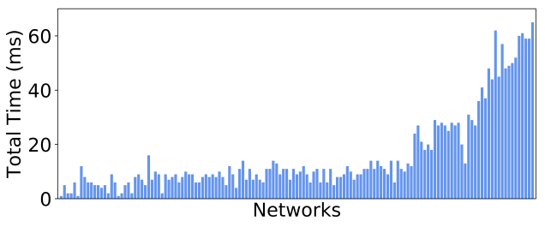
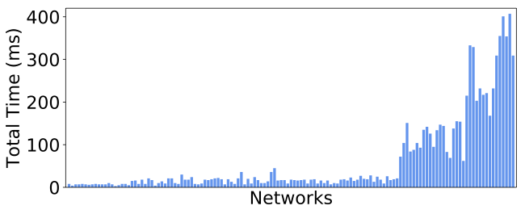
Evaluation: Scalability
Management interface reachability
1K
Lines of configuration
23K
Local equivalence of routers
(For all n comparisons)
1K
Lines of configuration
23K

Slide 37
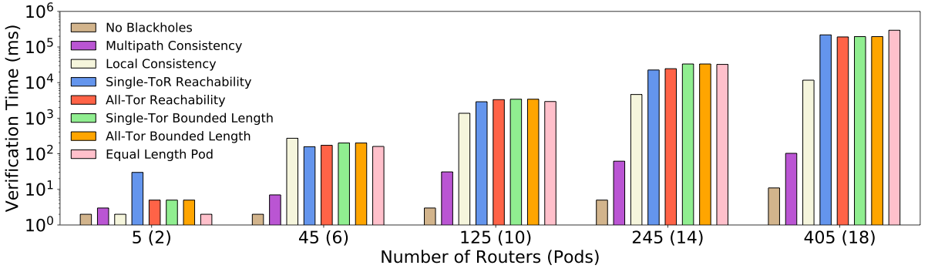
Evaluation: Scalability

Slide 38
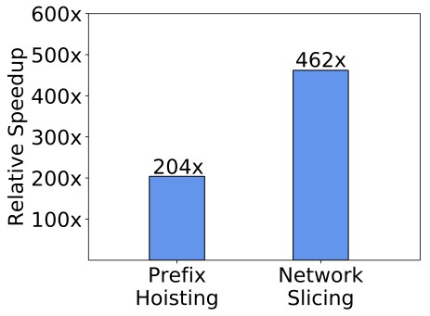
Evaluation: Optimizations
Average speedup for an all-source
reachability query for data centers
Both with prefix hoisting alone,
and with network slicing added
Notes:
It was very slow – BAD!
Change this to be more concrete

Slide 39
Related Work
Testing
Verification
HSA [1]
Veriflow [2]
Batfish [3]
Minesweeper
[1] Kazemian et al, NSDI’12
[2] Khurshid et al, NSDI’13
[3] Fogel et al, NSDI’15
[4] Feamster et al, NSDI’05
[5] Fayaz et al, OSDI’16
[6] Weitz et al, OOPSLA’16
[7] Gember-Jacobson et al, SIGCOMM’16
Ping
Traceroute
ERA [5]
#Networks
RCC [4]
ARC [6]
Bagpipe [7]
#Dataplanes

Slide 40
Conclusions
Minesweeper is a general and scalable control plane verification tool
Encodes the control plane as an SMT formula
Can model a wide variety of features
in1
out1
Can verify a rich collection of properties
in2
out2
Can scale to many real networks

