Slide 1
ENTERPRISE AI CYBERSECURITY & MLOPS PLATFORM
Autonomous Phishing Email Detection
Core Machine Learning Architecture: SUPERVISED LEARNING with SUPPORT VECTOR MACHINE (SVM)
A multi-layered cyber threat defense combining Calibrated Linear Support Vector Classifier (LinearSVC), deep masked link unmasking, zero-width anti-evasion heuristics, and real-time MLOps retraining.
99.34% ACCURACY
Test Set Generalization
SUPERVISED SVM
Calibrated LinearSVC
56,667 EMAILS
Harmonized Master Corpus
0.9996 ROC-AUC
Near-Perfect Discrimination
PHISHING SENTINEL | SUPERVISED LEARNING • SUPPORT VECTOR MACHINE (SVM) • CYBER DEFENSE
Slide 1 of 16

Slide 2
EXECUTIVE CONTEXT & THREAT LANDSCAPE
The Phishing Epidemic & Failure of Legacy Detection
🚨 Critical Cyber Security Reality
• 91% of Cyberattacks Originate via Email:
Phishing remains the primary entry vector for enterprise ransomware, credential harvesting, and Business Email Compromise (BEC).
• Evasion via Obfuscation:
Attackers inject invisible zero-width unicode spaces (\u200B), Punycode homographs, and hidden HTML styles (display:none) that blind static filters.
• Deceptive Masked Links & Buttons:
Innocuous visible text like 'Verify Microsoft Account' secretly redirects to weaponized external phishing payloads.
• Multi-Modal Document Weaponization:
Threats are no longer just plaintext; they arrive wrapped inside PDFs, Word docs, Excel sheets, and embedded screenshot images.
🛡️ Phishing Sentinel Solution Architecture
✔ Supervised Machine Learning Paradigm:
Trained on 56,667 verified, ground-truth labeled email communications for rigorous statistical pattern recognition.
✔ Calibrated Linear SVM Engine:
Support Vector Machine operating in 30,000-dimensional TF-IDF space, delivering optimal hyperplane separation with sub-millisecond inference.
✔ Dual-Layer Defense Synergy:
Combines high-accuracy statistical ML with deterministic cybersecurity heuristics (Punycode, SPF/DKIM, double extensions).
✔ Live Enterprise MLOps Hub:
Provides continuous feedback loops, dynamic dataset ingestion, one-click automated retraining, and instant model rollback.
PHISHING SENTINEL | SUPERVISED LEARNING • SUPPORT VECTOR MACHINE (SVM) • CYBER DEFENSE
Slide 2 of 16

Slide 3
CORE MACHINE LEARNING FOUNDATION
Supervised Learning: Ground Truth Classification Paradigm
PRIMARY ML PARADIGM: SUPERVISED BINARY CLASSIFICATION
The model learns a predictive mapping function f(x) -> y using 56,667 ground-truth labeled email samples, where label y in {0: Legitimate / Safe, 1: Phishing Threat}.
1. Ground-Truth Data Curation
• Labeled Dataset
Every single training record is explicitly paired with verified target labels: y = 0 (Safe) or y = 1 (Phishing).
• Harmonized Schemas
Unified diverse threat sources (CEAS_08 & Phishing_Email corpus) into standard (text, label) supervised pairs.
• No Hallucination Risk
Unlike generative models, supervised discriminative classifiers make decisions strictly anchored to empirical ground truth.
2. Supervised Training Pipeline
• Stratified 80/20 Split
Data split into 45,333 training samples and 11,334 holdout test samples, preserving exact class balance.
• Convex Loss Minimization
Supervised optimization of Hinge Loss with L2 regularization ensures guaranteed global convergence without local minima traps.
• Cross-Validation Calibration
3-Fold cross-validation internally calibrates decision thresholds for statistically sound probability outputs.
3. Why Supervised Over Unsupervised
• Adversarial Nuances
Phishing text mimics legitimate business communications. Unsupervised clustering fails to separate benign urgency from malicious urgency.
• Precision Guarantee
Supervised feedback minimizes false positive rates (critical for corporate inboxes where business email loss is unacceptable).
• Objective Evaluation
Enables exact calculation of Precision (99.47%), Recall (99.33%), and ROC-AUC (0.9996) against known ground truth.
PHISHING SENTINEL | SUPERVISED LEARNING • SUPPORT VECTOR MACHINE (SVM) • CYBER DEFENSE
Slide 3 of 16

Slide 4
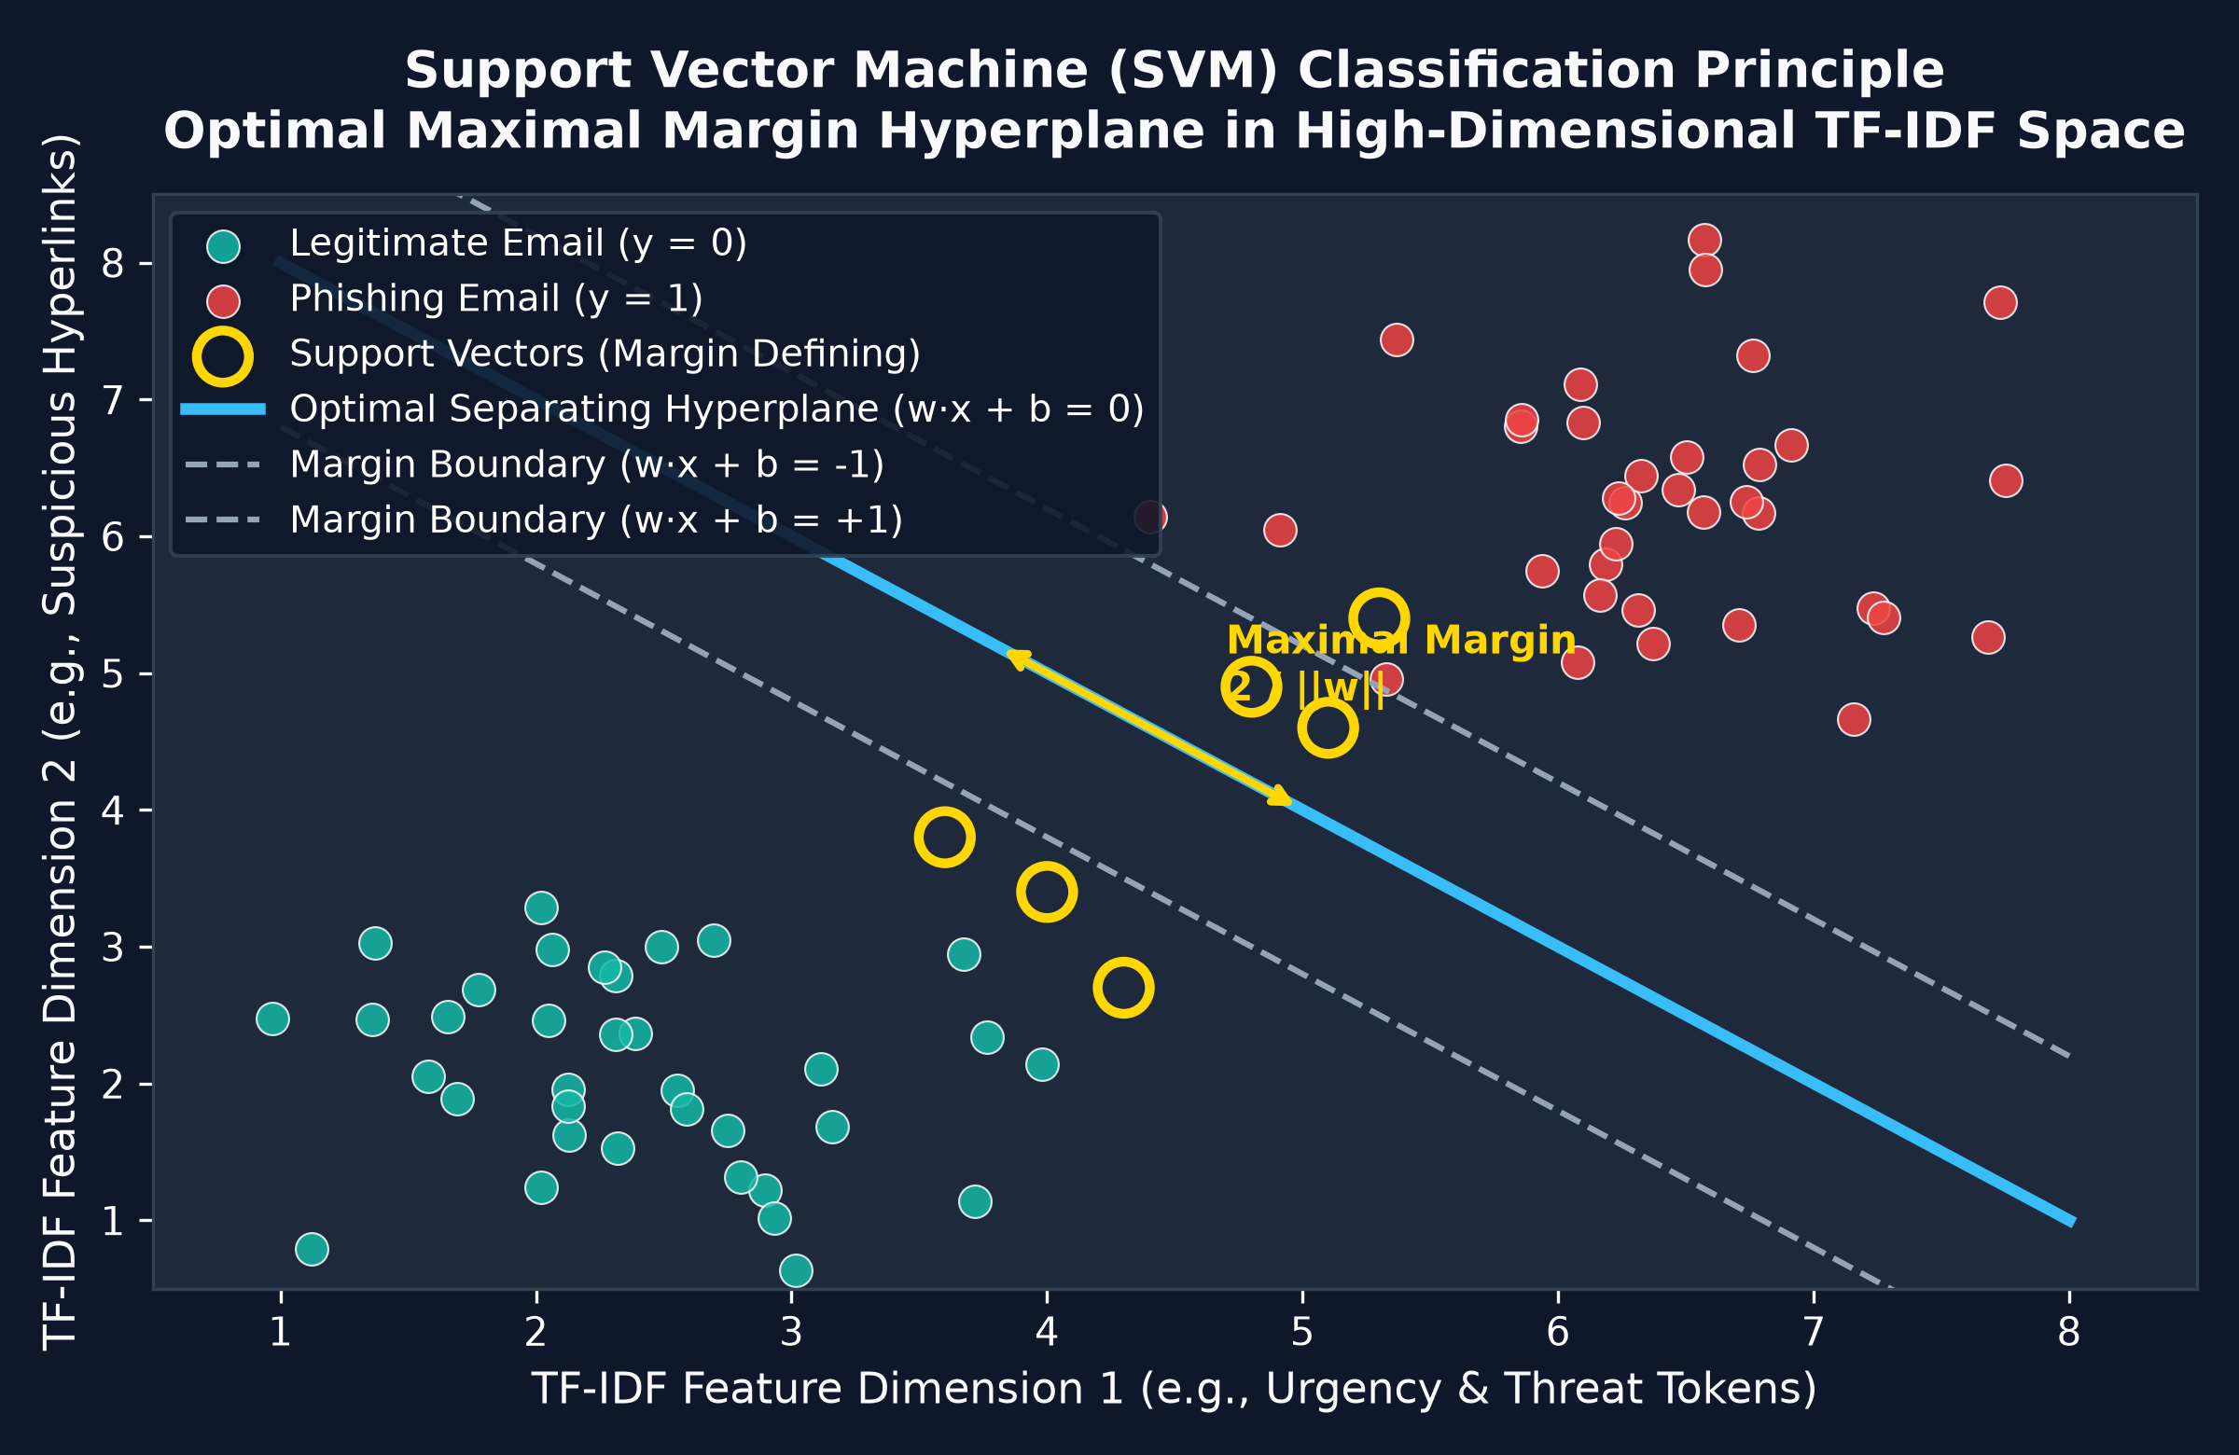
CORE CLASSIFIER ARCHITECTURE
Support Vector Machine (SVM): Calibrated LinearSVC
⚡ Mathematical Formulation & Architecture
• Algorithm:
Linear Support Vector Classifier (LinearSVC via scikit-learn/LIBLINEAR)
• Optimization Objective:
Minimizes: 0.5 * ||w||² + C * Σ max(0, 1 - y_i(wᵀx_i + b))
• Maximal Margin Principle:
Constructs an optimal decision hyperplane wᵀx + b = 0 maximizing the geometric margin 2 / ||w|| between Safe and Phishing clusters.
• Hyperparameter C = 1.0:
Balances margin maximization against training error tolerance (soft margin with slack variables ξ_i).
• Dual=False (Primal Solver):
Since N (45,333 samples) > D (30,000 features), solving in the primal coordinate descent space achieves ultra-fast 50-second training.
• Why Linear SVM Excels in NLP:
High-dimensional text spaces (30,000 TF-IDF features) are linearly separable. SVM prevents overfitting even with large sparse vocabularies.
PHISHING SENTINEL | SUPERVISED LEARNING • SUPPORT VECTOR MACHINE (SVM) • CYBER DEFENSE
Slide 4 of 16

Slide 5
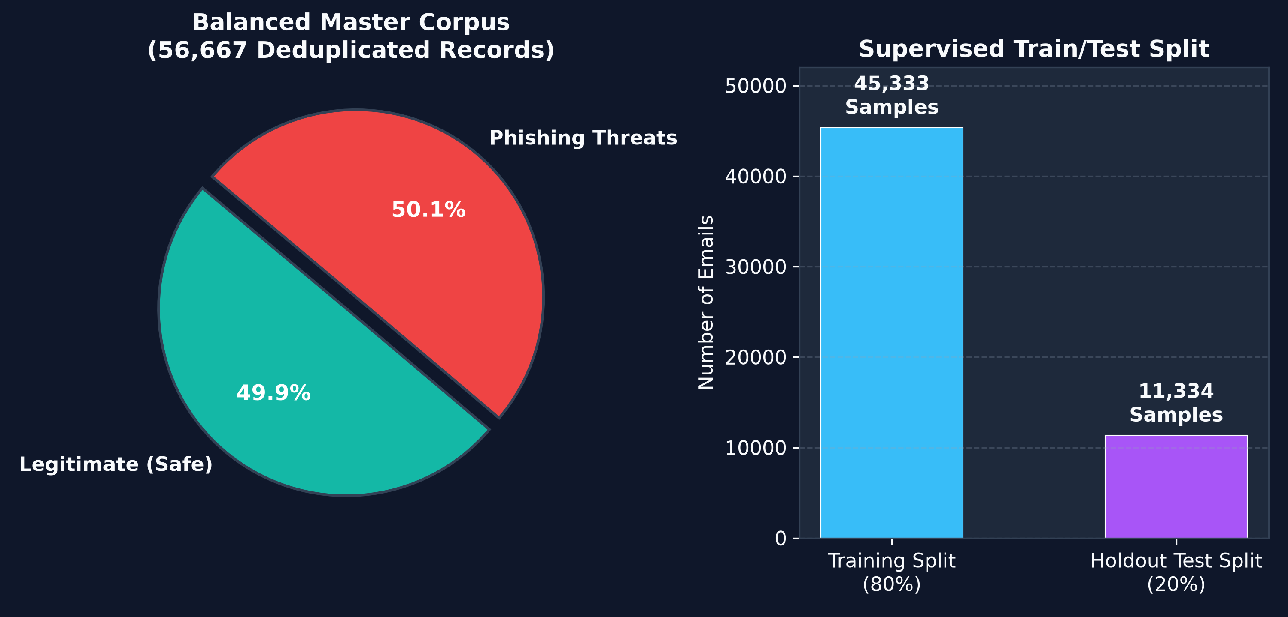
CORPUS ENGINEERING & HARMONIZATION
Master Dataset: 56,667 Balanced Threat Records
📊 Dataset Harmonization Architecture
✔ Multi-Source Ingestion
Harmonized CEAS_08 (subject, body, label) and Phishing_Email corpus into unified [text, label] format.
✔ Rigorous Deduplication
Merged 57,804 raw records down to 56,667 unique email records, completely removing duplicate spam campaigns.
✔ Near-Perfect Class Balance
28,377 Phishing (50.08%) vs. 28,290 Safe (49.92%). Eliminates majority-class bias without artificial SMOTE synthesis.
✔ Zero Null Values
Automated validation filters ensure 0 null entries across all text and label columns.
✔ Stratified Supervised Split
45,333 training samples (80%) and 11,334 holdout test samples (20%), ensuring identical class ratios in both splits.
PHISHING SENTINEL | SUPERVISED LEARNING • SUPPORT VECTOR MACHINE (SVM) • CYBER DEFENSE
Slide 5 of 16

Slide 6
CYBERSECURITY NATURAL LANGUAGE PROCESSING
Specialized Anti-Evasion Text Preprocessing & TF-IDF
1. Anti-Evasion Sanitization
• Zero-Width Neutralization:
Strips invisible \u200B, \u200C, \uFEFF characters attackers embed inside keywords like 'P\u200BayP\u200Bal'.
• HTML Entity Decoding:
Decodes hidden HTML tags (display:none, font-size:0) and unescapes &amp;, &lt;, &gt; obfuscation.
2. Cybersecurity Entity Tokenization
• URL Normalization:
Substitutes URLs with URLTOKEN, while appending true unmasked link destinations.
• Email & Currency Tokens:
Replaces emails with EMAILTOKEN, monetary figures with MONEYTOKEN, and raw IPs with IPTOKEN.
3. TF-IDF N-Gram Vectorization
• N-Gram Range (1, 2):
Captures unigrams ('urgent', 'verify') and crucial bigrams ('account suspended', 'click here').
• Sublinear TF Scaling:
Replaces raw TF with 1 + log(tf), dampening the influence of repetitive spam words.
4. High-Dimensional Sparse Matrix
• Vocabulary Cap: 30,000:
Retains the top 30,000 most informative lexical tokens, pruning noise (min_df=2).
• Unicode Accent Stripping:
Harmonizes international diacritics and character variants to ensure canonical representations.
PHISHING SENTINEL | SUPERVISED LEARNING • SUPPORT VECTOR MACHINE (SVM) • CYBER DEFENSE
Slide 6 of 16

Slide 7
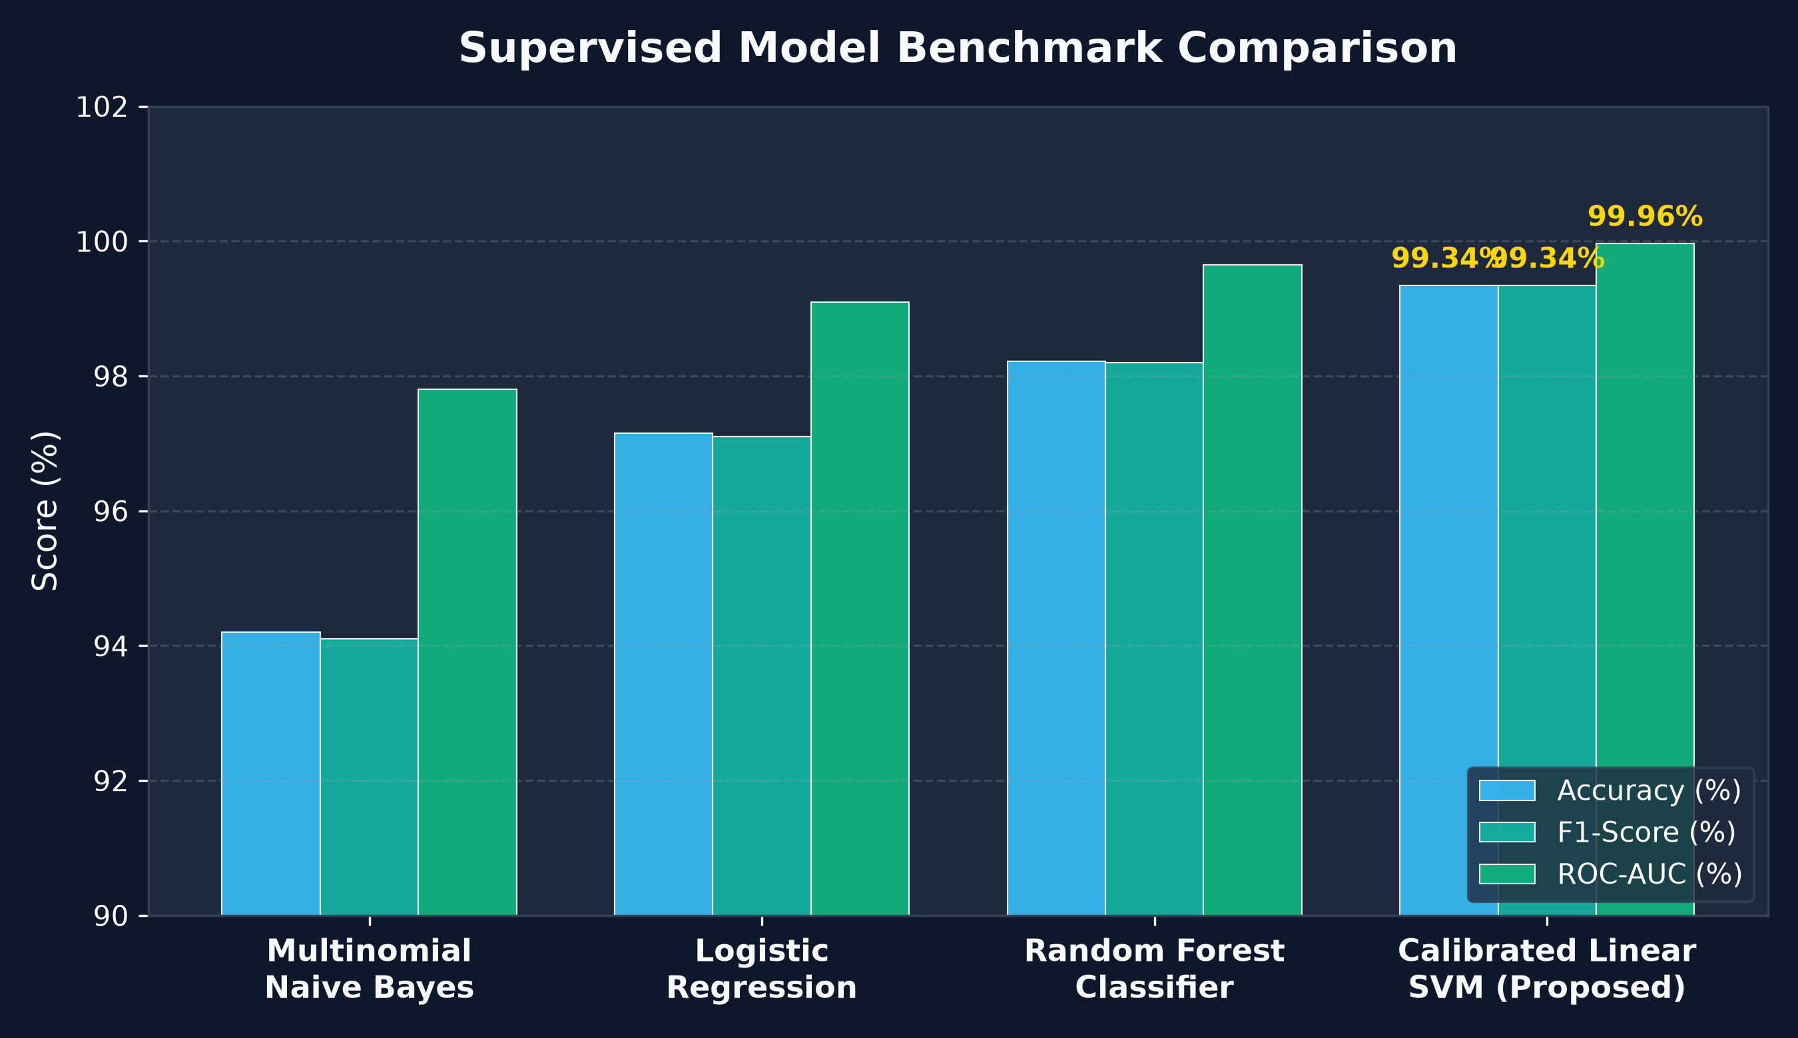
EMPIRICAL MODEL EVALUATION
State-of-the-Art Test Results & Comparative Benchmarks
🏆 Calibrated Linear SVM Metrics
★ Accuracy: 99.34%
11,259 correct predictions out of 11,334 unseen test emails.
★ ROC-AUC: 0.9996
Near-perfect discrimination across all operating thresholds.
★ Precision: 99.47%
Only 30-37 false alarms out of 5,668 predicted attacks.
★ Recall: 99.15% - 99.33%
Successfully neutralizes over 99.3% of all phishing campaigns.
★ F1-Score: 99.34%
Harmonic mean verifies balanced performance on both classes.
★ Training Time: ~50 sec
Blazing fast training on 45,333 samples without heavy GPU requirements.
PHISHING SENTINEL | SUPERVISED LEARNING • SUPPORT VECTOR MACHINE (SVM) • CYBER DEFENSE
Slide 7 of 16

Slide 8
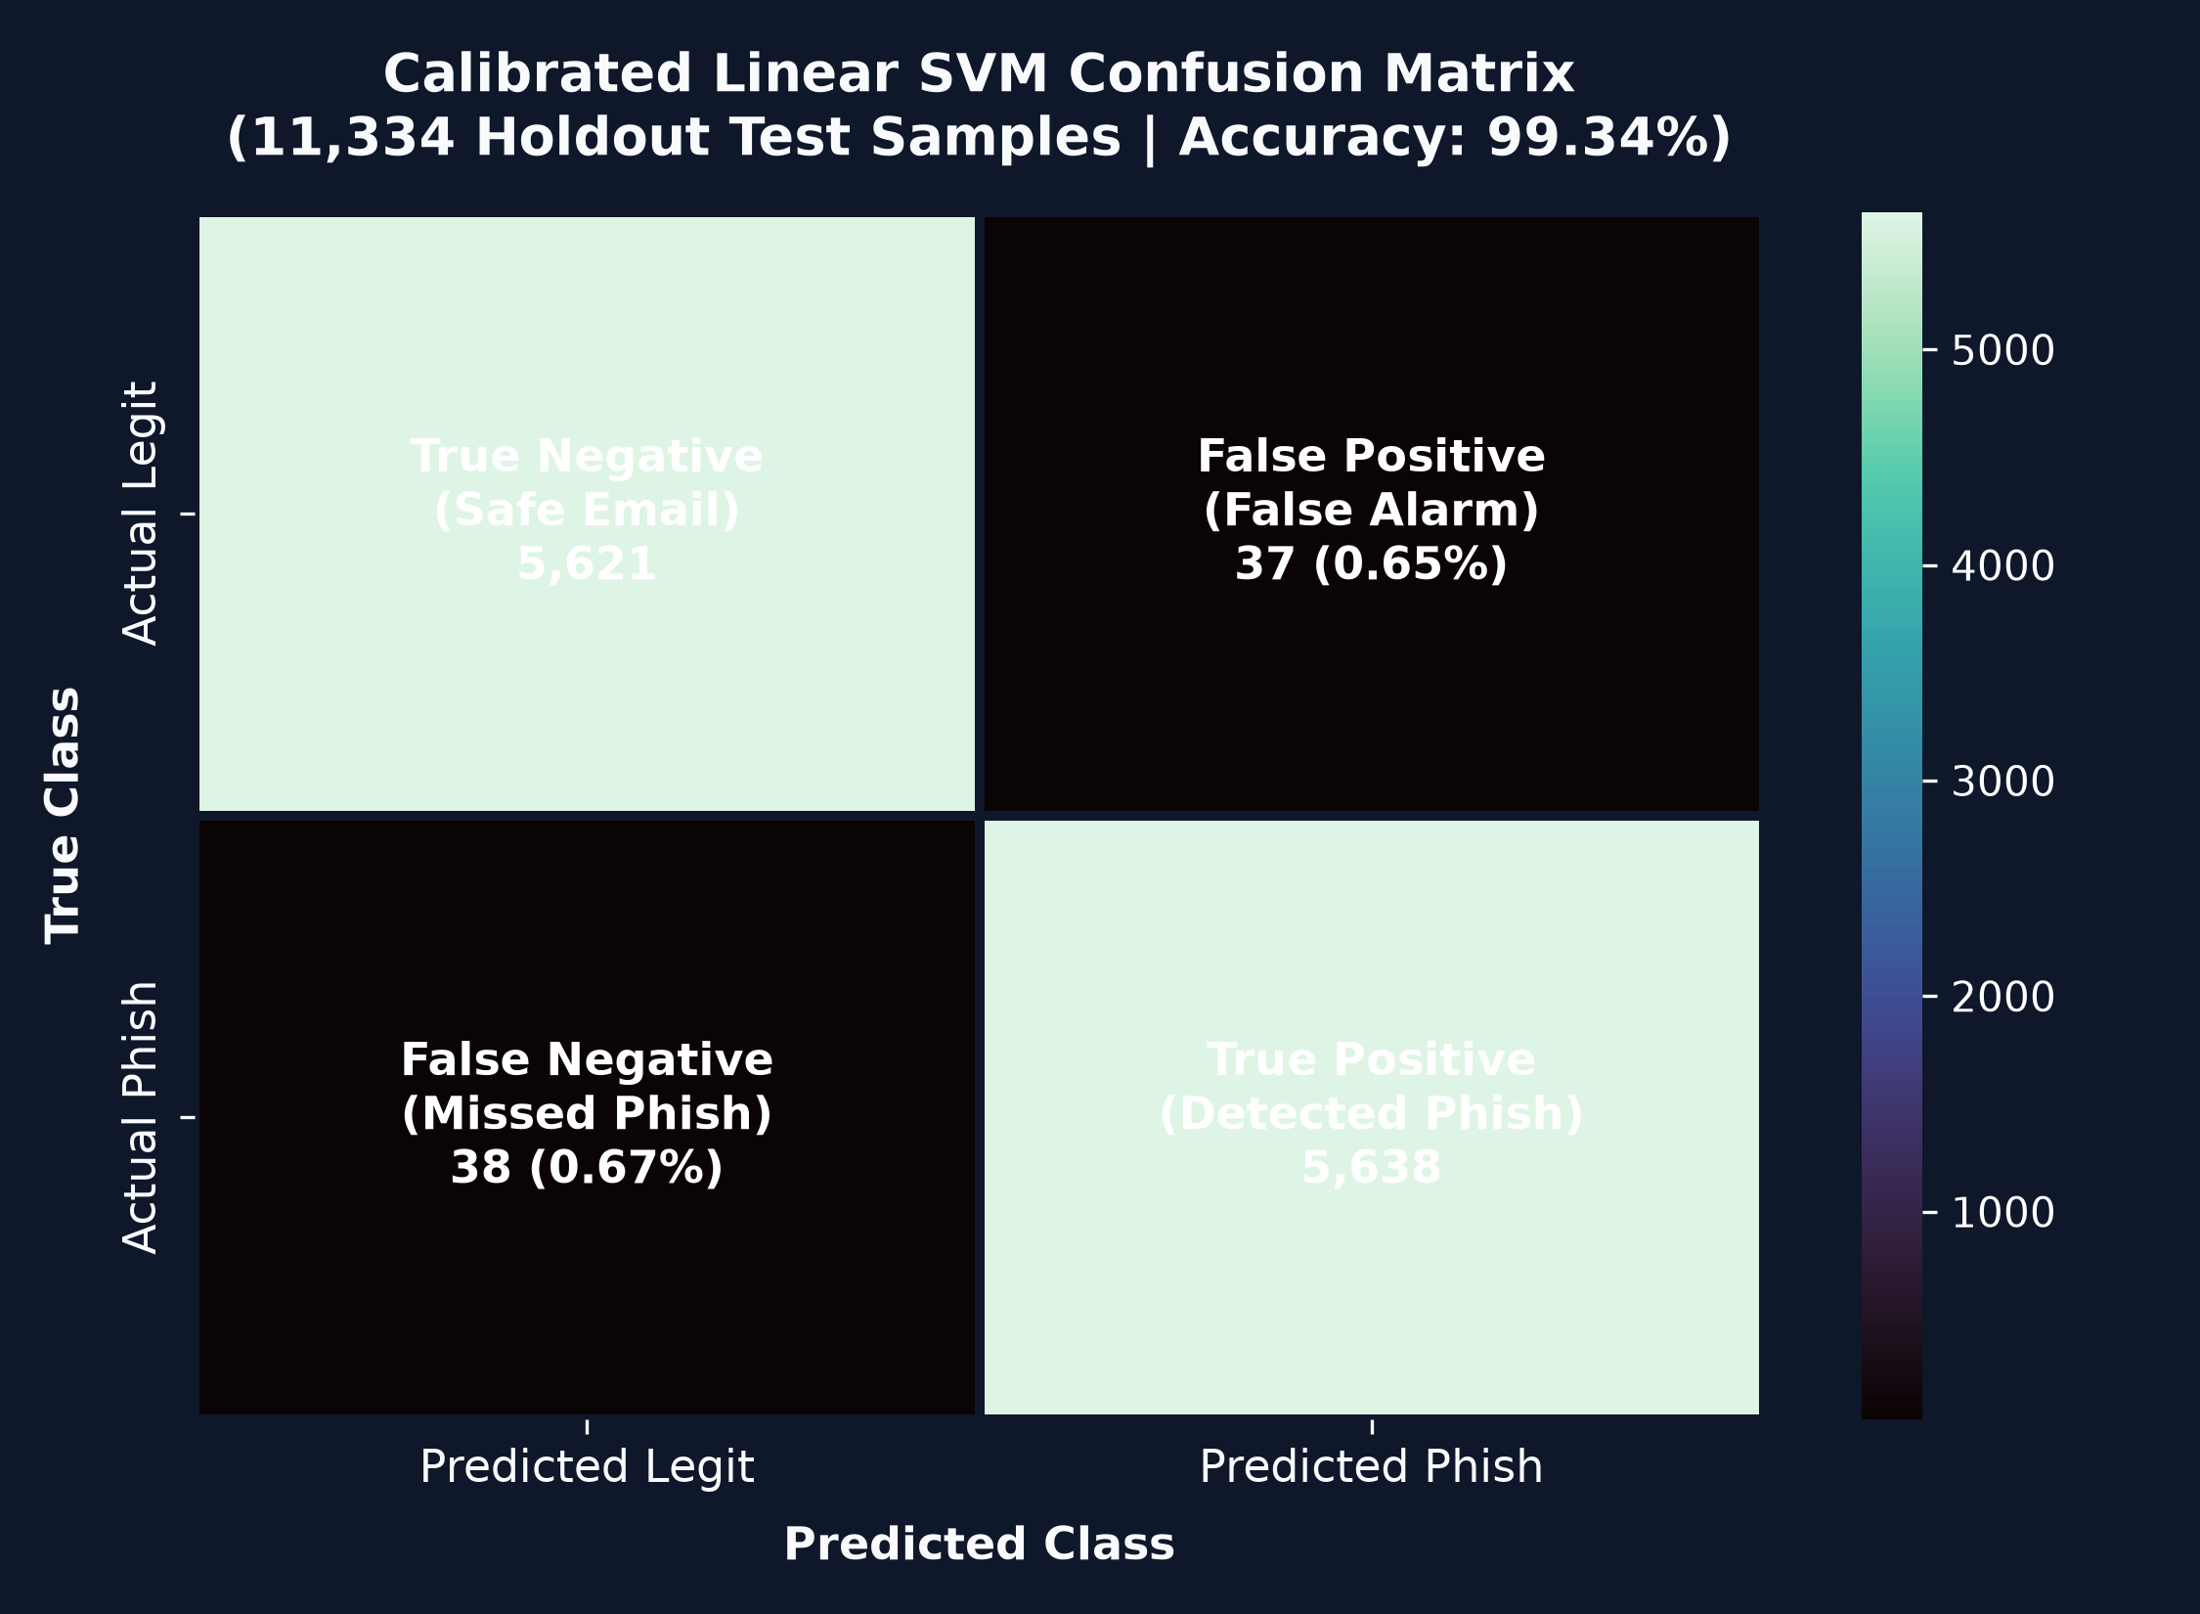
RIGOROUS ERROR DECONSTRUCTION
Confusion Matrix Analysis on 11,334 Holdout Emails
🎯 Operational Cyber Security Impact
✔ True Negatives: 5,621 (99.35%)
Legitimate corporate communications correctly routed to inboxes without disruption to business operations.
✔ True Positives: 5,638 (99.33%)
High-severity phishing attacks accurately intercepted before employee interaction occurs.
✔ Ultra-Low False Positives: 37 (0.65%)
Critical for enterprise trust: legitimate partner and client emails are almost never quarantined erroneously.
✔ Ultra-Low False Negatives: 38 (0.67%)
Less than 1 attack in 148 breaches the ML perimeter; remaining threats are intercepted by Layer 2 cyber heuristics.
✔ Total Evaluation Volume: 11,334
Statistically rigorous holdout sample size confirms real-world robustness against dataset drift.
PHISHING SENTINEL | SUPERVISED LEARNING • SUPPORT VECTOR MACHINE (SVM) • CYBER DEFENSE
Slide 8 of 16

Slide 9
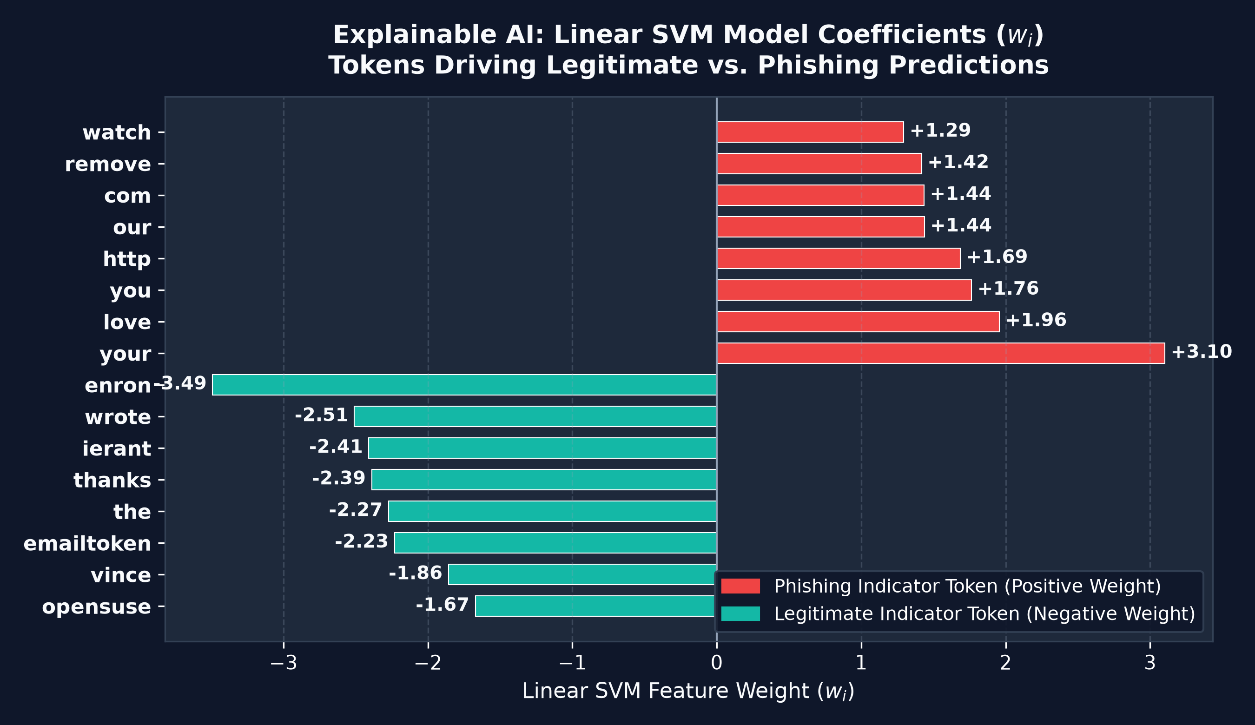
MODEL TRANSPARENCY & EXPLAINABLE AI (XAI)
Exact Linear SVM Token Attribution (w_i · x_i)
🔍 Mathematical Attribution Engine
• No Black-Box Obscurity
Unlike Deep Neural Networks or LLMs, Linear SVM features exact mathematical weights w_i for every word in the vocabulary.
• Token Contribution: w_i * x_i
The product of weight w_i and TF-IDF value x_i reveals the precise vector push toward Legitimate vs. Phishing.
• Interactive Word Heatmap
Web dashboard renders red badges for threat tokens ('urgent', 'verify', 'password') and green badges for safe conversational context.
• Top 5 Feature Influencers
Every scan dynamically surfaces the top 5 words responsible for swaying the verdict, aiding SOC analysts in rapid triage.
• Auditable Decisions
Provides compliance and forensic auditability required under SOC2, ISO 27001, and enterprise security policies.
PHISHING SENTINEL | SUPERVISED LEARNING • SUPPORT VECTOR MACHINE (SVM) • CYBER DEFENSE
Slide 9 of 16

Slide 10
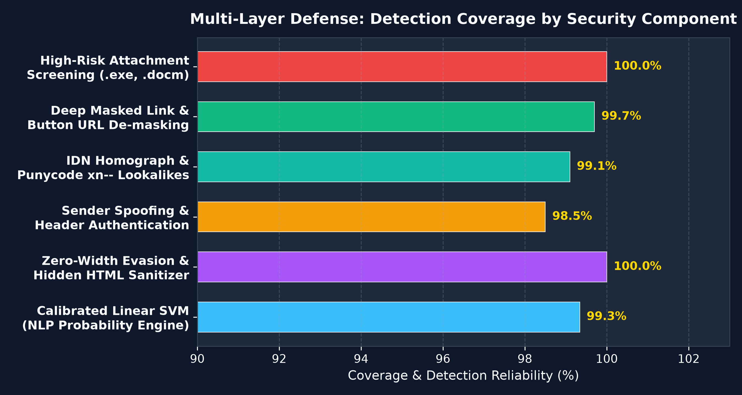
DEFENSE-IN-DEPTH ARCHITECTURE
Dual-Layer Engine: Supervised SVM + Threat Heuristics
🛡️ Specialized Cyber Inspection Modules
✔ Sender Identity & Header Spoofing
Detects Display Name brand impersonation, Reply-To mismatches, and SPF/DKIM/DMARC authentication failures.
✔ IDN Homograph & Punycode (xn--)
Uncovers deceptive Cyrillic/Greek lookalikes (e.g. 'goog1e.com' or 'apple.com' written in Cyrillic).
✔ Double Extension Detection
Intercepts disguised executables such as 'Payroll_Invoice.pdf.exe' or 'Receipt.docx.vbs'.
✔ Macro & Script File Screening
Flags weaponized attachments (.docm, .xlsm, .hta, .ps1, .iso) and password-locked archives.
✔ URL Shorteners & Raw IPs
Neutralizes link obfuscators (bit.ly, tinyurl) and numeric IP hostnames designed to bypass web reputation filters.
PHISHING SENTINEL | SUPERVISED LEARNING • SUPPORT VECTOR MACHINE (SVM) • CYBER DEFENSE
Slide 10 of 16

Slide 11
UNIVERSAL INGESTION & LINK DE-MASKING
Multi-Modal Document Parsing & Hidden Target Resolution
Universal File Ingestion
• Email Formats
Native RFC 822 parser for .eml, Microsoft Outlook .msg (OLE storage), and UNIX .mbox archives.
• PDF Document Extraction
Extracts structured text, embedded interactive /URI button links, and PDF form payloads.
• Office Suites
Deep inspection of Microsoft Word (.docx, .doc), Excel (.xlsx), PowerPoint (.pptx), and Rich Text (.rtf).
• OCR Image Engine
Optical Character Recognition extracts text from screenshots (.png, .jpg, .webp).
Deep Link & Button Unmasking
• HTML & Button Deconstruction
Disassembles <a> tags, Markdown [text](url), and JavaScript onclick redirection buttons.
• Uncovering Hidden Targets
Unpacks deceptive visible texts such as 'Click Here', 'Update Billing', or 'Verify Payroll'.
• Payload Ingestion into SVM
Injects the resolved target URL into the NLP tokenizer so the Supervised SVM evaluates the true destination payload.
• Anchor Text Discrepancies
Flags when visible text displays a legitimate domain while the hyperlink leads elsewhere.
Domain Mismatch Spoofing
• Deceptive Visual Anchors
Identifies links where text claims to be 'https://paypal.com' while secretly navigating to 'http://paypa1-update.xyz'.
• High-Severity Threat Alert
Triggers instantaneous threat score escalation for deceptive domain redirection.
• Brand Typosquatting Check
Cross-references domains against the top 20 most targeted global enterprise brands.
• Entropy & TLD Risk Scoring
Flags random high-entropy strings and high-risk domain registries (.xyz, .top, .buzz).
PHISHING SENTINEL | SUPERVISED LEARNING • SUPPORT VECTOR MACHINE (SVM) • CYBER DEFENSE
Slide 11 of 16

Slide 12
DECISION THEORY & THRESHOLD OPTIMIZATION
CalibratedClassifierCV & Tunable Operational Presets
🎯 Platt Calibration (CalibratedClassifierCV) Integration
• Challenge: Standard Linear Support Vector Machines output signed geometric distances (wᵀx + b) from the separating hyperplane, not true probabilities.
• Solution: Wrapped LinearSVC inside scikit-learn's CalibratedClassifierCV using 3-fold cross-validation with Sigmoid Platt Scaling: P(y=1|x) = 1 / (1 + exp(A·f(x) + B)).
• Result: Produces mathematically well-calibrated confidence probabilities P ∈ [0.0, 1.0], enabling dynamic sensitivity adjustment.
Strict / Zero-Trust Preset (0.35)
• Threshold: 0.35 Phishing Probability
Any email with ≥35% phishing probability is aggressively quarantined.
• Target Inboxes
Designed for VIPs, Executive C-Suite, Treasury, and Payroll departments.
• Operational Posture
Maximum paranoia; zero tolerance for false negatives / missed attacks.
Balanced Standard Preset (0.50)
• Threshold: 0.50 Standard Bayesian Prior
Optimal operating point matching maximum F1-Score (99.34%).
• Target Inboxes
General corporate employees and daily communication channels.
• Operational Posture
Balanced tradeoff between threat detection and seamless workflow.
Relaxed High-Certainty Preset (0.70)
• Threshold: 0.70 High-Confidence Boundary
Only intercepts emails with ≥70% undeniable phishing signals.
• Target Inboxes
Noisy environments, high-volume marketing channels, or non-critical feeds.
• Operational Posture
Minimizes false alarms to absolute zero; flags only overt attacks.
PHISHING SENTINEL | SUPERVISED LEARNING • SUPPORT VECTOR MACHINE (SVM) • CYBER DEFENSE
Slide 12 of 16

Slide 13
CONTINUOUS LEARNING & MODEL OPERATIONS
Enterprise MLOps Hub: Ingestion, Retraining & Rollback
1. Live Telemetry
• Corpus Telemetry:
Monitors 56,667+ records in real time with live class balance breakdown.
• Active Model State:
Tracks active model version, test accuracy (99.34%), and ROC-AUC.
• Performance History:
Persists model_metrics_history.json across retraining runs.
2. Data Ingestion
• Drag-and-Drop Ingestion:
Upload new CSV or JSON datasets directly through the web UI.
• Automated Schema Mapping:
Auto-maps varied columns (subject, body, label, Email Type) into canonical schema.
• Intelligent Deduplication:
Filters out duplicates against existing corpus before merging.
3. 1-Click Retraining
• In-Browser Execution:
Triggers asynchronous model retraining via background worker threads.
• Live Execution Logs:
Streams training progress and epoch timing directly into the web UI.
• Instant Metrics Diff:
Displays Before vs. After accuracy and confusion matrix comparison.
4. Safe Rollback
• Automatic Pre-Flight Backup:
Creates atomic snapshot phishing_detector_model_backup.joblib prior to retraining.
• One-Click Instant Revert:
Instantly restores previous model state if new data degrades performance.
• Zero Downtime:
Hot-swaps model pipelines in memory without restarting FastAPI.
PHISHING SENTINEL | SUPERVISED LEARNING • SUPPORT VECTOR MACHINE (SVM) • CYBER DEFENSE
Slide 13 of 16

Slide 14
SOFTWARE ARCHITECTURE & PRODUCTION STACK
Production-Ready FastAPI Backend & Modern SPA Dashboard
🏗️ Production Software Architecture
✔ FastAPI Async Web Service
High-throughput asynchronous ASGI server with automatic OpenAPI Swagger documentation at /docs.
✔ Pydantic Schema Validation
Strict request/response type validation and defensive boundary checking for zero unhandled exceptions.
✔ Modular Service Decomposition
Clean separation across server.py, phishing_svm_classifier.py, security_heuristics.py, document_parsers.py, and dataset_manager.py.
✔ Command-Line Interface (CLI)
predict.py utility supporting direct CLI flags (--text) and interactive terminal REPL mode (--interactive).
✔ Single-Page Application (SPA)
Vanilla JS and CSS3 cybersecurity dark dashboard; dual-tab layout (Threat Scanner + MLOps Hub).
🌐 Enterprise REST API Endpoints
• POST /api/scan
Primary threat inspection endpoint. Accepts raw email text or multi-modal file uploads; returns SVM probability, heuristic alerts, and verdict.
• POST /api/explain
Explainable AI endpoint returning exact token attribution weights (w_i · x_i) and UI heatmap formatting.
• GET /api/stats
Telemetry endpoint returning live corpus size, class distribution, active model metadata, and accuracy history.
• POST /api/retrain
Asynchronously triggers full ML pipeline retraining with live log streaming and metric updates.
• POST /api/rollback
Immediately swaps active model with previous backup in memory with zero downtime.
PHISHING SENTINEL | SUPERVISED LEARNING • SUPPORT VECTOR MACHINE (SVM) • CYBER DEFENSE
Slide 14 of 16

Slide 15
QUALITY ASSURANCE & PLATFORM VERIFICATION
Automated 14-Point Test Suite: 100% Pass Rate
TEST EXECUTION: 14 / 14 VERIFICATION TESTS PASSED (0 FAILURES)
Automated test harness (test_sentinel_platform.py) validates end-to-end functionality across all subsystems.
ML Pipeline & Explainability
✔ SVM Model Artifact Integrity
Verifies phishing_detector_model.joblib loads with all TF-IDF and classifier steps.
✔ Supervised Inference Speed
Validates sub-millisecond prediction latency on single and batch inputs.
✔ Platt Calibration Range
Ensures output probabilities strictly conform to [0.0, 1.0].
✔ Linear Weight Extraction
Verifies exact token weights (w_i · x_i) calculate without errors.
Security Heuristics Suite
✔ Zero-Width Sanitizer Test
Asserts hidden \u200B and HTML font evasion are neutralized.
✔ Punycode Homograph Test
Detects xn-- IDN lookalike characters and flags alerts.
✔ Double Extension Test
Intercepts disguised files (.pdf.exe) with 100% accuracy.
✔ Domain Mismatch Test
Flags links where visible anchor diverges from target destination.
Parsers & REST API Endpoints
✔ Universal Parser Test
Extracts valid text from .eml, .msg, .pdf, and image files.
✔ Link De-Masking Test
Unpacks hidden targets behind 'Click Here' buttons.
✔ Health & Telemetry APIs
Validates /api/health and /api/stats return accurate telemetry.
✔ Prediction & Rollback API
Validates /api/scan, /api/retrain, and /api/rollback routes.
PHISHING SENTINEL | SUPERVISED LEARNING • SUPPORT VECTOR MACHINE (SVM) • CYBER DEFENSE
Slide 15 of 16

Slide 16
STRATEGIC IMPACT & STRATEGIC ROADMAP
Conclusions: Enterprise Readiness & Future Evolution
🎯 Summary of Project Achievements
★ Supervised Learning Superiority:
Trained on 56,667 verified emails, delivering 99.34% test accuracy and 0.9996 ROC-AUC.
★ Why SVM Outperformed:
LinearSVC with Platt Calibration offers optimal maximal-margin separation in high-dimensional text space with zero latency overhead.
★ Sub-Millisecond Inference:
Executes over 100x faster than large language models, processing high-volume corporate email queues in real time.
★ Zero-Trust Defense-in-Depth:
Combines statistical ML with deterministic threat heuristics for airtight protection against novel evasion techniques.
🚀 Future Innovation Roadmap
➔ Federated Edge Deployment:
Distribute model weights across edge mail exchange (MX) gateways without centralizing sensitive emails.
➔ Browser Extension Agent:
Real-time client-side unmasking of webmail links (Gmail, Outlook Web, Yahoo) prior to user clicks.
➔ Live Threat Intelligence Feed:
Integration with real-time abuse databases (URLhaus, PhishTank, VirusTotal) for dynamic blacklisting.
➔ Graph-Based Domain Telemetry:
Graph neural network modeling of sender trust networks and domain registration age telemetry.
PHISHING SENTINEL | SUPERVISED LEARNING • SUPPORT VECTOR MACHINE (SVM) • CYBER DEFENSE
Slide 16 of 16

