Slide 1
Long-term sediment flow monitoring in the Baksan River catchment: challenges and flood-event dynamics
Ivanov V.A.¹ ², Pavlyukevich E.D.², Krylenko I.V.¹, Krylenko I.N.^{1,2}, Tsyplenkov A.S., Batchaev I.I.³ Bogachenko E.M.⁴, Golosov V.N. ¹
¹Lomonosov Moscow State University– Moscow, Russia (*viktoro.1998@yandex.ru)
²Water Problem Institute RAS, Moscow, Russia
³ High-Mountain Geophysical Institute, Nalchik, Russia
⁴ Kabardino-Balkarian Center for Hydrometeorology and Environmental Monitoring, Nalchik, Russia
This work was supported by the grant of the The Government of the Russian Federation (Agreement №075-15-2025-008 date 27.02 2025).

Slide 2
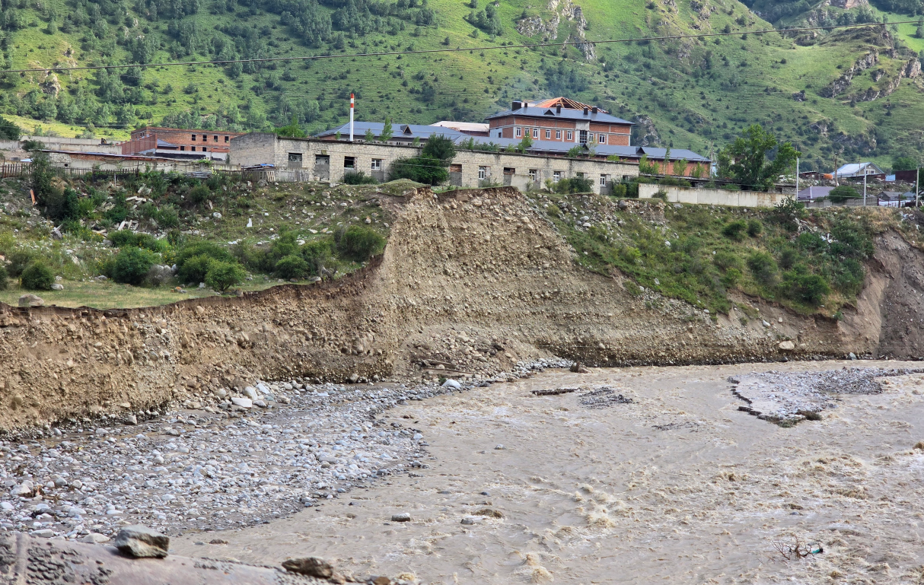
Introduction
Baksan river, Tyrnauz

Slide 3
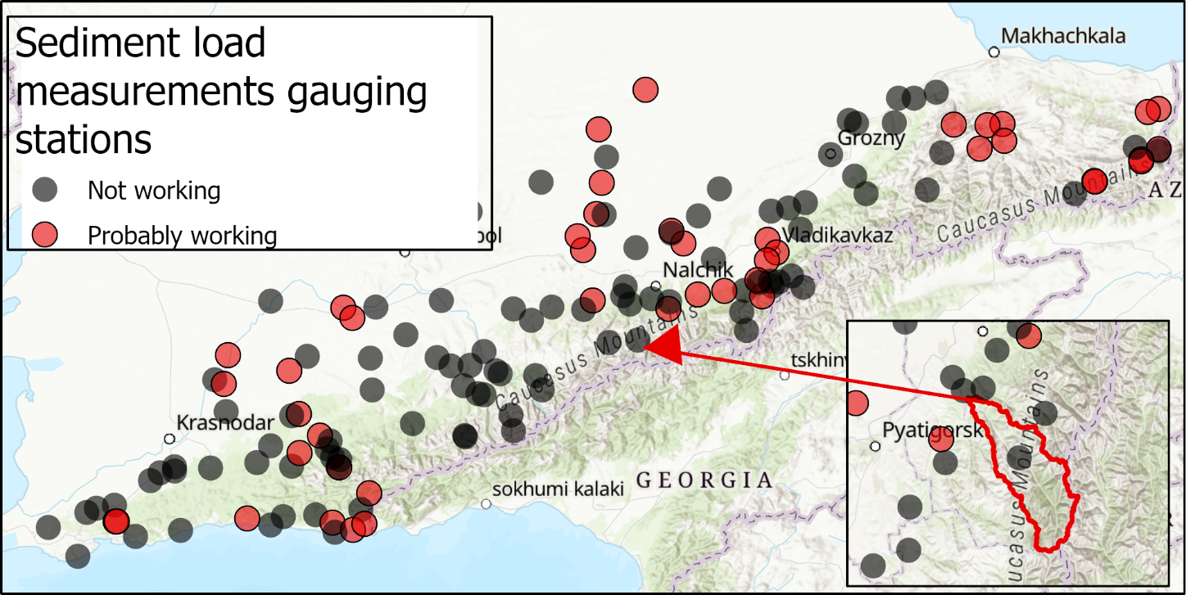
Sediment gauging in Caucasus: suspended load
Max density 3.5 gauges / 10 000 km2
Current density 1 gauge / 10 000 km2
<< 2 measurements per day
Study area:
Baksan river catchment

Slide 4
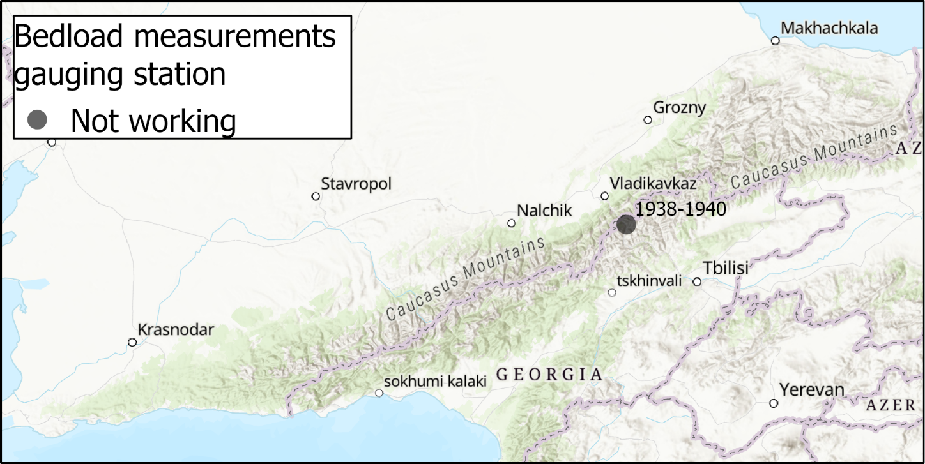
Sediment gauging in Caucasus: bedload
Only one gauging station, F = 778 km², Qmean = 67 m³/s
Working period 1938-1940
37-47 measurements per year

Slide 5
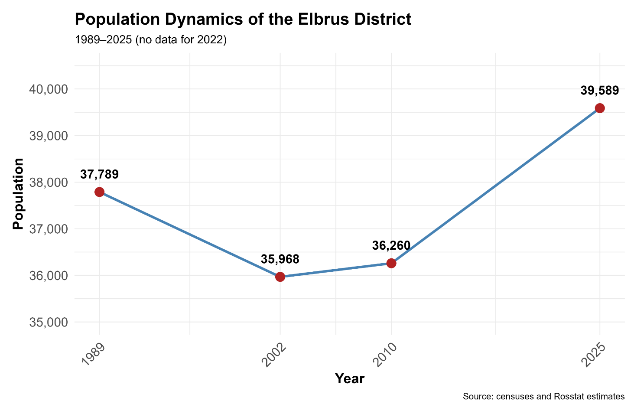
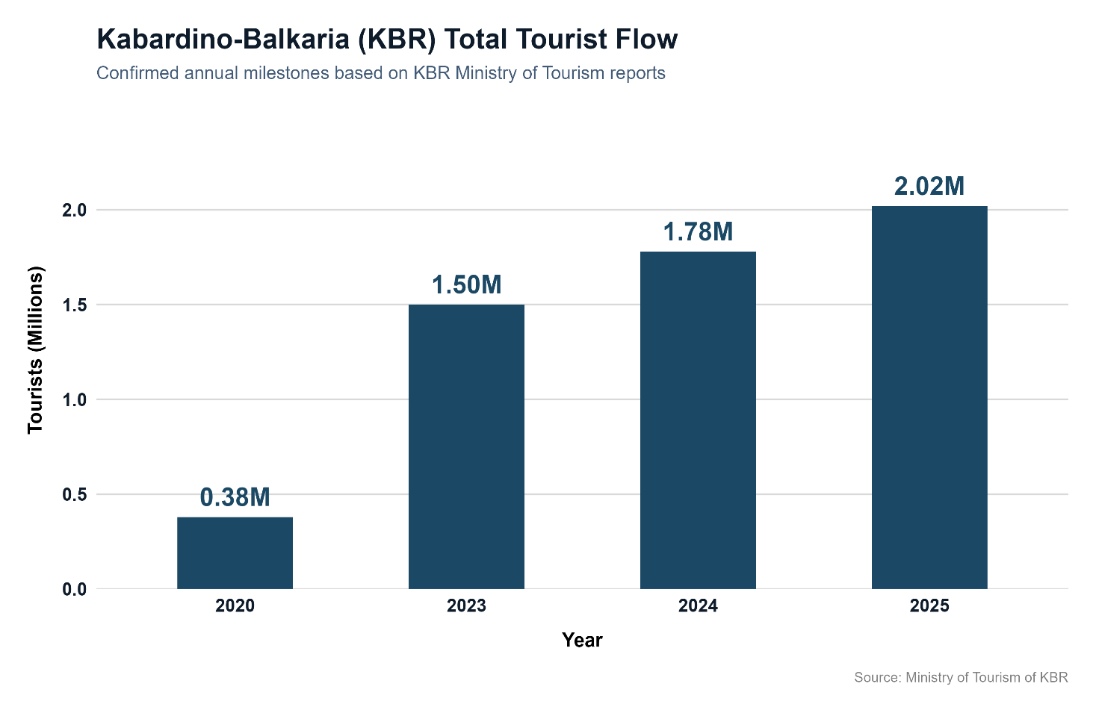
Study area: Baksan river watershed

Slide 6
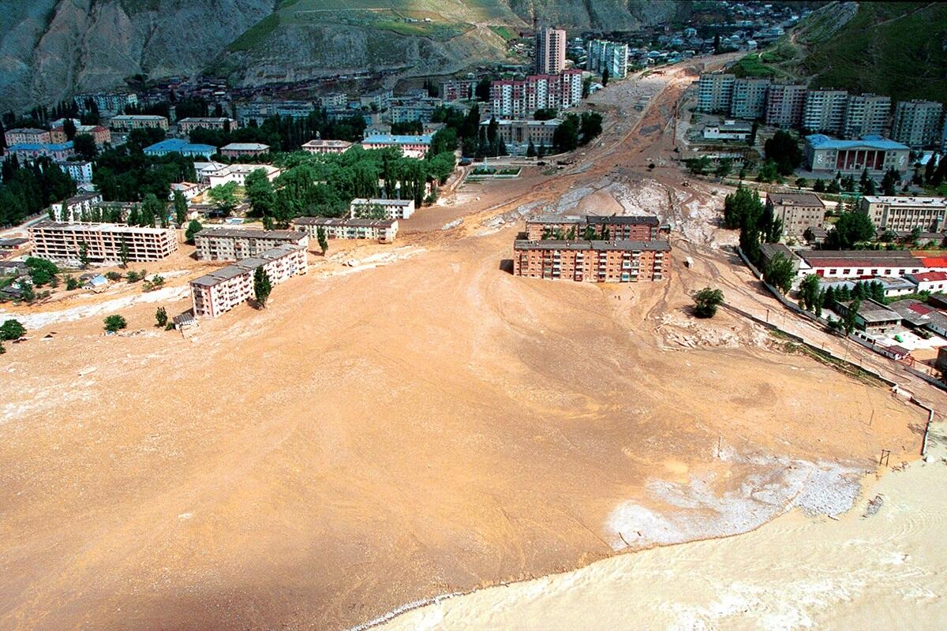
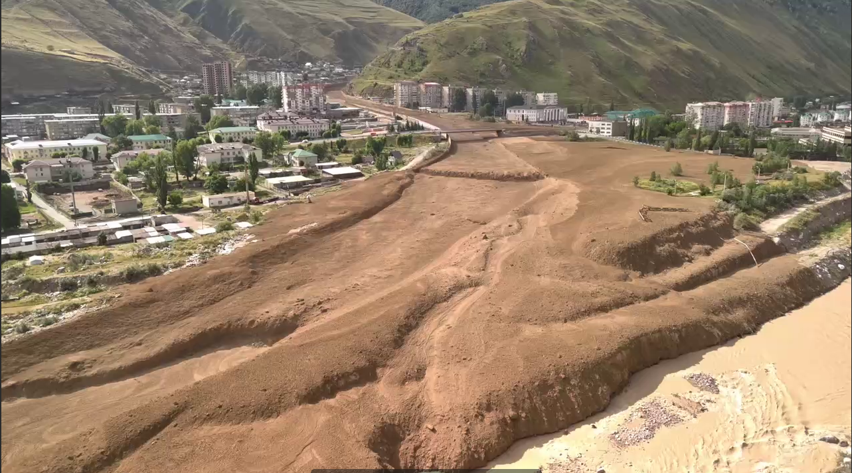
Disasters on Baksan catchment
Debris flow in Tyrnauz, 2000
Debris in Tyrnauz, 2025
Debris flows have been documented here in 1937, 1960, 1961, 1962, 1977, 1999, 2000, 2002, 2011, 2017, 2025
Glacial lake outburst floods (GLOF) Bashkara Lake 1950s, 2017
GLOF from Azau Lake in 2000, 2006, 2025

Slide 7
Study goal
To organize automatic high-frequency turbidity monitoring in the Baksan catchment
To characterize the extreme hydrological events of 2025
To quantify the contribution of the identified high turbidity events to the total annual sediment yield for Baksan River catchment

Slide 8
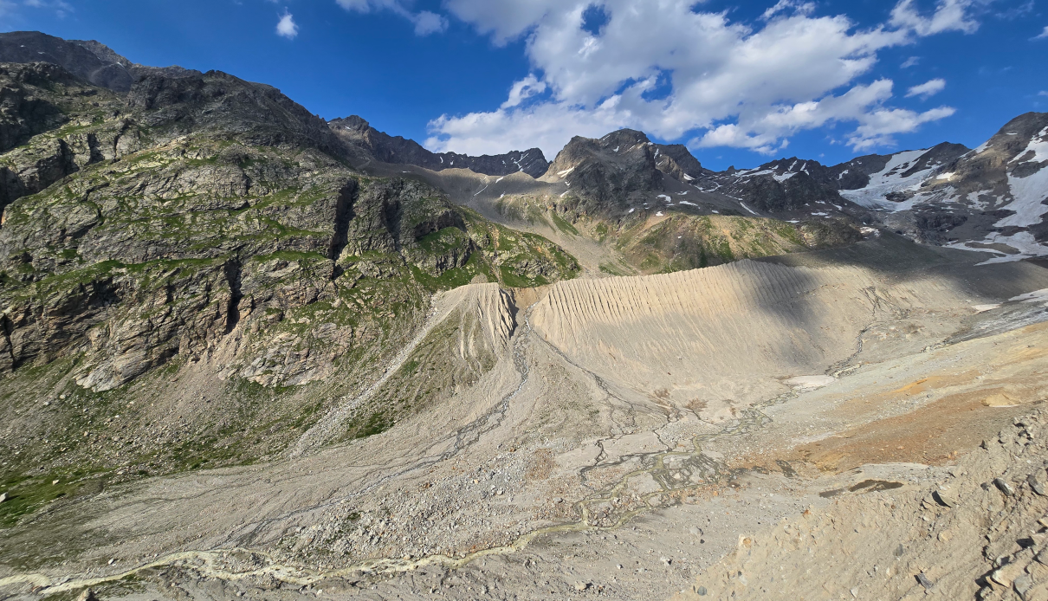
Methods
Djankuat creek catchment

Slide 9
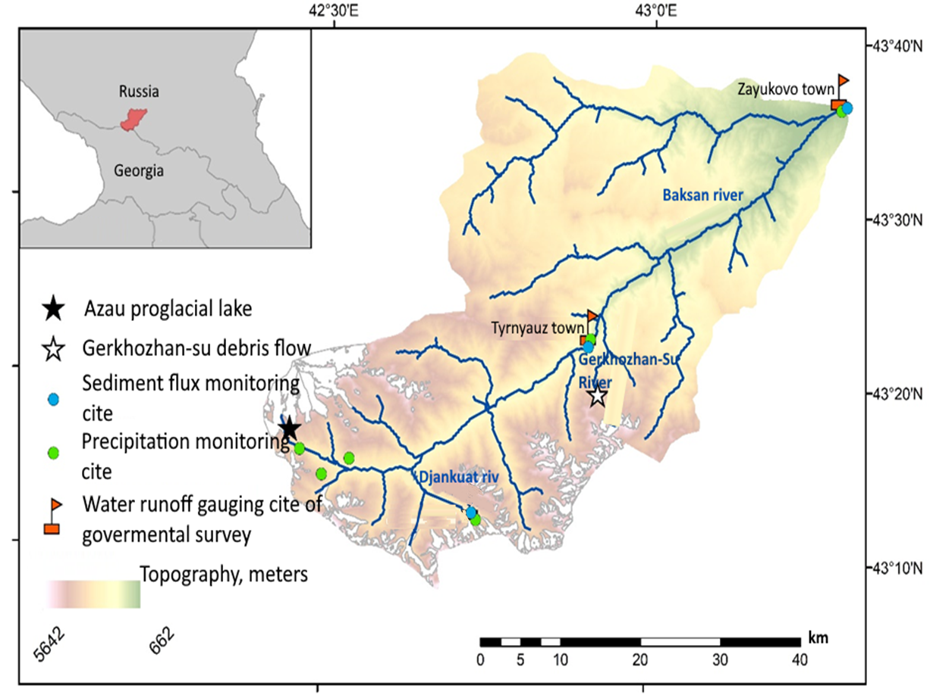
Moscow State University and Russian academy of Science monitoring 2015 - 2026
Hydrological gauges:
Djankuat creek
(F = 8 km², Q = 1.5 m³/s, Elev = 3200 m, 2015-2026)
2. Zayukovo, Baksan river
(F = 2100 km², Q = 34.9 m³/s, Elev = 2360 m, 2025 – 2026)
3. Tyrnauz, Baksan river
(F = 838 km², Q = 23.9 m³/s, Elev = 2990 m, 2025 – 2026)

Slide 10
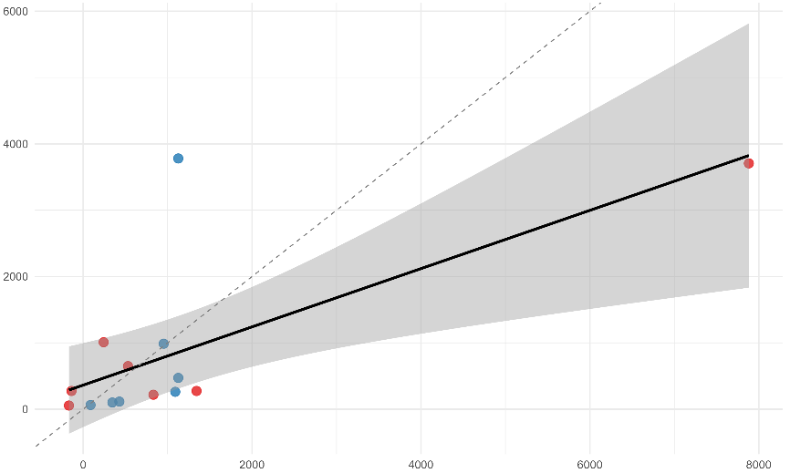
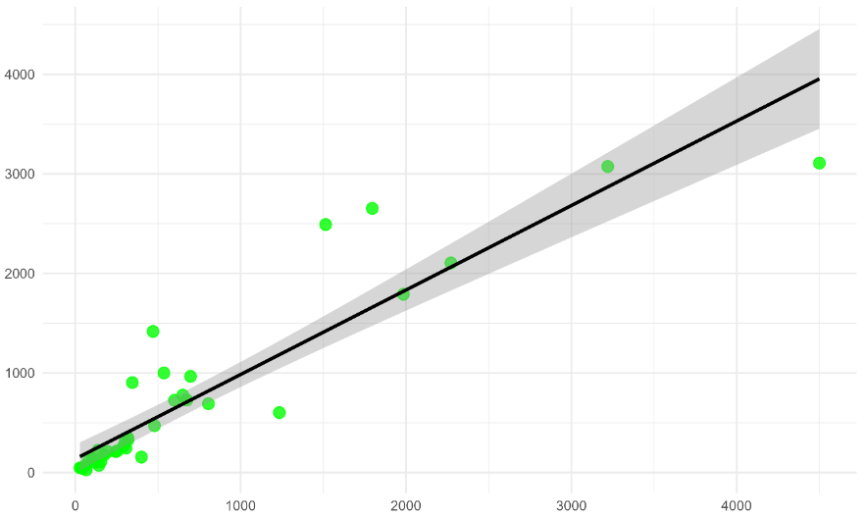
Moscow State University and Russian academy of Science monitoring 2015 - 2026
Data | Source | Time resolution
Water runoff, Q | Governmental gauge | 1 day
 | Water runoff measurement on Djankuat | 20-30 times for year
Water level, H | Water level logger | 30 minutes
Turbidity, SSC | Turbidity logger | 1 minute – Tyrnauz, Zayukovo 7 times per day– Djankuat
 | Water sampling | 3-8 times per month
Meteorology, P | Governmental meteostation | Tyrnauz, Cheget, Terskol - 3 hours
 | Device meteostation | Tyrnauz, Djankuat - 30 minutes
 | Aquatic rain measurements | Azau - 1 hour
SSC, mg/l
Turbidity, NTU
SSC, mg/l
Turbidity, NTU

Slide 11
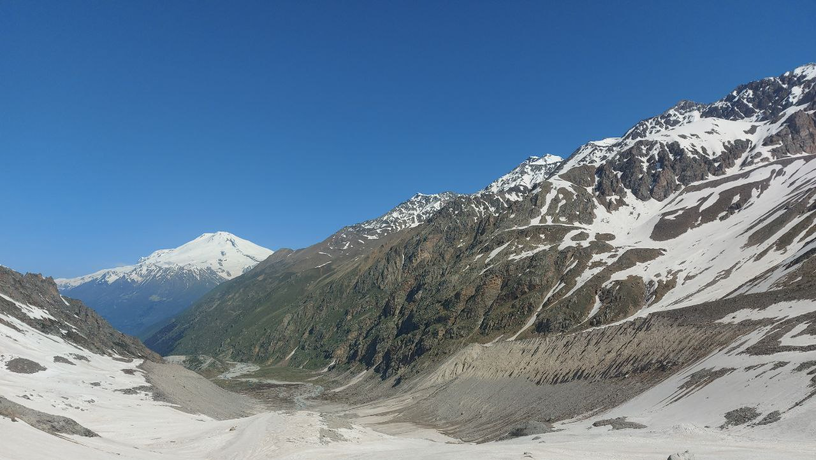
Results
Djankuat creek catchment, photo from glacier

Slide 12
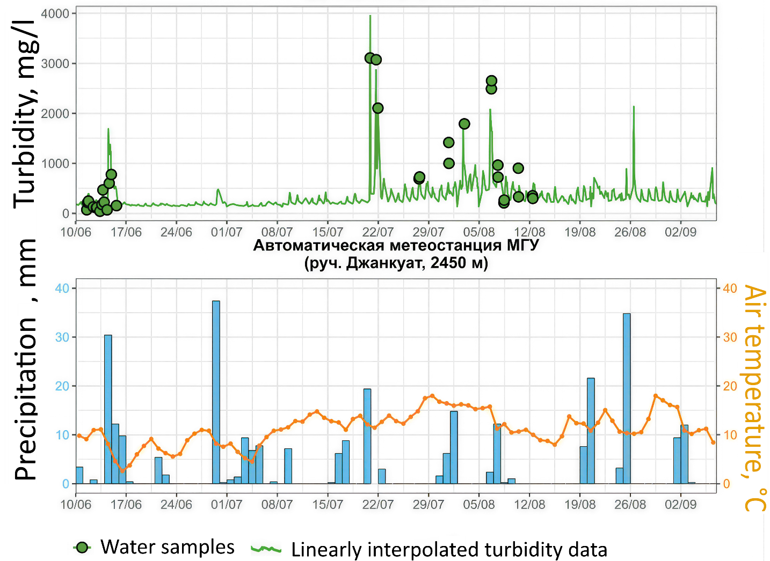
Djankuat creek
Djankuat creek, 2025
Turbidity measurements 7 times a day
Period of measurements 2015-2025
, 2025

Slide 13
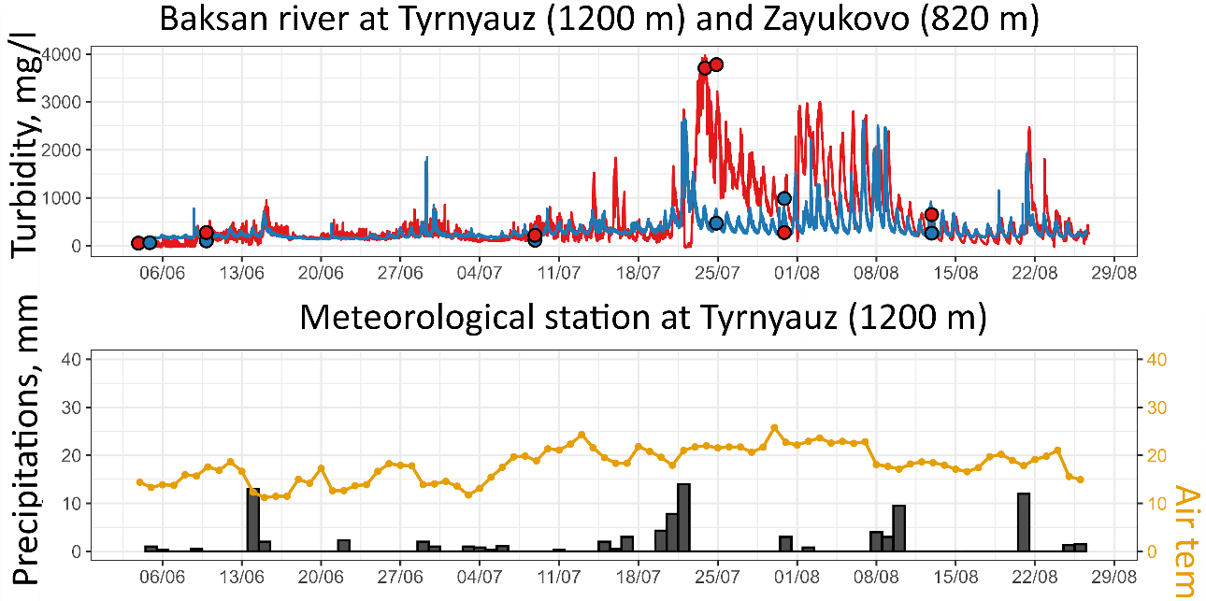
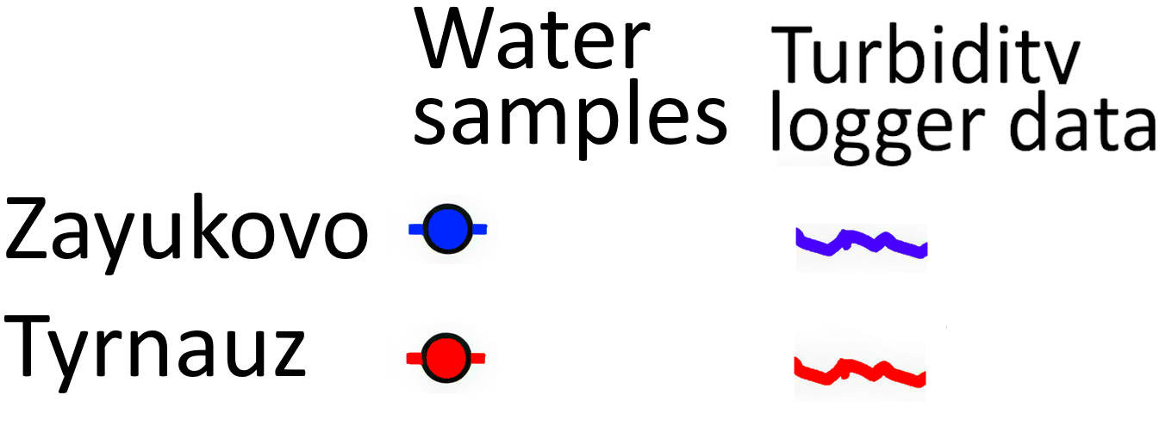
Baksan river
2025
Two turbidity loggers upstream (Tyrnauz) and downstream (Zayukovo)
Period of measurements 2025:
Big debris flow at Girhozhan-Su (21,31 July)
GLOF of Azau lake (6 August)
Girhozahan-su tributary
(Debris flow event)
Azau lake (GLOF)
Tyrnauz
Zayukovo

Slide 14
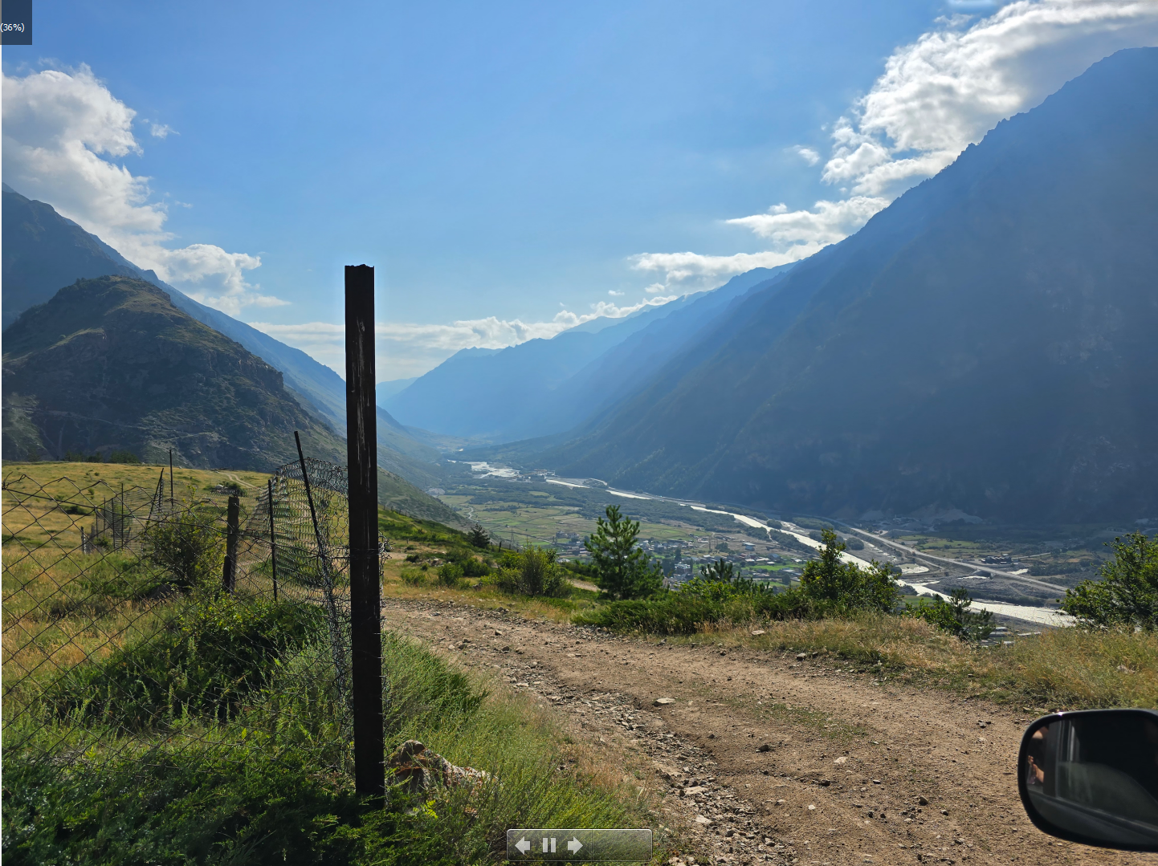
Sediment flow dynamics analyses
Baksan river, upstream Tyrnauz

Slide 15
Sediment flux hysteresis

Slide 16

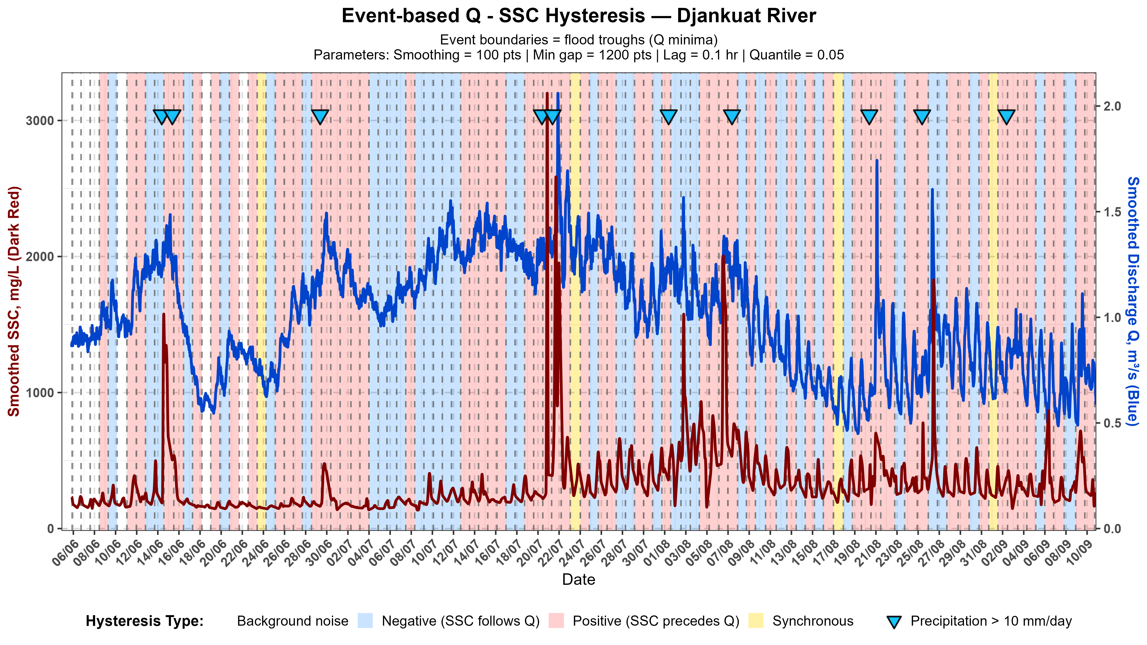
Sediment flux hysteresis
SSC, mg/l
SSC, mg/l
Q, m3/s
Q, m3/s
Positive (Clockwise) Hysteresis —SSC peak precedes Q peak:
Dominant Origin: Channel & Near-Stream Sources (in-channel deposits, riverbank collapse, or periglacial zone).
Transport Dynamics: Rapid flushing of easily erodible sediment near the gauging station before the hydrograph peak occurs.
Negative (Anti-Clockwise) Hysteresis — SSC peak lags behind Q peak:
Dominant Origin: Catchment & Hillslope Sources (arable land, hillslope gullies, sheet fluvial erosion).
Transport Dynamics: Delayed sediment delivery due to longer travel distance from remote sub-catchments or time required for overland flow build-up.

Slide 17
2025

Slide 18
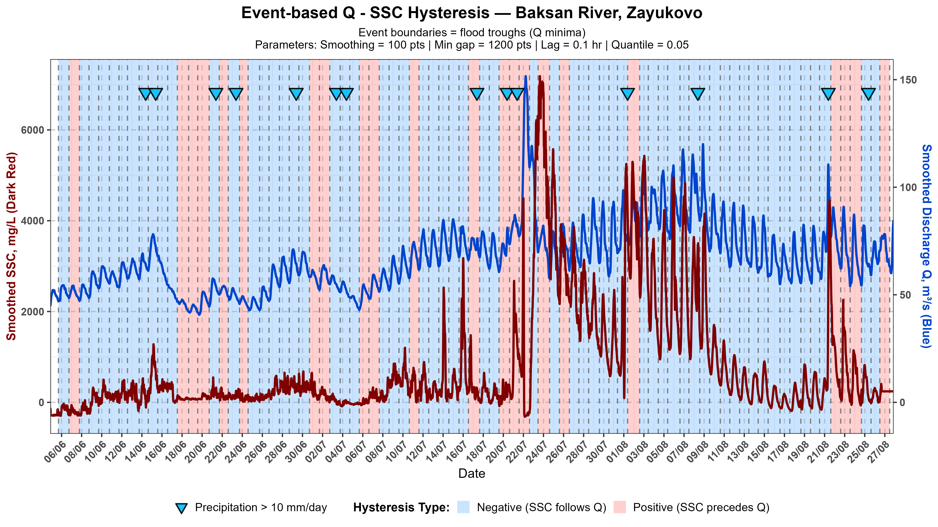

Slide 19
Sediment runoff component separation

Slide 20
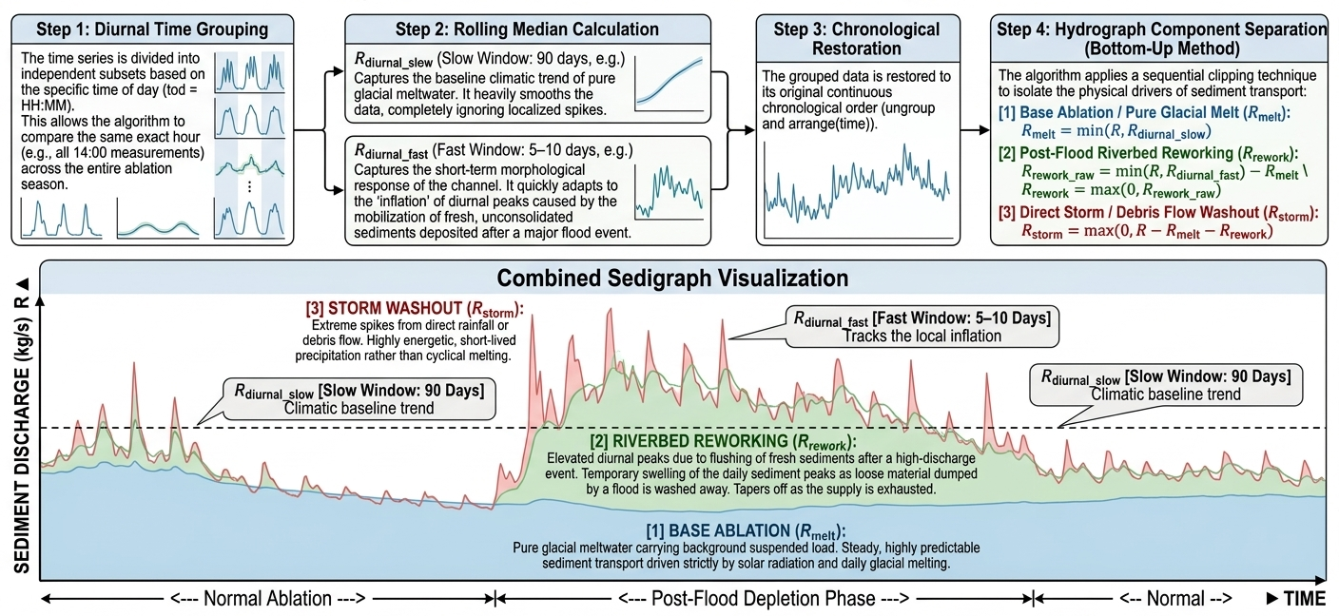
Sediment runoff component separation

Slide 21
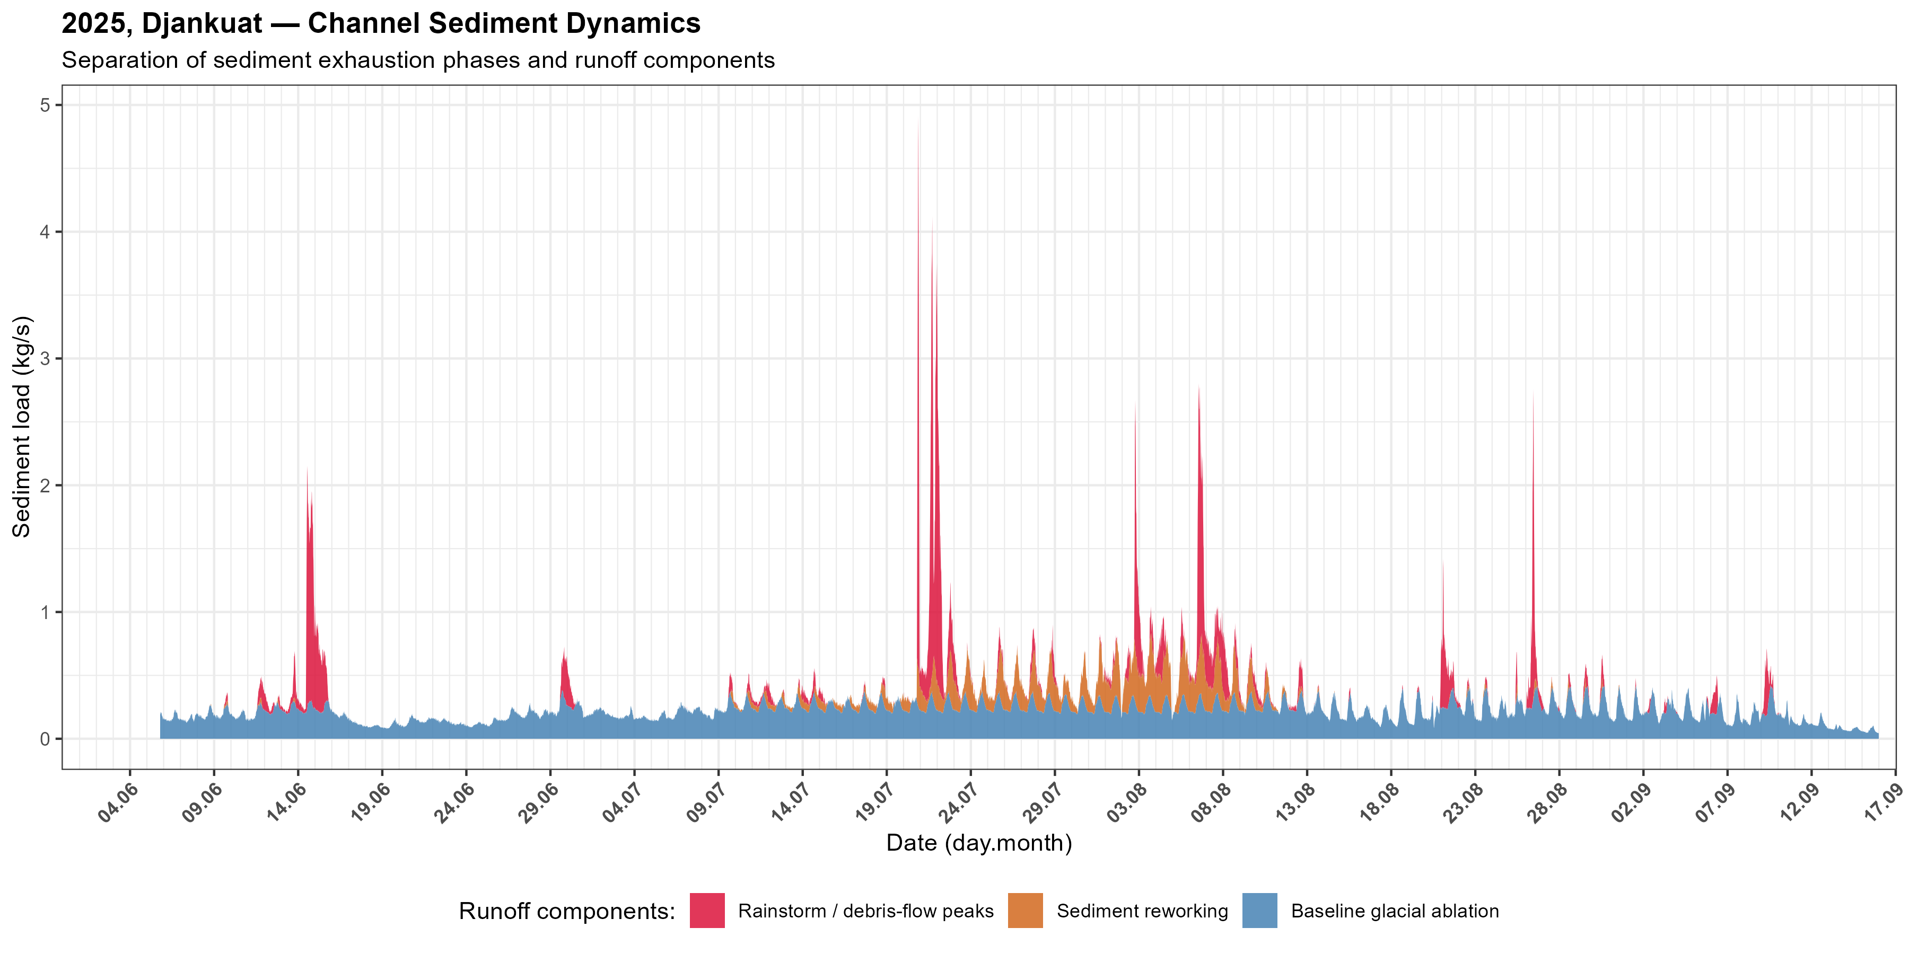
Sediment runoff component separation: Djankuat 2025

Slide 22
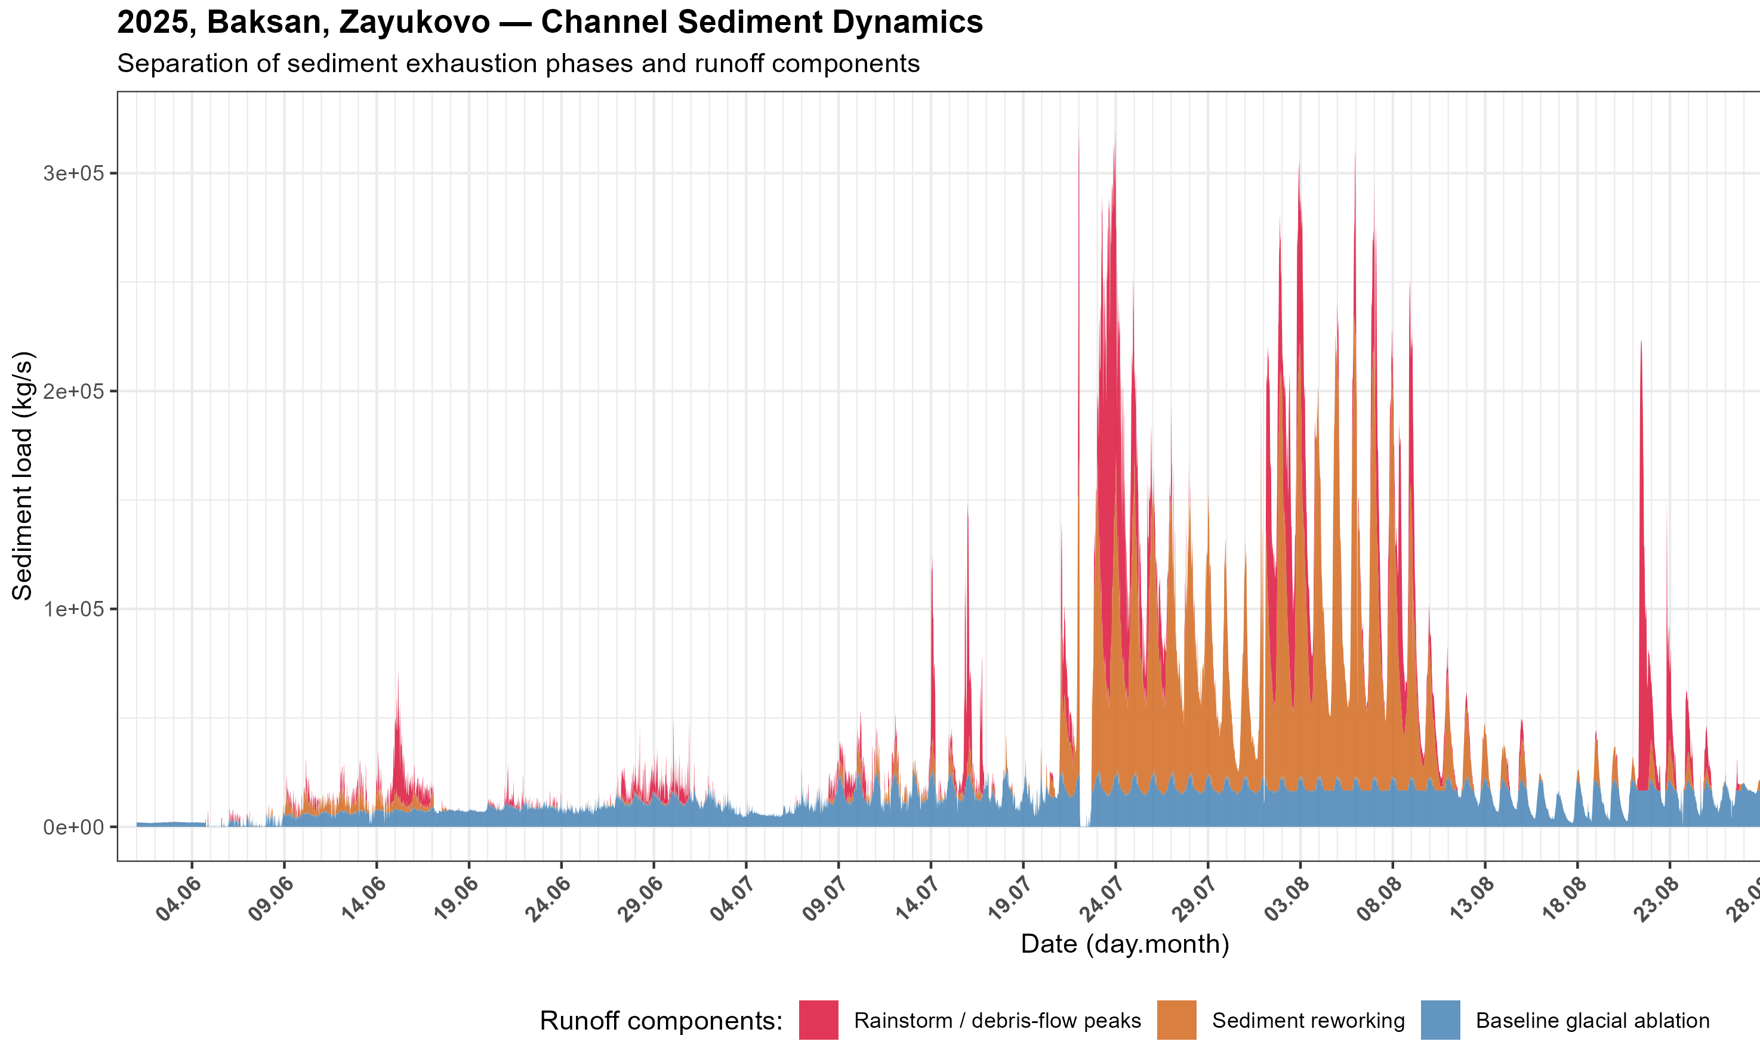
Sediment runoff component separation: Baksan, Zayukovo

Slide 23
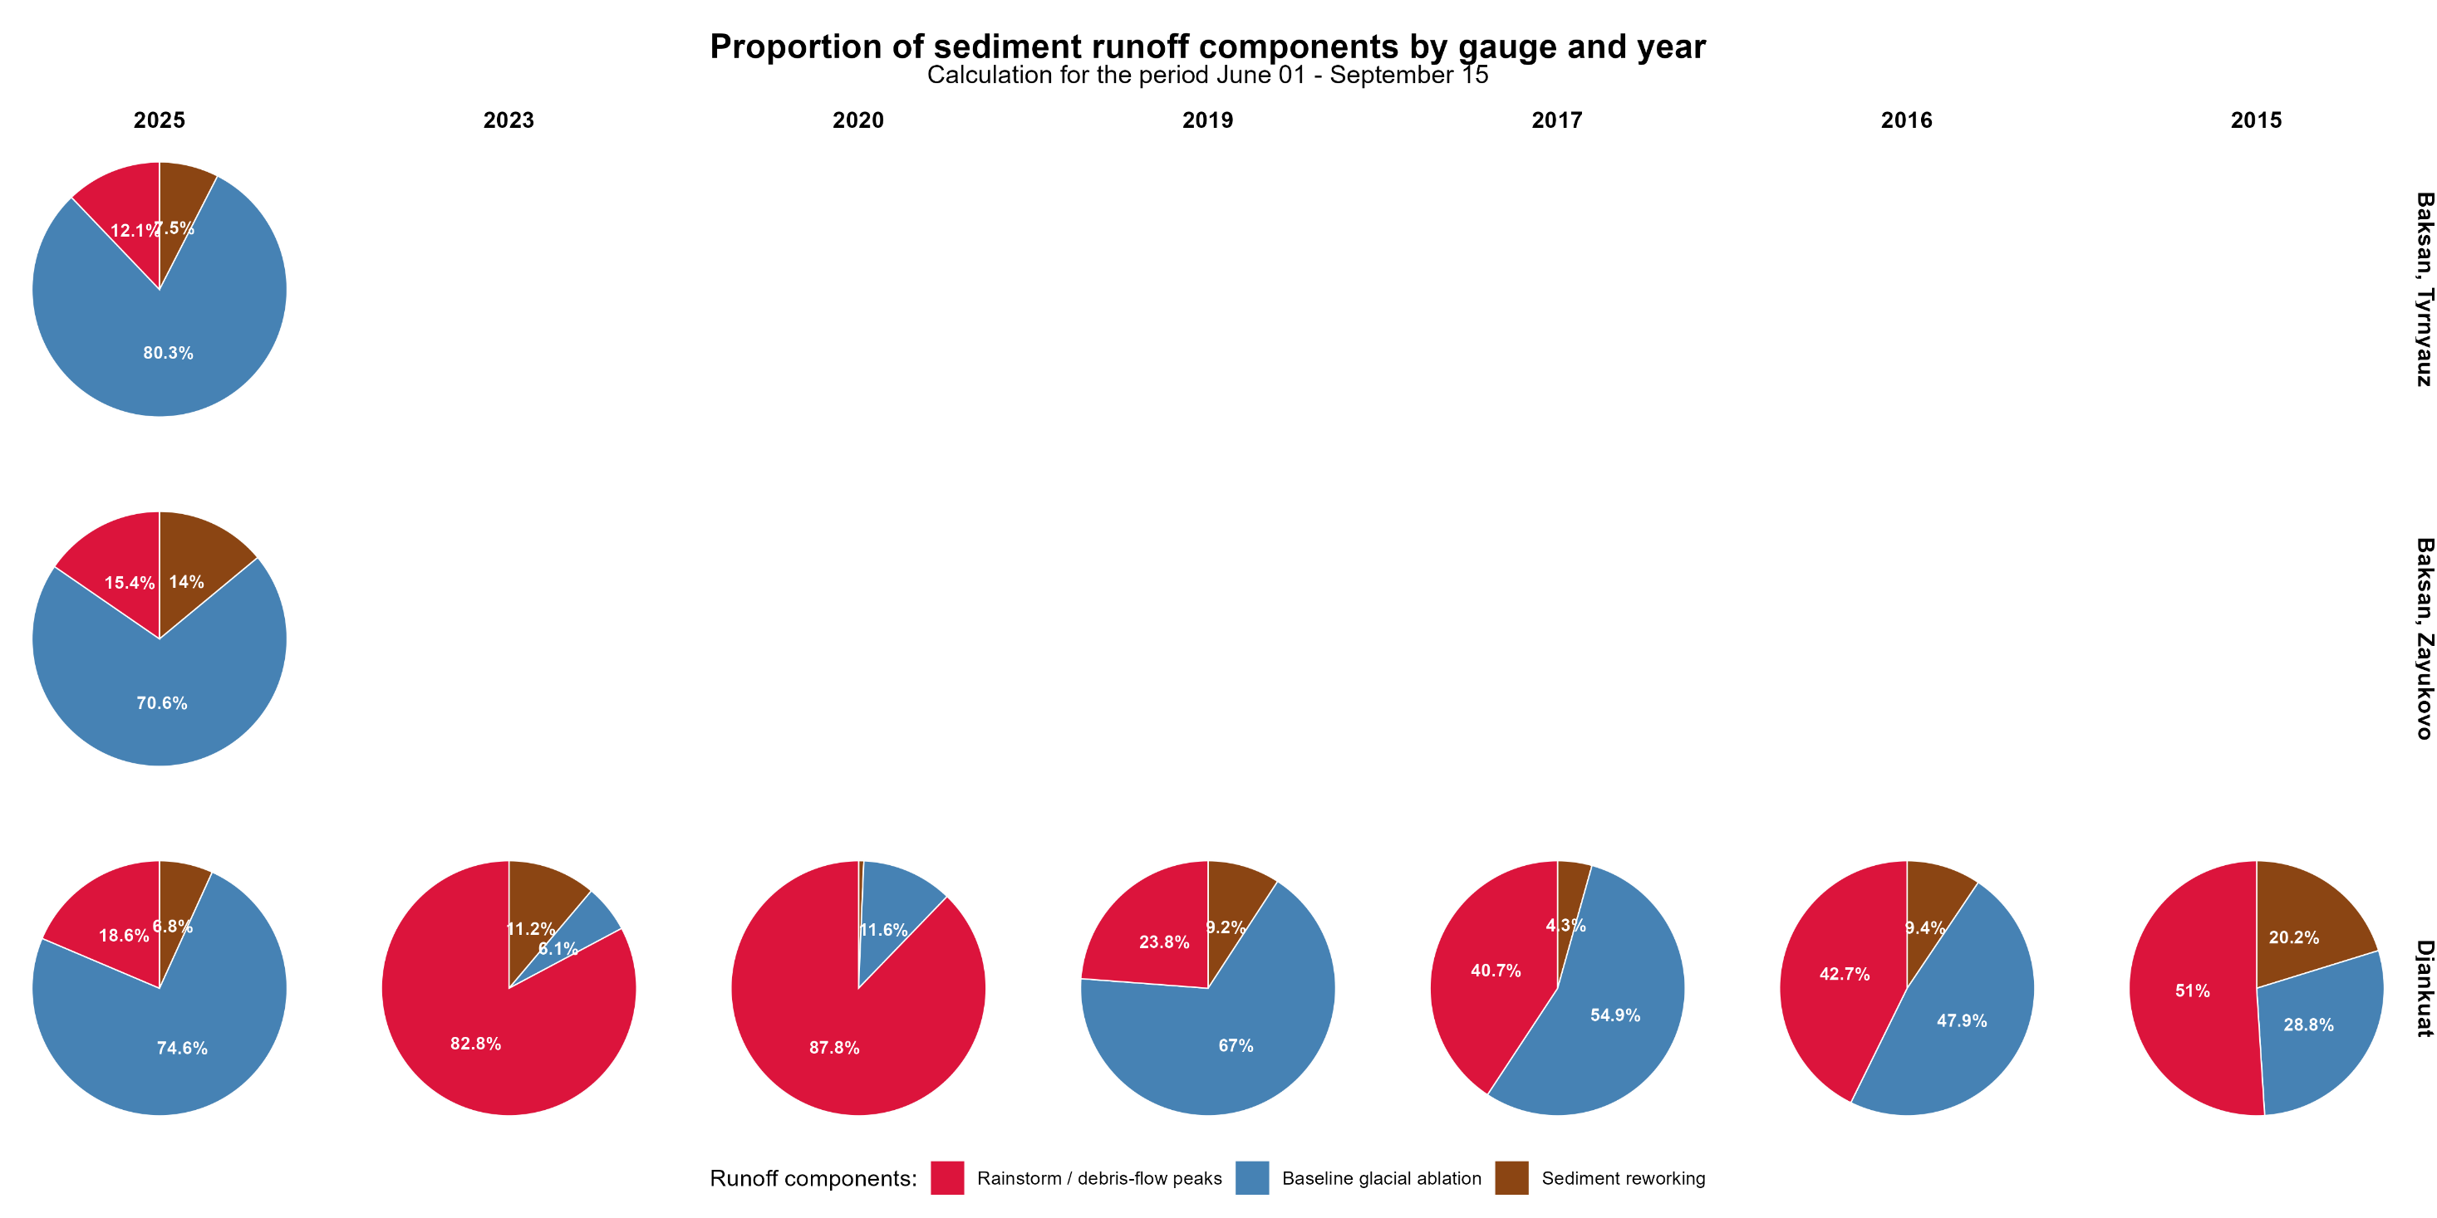
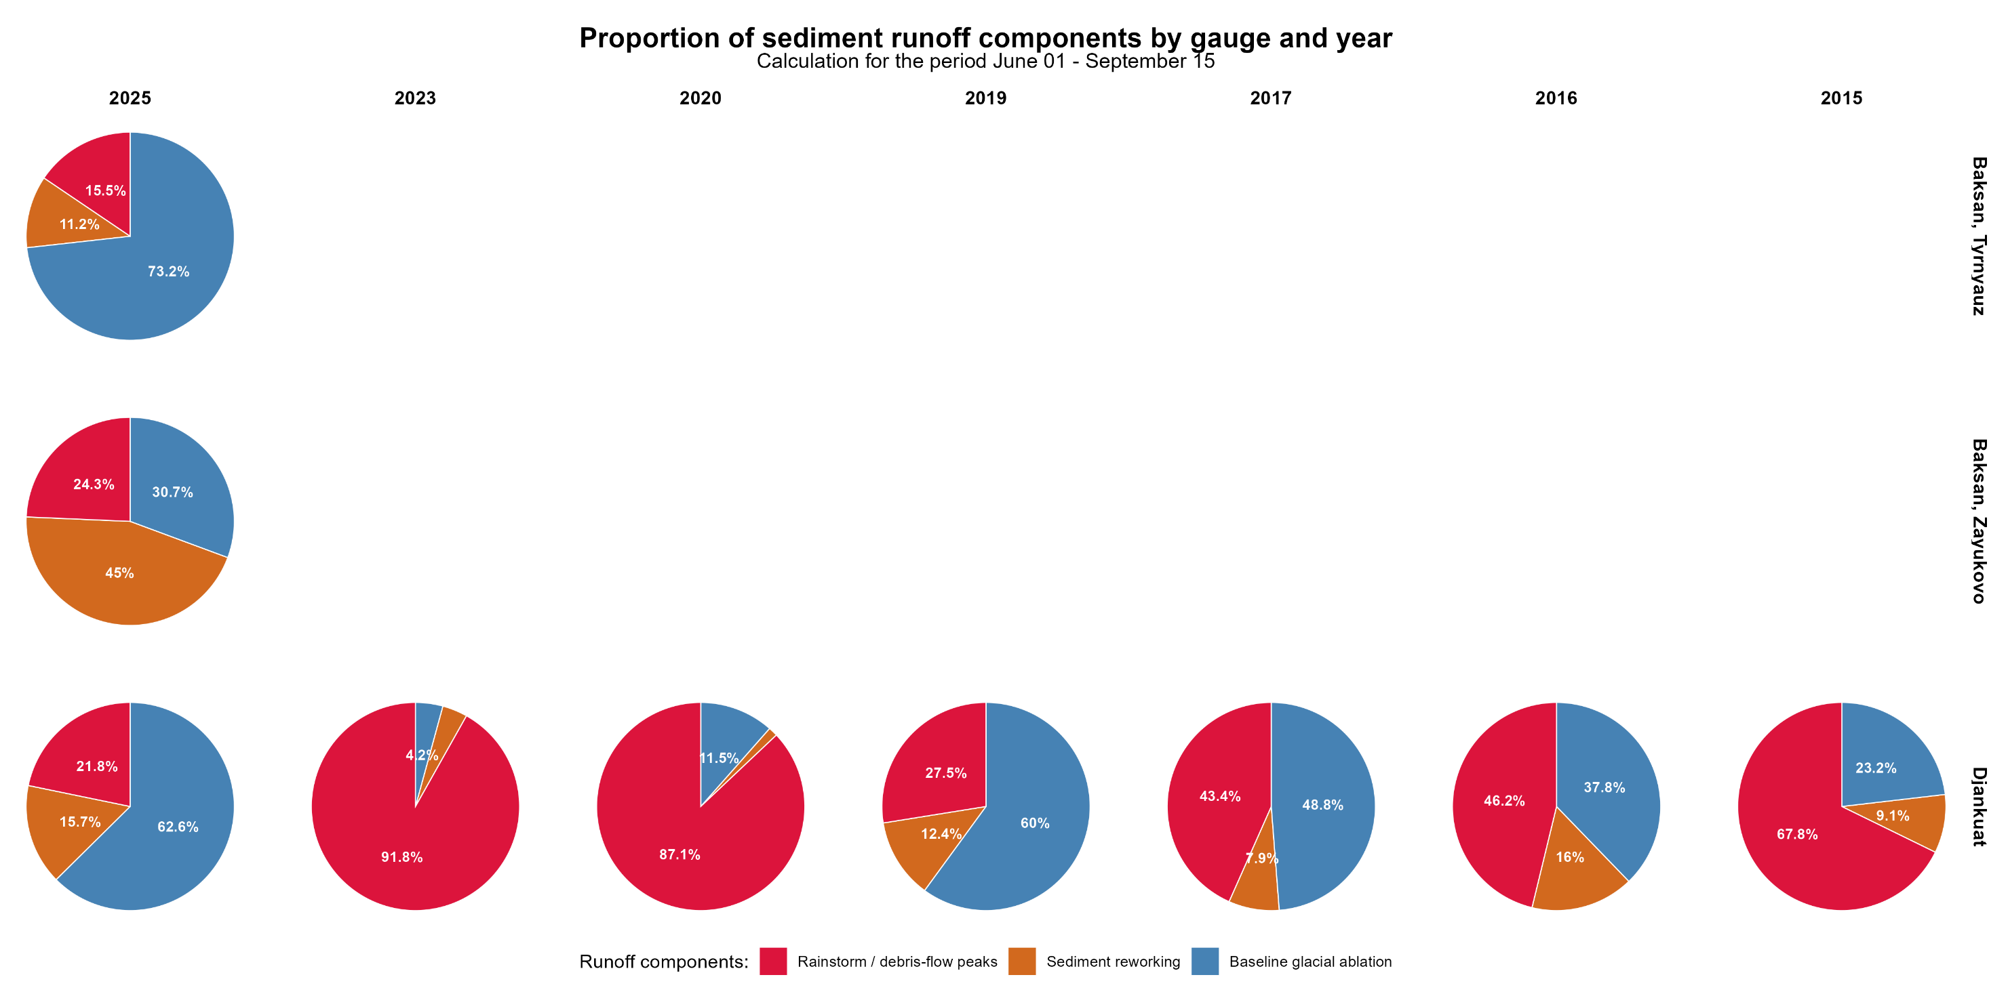
Proportion of sediment runoff components by gauge and ablation period

Slide 24
Conclusions
Annual sediment yield and its interannual variability were estimated for three gauging stations.
Hysteresis analysis was performed for the study rivers in 2025.
The hysteresis analysis revealed that positive hysteresis dominates in small periglacial catchments, which may reflect the predominant role of upper periglacial sediment sources.
A sediment-yield source-separation method was developed based on median smoothing with variable window sizes. This method allows sediment yield to be partitioned into rainstorm-driven sources, channel and floodplain sediment reworking, and glacial erosion.
Sediment sources in small catchments were found to vary substantially between years. For the Baksan River at Zayukovo, the dominant source is sediment reworking (49%), while rainfall-induced debris flow events account for 25%. At the Tyrnyauz gauging station, located upstream of the debris flow event, glacial erosion is the main source (73%).

Slide 25
Possible future directions
Perform in-depth validation of the suspended sediment source apportionment.
Apply a Monte Carlo approach to quantify uncertainty and test the robustness of the sediment source separation.
Conduct further comprehensive testing and sensitivity analysis of model parameters.
Convert black-box (data-driven) models into physically based models by incorporating regression relationships based on sediment source factors.
Establish a high-density meteorological monitoring network for calibration
Establish a high-density turbidity monitoring network for calibration

Slide 26
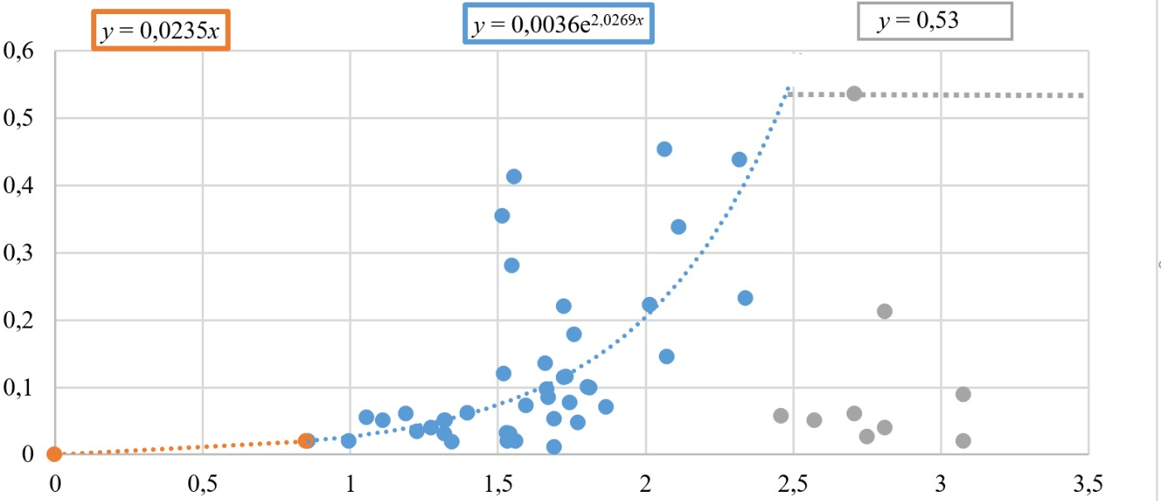
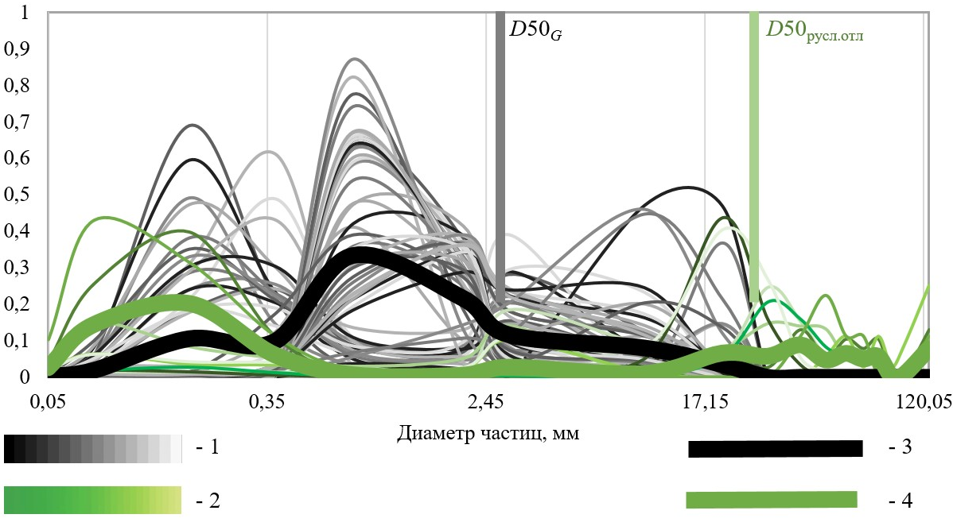
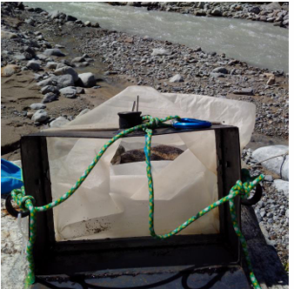
P.S. Few words about bedload
Fraction percentage/100
Bedload, kg/s
Particle diameter, mm
Water runoff, m³/s
Diameter of bed load samples and floodplain sediments according to field data, august 2023:
1 – bed load samples, 2016, 2017,2023, 2024, 2025;
2 – samples of riverbed sediments;
3 – weighted average value for bedlaod samples;
4 – average value for all floodplain sediments samples
Bedload is ~13% of annual sediment load
Halley-Smith sampler

