Slide 1


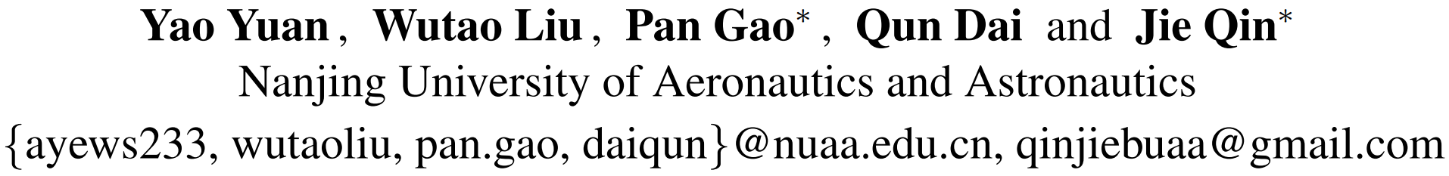
Unified Unsupervised Salient Object Detection via Knowledge Transfer
Notes:
Good afternoon, everyone. I am honored to stand before you today as the lead author of this paper, titled Unified Unsupervised Salient Object Detection via Knowledge Transfer. Today, I will share with you the findings and innovations we've discovered in this research area.

Slide 2
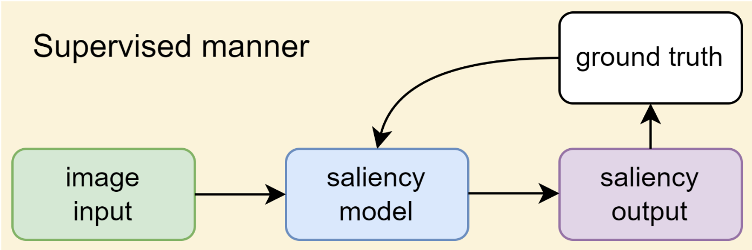
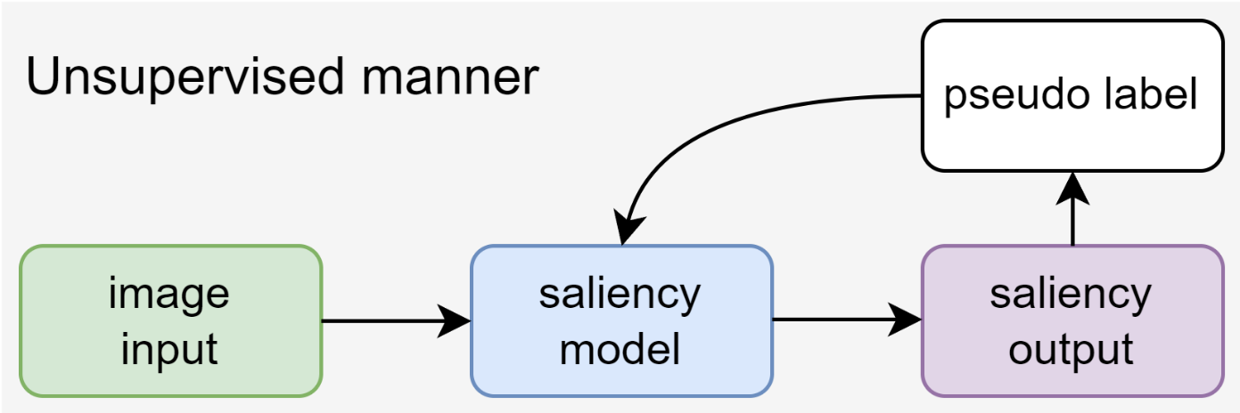
01
Introduction
Salient object detection (SOD) aims to identify the most visually significant objects in images. Supervised SOD methods have achieved excellent results, but due to their heavy reliance on pixel-level annotations for salient objects, unsupervised SOD (USOD) has been gaining increasing attention.
USOD not only eliminates the need for annotated data but also exhibits strong generalization performance.
Notes:
Firstly, let me briefly introduce this research area.
Salient object detection aims to identify the most visually significant objects in images. While supervised SOD methods have achieved remarkable results, their reliance on pixel-level annotations for salient objects limits their performance in real-world scenarios. This has raised interest in Unsupervised Salient Object Detection, which removes the need for annotated data and demonstrates strong generalization performance.
In unsupervised training, we use pseudo labels instead of ground truth to train the model. Therefore, the quality of pseudo labels has a significant impact on the performance of the model, and we will discuss it later.

Slide 3
01
Introduction
However, current Unsupervised Salient Object Detection (USOD) methods still face the following three major challenges:
1. Obtaining initial saliency cues (pseudo-labels). Existing hand-crafted feature-based methods and deep learning methods still unable to complete this task well.
2. Improving pseudo-label quality. The performance of the saliency model heavily relies on the quality of pseudo-labels. Enhancing the quality of these labels can significantly improve the model's effectiveness.
3. Limited exploration in migration. Current USOD methods predominantly target specific modalities like RGB, RGB-D, and RGB-T, yet they have not extensively investigated the potential benefits of unsupervised approaches in transfer learning and generalization.
Notes:
Current Unsupervised Salient Object Detection methods face the following three major challenges:
The first point is Obtaining Initial Saliency Cues (Pseudo-labels): Existing hand-crafted feature-based methods and deep learning approaches struggle to generate reliable saliency cues.
Due to the unsupervised nature, existing deep learning methods often suffer from issues such as unstable training process and performance degradation.
The second is improving Pseudo-label Quality: The effectiveness of USOD heavily relies on the quality of pseudo-labels generated during the training process. However,
existing methods still fall short in improving the quality of pseudo-labels.
The third is Limited Exploration in Migration: Current USOD methods mainly focus on specific modalities like RGB, RGB-D, and RGB-T.
We contend that this focus limits the benefits and potential of the unsupervised training approach. Thus, our goal is to develop a unified framework for unsupervised SOD.

Slide 4
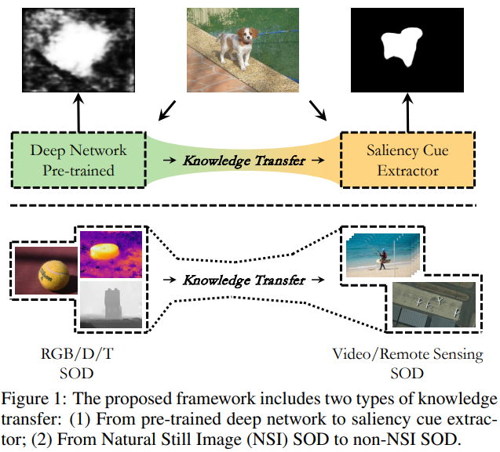
01
Introduction
Our method is grounded in knowledge transfer.
It incorporates two types of transfer: one extracts saliency cues from pre-trained deep networks (e.g., MoCo-v2), while the other transfers knowledge from Natural Still Image (NSI) SOD (including RGB, RGB-D, RGB-T) to non-NSI SOD.
Our contribution is fundamentally based on how to achieve these two types of knowledge transfer.
Notes:
Our method is grounded in knowledge transfer.
It incorporates two types of transfer: one extracts saliency cues from pre-trained deep networks (e.g., MoCo-v2), while the other transfers knowledge from Natural Still Image SOD to non-NSI SOD.
Then let's take a look at how these two types of knowledge transfer can be achieved, which is where our contributions lie.

Slide 5
01
Introduction
Main contributions can be summarized as:
1) We propose the Progressive Curriculum Learning-based Saliency Distilling (PCL-SD) mechanism to extract saliency cues from easy samples to hard ones.
2) We design the Self-rectify Pseudo-label Refinement (SPR) mechanism to gradually improve the quality of pseudo-labels during the training process.
3) We devise an Adapter-tuning method to transfer saliency knowledge from NSI SOD to non-NSI SOD tasks, achieving impressive transfer performance.
Notes:
Then let's take a look at how these two types of knowledge transfer can be achieved, which is where our contributions lie.

Slide 6

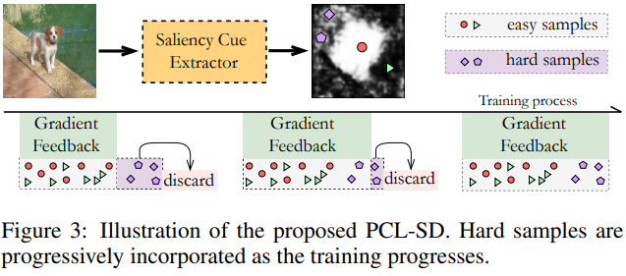
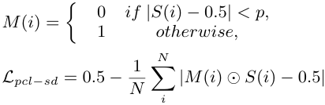
02
Methodology: Progressive Curriculum Learning-based Saliency Distilling
The PCL-SD mechanism rigidly excludes hard samples at the early stages of training and gradually incorporates them as training progresses. As a result, the model progressively extracts saliency knowledge from easy to hard samples, and the entire training process becomes more robust and stable.
The basic saliency distilling.
The partitioning of hard samples.
The proposed PCL-SD.
Notes:
Let us start at Contribution 1: Progressive Curriculum Learning-based Saliency Distilling
The concept of saliency extraction or distilling can be visualized through the first formula presented in the right, illustrating the process of shifting each pixel's predicted value from 0.5 towards 0 or 1. This transformation provides a basis for divide easy and hard samples: predictions closer to 0.5 indicate greater difficulty. In the early stages of training, hard samples may be misdirected, leading to what we term as error accumulation.
As shown in the left diagram, the PCL-SD mechanism strategically excludes hard samples during the initial phases of training, processively incorporating them as the training progresses. This approach ensures a gradual extraction of saliency knowledge from easy to hard samples, enhancing the model's adaptability and stability throughout the training process.
The formula at the bottom describes the final process of saliency distilling. The removal of hard samples is achieved through the employment of a mask matrix.

Slide 7
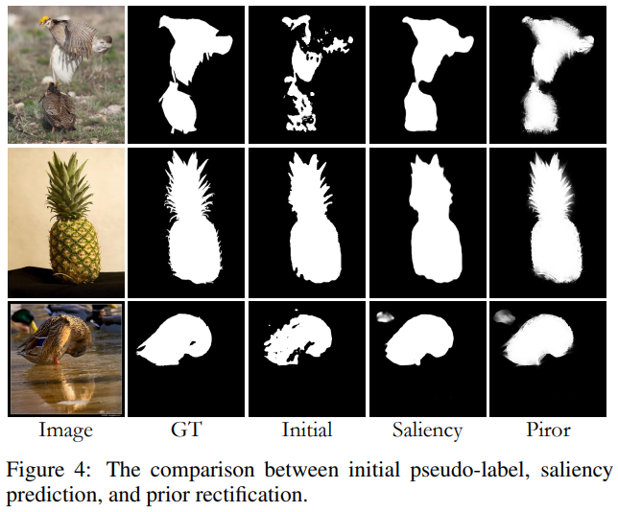

02
Methodology: Self-rectify Pseudo-label Refinement (SPR)
From the left image, it is evident that the initial pseudo-labels, the posterior rectifications from the model's saliency prediction, and the prior rectification from a real-time pixel refiner each possess distinct advantages and disadvantages.
The SPR mechanism effectively integrates prior and posterior rectifications, gradually improving the quality of pseudo labels during the training process, demonstrating strong self-supervised performance.
The process of updating pseudo labels.
Notes:
Then we move to Contribution 2: Self-rectify Pseudo-label Refinement
As we mentioned earlier, the quality of pseudo-labels significantly impacts the performance of the model.
From the left figure, we observe that the posterior rectifications from the model's saliency prediction can effectively refine the initial pseudo-labels by incorporating high-level semantic information. This refinement process may result in some loss of local details. However, the prior rectification from a real-time pixel refiner effectively complements these local details.
The SPR mechanism capitalizes on integrating the strengths of both prior and posterior rectifications, gradually improving the quality of pseudo labels during the training process, achieves strong self-supervised performance.
The formula below shows the composition of the refined pseudo-labels.

Slide 8
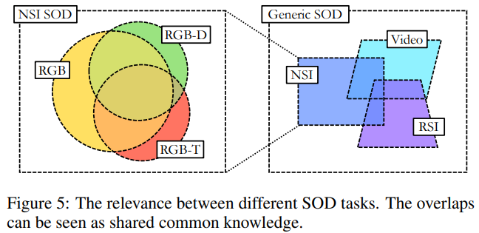


02
Methodology: Knowledge Transfer via Adapter-tuning
We devise an Adapter-tuning method to transfer the acquired saliency knowledge, leveraging shared knowledge to attain superior transferring performance on the target tasks. Specifically, we employed an Adapter structure to fine-tune the deep layers of the model, allowing it to adapt to the target task without experiencing performance degradation.
w/o adapter
w/ adapter
Notes:
The tasks within NSI SOD benefit from a greater amount of shared knowledge, allowing for the joint training of multiple tasks to achieve a better generalization performance. However, as we broaden our focus to generic SOD tasks, the inherent gap between tasks becomes the primary influencing factor. Joint training becomes more challenging and poses risks of model degradation
We posit that identifying an appropriate fine-tuning method can effectively address this issue.
Here we provide a simple example of adapter tuning. Here, F represents the deep features extracted by the backbone, Fˆ denotes the processed features, and T signifies the network layer or module performing the processing. In specific end-to-end SOD models, T can comprise a convolutional layer that modifies the number of feature channels or a network module that enhances the features.
For more details on implementing adapter tuning, please refer to our paper.

Slide 9
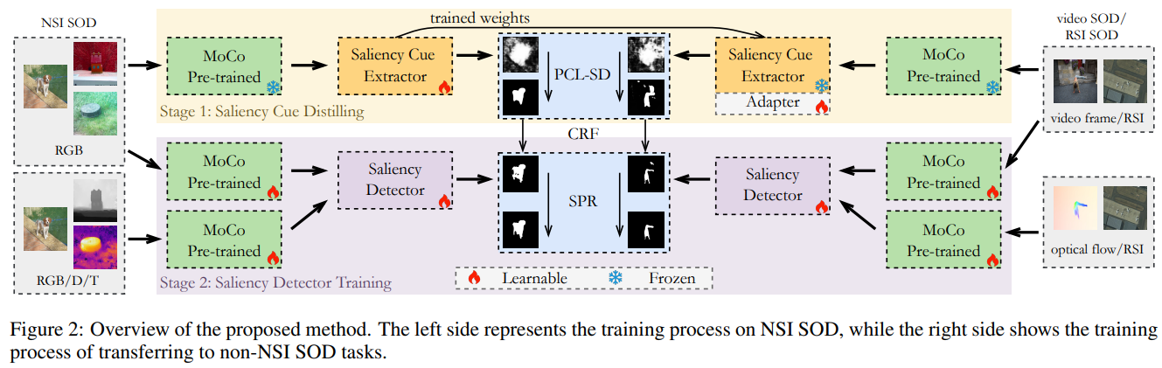
02
Methodology: Framework
We propose a two-stage framework for unified USOD tasks. In stage 1, we train a saliency cue extractor (SCE) to transfer saliency knowledge from a pre-trained deep network (e.g., MoCo-v2). In stage 2, we utilize the obtained saliency cues as initial pseudo-labels to train a saliency detector (SD). We train our base model on Natural Still Image (NSI) datasets and subsequently transfer the model to non-NSI SOD tasks such as video SOD and Remote Sensing Image (RSI) SOD.
Notes:
Finally, let me introduce the method we proposed, a two-stage framework designed for unified USOD tasks. In the first stage, we introduce a saliency cue extractor trained to transfer saliency knowledge from a pre-trained deep network.
Moving to stage 2, we utilize these extracted saliency cues as initial pseudo-labels to train a saliency detector. Our approach begins by training the base model on datasets containing Natural Still Images, ensuring a solid foundation in SOD. Then, we transfer and adapt this model to non-NSI tasks, including challenges like video SOD and RSI SOD.

Slide 10
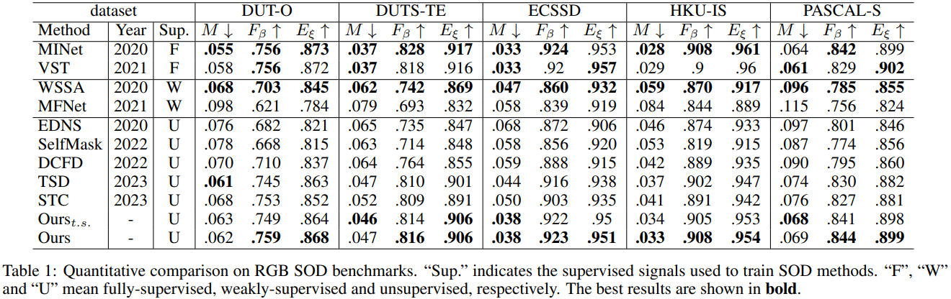
03
Experiments: Experimental Results
Quantitative Comparison:
Notes:
Due to time constraints, we won't go into details about the experimental part. If you're interested, we can discuss it further during the poster session later.
The following are the quantitative comparison results of our method on 5 SOD tasks.
Here, F refers to full supervision, W refers to weak supervision, and U refers to unsupervised
t.s. means task specific, indicating that only the dataset of the target task was used.
First is RGB SOD, followed by RGB-D and RGB-T, then video and Remote Sensing image

Slide 11
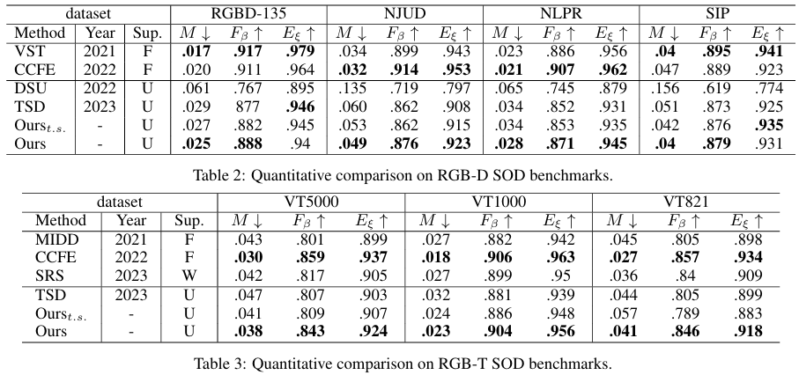
03
Experiments: Experimental Results
Quantitative Comparison:

Slide 12
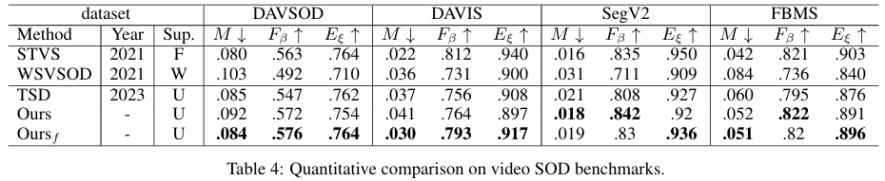
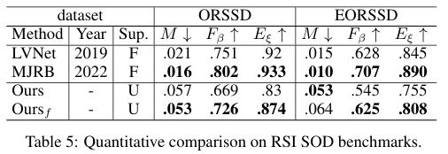
03
Experiments: Experimental Results
Quantitative Comparison:

Slide 13
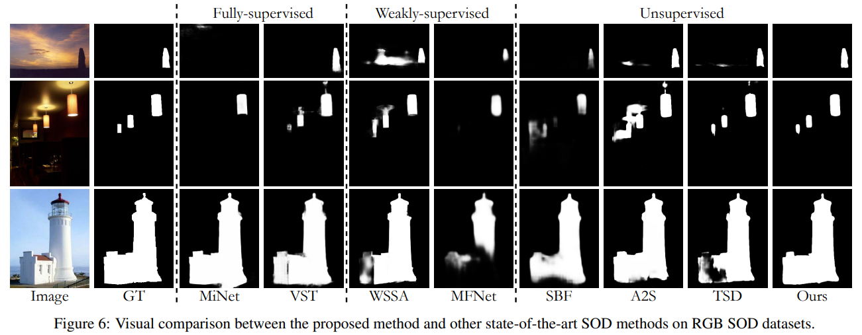
03
Experiments: Experimental Results
Qualitative Comparison:

Slide 14
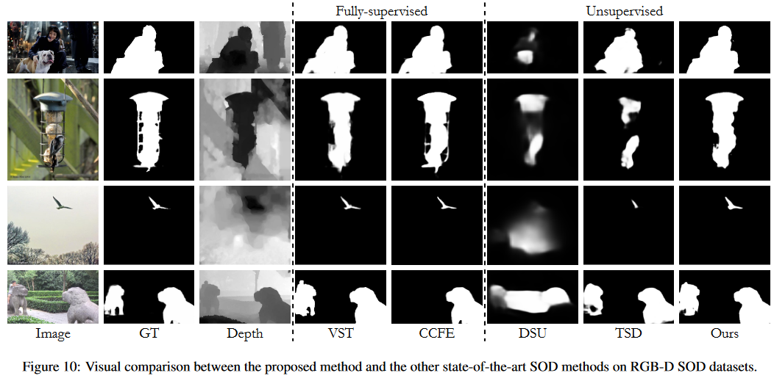
03
Experiments: Experimental Results
Qualitative Comparison:

Slide 15
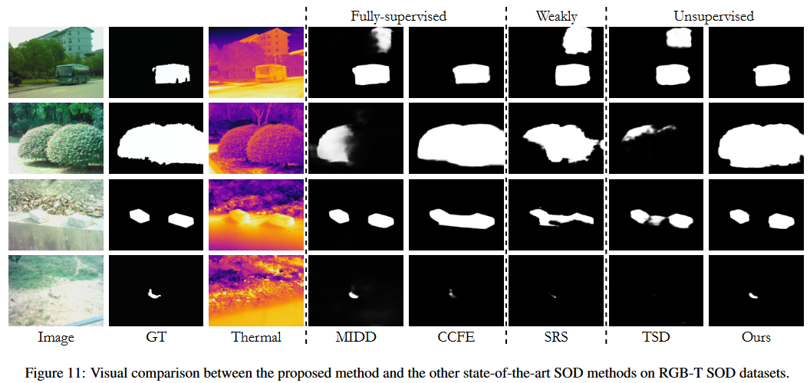
03
Experiments: Experimental Results
Qualitative Comparison:

Slide 16
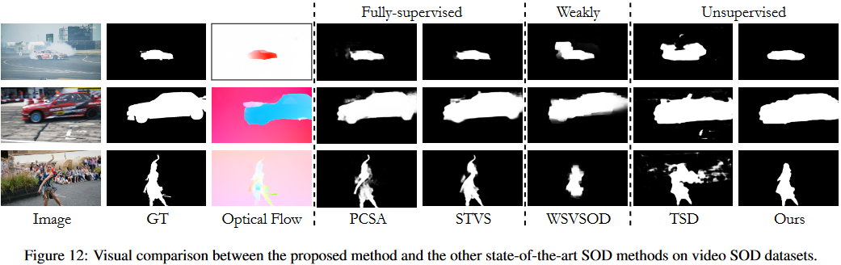
03
Experiments: Experimental Results
Qualitative Comparison:

Slide 17
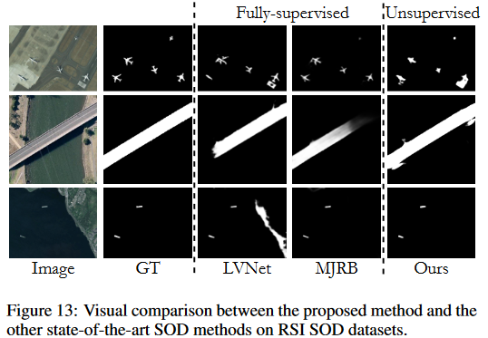
03
Experiments: Experimental Results
Qualitative Comparison:

Slide 18
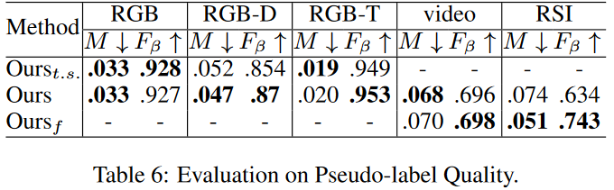
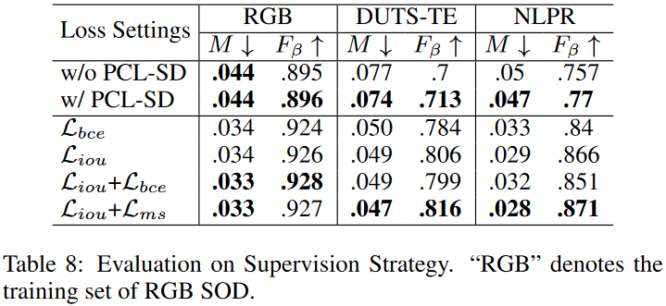
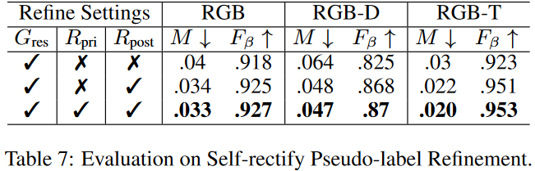
03
Experiments: Ablation Study
Notes:
This is tha ablation study of our proposed method.

Slide 19
04
Conclusion&Discussion
This paper proposes a two-stage unified unsupervised SOD framework for generic SOD tasks, with knowledge transfer as the foundation.
Merits:
More stable distilling of saliency cues.
Improved pseudo-label refinement.
Adapter-tuning driven knowledge transfer.
Limitations and Future works:
From Modality-Agnostic to Modality-Informed: During the training process, the model treats different modalities, such as depth, thermal, and optical flow, in a modality-agnostic manner, which may limit the model’s ability to exploit saliency information specific to each modality. Hence, transitioning from a modality-agnostic to a modality-informed approach is essential to facilitate better learning of shared saliency knowledge across different SOD tasks.
Deeper and More Targeted Migration: We treated both tasks as non-NSI SOD tasks without incorporating more targeted adaptation measures. For instance, in video SOD, we did not directly input video data into the model but treated each frame as a separate two-dimensional image. We plan to explore more tailored strategies specifically designed for these tasks.
Notes:
Hence, transitioning from a modality-agnostic to a modality-informed approach is essential to facilitate better learning of shared saliency knowledge across different SOD tasks.
We plan to explore more tailored strategies specifically designed for these tasks.

Slide 20
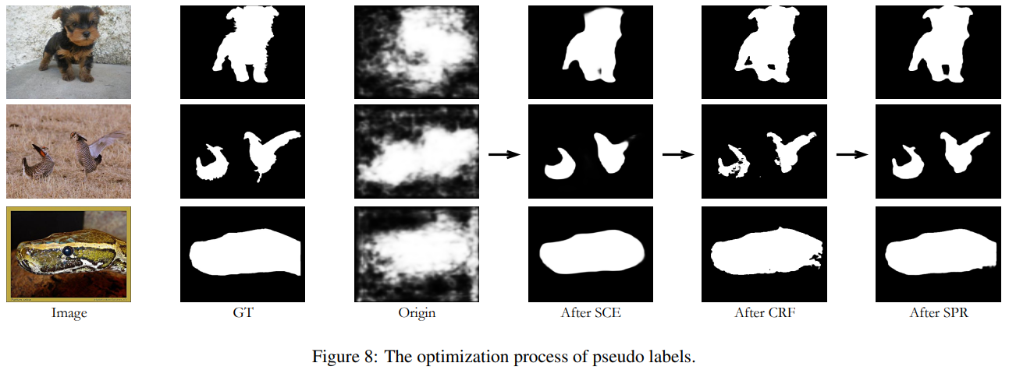
04
Conclusion&Discussion
This paper proposes an efficient learning-based geometry codec, dubbed Pointsoup, aiming at large-scale point cloud scenes.
Merits:
High Performance - SOTA efficiency on multiple large-scale benchmarks.
Low Decoding Latency - 90~160× faster than the conventional Trisoup decoder.
Robust Generalizability - Applicable to large-scale samples once trained on small objects.
High Flexibility - Variable-rate control with a single neural model.
Light Weight - Fairly small with 761k parameters (about 2.9MB).
Limitations:
Rate-distortion performance is inferior to G-PCC Octree codec at high bitrates (e.g., bpp>1). The surface approximation-based approaches (Pointsoup and Trisoup) seem hard to characterize accurate point positions even if given enough bitrate budget.
Naive outdoor LiDAR frame coding efficacy is unsatisfactory. Due to the used sampling&grouping strategy, the pointsoup is limited to point clouds with relatively uniform distributed points, such as S3DIS, ScanNet, dense point cloud map, 8iVFB (human body), Visionair (objects), etc.

Slide 21



Thank you for listening!
For more information, please check:
Github
WeChat
I2ML Website

