Slide 1
BlitzLogix
A product of cybercraft
Faiz-ul-hassan
Hamza bin Riaz
Faris Ali

Slide 2
about
Simplify logistics management for a large corporation
Seamlessly integrate various logistics roles
Automate tasks for greater operational efficiency
Fit into existing information technology infrastructure

Slide 3
Functional Requirements
Separate interfaces for various organizational roles
Allow parcel to be picked up from customer’s home
For effortless intra and inter city delivery
Allow for tracking of parcels
List various modern payment methods
Register and record feedback
Generate employee reports

Slide 4
Non-Functional Requirements
Provide fast performance
Easy to use interfaces
Handle large volume of users
Be secure from cyber threats
Be cross platform
Be robust by handling possible errors

Slide 5
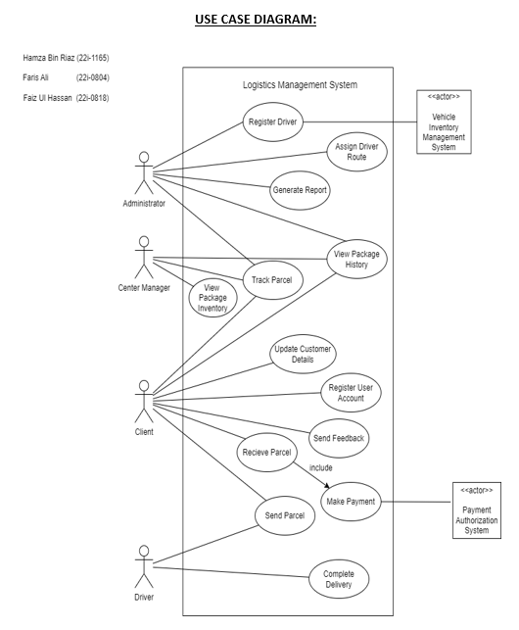
Use case diagram

Slide 6
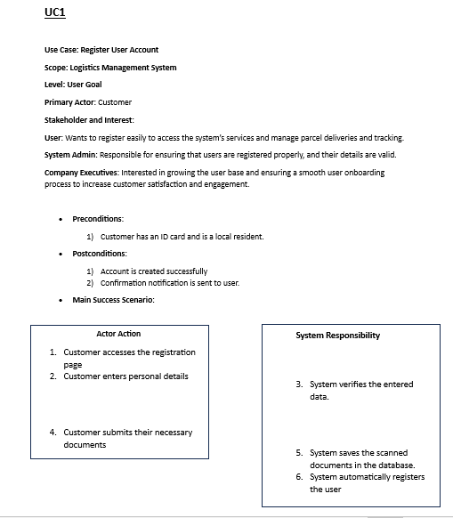
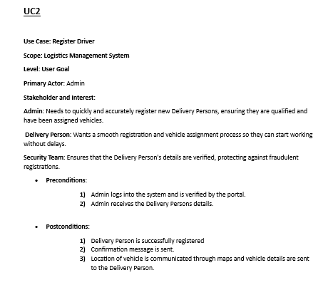

Slide 7
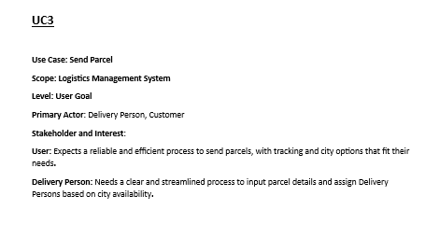
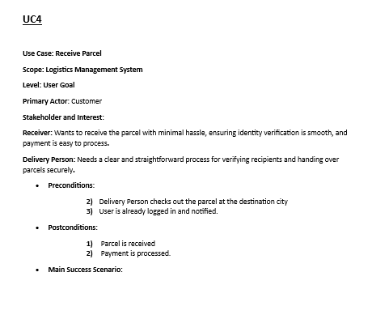

Slide 8
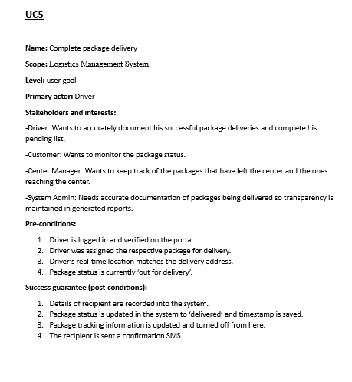
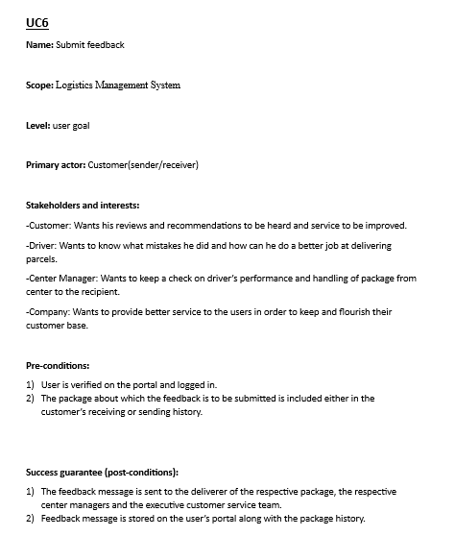

Slide 9
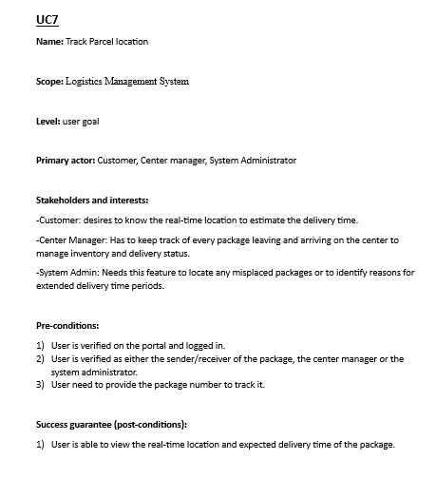
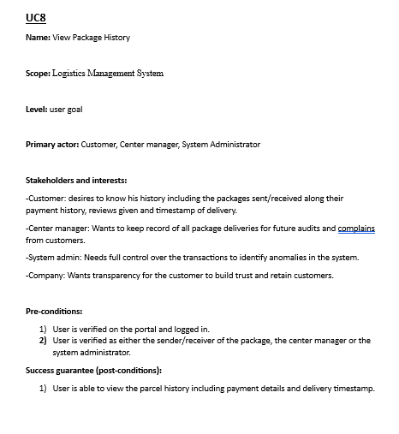

Slide 10
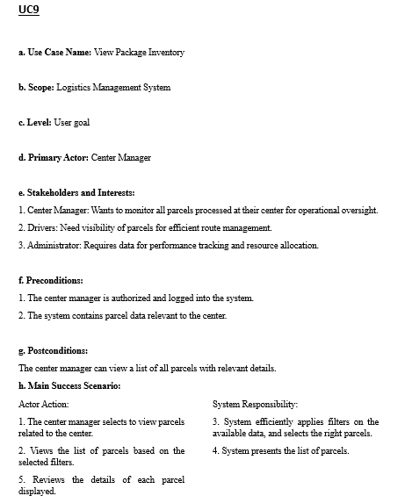
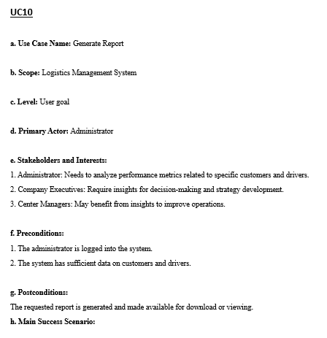

Slide 11
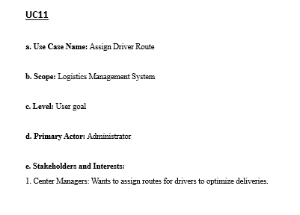
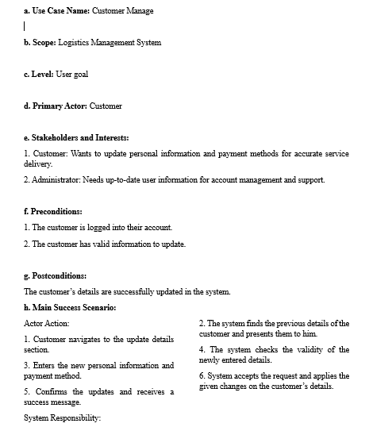

Slide 12
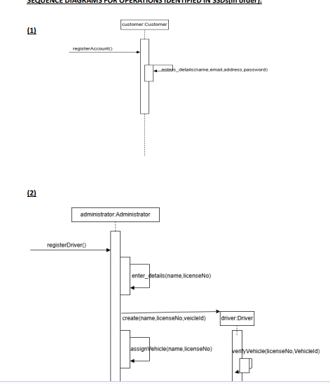
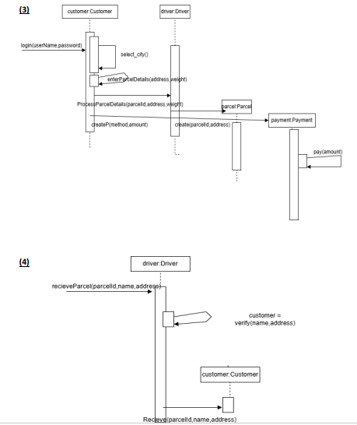

Slide 13
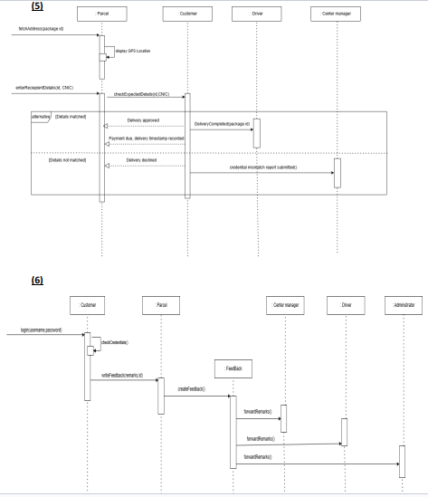
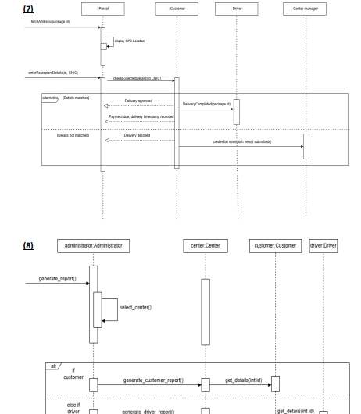

Slide 14
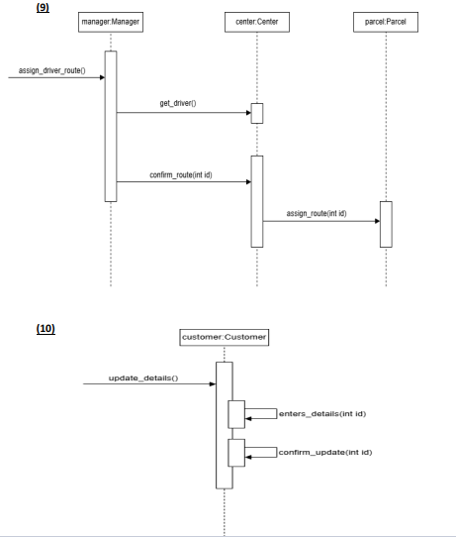

Slide 15
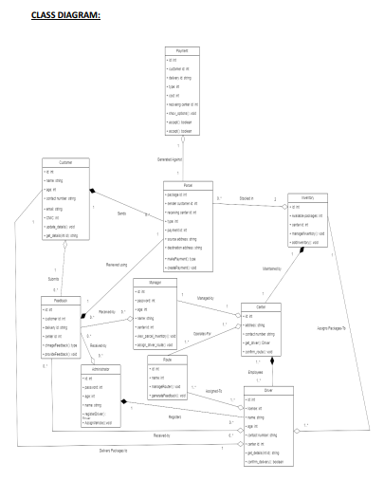

Slide 16
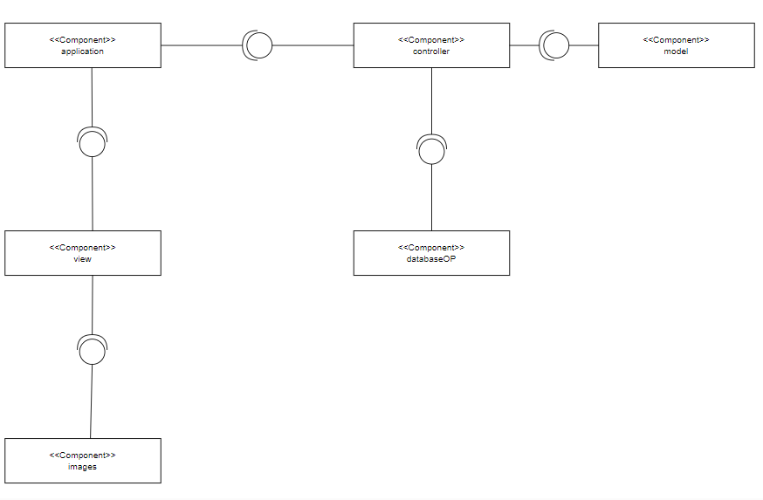

Slide 17
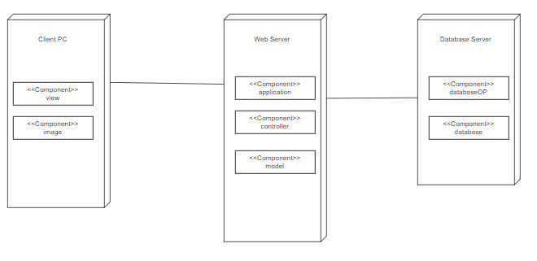

Slide 18
