Slide 1


I2D2 County-LEVEL INDICATORS
Notes:
Presented to MIECHV team on September 22, 2021, by Giorgi Chighladze

Slide 2

ECI State-wide indicators
Improving the quality of life for young children and their families in Iowa
Five desired results
16 state-wide indicators to determine progress toward achieving the result areas
Usually collected by public agencies
Source: ECI 2020 Annual Report Highlights. https://earlychildhood.iowa.gov/sites/default/files/documents/2021-01/ECI_AnnualReportHighlights2020_Final.pdf
Notes:
ECI provide state-wide indicators
ECI indicators are based on more than children’s status, and includes education, health and monetary variables as well as community

Slide 3
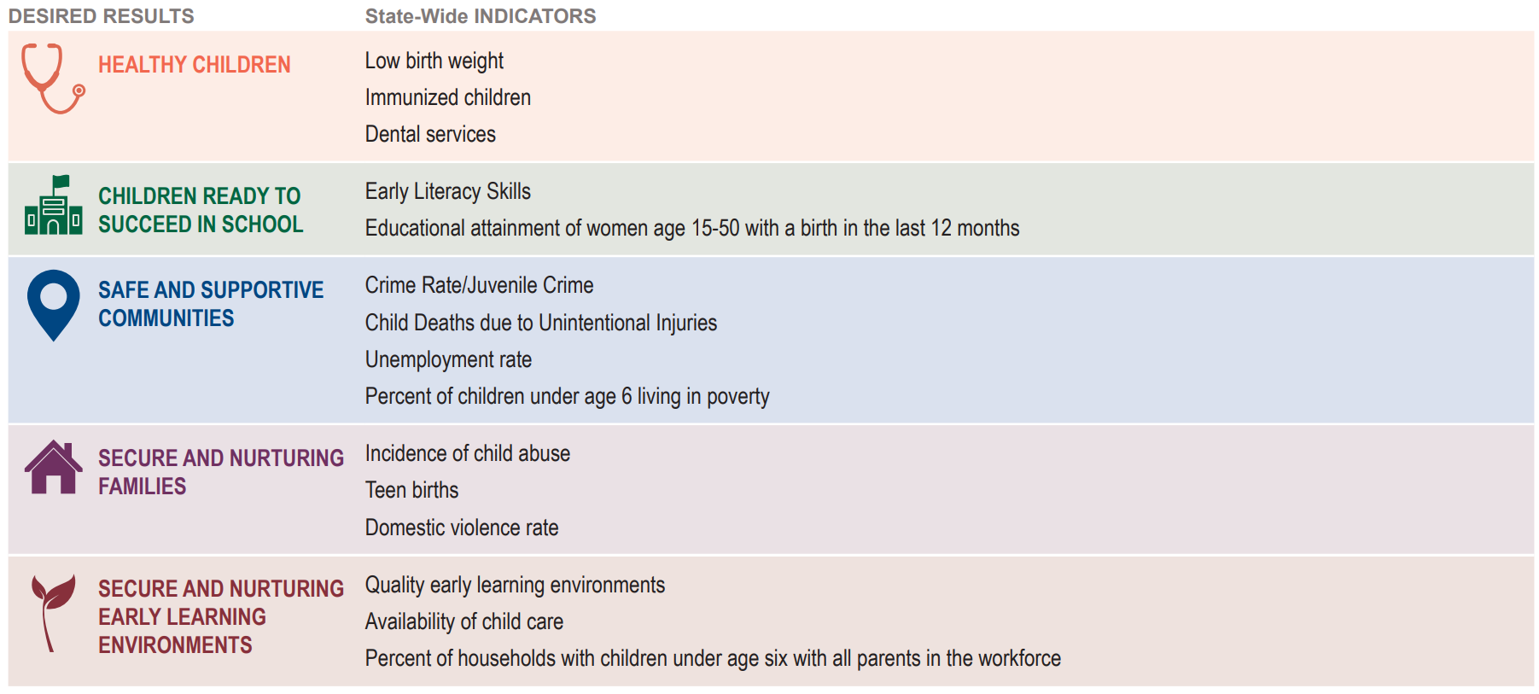





ECI State-wide indicators
MIECHV Benchmarks
Improved Maternal and Newborn Health
Improved School Readiness and Achievement
Reduced Crime or Domestic Violence
Reduced Child Injuries, Abuse, and Neglect
Improved Family Economic Self-sufficiency
Source: ECI Statewide Indicators FY20 Report. https://earlychildhood.iowa.gov/document/eci-2020-annual-report
Notes:
ECI indicators represent essential metrics for providing comprehensive picture of child wellbeing in Iowa
MIECHV asks contractors to establish and use benchmarks that demonstrate improvements in areas similar to ECI desired results
https://idph.iowa.gov/Portals/1/userfiles/80/IDPH%20MIECHV%20overview%20and%20map%202020.pdf
https://daiseyiowa.daiseysolutions.org/articles/miechv-benchmark-measures-at-a-glance/

Slide 4
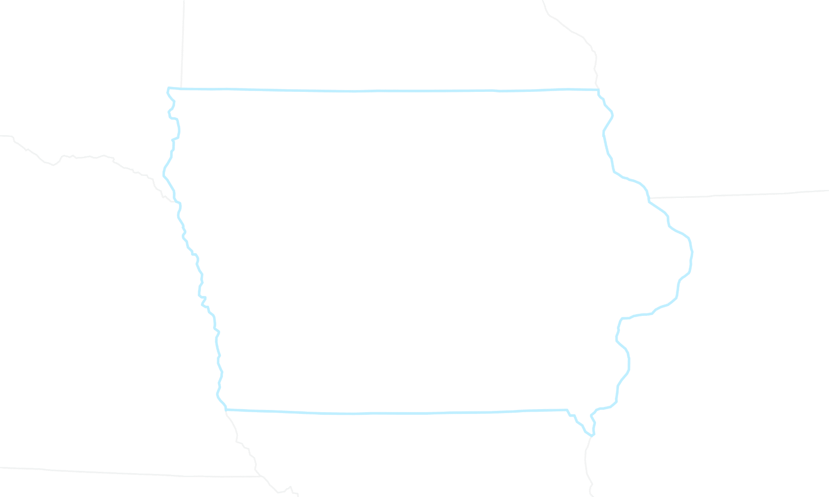
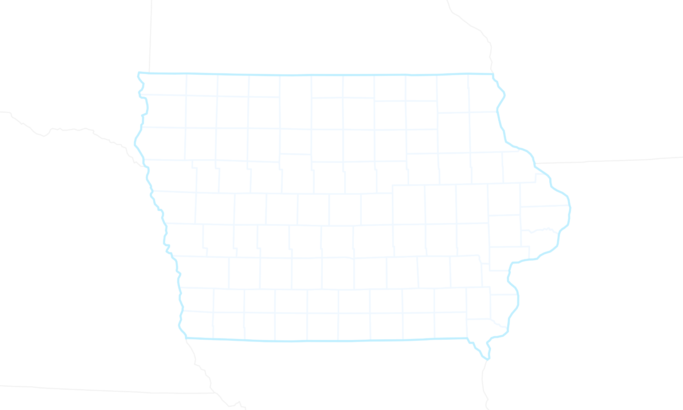
CHALLENGES with STATE-WIDE INDICATORS
State-wide indicators are valuable, but do not reflect county-specific challenges
Disaggregation of ECI indicators by county:
Will shed light on any inequities between counties and provide more comprehensive understanding of the factors limiting child wellbeing
Will enable stakeholders and decision-makers within a country to implement more accurately targeted intervention
Data are scattered across multiple agencies and platforms (in diverse formats) requiring intensive data processing
Notes:
Iowa is not uniform
Counties differ (demographics, economic, health, other)
Our goal is to get closer to individual communities and help them understand and address local problems
Local decision makers should be lead by relevant information

Slide 5
I2D2 Data Drive
Data Processing
Data hub that provides all relevant info in well structure and fully documented fashion to drive local decision-making
Collecting, synthesizing and updating datasets centrally, thus warranting high quality of the data
Empowering Interface
Providing interface to interact, visualize and retrieve compiled datasets for further use
Indicator Computation
Calculating indicators in a consistent manner to ensure uniformity across all counties
Notes:
New I2D2 tool

Slide 6
I2D2 Indicators
Total of 104 indicators
Includes all (16) ECI indicators
Encompasses 17 of 23 MIECHV indicators
Currently developing 21 indicators
Comprises 14 of ECI indicators
Overlaps with 10 of MIECHV indicators
6 Indicators Unique to MIECHV
3rd Trimester smoking
3rd Trimester alcohol use
Income inequality
Alcohol and drug-related crime
Opioid-related hospitalizations
Medicaid-reimbursed births
Notes:
Not all indicators are made equal
I2D2 indicators need to be distilled and refined

Slide 7
# | Indicator | Definition | ECI | MIECHV | MIECHV Names of Indicators
1 | Low Birth Weight | Percentage of babies born who weigh under 2,500 grams (5lbs. 9 oz.) | ✔ | ✔
2 | Immunized Children | Rate of children immunized in Iowa by age 2 | ✔
3 | Early Literacy Skills | Percent of kindergartners meeting the Fall benchmark for the early literacy universal screening measure | ✔
4 | Educational Attainment of Mothers | Percentage of women age 15-50 with a birth in the past 12 months by educational attainment (less than high school, high school graduation, some college, bachelor’s degree or higher) | ✔ | ✔
5 | Crime Rate | Rate of serious crime per 100,000 population | ✔ | ✔
6 | Juvenile Crime | Total juvenile arrests per 100,000 estimated juvenile population | ✔ | ✔
7 | Unemployment Rate | Percentage of unemployed persons | ✔ | ✔
8 | Children in Poverty | Percentage of children, under 6, who live in families with incomes below 100 percent of the U.S. poverty threshold. | ✔ | ✔
9 | Incidence of Child Abuse | Child Abuse Incidence Rate per 1,000 for children 5 years and under. | ✔ | ✔
10 | Domestic Violence Rate | Domestic abuse rate per 100,000 | ✔ | ✔
11 | Teen Births | Number and percentage of all births to mothers under age 20. | ✔ | ✔
12 | Working Parents | Percentage of children under 6 years with all parents in the labor force. | ✔
13 | Quality Early Learning Environments | Number of quality early learning environments that have achieved a QRS level 4-5. | ✔
14 | Availability of Child Care | Number of slots potentially available for a child in a licensed or registered setting. | ✔
15 | Children with No Dental Problems | Percentage of students in Kindergarten with no obvious dental problems
16 | Availability of Medicaid Doctors | Number of pediatricians that accept Medicaid for services
17 | Availability of Medicaid Dentists | Number of dentists that accept Medicaid for services.
18 | Children with Health Coverage | Number and percentage of minor children with health coverage by income and poverty level.
19 | Homelessness count | Sheltered and unsheltered point in time counts of homeless individuals.
20 | Poverty | Percentage of all people in poverty. |  | ✔
21 | Family Support Programs | Percentage of accredited family support programs.
Low Birth Weight
Maternal Education
Crime
Juvenile Crime
Unemployment
Child Poverty
Child Abuse and Neglect
Domestic Violence
Teen Births
Poverty
Notes:
- Covers 10 MIECHV indicators

Slide 8
# | Indicator | Definition | ECI | MIECHV | MIECHV Definition
1 | Low Birth Weight | Percentage of babies born who weigh under 2,500 grams (5lbs. 9 oz.) | ✔ | ✔ | Percentage of live births weighing at less than 5.5 pounds at the time of birth
2 | Immunized Children | Rate of children immunized in Iowa by age 2 | ✔
3 | Early Literacy Skills | Percent of kindergartners meeting the Fall benchmark for the early literacy universal screening measure | ✔
4 | Educational Attainment of Mothers | Percentage of women age 15-50 with a birth in the past 12 months by educational attainment (less than high school, high school graduation, some college, bachelor’s degree or higher) | ✔ | ✔ | Percentage of mothers who gave birth who have a high school education
5 | Crime Rate | Rate of serious crime per 100,000 population | ✔ | ✔ | Crime rate per 1,000 people
6 | Juvenile Crime | Total juvenile arrests per 100,000 estimated juvenile population | ✔ | ✔ | Juvenile arrest rate per 1,000 juveniles
7 | Unemployment Rate | Percentage of unemployed persons | ✔ | ✔ | Percentage of labor force population who are unemployed
8 | Children in Poverty | Percentage of children, under 6, who live in families with incomes below 100 percent of the U.S. poverty threshold. | ✔ | ✔ | Percentage of population under 18 who live in poverty
9 | Incidence of Child Abuse | Child Abuse Incidence Rate per 1,000 for children 5 years and under. | ✔ | ✔ | Rate of children age 0-17 who are confirmed to have been abused or neglected during the year per 1,000 children
10 | Domestic Violence Rate | Domestic abuse rate per 100,000 | ✔ | ✔ | Domestic abuse rate per 100,000 people
11 | Teen Births | Number and percentage of all births to mothers under age 20. | ✔ | ✔ | Number of births per 1,000 female population ages 15-19
12 | Working Parents | Percentage of children under 6 years with all parents in the labor force. | ✔
13 | Quality Early Learning Environments | Number of quality early learning environments that have achieved a QRS level 4-5. | ✔
14 | Availability of Child Care | Number of slots potentially available for a child in a licensed or registered setting. | ✔
15 | Children with No Dental Problems | Percentage of students in Kindergarten with no obvious dental problems
16 | Availability of Medicaid Doctors | Number of pediatricians that accept Medicaid for services
17 | Availability of Medicaid Dentists | Number of dentists that accept Medicaid for services.
18 | Children with Health Coverage | Number and percentage of minor children with health coverage by income and poverty level.
19 | Homelessness count | Sheltered and unsheltered point in time counts of homeless individuals.
20 | Poverty | Percentage of all people in poverty. |  | ✔ | Percentage of population for all ages who live in poverty
21 | Family Support Programs | Percentage of accredited family support programs.
Notes:
Metrics used for indicators are sometimes different
Some differences should not effect the ranking of counties used for risk calculations by MIECHV

Slide 9
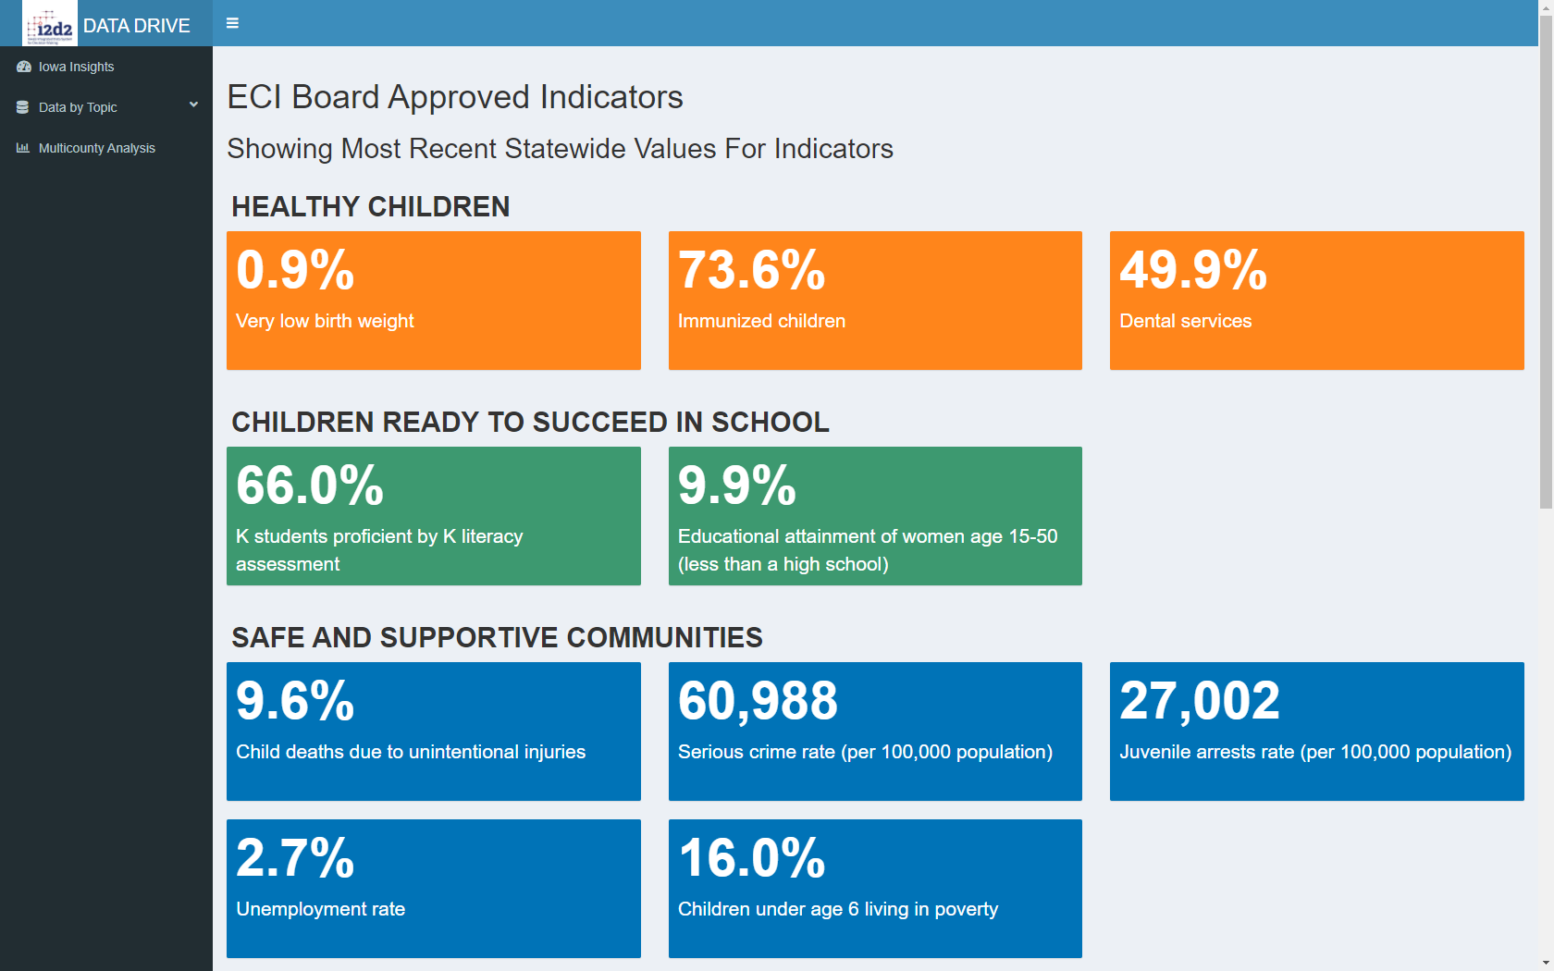
I2D2 Data Drive

Slide 10
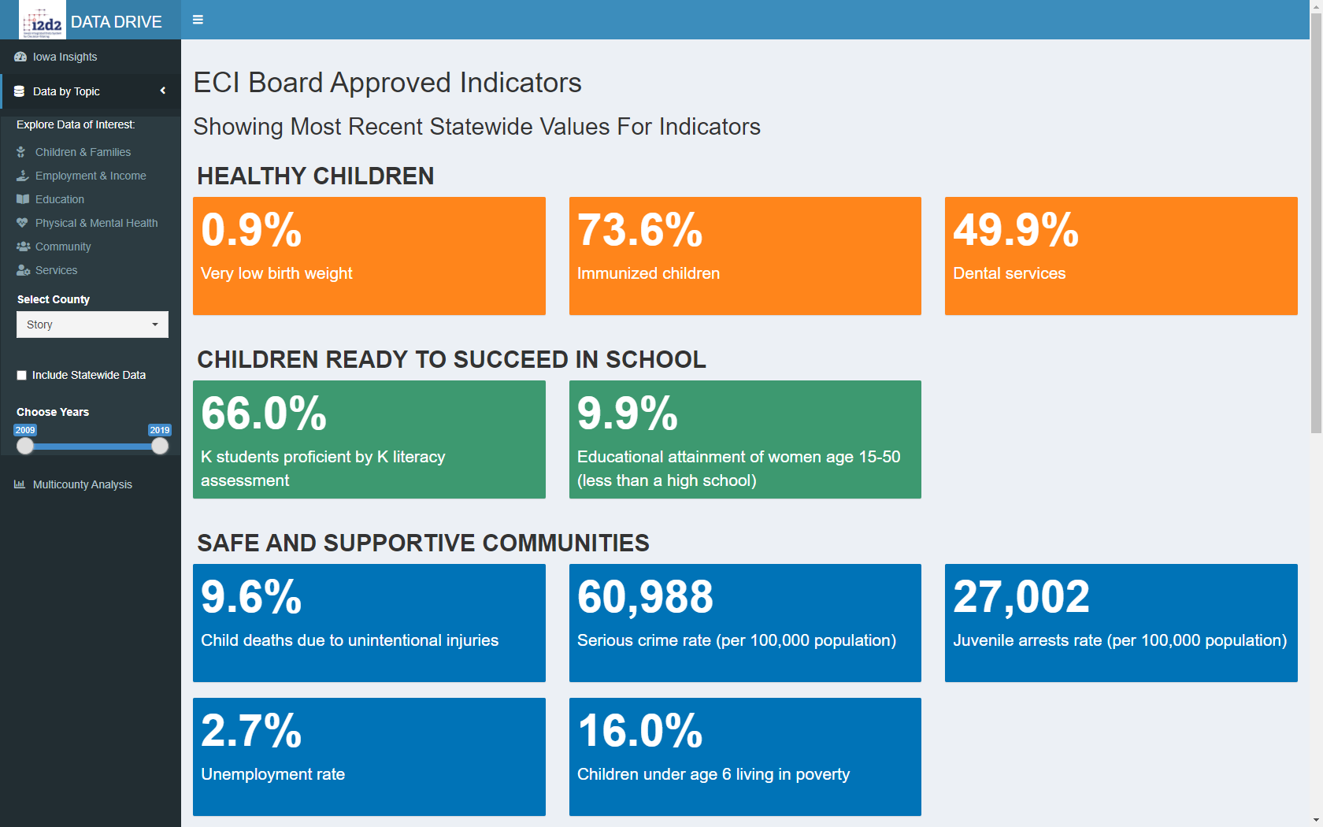
I2D2 Data Drive

Slide 11
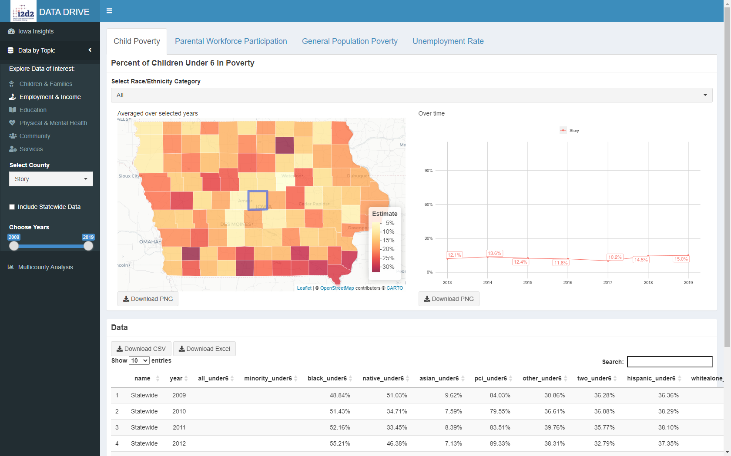
I2D2 Data Drive

Slide 12
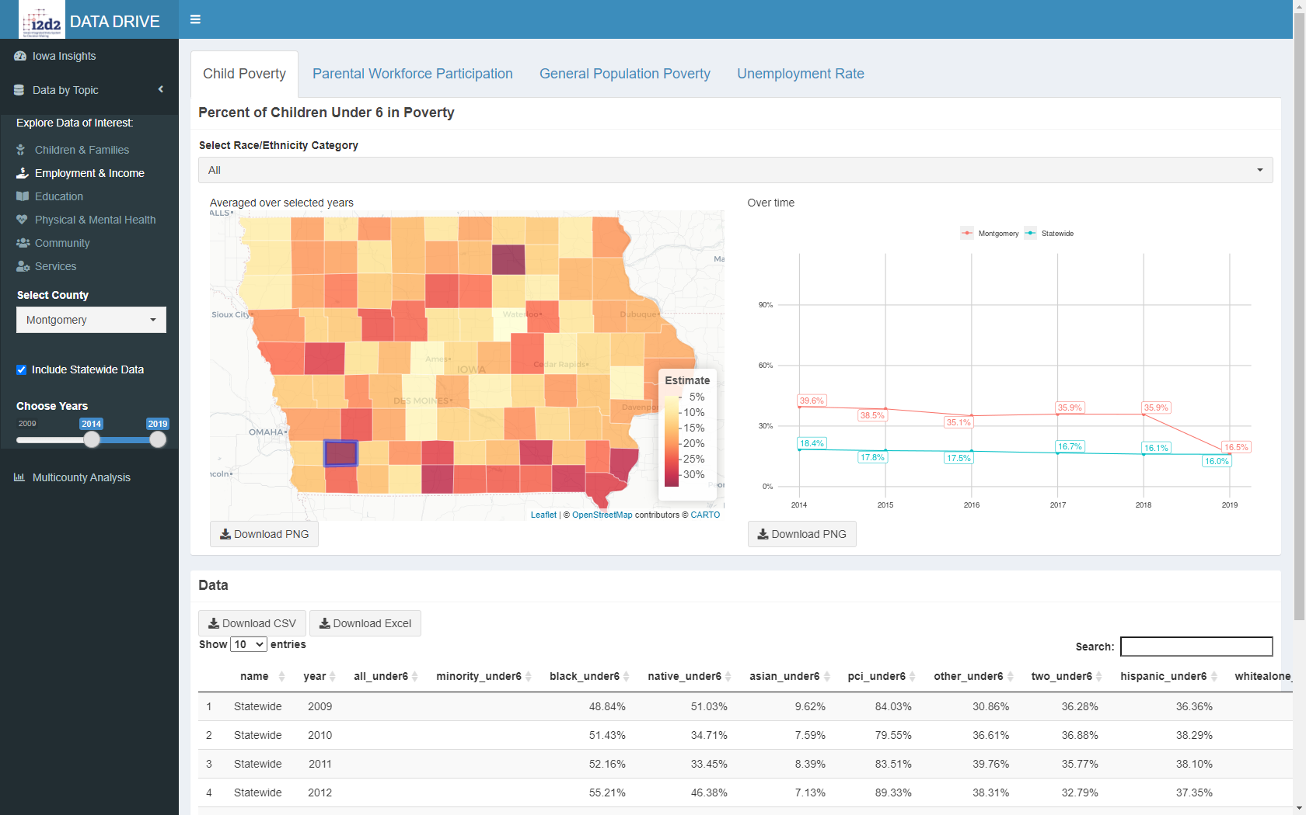
I2D2 Data Drive
Indicator-specific selectors
Selections apply to all indicators across all categories and tabs

Slide 13
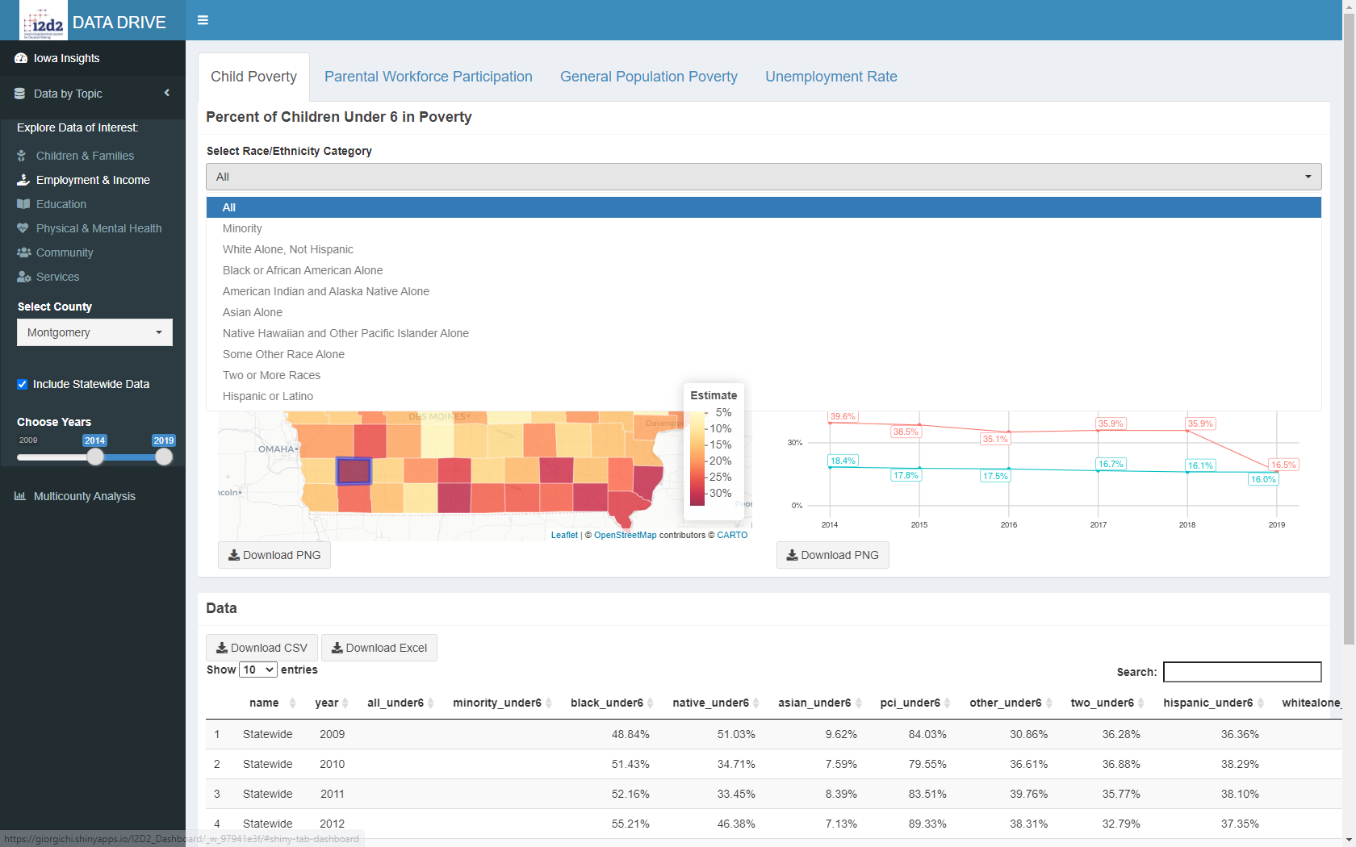
I2D2 Data Drive

Slide 14
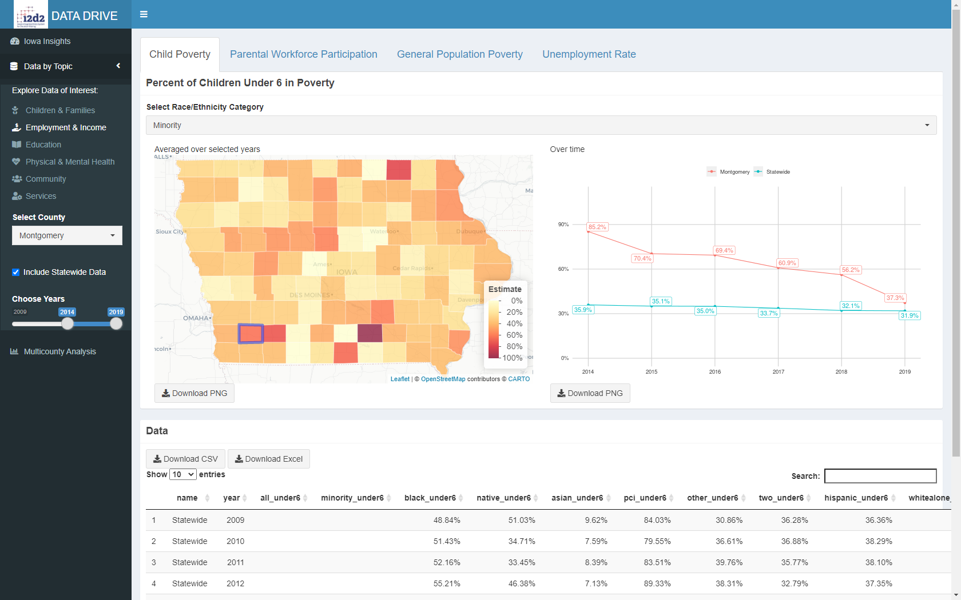
I2D2 Data Drive

Slide 15
CONCLUSIONS
I2D2 Data Drive contextualizes the ECI framework to reflect the multi-faceted nature of child wellbeing in Iowa
Shifting from state- to county-level indicators will allow in-depth understanding of child wellbeing at more relevant geographic scale
Quantifying quality of life for children and their families at county level will give more comprehensive and high-resolution picture of challenges and opportunities in Iowa counties and enable targeted intervention by identifying services needed
Notes:
Holistic nature of the collecting data will help to reveal the interplay of factors that underlie changes in child quality on more relevant geographical scale
Calculate and incorporate in I2D2 Data Drive new indicators
Get sub-county level data

