Slide 1
15
14
13
gap
12
reinjection point
11
10
9
missed approaching aircraft
8
7
6
5
4
3

Slide 2
gap
reinjection point
15
14
13
missed approaching aircraft
5
gap
12
11
10
9
8

Slide 3
6
4
4
7
8
10
12
13
9
11
6
miss approach
point
reinjection
point

Slide 4
15
14
13
12
11
gap
10
reinjection point
9
8
missed approaching aircraft
7
6
5
4

Slide 5
15
14
13
12
reinjection point
11
5
missed approaching aircraft
gap
10
9
8

Slide 6
4
6
4
6
4
6
10
11
7
9
8
miss approach
point
reinjection
point

Slide 11
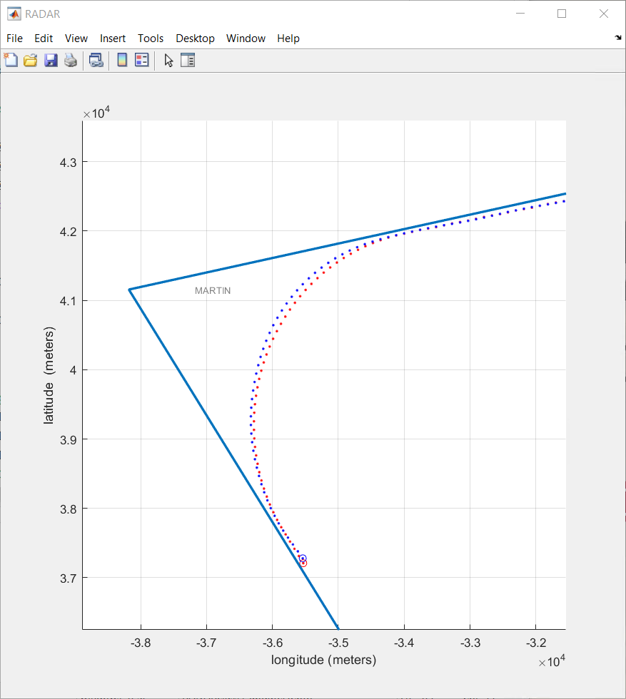
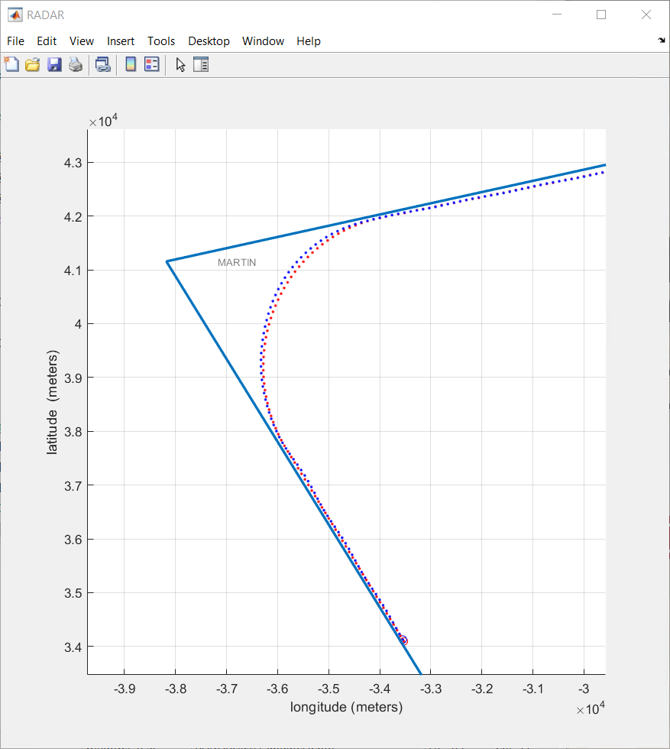

Slide 12
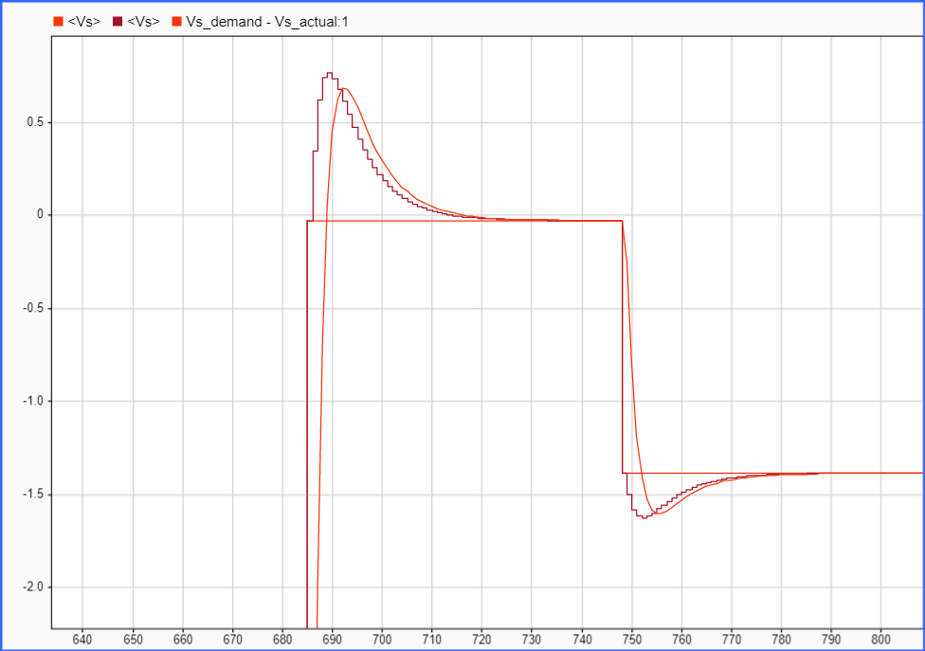
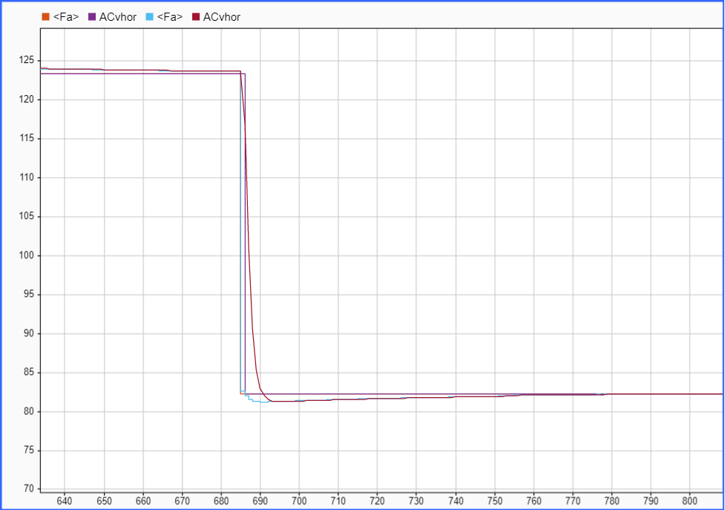
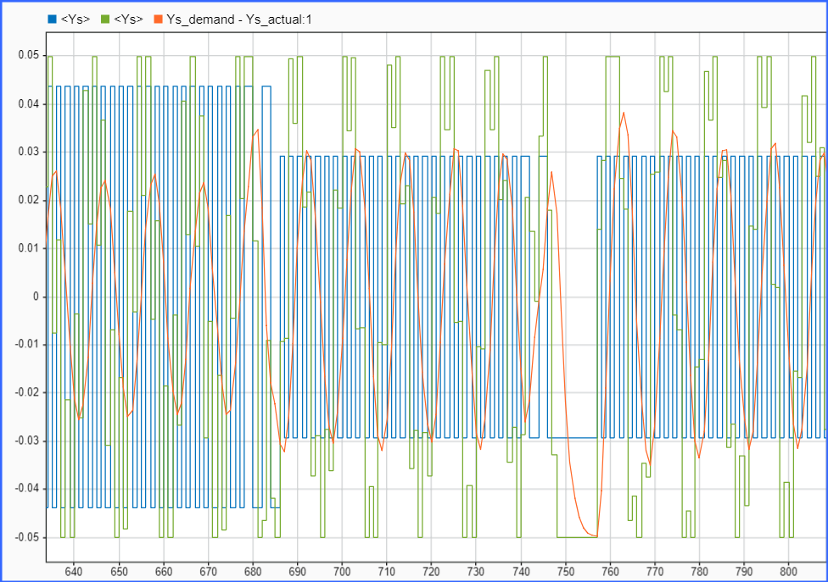
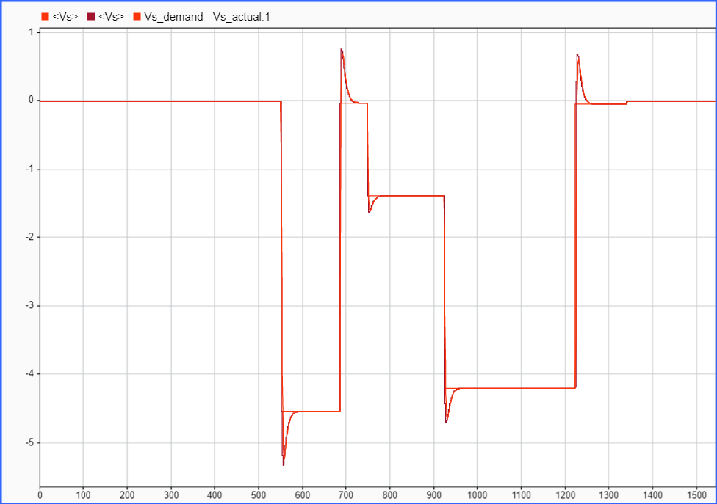
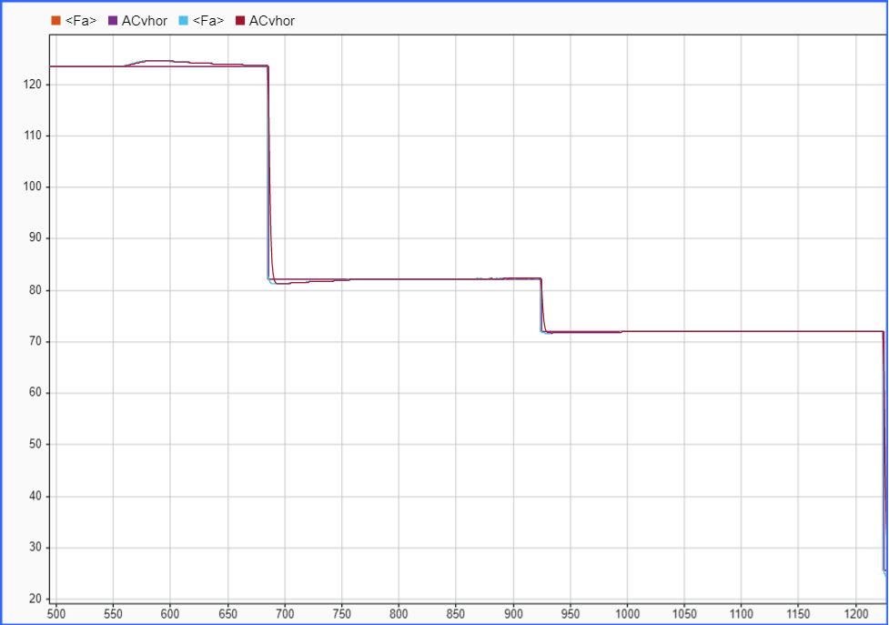
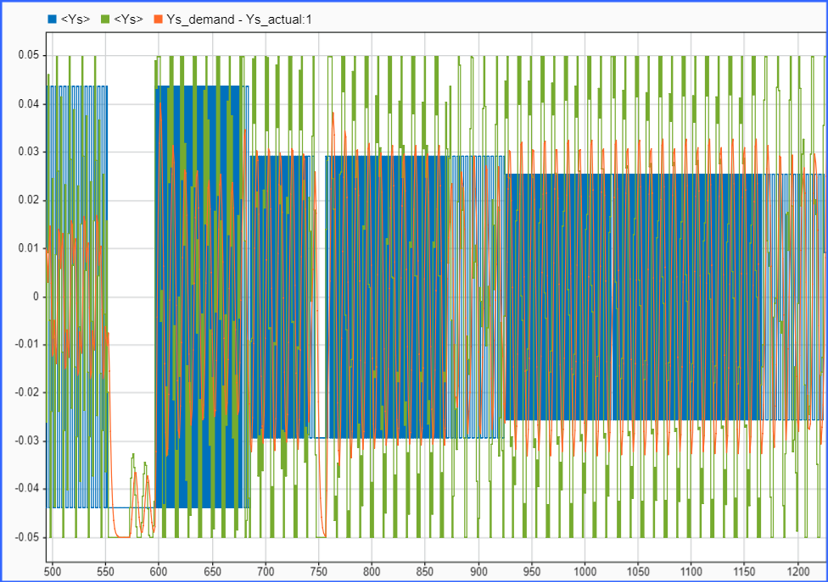
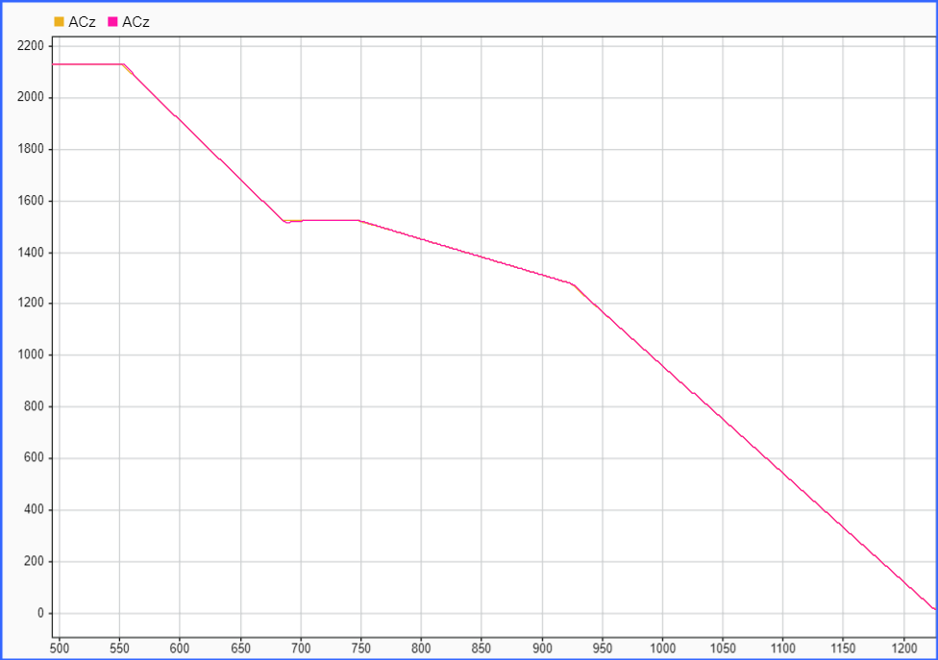
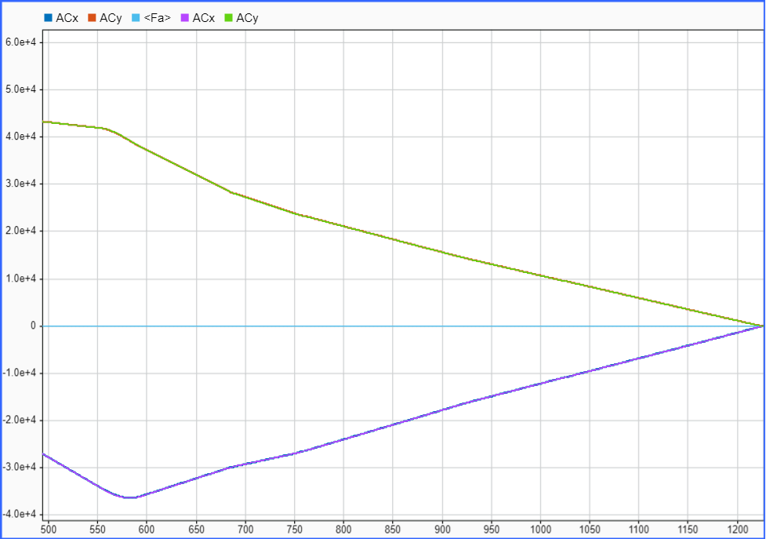
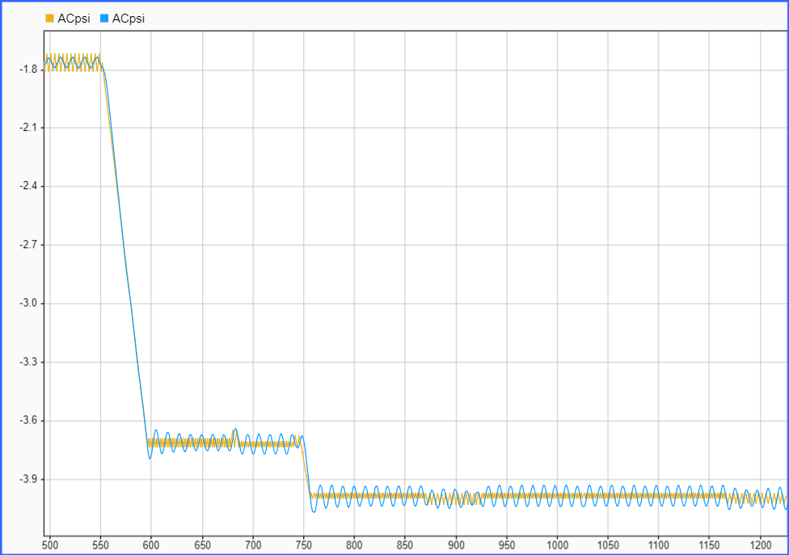
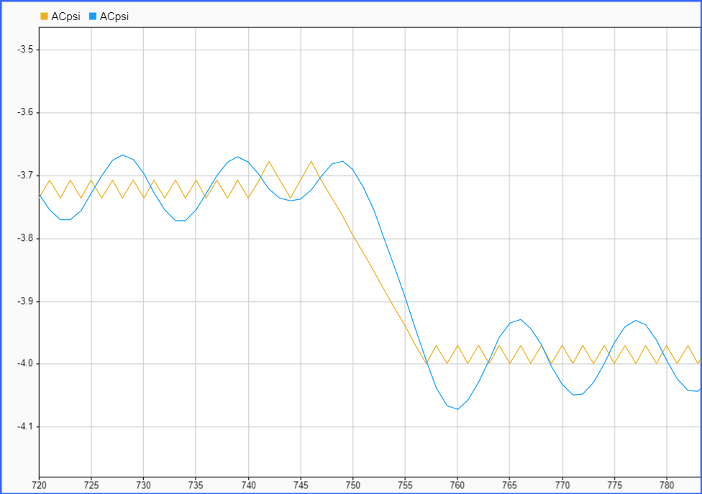
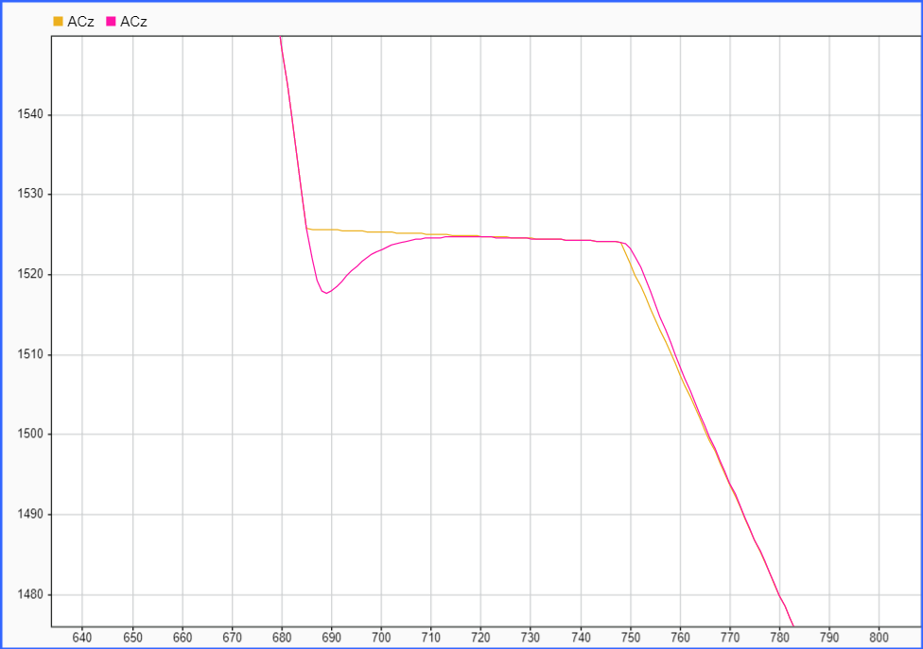
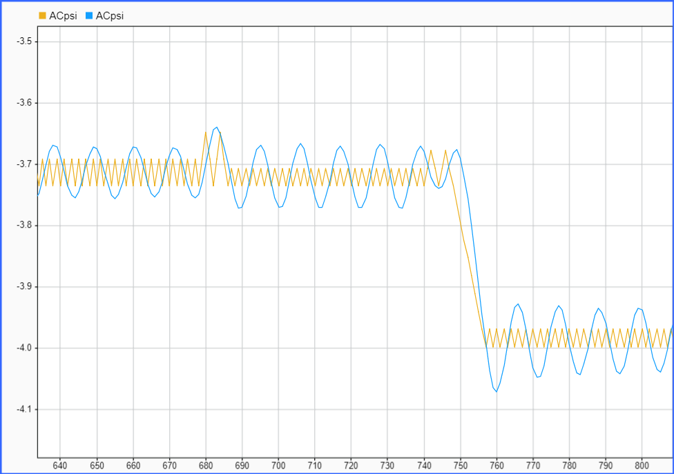

Slide 14
4
6
4
6
4
6
4
6
8
9
10
7

