Slide 1
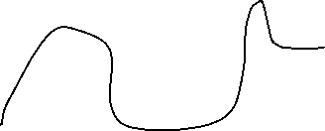
T
T
T
POS
VEL
ACEL
FO
JERK
SNAP
CRCL
T
POS
VEL
INSERTAR

