Slide 1
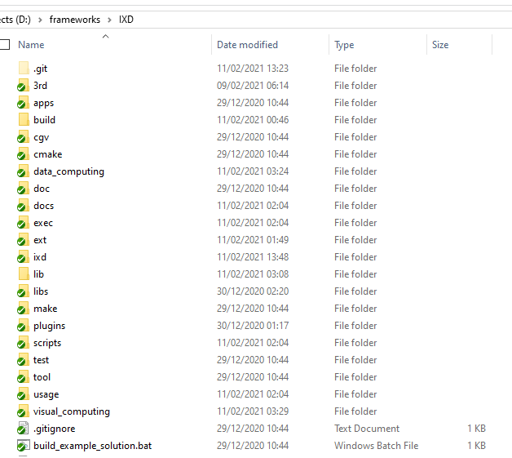
Managed to libraries
Quick test

