Slide 1
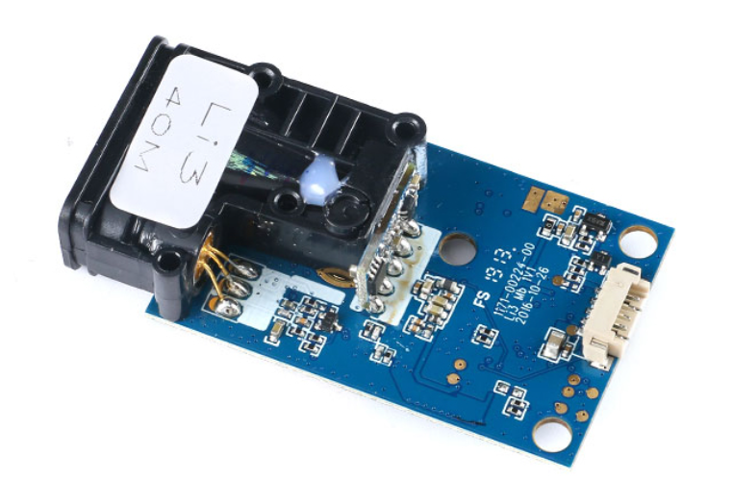
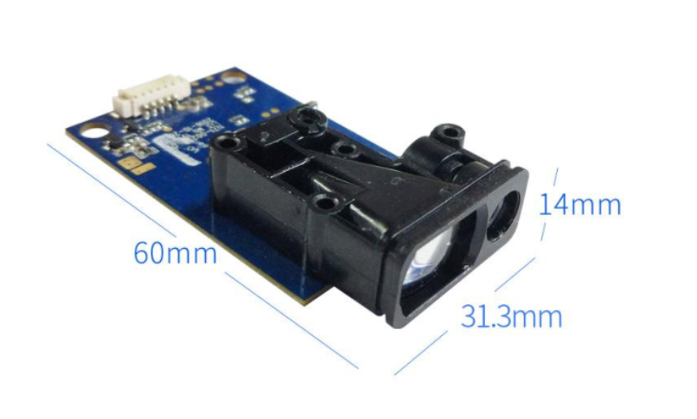
1. Youxin Electronics TW10S-UART

Slide 2
1. Youxin Electronics TW10S-UART
Baud rate : (4800, 9600, 19200, 38400, 57600, 115200) optional, default 38400.
Power supply voltage: 3.3V
Working Current: <180mA
Measuring frequency: up to 5 Hz
Accuracy：± 2mm + 5e(-5)D, D measuring distance
Working temperature:-10 to 50 ℃

Slide 3
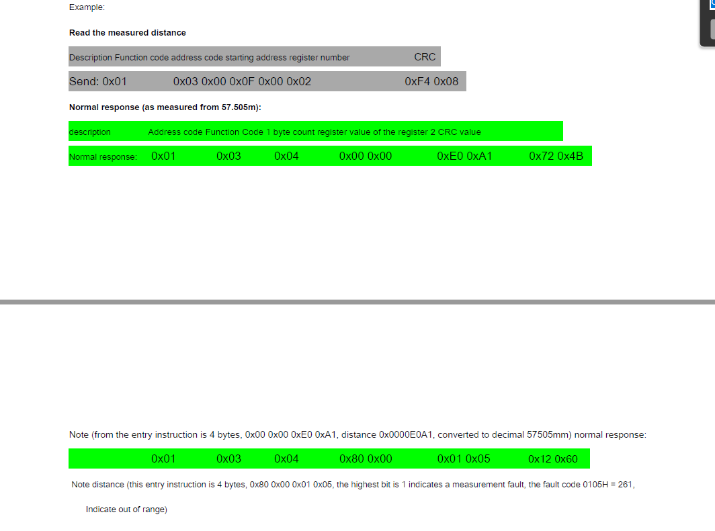
1. Youxin Electronics : TW10S-UART

Slide 4
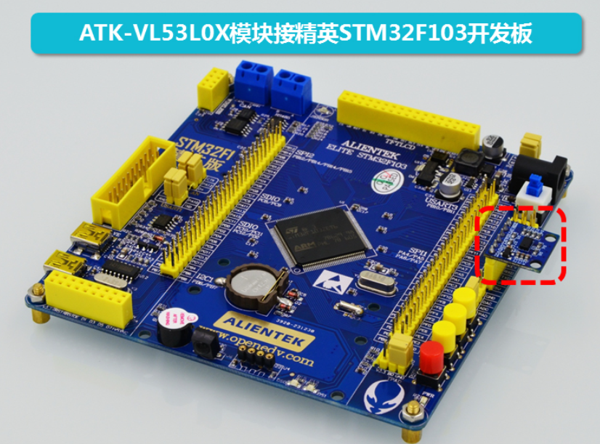
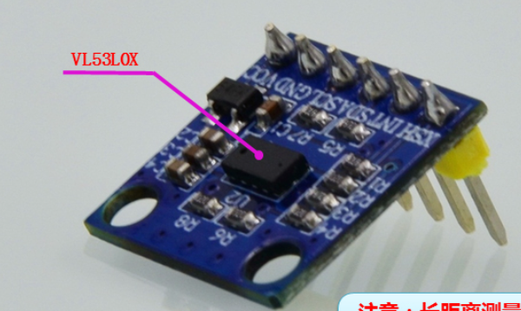
2. Risym ATK-VL53L0X

Slide 5
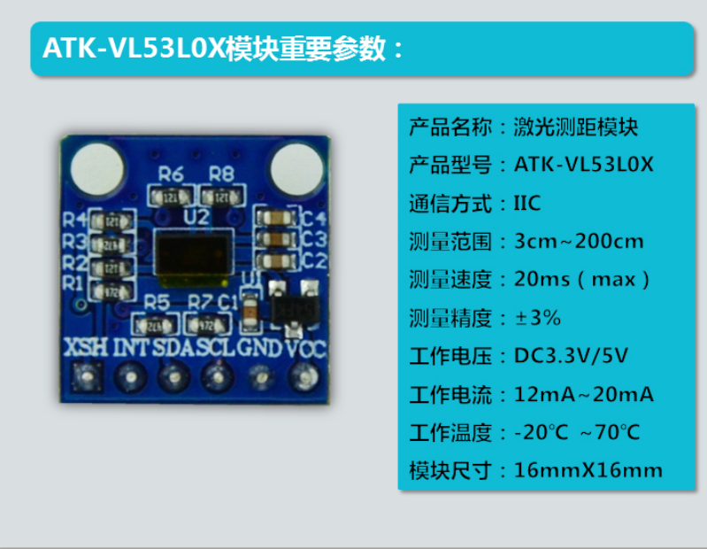
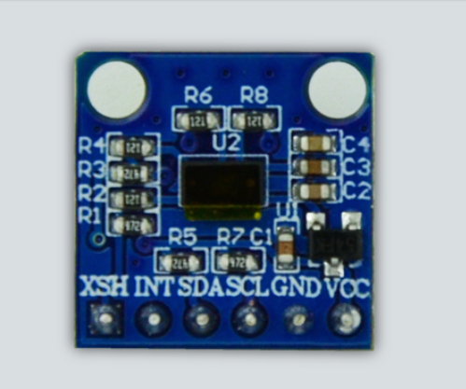
2. Risym ATK-VL53L0X

Slide 6
2.Risym ATK-VL53L0X

Slide 7
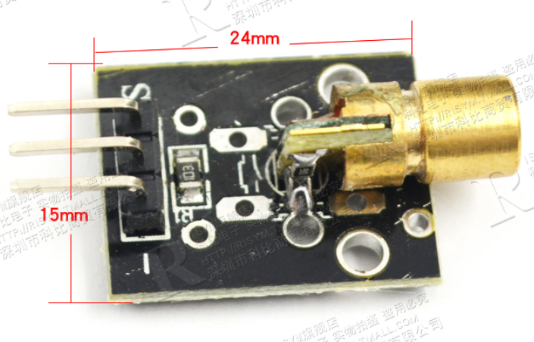
3. Risym 008
Power supply voltage: 5V
Laser wavelength: 650 nm

Slide 8
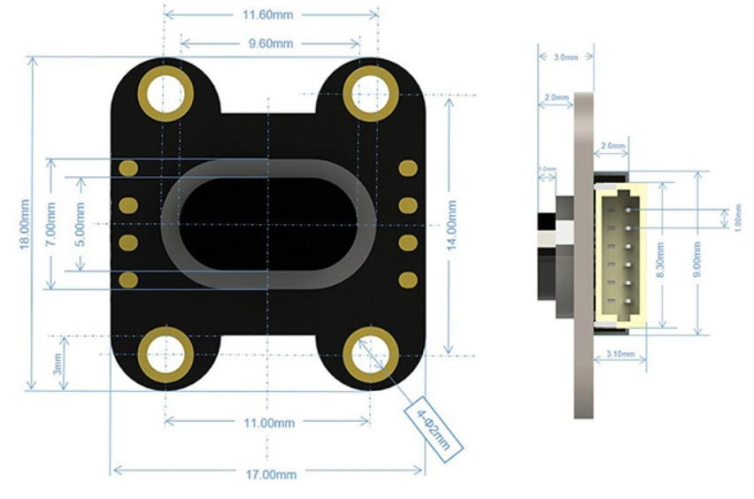
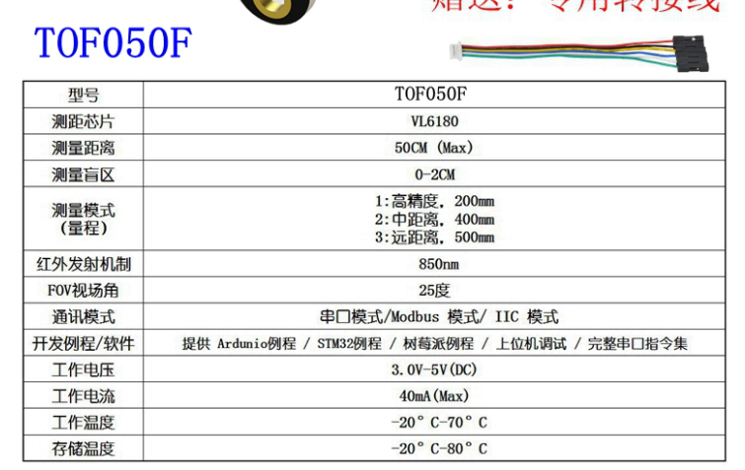
4. Meowbit -TOF050F-VL6180

