Slide 1

Reusing ARC service: the Italian experience
Lisbon, 27 and 28 April 2021
I3S ESSnet final workshop
Francesco Amato, Mauro Bruno, Eleonora Ciocca, Giuseppina Ruocco, Simona Spirito
Istat | DIRECTORATE FOR METHODOLOGY AND STATISTICAL PROCESS DESIGN, DATA COLLECTION DIRECTORATE

Slide 2
Outline
Context overview
AS-IS architecture
TO-BE architecture
Business case
Main results
Conclusions

Slide 3
Context overview
In Istat, Administrative Data (AD) is acquired and treated according to the following steps:
Annual planning of data supplies
Metadata update process and formalization of requests to data providers through ARCAM, a portal for AD acquisition
Data transmission and monitoring of data supplies
Standardized data loading in the System of Integrated Microdata (SIM)
Technical checks
Release of data to final users and archiving
Currently, the technical checks are carried out by SIM only for administrative sources with personal data. Therefore, the purpose of ARC reuse is to perform consistency checks for AD sources without personal data

Slide 4
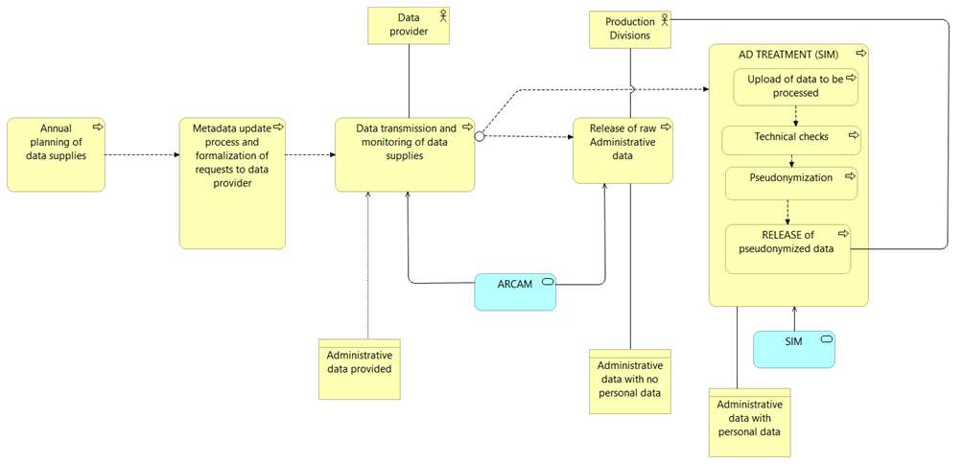
AS-IS architecture
The As-Is architecture is currently based on two main systems:
ARCAM for acquiring all type of AD sources and release of AD without personal data
SIM for checking and releasing AD with personal data
AS-IS

Slide 5
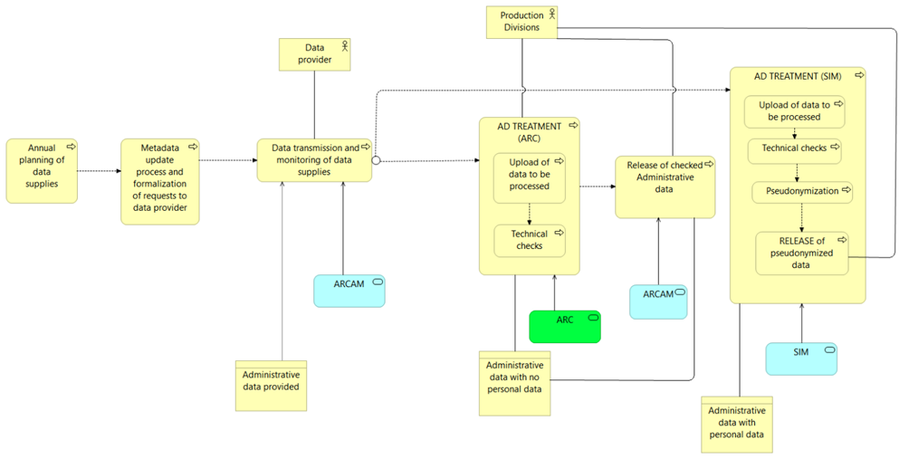
TO-BE architecture
In the proposed TO-BE architecture, AD without personal data could be managed by ARC application, to run the same type of technical checks performed in SIM for AD with personal data
TO-BE

Slide 6
Business case
In order to test ARC functionalities, an AD source validated by SIM was chosen, followed by:
Selection of a subset of variables
Set up of ARC data model and control rules
Comparative analysis between ARC output and SIM technical checks
The technical checks to be set in ARC are:
Benchmark of the dataset structure against the expected record layout
Number of uploaded records
For each variable, percentage of values on the total of records
For each classification variable, frequency distribution of its modalities (excluding missing values)
Analysis of results in time series, to evaluate data quality over time

Slide 7
Main results
Full compliance of ARC output with data checks performed in the current application
To run the technical checks for the specific use case, new functionalities have been developed
Currently, the additional functionalities allow to run 3 out of 5 checks listed
Status of new functionalities to implement
Check | New ad hoc functionalities | Activity status
Number of records in the file acquired | Not required | Already existing in the application
For each variable, percentage of non-missing values on the total of records | Yes | Implemented
For each classification variable, frequency distribution of its modalities, excluding missing values | Yes | Implemented
Verify that the table acquired respects the established record layout | Yes | To be analyzed and enhanced in the GUI
Display the results of technical checks in time series | Yes | To be analyzed and implemented

Slide 8
Conclusions
The reuse experience has highlighted potential enhancements, resulting both from the process revision and the reuse of ARC to support data acquisition and management
Further analysis is needed to assess the impact of ARC reuse on the production chain
Additional tests must be carried out involving statistical colleagues and using several sources, to evaluate ARC usability from the users perspective

Slide 9
Thank you

