Slide 1

Implementing shareable statistical services from existing components: Relais statistical service
Lisbon, 27 and 28 April 2021
I3S ESSnet final workshop
Francesco Amato, Mauro Bruno, Giuseppina Ruocco, Laura Tosco, Luca Valentino
Istat | DIRECTORATE FOR METHODOLOGY AND STATISTICAL PROCESS DESIGN

Slide 2
Outline
Relais overview
Main implementation activities
Official statistical standards
Target architecture
Relais at a glance

Slide 3
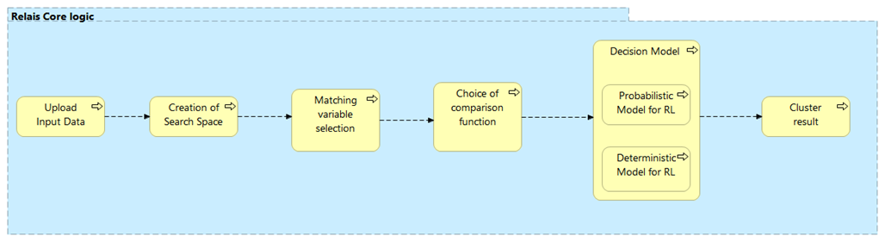
Relais overview
Relais (Record Linkag At IStat) is a software designed as an integrated environment to solve record linkage problems. The record linkage process is structured in sub-phases that can be combined to achieve the best process for the data being processed. Relais allows to execute two different record linkage approaches. The deterministic and probabilistic ones. The first version of Relais dates back to 2007
Relais business layer
https://www.istat.it/en/methods-and-tools/methods-and-it-tools/process/processing-tools/relais

Slide 4
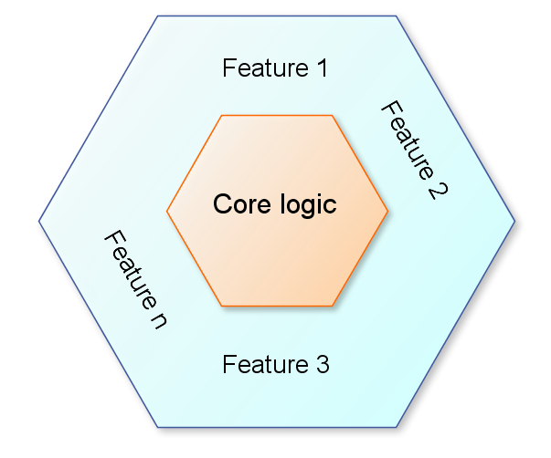
Main implementation activities
Analysis of available version of the software, based on a monolithic architecture difficult to install in modern IT environments (e.g. containers, cloud architecture, rest apis). The core logic in Relais is implemented in R and Java. The toolkit was designed as a software running on desktop computer
Design of a target architecture according to official statistics standard to connect each step of Relais to a re-designed software component
The software was already structured in a well-organized pipeline, so the reengineering activities have started from the core logic, mainly the deterministic and probabilistic approach
Development of an environment to test and execute statistical services: IS² Workbench
Shareable Service

Slide 5
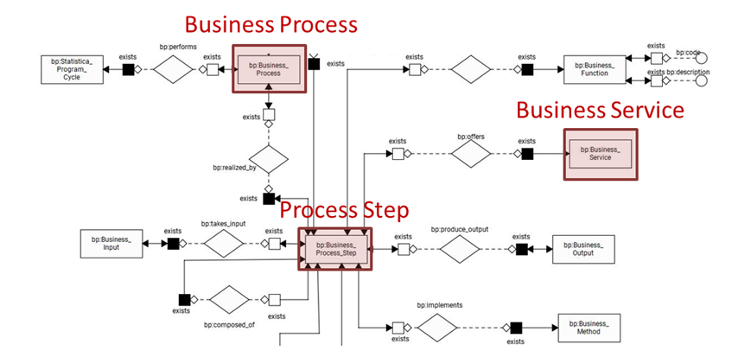
Official statistical standards
Analysis of core logic and additional features according to CSPA 2.0 Baseline features:
Documentation
Internationalization
Open source
Containerization
Metadata model based on the following GSIM concepts: Business Function, Business process, Process step, Process Input/Output, Rule, Method, Data Set, Variable
GSIM concepts used for metadata modelling

Slide 6
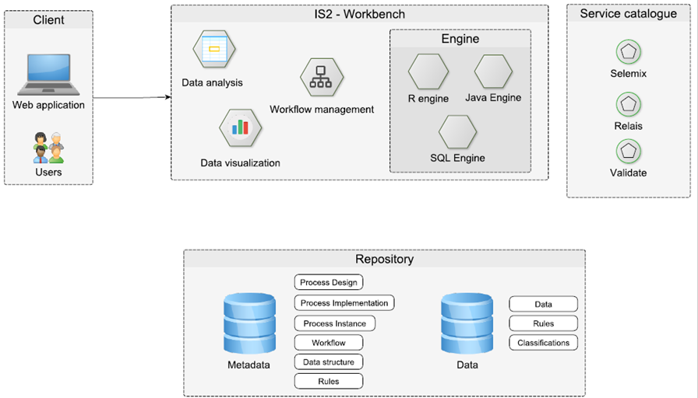
Target architecture (1)
Relais has been rengineered according to a generalized architecture (Istat Statistical Service - IS²) that allows users to select statistical services in a catalogue and execute them through a web application (IS² Workbench)
The IS² Workbench allows to visualize and analyze input and output data and execute several processes managed by different workflows
IS² Architecture

Slide 7

Target architecture (2)
IS2 Workbench is composed by:
Engines: available services use different engines, currently: R, Java and SQL.
Additional Components for data analysis and data visualization.
Workflow management to create Working Session (data upload and preprocessing), Processing Session (assigning specific roles to some variables, selecting auxiliary information, setting the model parameters), Run method and Analyze output of each iteration
Code, documentation & Docker images https://github.com/mecdcme/is2/releases/tag/v1.0
IS² Workbench

Slide 8
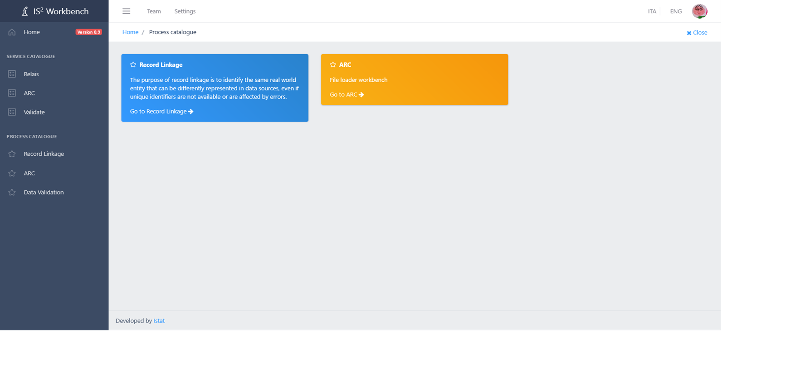
Relais at a glance (1)
Workbench - Landing page

Slide 9
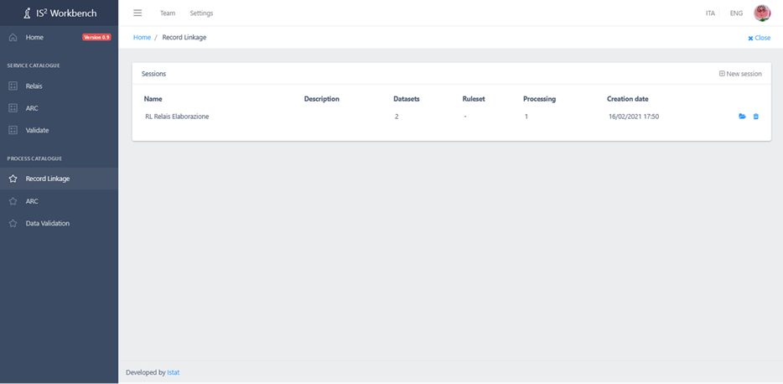
Relais at a glance (2)
Workbench - Work Session

Slide 10
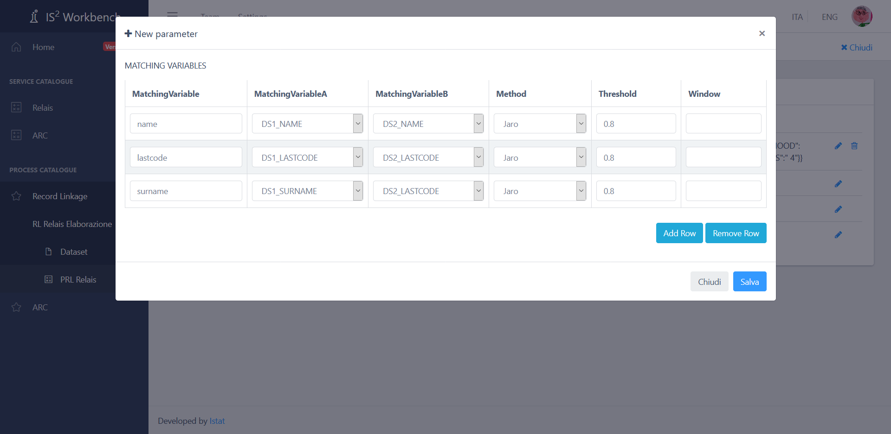
Relais at a glance (3)
Workbench – Process parameters

Slide 11
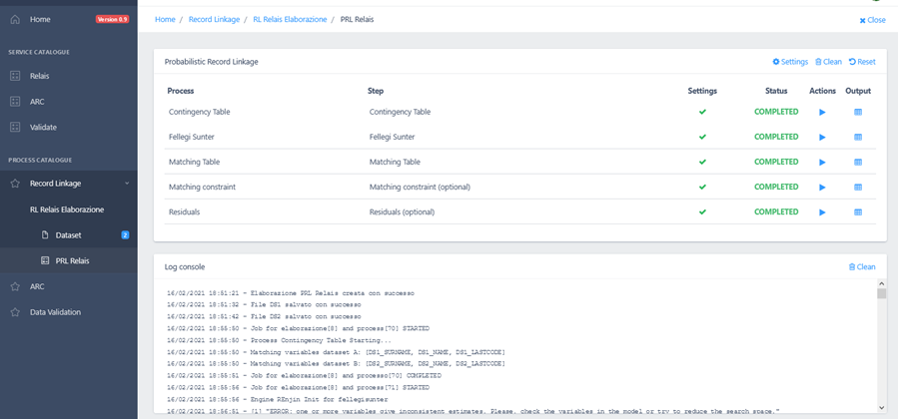
Relais at a glance (4)
Workbench – Run process

Slide 12
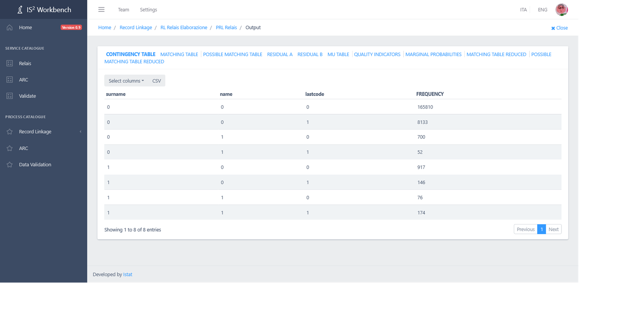
Relais at a glance (5)
Workbench – Analyze output

Slide 13
Thank you…

