Slide 1

Statistical service architecture
I3S Roma meeting, may 2019

Slide 2
Objective of a statistical service
A statistical service, regardless of the method implemented performs the following tasks:
1. Upload and manage input data, to provide initial data to process
2. Parameters and variables settings
3. Run method
4. Analyse output

Slide 3
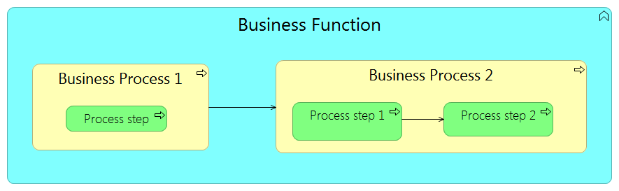
Mapping to GSIM
Business function
Business process
Process step

Slide 4
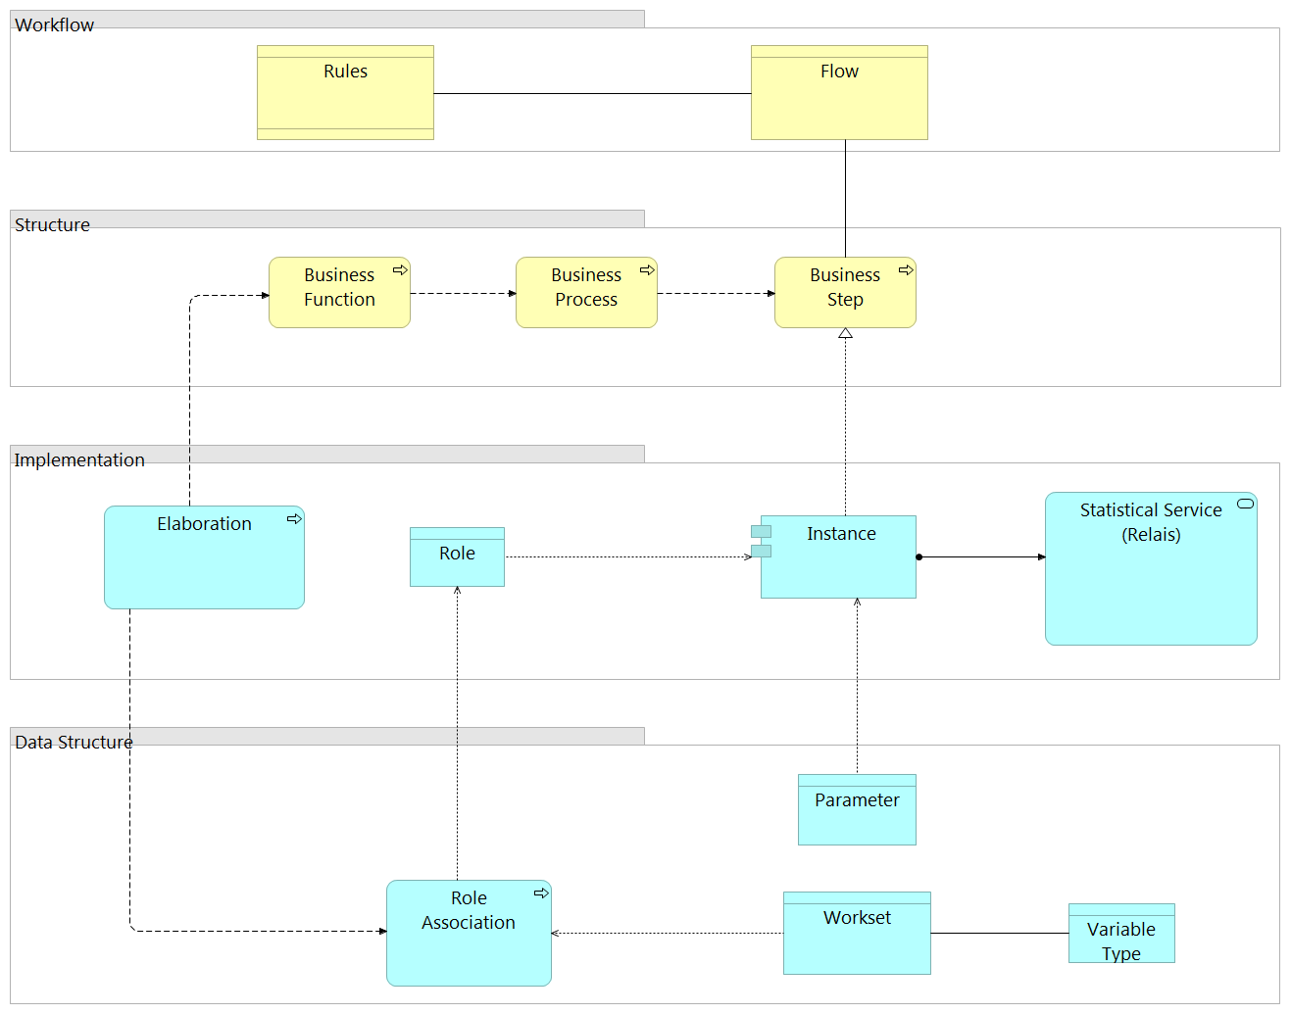

Slide 5
Business layer of a statistical service Create Working data upload and preprocessing Create Processing Session: by mapping initial data with standardized metadata, input data are transformed in working data. In this step, the user can classify and manage the information to process by: i) assigning specific roles to some variables (e.g. identification variable, classification, core variables); ii) selecting auxiliary information (if needed); iii) setting the model parameters Run method: working data, with their standardized data structures, can be processed by one or more iterations of the statistical method. The result of each iteration is stored in standardized data structures (output data) Analyse output

Slide 6
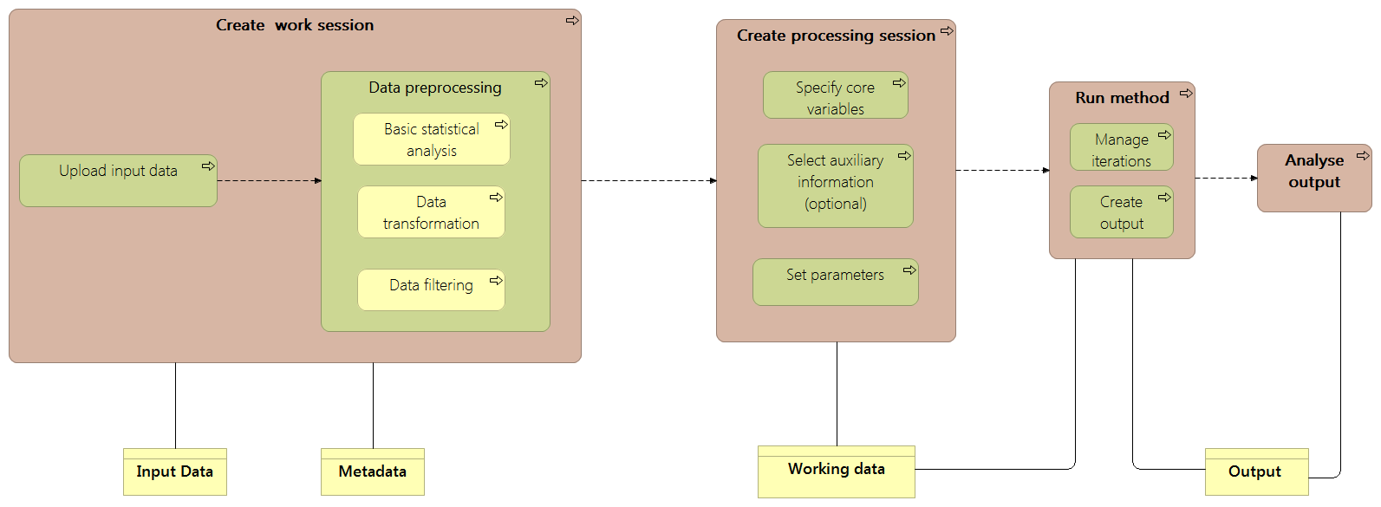
Generalized architecture of a statistical service (1)
Business layer

Slide 7
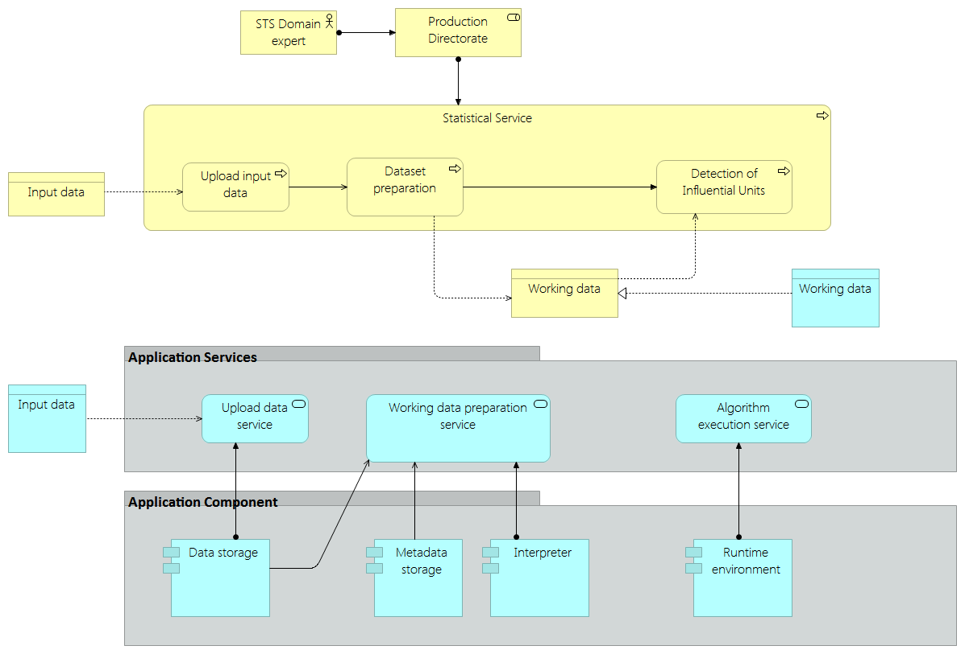
Generalized architecture of a statistical service (2)
Application layer

Slide 8
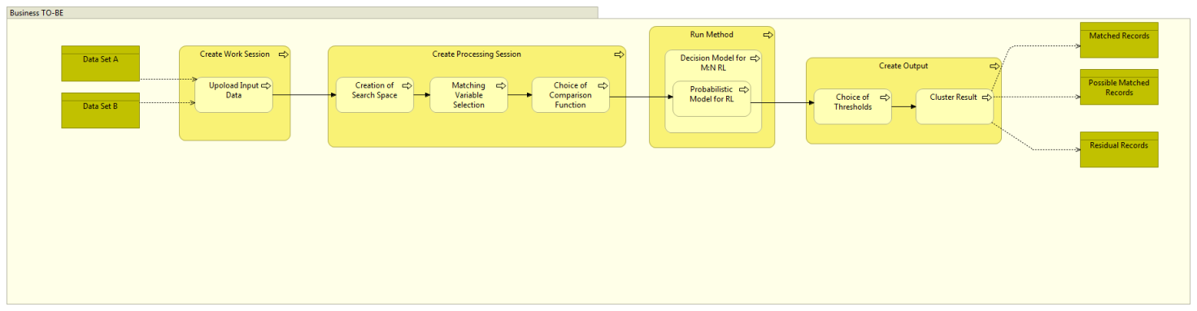
RELAIS TO BE Architecture

