Slide 1

WP 4 - communication
Create and communicate success stories
Consortium meeting 20-05-2020

Slide 2
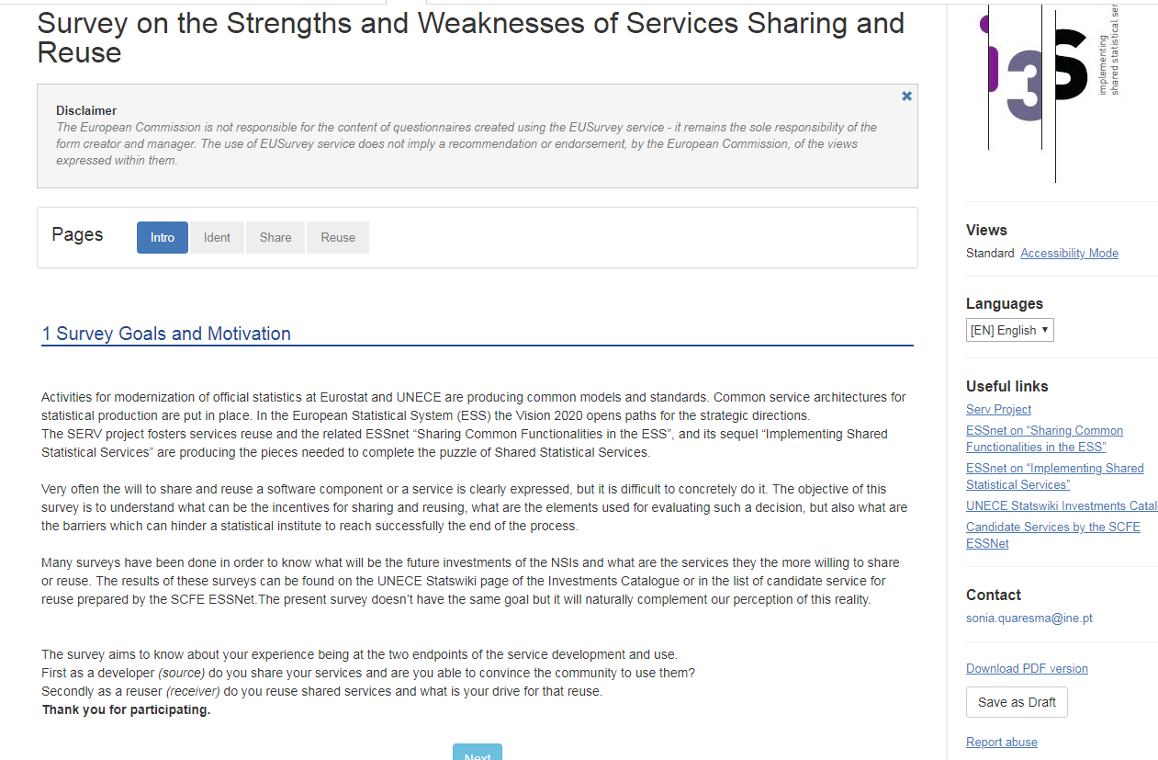
TRACK 4 - communication
TOULOUSE HACKATHON - JANUARY 2020
Notes:
For the first area we launched a survey that was open for answers by all partners from 18 November until 18 December

Slide 3
Survey on the strengths and weaknesses of Services Sharing and Reuse
17 answers
- Reopen the survey to obtain more answers
- Work with the answers we have
Results dissemination
- Was discussed in the Steering committee of the DIME/ITDG (February) to endorse this complementary survey and disseminate results
The results would be presented in the steering committee of June
Due to Covid situation this presentation will no longer happen

Slide 4
Survey on the strengths and weaknesses of Services Sharing and Reuse
Lisbon Workshop
Make similar survey
to participants
Discuss
survey results
Discuss key concepts
like reuse, share,…

Slide 5
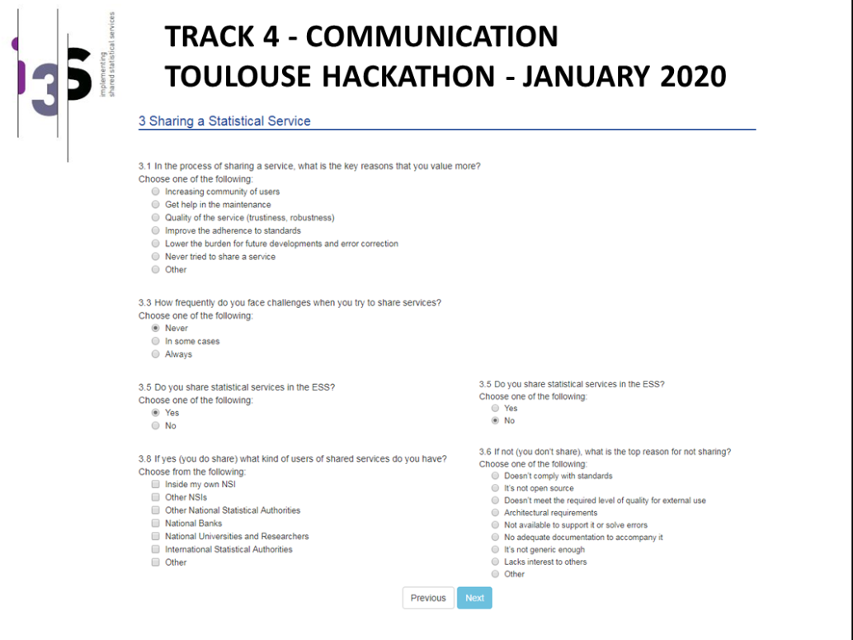
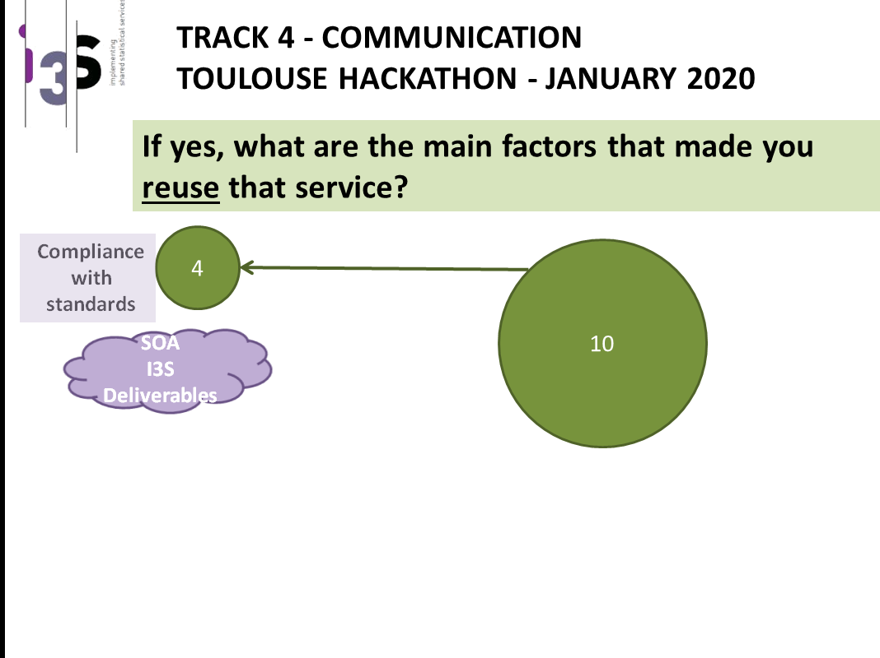
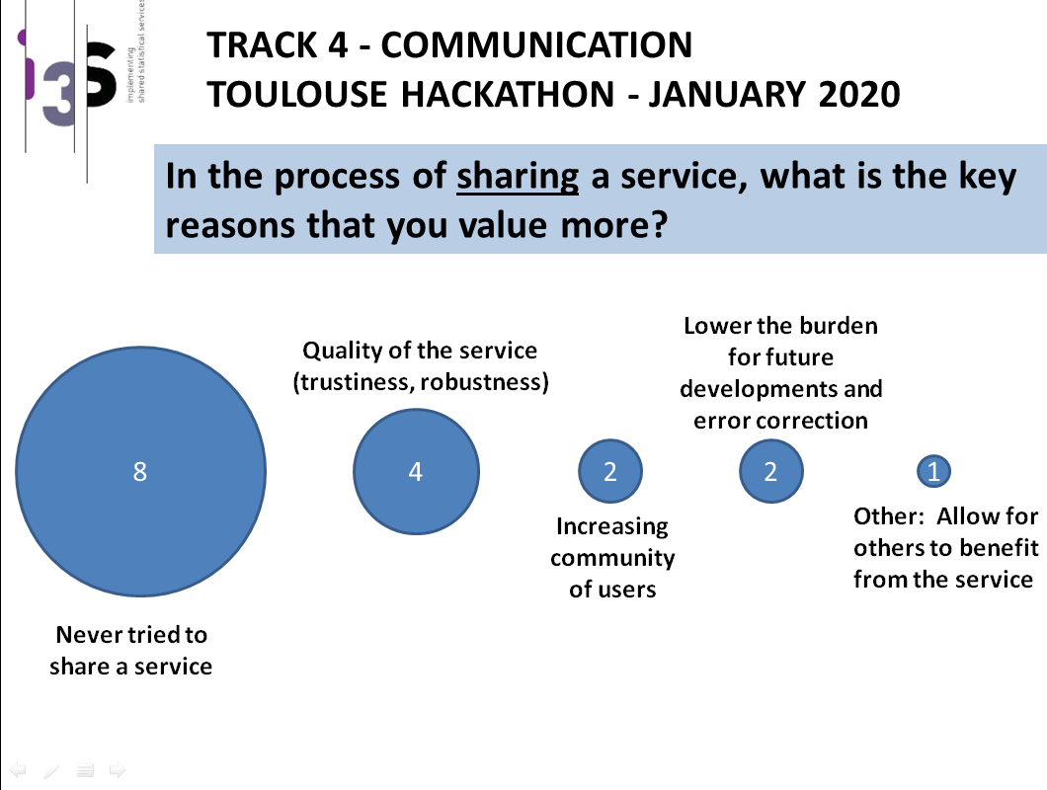
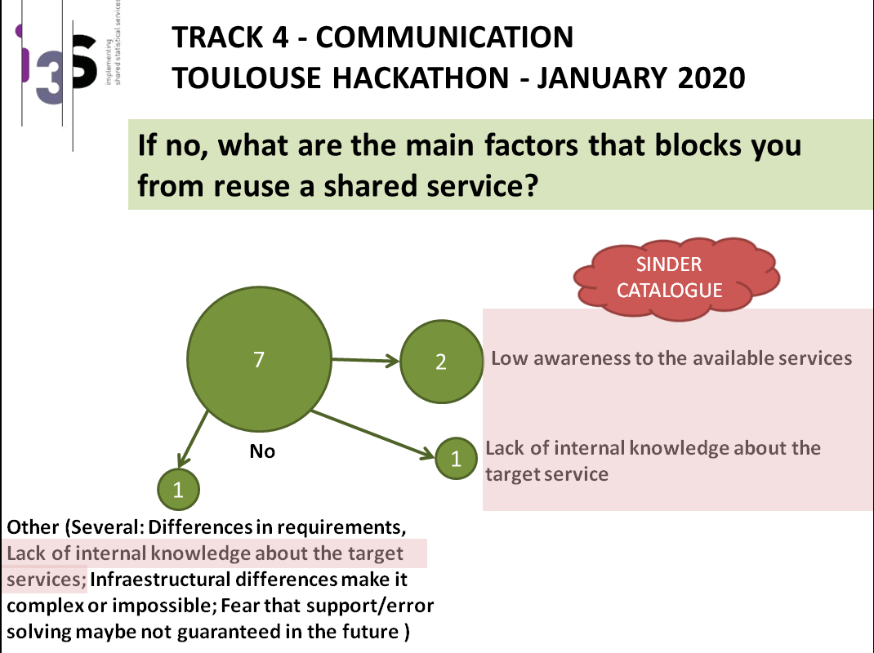
Survey on the strengths and weaknesses of Services Sharing and Reuse
Deliverable 4.1
Survey
Main results
Guidelines for problems

Slide 6
Flyers
Flyer template
Header with logo, and possibly the receiver (What is the name of the service? Who is the source of the service?)
Service description: history (How long has it been used? Is it used in other NSIs? What have been the incentives to develop and use this service?), functionalities (Which problem is solved?), architecture (Is it possible to relate to the GSBPM?)
Conditions of using
Documentation and additional resources, link to the Catalogue (What is the channel to obtain the service? Is a manual available? Is there any help desk? What is the level of technical support? Is there any support for day to day operation? Is there some tool/demo app to evaluate/try the service?)
Future development
License
Contact (Does the possibility to provide feedbacks on the service exist? Is there a user group? Is it possible to contribute to the development of the service?)

Slide 7
Flyers
Main target:
Manager
IT
Methodologist
Subject matter specialist

Slide 8

Flyers

Slide 9
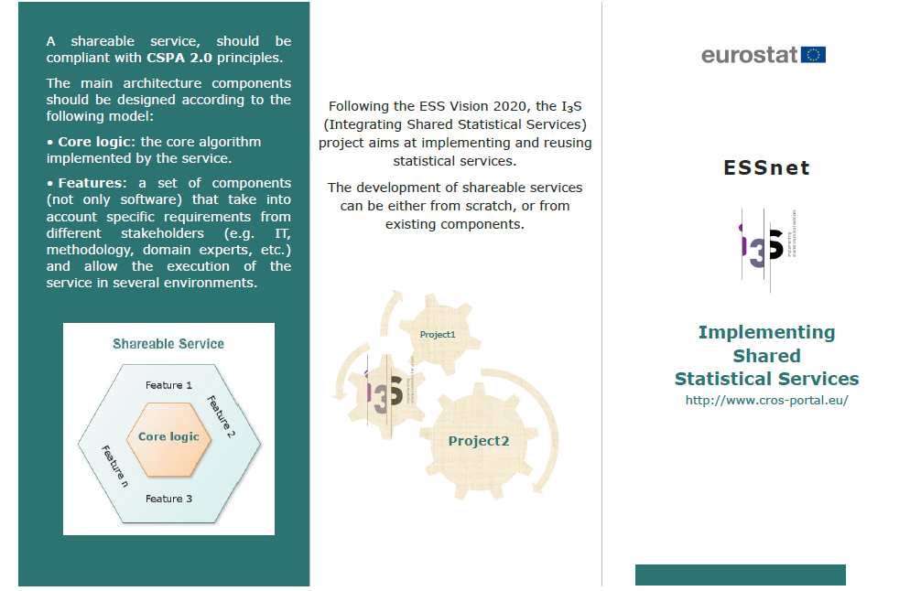
Flyers

Slide 10
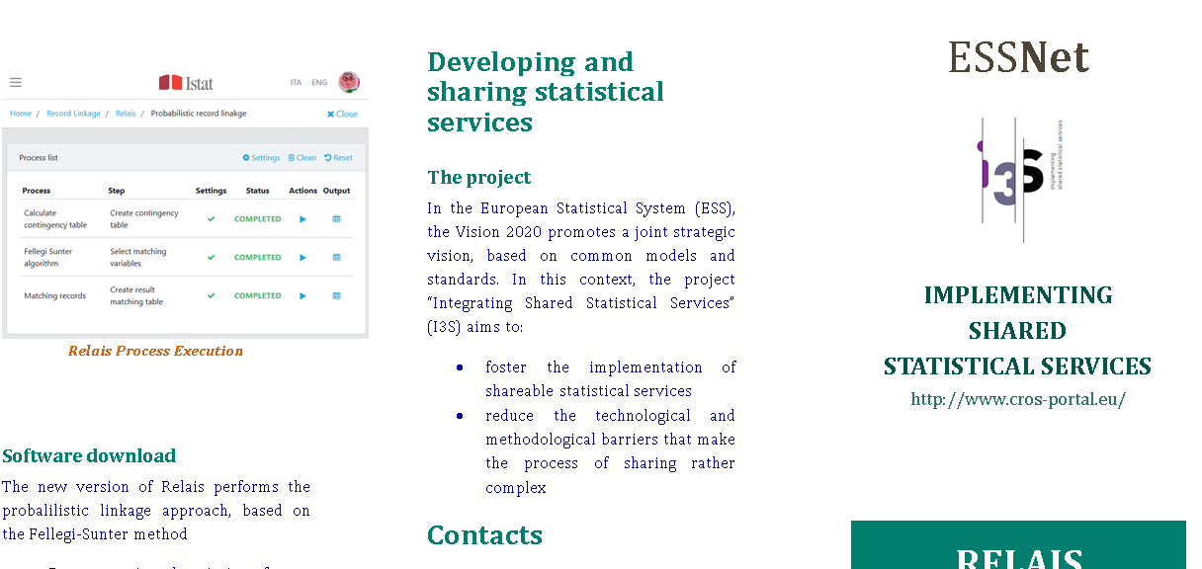
Flyers

Slide 11
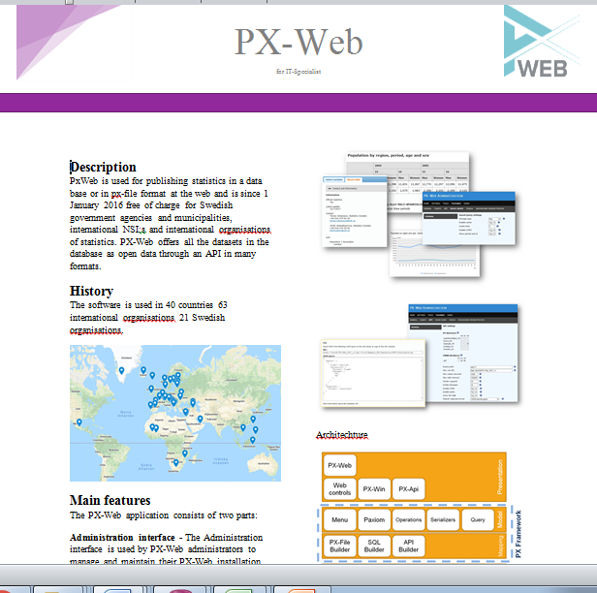
Flyers

Slide 12
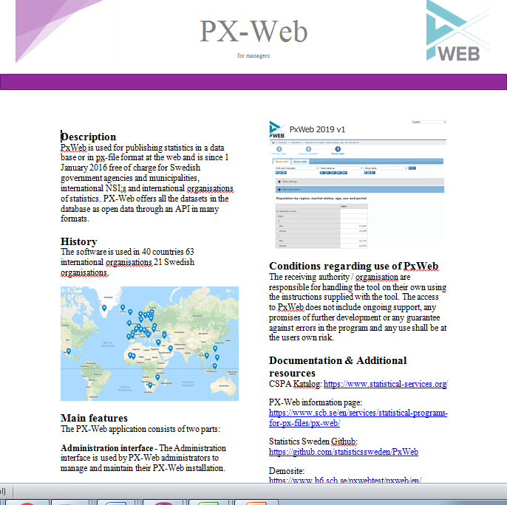
Flyers

Slide 13
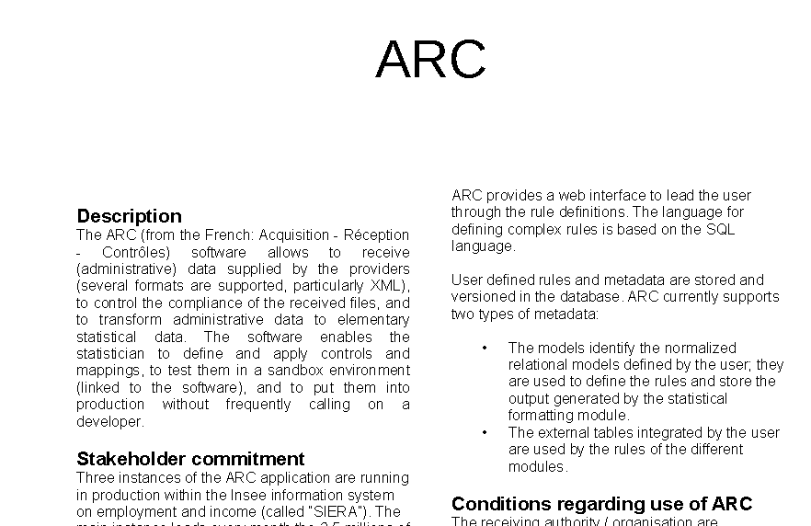
Flyers

Slide 14
Success stories
Success stories types
Interviews
Paper
Filmed
Written testimony

Slide 15
Success stories
Success stories template
Name of the service?
The source of the service ?
How long has it been used ?
Who uses the service ?
Service description ?
What problems were solved ?
What were the productivity gains obtained ?
Before using this service, how was the problem addressed?
Were there incentives to use this service ?
Is it possible to relate to the GSBPM ?
Where did the service get to know ?
If its existence was known prior, would it be useful?

Slide 16
Success stories
Success stories template
Channel to obtain the service ?
Manual available ?
Help desk ?
What is the level of technical support ?
Support for day to day operation ?
Were there some tool/demo app to evaluate/try the service ?
Easy to know and install new versions of the service?
The technical requirements were explicitly known before use?
Were technical requirements easily overcome?
Providing feedbacks on the service exist ?
Is it possible to contribute to the development of the service ?

Slide 17
Sinder
Future development based on catalogue
Catalogue should allow other items needed to Sinder
When navigating Sinder, the shortest path should be calculated
When a service is matched, all their characteristics should be displayed
When a service is not matched, a similar service could be presented

Slide 18
Sinder
Future development based on catalogue
Catalogue should allow other items needed to Sinder
When navigating Sinder, the shortest path should be calculated
When a service is matched, all their characteristics should be displayed
When a service is not matched, a similar service could be presented

Slide 19
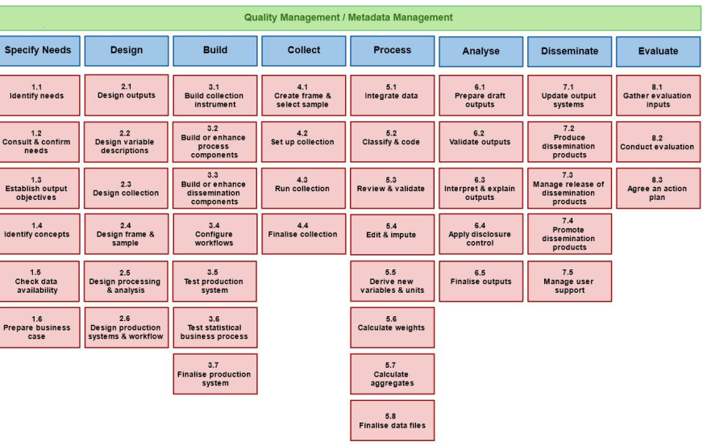
Notes:
We already started working on Sinder and have some ideias but we will need your help to better understand the services available and write the right questions for them

Slide 20
Prepare maps
Computing indexes
Yes
Seasonal Adjustment
SINDER
Yes
Yes
Yes
It Uses JAVA
Is Not Propriarty
Is RESTfull
Uses Method 1
Uses Method 1
You should try JDEMETRA+
Sorry. We don’t have that service
You should try Chart Generator
...
Notes:
We already started working on Sinder and have some ideas but we will need your help to better understand the services available and write the right questions for them

Slide 21
Lisbon workshop agenda
2 or 3 days ?
Who? ESS or CSPA community? It depends on the capacity of the room at INE. We need a big room for the plenary, and some smaller rooms for the small groups sessions.
Some inquires were made and, if booked ahead, a big room for more than 300 people is available. There are also 3 more smaller rooms that could be used for groups sessions

Slide 22
Lisbon workshop agenda
2 days option
First day morning (9:00 to 12:30):
Results of the ESSNet (all the morning)
First day afternoon "Beyond the ESSNet" (14:00 to 17:30):
Icebreaker (30 minutes)
Lessons learnt and open points in the ESSNet (and the survey) (30 minutes)
Additional questions (and the answers) for the survey, not in plenary but in small groups (1 hour)
Coffee break
Restitutions in plenary (15 minutes)

Slide 23
Lisbon workshop agenda
2 days option
Second day morning "CSPA session":
Presentation of CSPA 2.0 (30 minutes)
The catalogue (30 minutes)
The Sinder (30 minutes)
Coffee break
VTL presentation (1 hour)
Second day afternoon "Practical session":
Containerization for dummies
"I build my statistical process with the services in the Catalogue", in small groups

Slide 24
Lisbon workshop agenda
3 days option
Other ideas taken in the Wiesbaden agenda:
Other NSIs presentation of one of their services
Session on architecture?
Presentation of the awesome list by CBS, what do you do with that?
Opensource strategy of NSIs?
Poster session (30 minutes)

Slide 25
Future developments
Finalize deliverable D4.1
Make adapted survey for Lisbon workshop
Finalize fliers
Make some success stories:
ARC – France
PxWeb – Norway
Tau-Argus – Portugal
RELAIS - ?
Make Sinder paths to some services
Finalize deliverable D4.2

