Slide 1
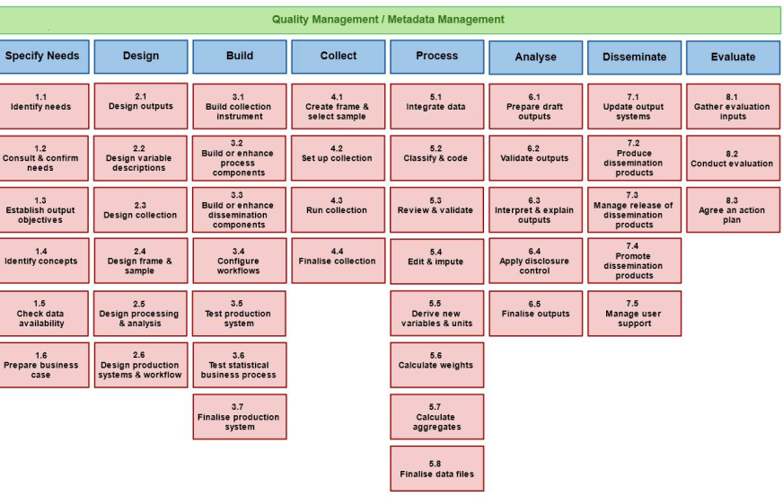
Notes:
We already started working on Sinder and have some ideias but we will need your help to better understand the services available and write the right questions for them

Slide 2

TRACK 4 - communication
TOULOUSE HACKATHON - JANUARY 2020
SINDER
Are you interested in Processing Statistical data?
Seasonal Adjustment
Yes
Do you accept Proprietary?
Yes
Yes
JAVA?
No
Computing indxese
Yes
Do you accept not RESTfull
No
Prepara maps
Are you interested in Integrating and classifying data?
Yes
Method 1
No
You should try JDEMETRA+!
Relais performs the probalilistic linkage approach, based on the Fellegi-Sunter method. You should try this service!
Yes
Method 2
No
Are you interested in deriving new variables and calculating weights?
JDemetra+ is the software recommended by Eurostat and the ECB for handling time series of official statistics. You should try this service!
You should try Chart Generator
Sorry. We don’t have that service
Notes:
We already started working on Sinder and have some ideias but we will need your help to better understand the services available and write the right questions for them

Slide 3
Notes:
We already started working on Sinder and have some ideias but we will need your help to better understand the services available and write the right questions for them

Slide 4
Prepar maps
Computing indxese
Yes
Seasonal Adjustment
SINDER
Yes
Yes
Yes
It Uses JAVA
Is Not Propriarty
Is RESTfull
Uses Method 1
Uses Method 1
You should try JDEMETRA+
Sorry. We don’t have that service
You should try Chart Generator
...
Notes:
We already started working on Sinder and have some ideas but we will need your help to better understand the services available and write the right questions for them

