Slide 1
Sharing Algorithms
ESSNet Rome
Matjaž Jug, Statistics Netherlands
May 21, 2019

Slide 2
Content
Context
Benefits of sharing algorithms
Use cases / examples
CBS Data Strategy PoCs
OECD Algorithm Bank
ESS Reference Methodological Framework for processing MNO data for Official Statistics
UN Global Platform Methods Library
Opal Project
Challenges/questions

Slide 3
Why should we care – benefits of sharing algorithms
Transparency: open to internal and external review of code and possibility to test and experiment every phase of the project.
Productivity: collaborate on algorithms; share and co-edit (live) code
Security: secure storage of algorithms thanks to code management (versioning, fork, roll-back), traceability of contributions, bug tracking..
Multi-domain approach: data cleaning and transformation, numerical simulation, statistical modeling, data visualization, machine learning...
Standardization: Standard methodology can be developed and deployed with shared algorithms.
Innovation: low barrier to entry with possibility to re-use methods developed externally (academia, private sector, other NSOs).

Slide 4


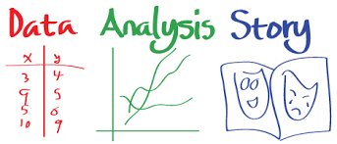
New data sources and complex processing

Slide 5
4
CBS Data Strategy- 4 Architectural patterns
Data distributed
Data remains where it is and is processed in a distributed way (for example data virtualization).
SN (encrypted) data and/or algorithm makes a roundtrip to enrich datasets (for example using sMPC)
Data connected/processed ” virtually”
SN data/Algorithm copied to External partner
Data/Algorithm makes “roundtrip”
External data collected and copied to SN
3
4
Data maintened @ Statistics Netherlands
Data (partly) maintained @ 3rd party
External data is copied to the SN environment to be processed there (e.g. SN environment for external research).
SN (encrypted) data and/or algorithm copied to the trusted environment (for example HPC processing at Surf)
1
2
Data centralized

Slide 6
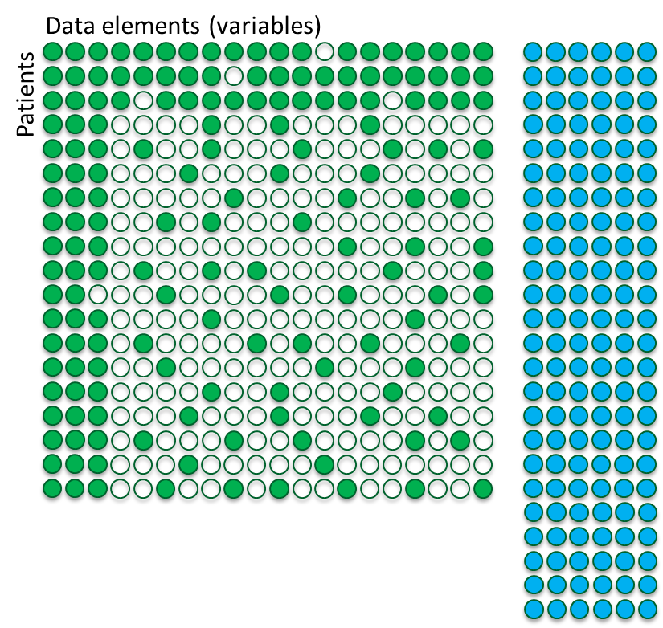
Use case: privacy-preserving data sharing
Health “Big Data” is extremely privacy sensitive, using it responsibly is key to establish trust and unlock the potential of this data
Data is extremely partitioned across different entities: citizens, hospitals, insurers, municipalities, schools, etc.
Sharing across these entities is not easy due to administrative, political, legal-ethical and technical challenges.
Goal of the project is to establish a scalable technical and governance framework which can combine access-restricted data from multiple entities in a privacy-preserving manner

Slide 7
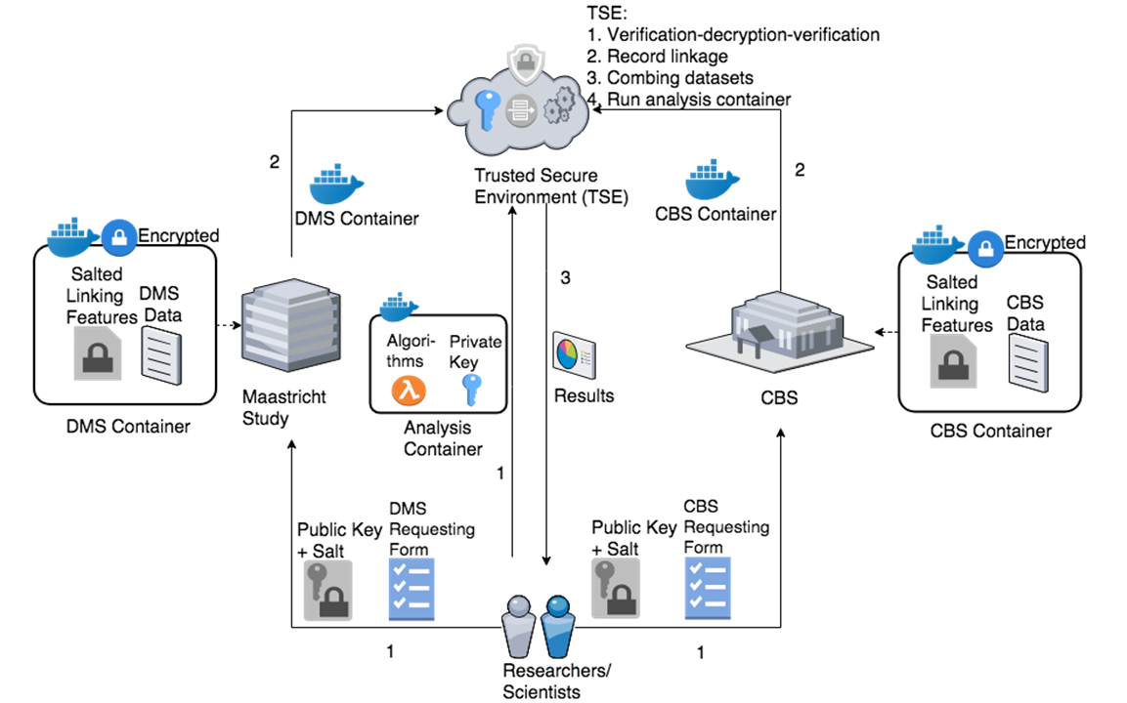



Analysing combined data within a ‘trusted secure environment’
The set-up of the systems guarantees that both parties will get no insight in the underlying datasets, but are only able to see the results

Slide 8
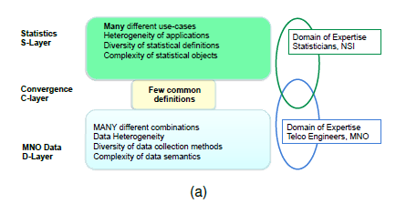
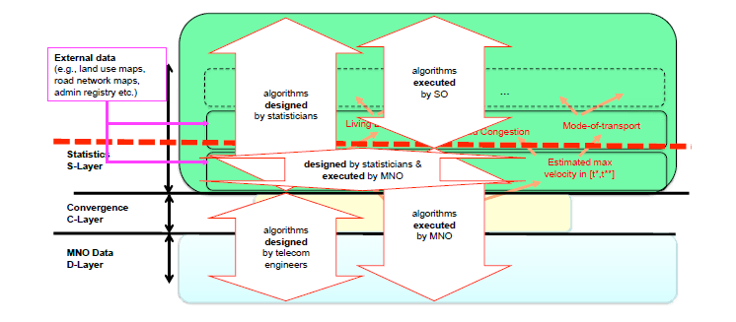
ESS Reference Methodological Framework for processing MNO data for Official Statistics

Slide 9
OECD Smart data STRATEGY
Integrating
The Data
Cycle
Embracing
Smart
Data

Slide 10
Develop Smart data practices
Evaluate
Data
Stats & Data
Skills
Policy Simulation
& Visual Data Analytics
Disseminate
Data
Forecasting
& Modelling
SOURCE NEW DATA
APPLY DATA SCIENCE TECHNIQUES
MANAGE DATA LIFECYCLE
Geospatial
Analysis
Analyse
Data
SHARE &
DESIGN
ALGORITHMS
Web Scraping
& Text Mining
Process
Data
Administrative
Micro-Data
Collect
Data
Commercial
Data
R, Python
Programming
Design
Data
Crowdsourcing,
Polling & Web surveys

Slide 11
Develop Smart data Solutions
Data
Portals
Open
Algorithms
Policy
Simulators
Third Party
Products, Platforms
Open
APIs
SOURCE NEW DATA
APPLY DATA SCIENCE TECHNIQUES
MANAGE DATA LIFECYCLE
Data Science
Environment
Augment Data
DATA
CORE(S)
ALGORITHMS
BANK &
SANDBOX
DATA
LAKE(S)
Any data modelled by others
Structured
Unstructured
Experimental – or not
Multi-techniques
Micro-data Analysis
Spatial Analysis
Machine Learning
Text Mining
Visual Data Analytics
Policy Simulation
…
Quality standards – or not
Statistical
Environment
Combine Data
Modelled data & metadata (SDMX), process (GSBPM)
Sustainability over time
Controlled sources
(standard setting)
Quality standards
3d party
Data sources
& Data Lakes
Statistical
Reporting
Policy
Surveys
Administrative
Micro-data

Slide 12
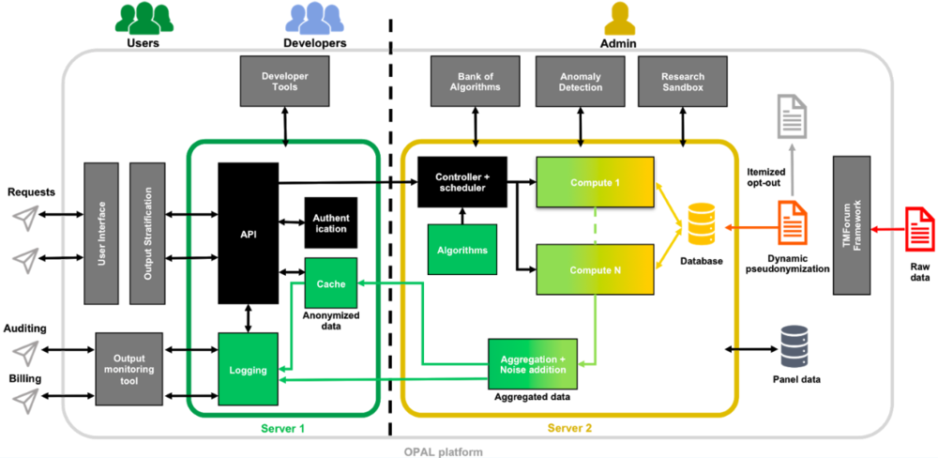
Opal project: open and secured platform and algorithms
https://www.opalproject.org
https://paris21.org/sites/default/files/2017-09/OPAL.pdf

Slide 13
OPAL (MIT) Principles for Privacy-Preserving Data Sharing
The OPAL project embraces three key concepts with the goal of making a broad array of data available for inspection and analysis without violating personal data privacy:
Move the algorithm to the data. Performing algorithm-execution on data at the location of the data repository means that raw data never leaves its repository, and access to it is controlled by the repository owner. Only aggregate answers or "Safe Answers" are returned.
Algorithms must be open. Algorithms must be openly published, studied and vetted by experts to be “safe” from violating privacy requirements and other needs stemming from the context of their use.
Data is always in an encrypted state. Data must be in an encrypted state while being transmitted and during computation.
https://www.trust.mit.edu/projects

Slide 14
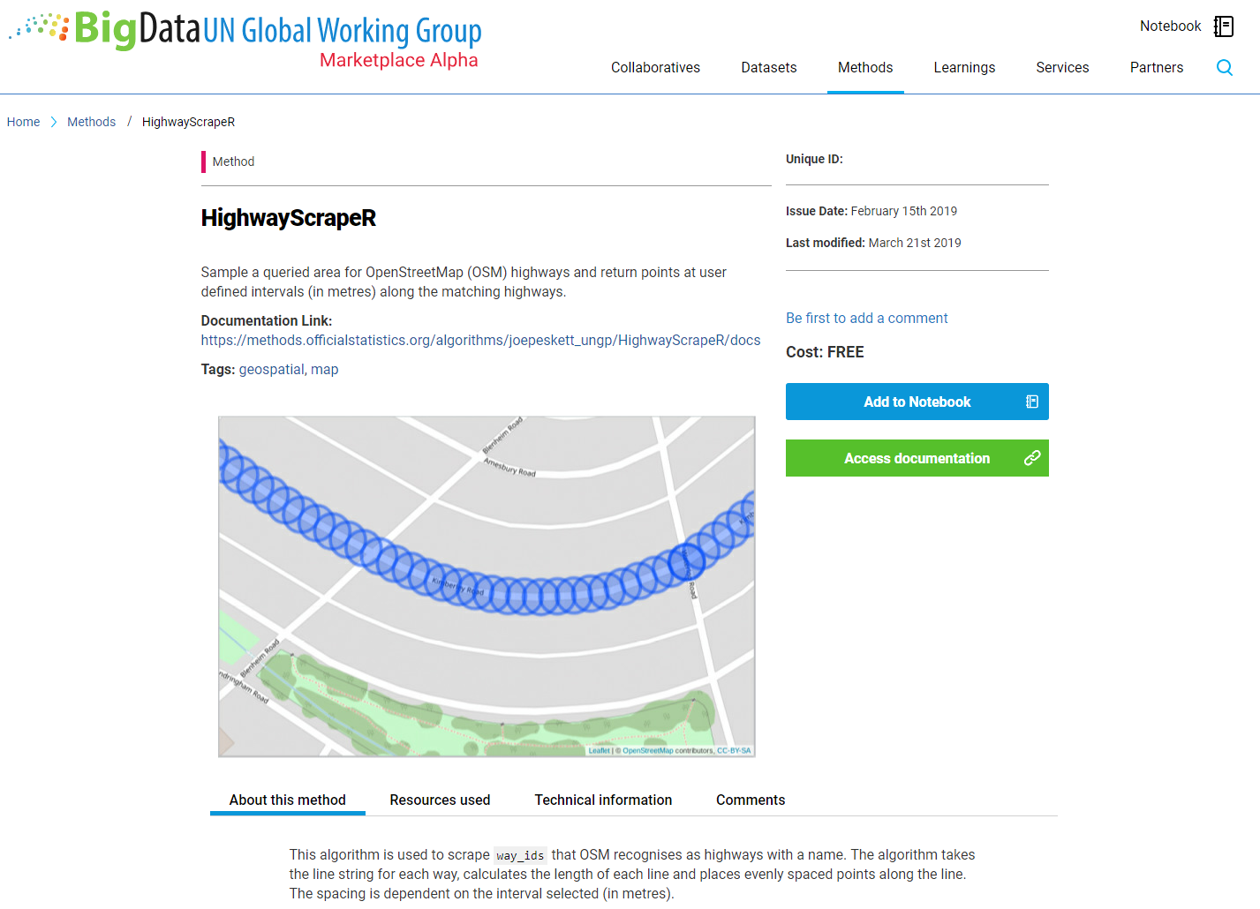
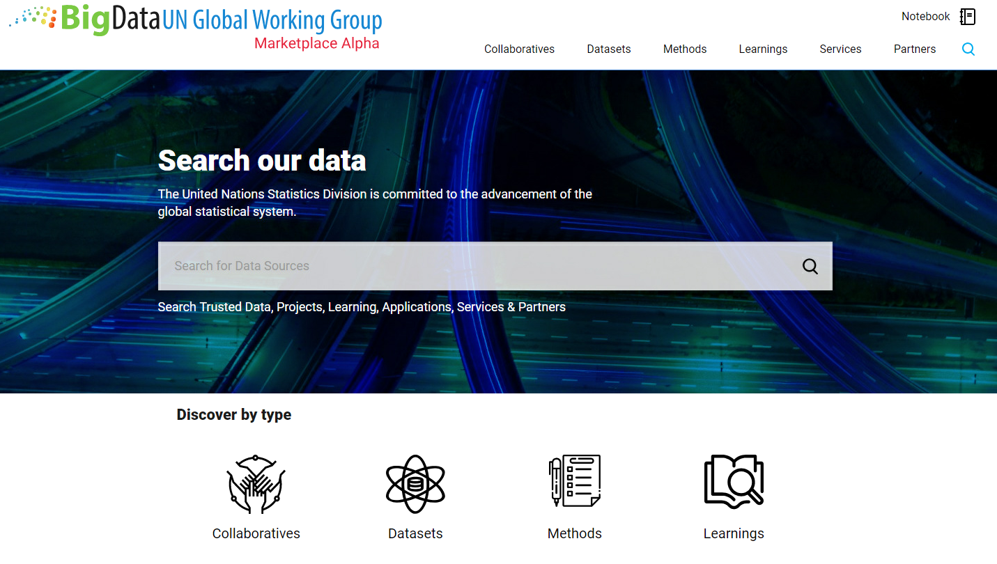
UN Global Platform Methods Store
https://marketplace.officialstatistics.org/

Slide 15

Algorithms Pipeline
Identification & Scoping
Data Exploration & Algorithm Development
Algorithm Publication & Consumption
Task teams identify topics, datasets and algorithms with potential
Algorithm pipeline updated
Trusted partnerships explore new data sources
Algorithms, methods and pipelines developed in shared ‘projects’ and released when ready
Algorithms stored and documented
Algorithms published onto Method Library
Algorithms available via API endpoints for UN consumption

Slide 16
Challenges/quastions
What are criteria that define algorithm as open, trusted etc?
What is expected from platforms where algorithms run?
Statistical (general) vs industry/domain (like mobile phone data) algorithms.
Standards for containers, APIs etc?
Statistical external or global (de-facto) standards?

