Slide 1
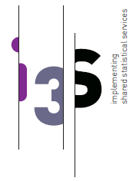
WP1 Updates
Consortium meeting
May 2020

Slide 2


Outline
WP1: Accomplished tasks
WP1: Work in progress

Slide 3
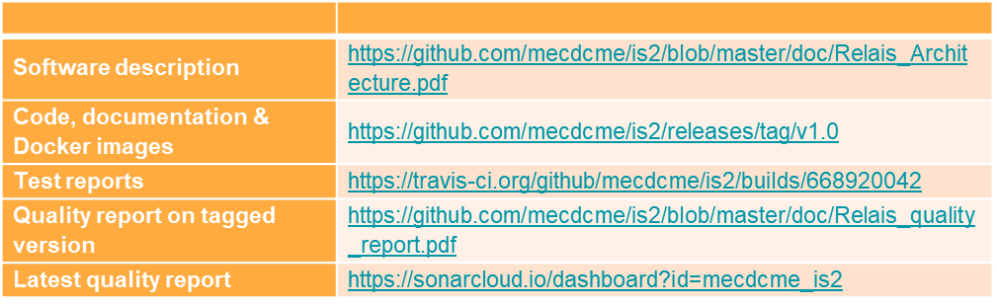
WP1: Accomplished tasks
Service2: RELAIS
D1.4.1 - Delivery M12
Status: final version
Communication activities: service flyer available in two different versions

Slide 4
WP1: Accomplished tasks
Guidelines on best practices
Updated draft version after Toulouse hackathon

Slide 5
WP1: Accomplished tasks
Guidelines on best practices
Updated draft version after Toulouse hackathon
The first paragraph of the updated version will provide an overview of the architectural recommendations to harmonize the guidelines with D2.1- Software and integration architecture recommendations and D2.2 – Cookbook on integration & use
Guidelines in practice
Architecture recommendations
On reuse and sharing services: Different ways of reuse ● Code / libraries - build, deploy and consume. ● Deployable binaries / packages - deploy and consume. ● “Centrally” deployed runnable services - consume. Analysis of service chain Cluster of functionalities
On service integration – relationship with legacy architecture Services and infrastructure
Versioning and environments

Slide 6

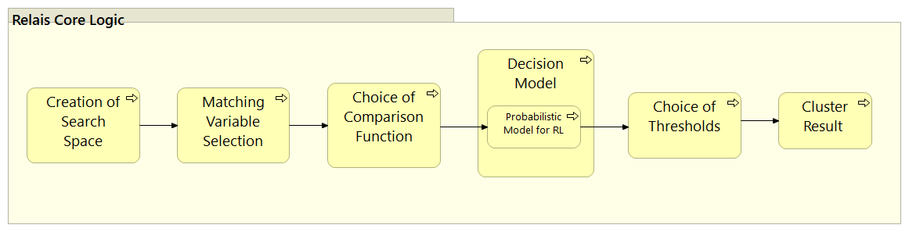
WP1: Work in progress
Service2: RELAIS
To enhance the current version, the “Search space reduction” functionality is under development
### Next steps
Integration with ARC
Implementation of the “Search space reduction” functionality

Slide 7
WP1: Work in progress
ARC integration in the Workbench (IS2) where RELAIS service runs
### Next steps proposal (Manuel and ARC team)
Modify IS2 to be able to run directly on both MySQL and Postgres databases
Get a feedback on the ARC/IS2 integration script from the IS2 team
Review the IS2 modellization
Enhance the IS2 documentation to explain how to add a new service in IS2 as we did for ARC
Describe the INSEE and ISTAT use cases for IS2 and ARC
Share the IS2 code

