Slide 1
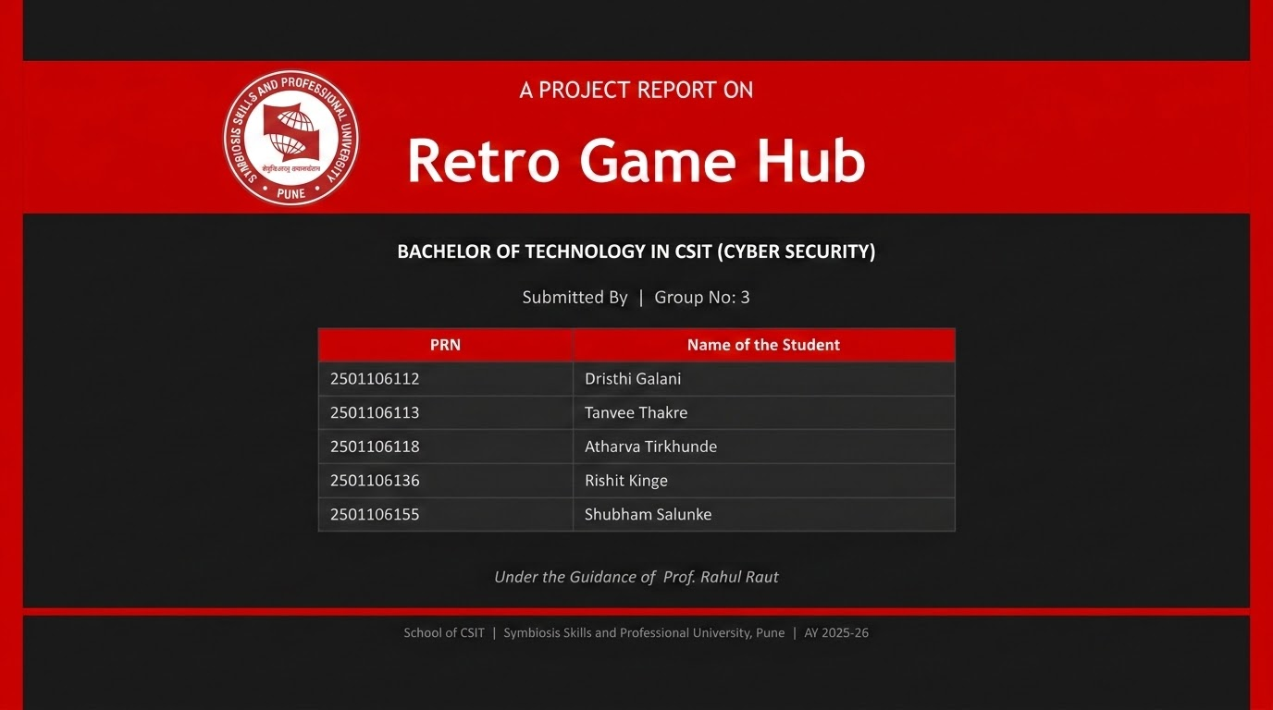

Slide 2
CONTENTS
1
Introduction
8
Industry Relevance
2
Literature Review
9
Challenges
3
Subject Integration Overview
10
Ethical Considerations
4
Design and Methodology
11
Future Scope
5
System Architecture
12
Conclusion
6
Implementation
13
References
7
Results
SCHOOL OF CSIT | SSPU PUNE

Slide 3
INTRODUCTION
Background
Motivation
Retro Game Hub is a browser-based arcade platform recreating classic notebook games — Tic-Tac-Toe, Dots & Boxes, Snakes & Ladders and more. Built using only HTML, CSS, and Vanilla JavaScript across 13 files (~4,200 lines) with zero external dependencies.
Build a compact, offline-capable gaming platform showcasing game logic, UI design, LocalStorage state persistence, and AI via Minimax & Alpha-Beta pruning. Accessible on any device, anywhere — even without internet.
Problem Statement
Scope
Most retro games are isolated mobile apps — bloated with ads, requiring accounts and data connections. There is a gap for a lightweight, browser-accessible hub that runs offline on any device with a unified player profile system.
9 playable games · Player profiles with PIN auth · Coin reward economy · Per-game & global leaderboards · 4 retro display themes · Procedural sound engine (7 music tracks, 12 SFX) · Responsive UI (360 px – 1440 px)
OBJECTIVES
Build a multi-game web app using only HTML, CSS & Vanilla JavaScript
Implement persistent player profiles & reward tracking using LocalStorage
Create AI opponents (Minimax, Alpha-Beta, Hunt/Target, Heuristic) for multiple games
Provide a polished retro interface with sound, themes & responsive design
SCHOOL OF CSIT | SSPU PUNE

Slide 4
LITERATURE REVIEW
Single-Game Implementations
Framework-Dependent Portals
Server-Dependent Platforms
Focus on one classic title (e.g. standalone Tetris or Tic-Tac-Toe clones) with no unified player system or progression. Simple to host but no cohesion.
Multi-game portals built on React / Angular. Heavier footprint, harder to host as a single static folder, and dependency-bound.
Require a backend to store player data. Cannot work offline and need a persistent internet connection to function.
COMPARATIVE STUDY — Retro Game Hub vs Existing Solutions
Feature | Standalone Clones | Framework Portals | Server Platforms | Retro Game Hub
No install required | ✓ | ✓ | ✓ | ✓
Multiple games | ✗ | ✓ | ✓ | ✓
Works offline | Usually | ✗ | ✗ | ✓
Player profiles | ✗ | Varies | ✓ | ✓
AI opponents | Sometimes | Varies | Varies | ✓
Zero dependencies | ✓ | ✗ | ✗ | ✓
SCHOOL OF CSIT | SSPU PUNE

Slide 5
SUBJECT INTEGRATION OVERVIEW
CS23201 | Data Structures & Algorithms
CS23202 | Web Technologies & Vulnerabilities
Concept: Arrays, Stacks, Queues, Game Trees
Concept: HTML, CSS, JS, LocalStorage, Web Security
Game state management, board representation (Tic-Tac-Toe, Connect Four), Minimax AI using tree structures
Complete frontend UI, responsive design, secure PIN-based login, avoiding plain-text storage
CS23203 | OS, Compiler & Security Engineering
CS23204 | Human Behavior
Concept: Process Flow, Memory Management, Security
Concept: UX, Cognitive Design, Interaction Principles
Modular code structure, efficient game loops, hashed PIN storage
Intuitive UI, retro themes, sound feedback, engaging gameplay experience
CS23205 | Python Programming
CS23206 | Applied Mathematics - II
Concept: Logic Building, Algorithm Design
Concept: Probability, Logic, Graph Theory, Optimization
Programming fundamentals (implemented in JS) — loops, conditionals, modular coding
AI decision-making (Minimax), probability-based mechanics (dice), scoring/reward calculations
SCHOOL OF CSIT | SSPU PUNE

Slide 6
DESIGN AND METHODOLOGY
Development Approach
SOFTWARE REQUIREMENTS
Iterative feature-branch workflow. Each game module built & tested in isolation before integration.
Sprint 1: SPA shell, player system, UI manager
Sprint 2: Tic-Tac-Toe, Dots & Boxes, Snakes & Ladders, coin system
Sprint 3: Battleship, Connect Four, Hangman, Memory Match
Sprint 4: Tetris, Pong + final bug-fix sprint
OS
Any OS with a modern browser (Windows, macOS, Linux, Android, iOS)
Browser
Chrome 100+ · Firefox 100+ · Edge 100+ · Safari 15+ · Samsung Internet 20+
JavaScript
Must be enabled (ES6+)
Server/DB
None — uses browser LocalStorage
Tools & Technologies
HTML5 · CSS3 (custom properties) · ES6+ Vanilla JavaScript
Web Audio API (procedural sound) · LocalStorage API · SVG
Dev Tools: VS Code · Chrome DevTools · Git
Installation
None — open index.html directly
Internet
Not required after first load
SCORING & REWARD MODEL
Win reward: 10–25 coins (fixed per game, varies by difficulty)
Participation reward: +2 coins for any completed game (win or lose)
Streak bonus: +5 coins for 3 consecutive wins
SCHOOL OF CSIT | SSPU PUNE

Slide 7
SYSTEM ARCHITECTURE
Modular Single-Page Application (SPA) Architecture
index.html
Main App Shell (6 Screens)
main.js
player.js
ui.js
sound.js
main.css
App Controller
Boot & Routing
Player DB
Coin Management
Screen Manager
Modals & HUD
Web Audio
Sound Engine
Styles Themes
CRT Effects
tictactoe.js
dots.js
snl.js
battleship.js
connectfour.js
hangman.js
memorymatch.js
tetris.js
pong.js
9 Individual Game Modules — each with own logic, AI, and reward handling
SCHOOL OF CSIT | SSPU PUNE

Slide 8
IMPLEMENTATION
KEY ALGORITHMS
Minimax (Tic-Tac-Toe)
Alpha-Beta Pruning (Connect Four)
Recursively explores every game state. Assigns +10 AI win / -10 AI loss / 0 draw. Always evaluates full tree (max 362,880 states) → unbeatable AI.
Minimax on 6×7 board, depth limited to 5. Pruning reduces nodes from O(b^d) to O(b^(d/2)). Heuristic scores centre control and open 2/3/4-disc sequences.
Hunt & Target (Battleship)
Heuristic AI (Dots & Boxes)
Hunt mode: fires at random non-adjacent cells. On hit → Target mode: fires at 4 orthogonal neighbours until ship sunk → reverts to Hunt.
3-tier strategy: (1) capture any completable box → (2) take safe line that won't give opponent a 3-sided box → (3) random fallback.
LocalStorage Player Schema (key: retro_players, indexed by player ID)
id — Unique player ID (3–16 alphanumeric chars)
pinHash — SHA-like hash of 4-digit PIN (never plain text)
avatar — Chosen emoji (set of 24)
coins — Running total
wins/games — Per-game & total counts
streak — Consecutive win count
SCHOOL OF CSIT | SSPU PUNE

Slide 9
RESULTS
13
~4,200
0
Total Files
Lines of Code
Dependencies
<200ms
<30MB
5
Page Load Time
Memory Usage
Supported Browsers
KEY TEST CASES & OUTCOMES
Test Case | Expected Result | Outcome
Player login and guest mode | Both modes accessible | ✓ Pass
Coin award on Tetris win | +20 coins added | ✓ Pass (after fix)
Coin award on Pong win | +12 coins added | ✓ Pass (after fix)
Game-over modal for all games | Modal appears with result | ✓ Pass
LocalStorage persistence | Coins survive page reload | ✓ Pass
Offline use after first load | All features work | ✓ Pass
SCHOOL OF CSIT | SSPU PUNE

Slide 10
INDUSTRY RELEVANCE
💻 Front-End Engineering
🤖 AI & Algorithm Design
🔐 Cyber Security Principles
Demonstrates production-grade proficiency in HTML5, CSS3, and ES6+ JavaScript without any framework dependency — directly applicable to web development roles.
Implementation of Minimax, Alpha-Beta pruning, and Hunt & Target AI reflects core CS fundamentals valued in software engineering and game development industries.
PIN hashing, avoiding plain-text storage, and modular security design align with CSIT programme outcomes and industry best practices for client-side security.
📱 PWA & Mobile Readiness
🎮 Game Development Patterns
☁️ Cloud & Scalability Path
PWA manifest file and responsive layout (360 px–1440 px) position the app for Play Store distribution via Trusted Web Activity (TWA).
State machines, game loops, canvas physics (Pong), and procedural audio via Web Audio API are patterns used directly in the indie game development industry.
Architecture is designed to scale — Phase 3 plans WebSocket multiplayer, Firebase/Supabase cloud sync, and tournament brackets, mirroring SaaS platform design.
SCHOOL OF CSIT | SSPU PUNE

Slide 11
CHALLENGES
Fragmented Coin Reward System
Problem: Each game handled outcomes independently, causing inconsistencies and bugs in coin allocation across the 9 games. Solution: Centralized reward via a unified PlayerDB.awardCoins() function followed by synchronized UI updates using UI.updateHUD().
Inconsistent Game-Over Handling
Problem: Different games triggered end-game states in different ways, leading to unpredictable modal behavior and missed coin credits. Solution: All game-ending scenarios standardized through a single modal system using UI.showWinModal(), improving reliability.
Duplicate Keyboard Listeners (Tetris)
Problem: On game restart, keyboard event listeners were registered a second time without removing the previous ones, causing double moves. Solution: Implemented proper listener de-registration before each game init to ensure a single active listener at all times.
Zero-Dependency Audio
Problem: Providing background music and SFX without any audio files or external libraries, while maintaining a rich multi-layered sound experience. Solution: Procedural audio synthesized entirely via Web Audio API oscillators — melody, bass, and harmony layers with 7 tracks and 12 SFX. Zero bytes of audio payload.
SCHOOL OF CSIT | SSPU PUNE

Slide 12
ETHICAL CONSIDERATIONS
Data Privacy & Security
No Ads or Monetization Dark Patterns
Player PINs are never stored in plain text. A SHA-like hash is applied before saving to LocalStorage. No personal data is transmitted to any server — all data stays on the user's own device.
The platform contains zero advertisements. The coin economy is transparent and non-deceptive. Guest mode ensures access to all games without forced registration or data collection.
Accessibility & Inclusivity
Academic Integrity
Responsive design supports screens from 360 px (budget phones) to 1440 px desktops. Works across 5 major browsers. Fully offline-capable, reducing the digital divide for users with limited internet.
All code is originally written by the team. External references (MDN, GeeksforGeeks, W3C specifications) are properly cited. The project declares no plagiarism and acknowledges all borrowed concepts.
Open-Source Community Respect
Responsible AI Design
No external libraries were used, avoiding license compliance risks. Documentation and open learning resources that guided the project are acknowledged in the References section.
AI opponents are deliberately balanced — not designed to frustrate users. Difficulty is appropriate to each game. AI is transparent in behaviour, with no deceptive or manipulative mechanics.
SCHOOL OF CSIT | SSPU PUNE

Slide 13
FUTURE SCOPE
PHASE 2 — Multiplayer & Expansion
Real-time multiplayer via WebSocket communication with simple room codes
New games: Rock-Paper-Scissors, Sudoku — expanding platform variety
Progressive Web App (PWA) framework for mobile device installation
PHASE 3 — Gamification & Cloud
Achievement badge system & daily challenge modes rotating every 24 hours
Customizable in-game elements — unlockable skins purchasable with coins
Global tournament brackets with up to 4-player multiplayer support
Cloud-based data sync using Firebase / Supabase for cross-device profiles
DEPLOYMENT
PWA manifest & icon assets already created — service worker implementation pending
Google Play Store distribution planned via Trusted Web Activity (TWA)
SCHOOL OF CSIT | SSPU PUNE

Slide 14
CONCLUSION
Retro Game Hub successfully delivers a complete browser-based arcade — proving that core web technologies alone can power complex, interactive applications.
✓ 9 Fully Functional Games
✓ Persistent Player Profiles
✓ Balanced AI Opponents
All games playable with consistent design, interaction patterns, and AI opponents.
Coin balances and progress reliably persist across sessions via LocalStorage.
Minimax, Alpha-Beta, Hunt/Target & Heuristic AI provide engaging single-player challenge.
✓ Responsive Retro UI
✓ Zero Dependencies
✓ Stable Architecture
Polished retro theme adapts seamlessly from 360 px mobile to 1440 px desktop.
Entire platform runs on HTML5, CSS3, and Vanilla JS — no framework, no server, no installs.
Reward system, game-over modals, and keyboard listeners unified and bug-free after final sprint.
Built with HTML · CSS · Vanilla JavaScript | SSPU Pune | BTech CSIT 2025-26
SCHOOL OF CSIT | SSPU PUNE

Slide 15
REFERENCES
[1] MDN Web Docs — HTML, CSS, and JavaScript Reference. Mozilla Developer Network. https://developer.mozilla.org
[2] Web Audio API Specification. W3C Working Draft. https://www.w3.org/TR/webaudio/
[3] Using the Web Storage API (LocalStorage). MDN Web Docs. https://developer.mozilla.org/en-US/docs/Web/API/Web_Storage_API
[4] Russell, S. and Norvig, P. (2020). Artificial Intelligence: A Modern Approach, 4th ed. Pearson.
[5] Minimax Algorithm in Game Theory. GeeksforGeeks. https://www.geeksforgeeks.org/minimax-algorithm-in-game-theory-set-1-introduction/
[6] Alpha-Beta Pruning. GeeksforGeeks. https://www.geeksforgeeks.org/minimax-algorithm-in-game-theory-set-4-alpha-beta-pruning/
[7] SVG — Scalable Vector Graphics. W3C. https://www.w3.org/Graphics/SVG/
[8] Progressive Web Apps (PWA). Google Developers. https://web.dev/progressive-web-apps/
SCHOOL OF CSIT | SSPU PUNE

Slide 16
Thank You
Retro Game Hub | Group 3 | BTech CSIT (Cyber Security)
Dristhi Galani · Tanvee Thakre · Atharva Tirkhunde · Rishit Kinge · Shubham Salunke
Under the Guidance of Prof. Rahul Raut
School of Computer Science and Information Technology
Symbiosis Skills and Professional University, Pune | AY 2025-26

