Slide 1
TFT team builder
Zhenyu Peng
Tianyu Gao

Slide 2
Description
User is able to view champions with the order they want.
User is able to view all traits and short traits description.
User is able to create teams.
User is able to view teams.
User is able to see recommend item on each champions when they view teams.

Slide 3
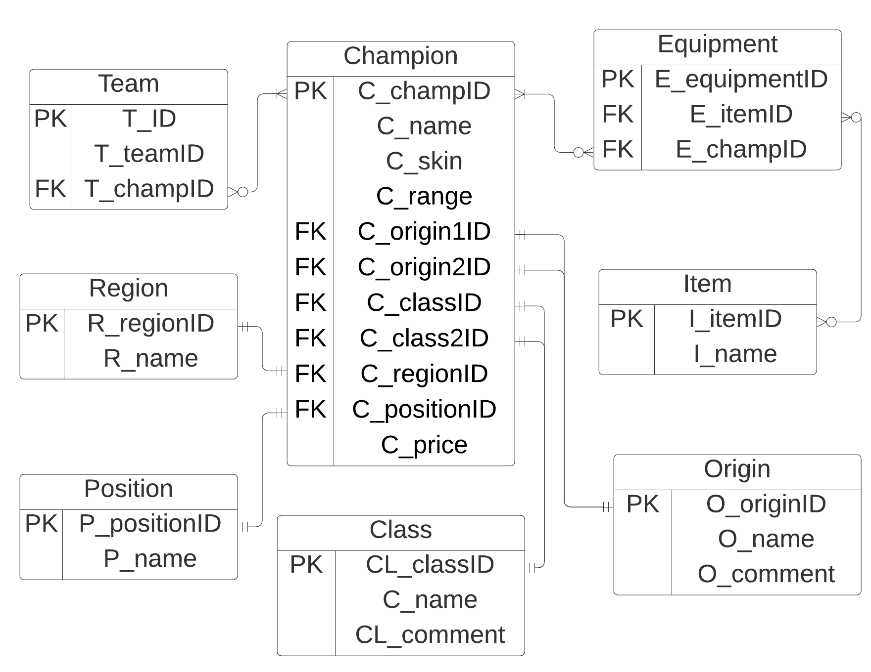
E/R Diagram

Slide 4
Relation Schema
Price
pr_PriceID | int
Pr_Price | int
Origin
O_originID | int
O_name | string
O_comment | string
Position
P_positionID | int
P_name | string
Champions
C_champID | int
C_name | string
C_skin | string
C_range | int
C_Origin1ID | int
C_Origin2ID | int
C_classID | int
C_class2ID | int
C_regionID | int
C_positionID | int
C_PriceID | int
Equipment
E_equipmentID | int
E_itemID | int
E_champID | int
Class
CL_classID | int
CL_name | string
CL_comment | string
Item
I_name | string
I_itemID | int
Team_D
T_teamID | int
T_name | String
T_comment | String
Team
T_ID | int
T_champID | string
T_teamID | int
Region
R_regionID | int
R_name | string

Slide 5
Github link
https://github.com/I8HER/CSE111-Project

Slide 6
DEMO

