Slide 1
ESB & WS-Security

Slide 2
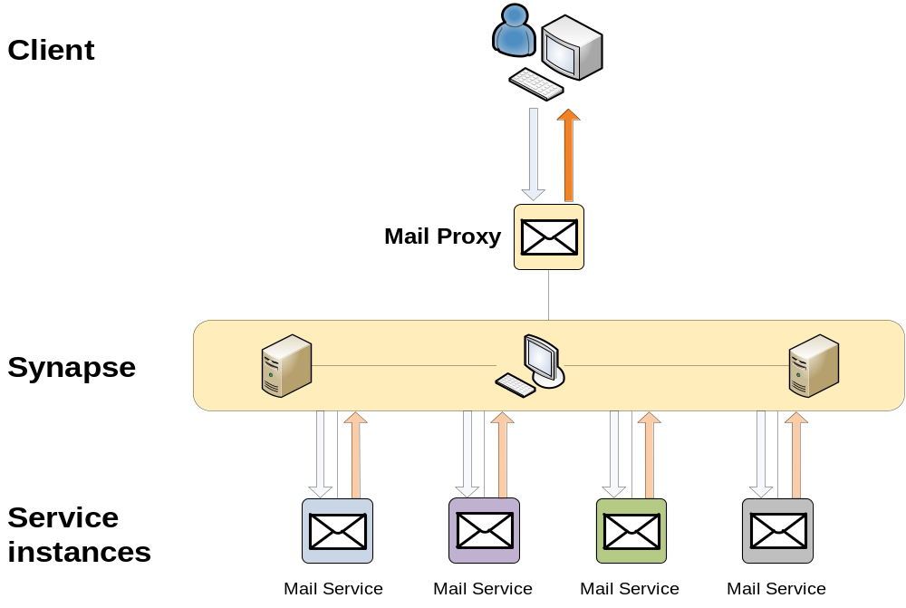
ESB: Synapse
Load balancing
Choose ODE instance
ESB is an island

Slide 3
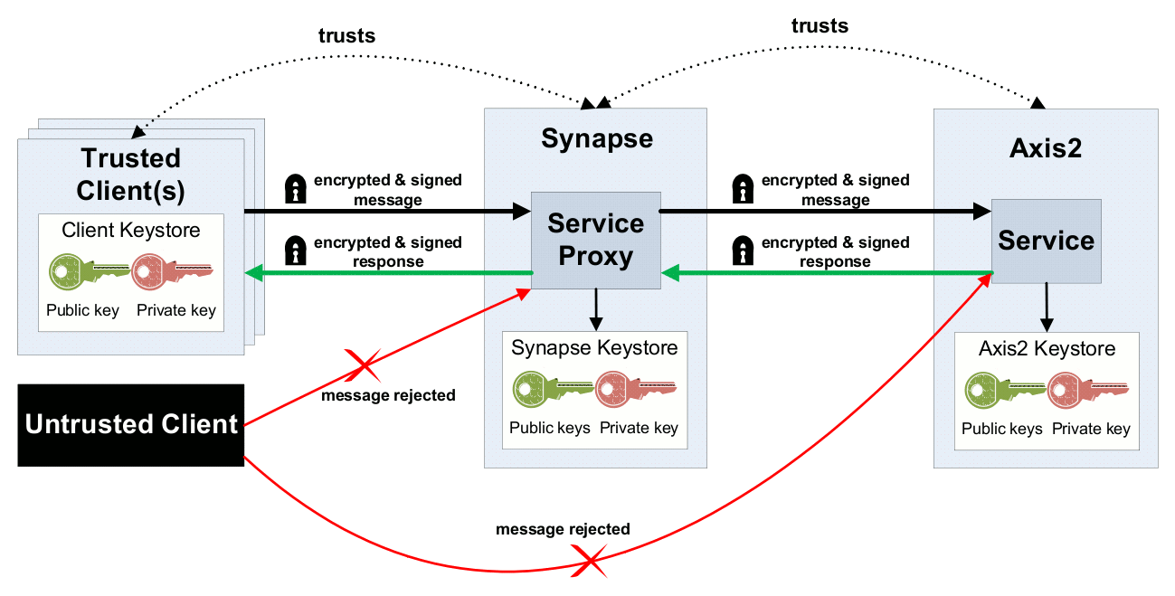
WS-Security: Rampart & WSS4J
Integration into Axis2
Usage in WS Clients/Servers
WSS4J necessity
Key distribution

Slide 4
End Of Document

