Slide 1
Innovation labs Gateway selection based on real-time analytics

Slide 2
Use Case: INTRODUCTION
New environment
5G Network
COM – P – A
Analytics module
Linked DPI product with analytics infrastructures
Use case: Gateway Selection
MWC 2017: P4S – Live demonstration
COM
P
A

Slide 3


Use Case: INTRODUCTION
Initial situation
Normal user
Central GW
Conventional performance

Slide 4

Use Case: INTRODUCTION
New situation
Enhanced performance
Local GW
Local GW
Central GW
Demanding user
Local GW
Local GW

Slide 5
Use Case: INTRODUCTION
Inefficient configuration
Local GW
Local GW
Central GW
Local GW
Local GW

Slide 6
Use Case: INTRODUCTION
Ideal configuration
Local GW
Local GW
Central GW
Local GW
Local GW

Slide 7
Use Case: model architecture
Internet
User_1
DPIsim
User_2
file.log
DPIsimLogParser.py
Bandwidth
&
Gateway
Assignation
Kafka
Analytics
Visualization
Database

Slide 8
Use Case: model architecture
Internet
User_1
DPIsim
Network traffic simulator
User_2
file.log
DPIsimLogParser.py
Bandwidth
&
Gateway
Assignation
Kafka
Analytics
Visualization
Database

Slide 9
Use Case: model architecture
Network traffic simulator
Bandwidth
&
Gateway
Assignation
Kafka
Analytics
Visualization
Database

Slide 10
Use Case: model architecture
Network traffic simulator
Bandwidth
&
Gateway
Assignation
Kafka
Analytics
Visualization
Database

Slide 11
Use Case: Network traffic generator
User
Traffic
Simulation time
Behaviour simulation
Profile
Web browsing
Video
VoIP

Slide 12
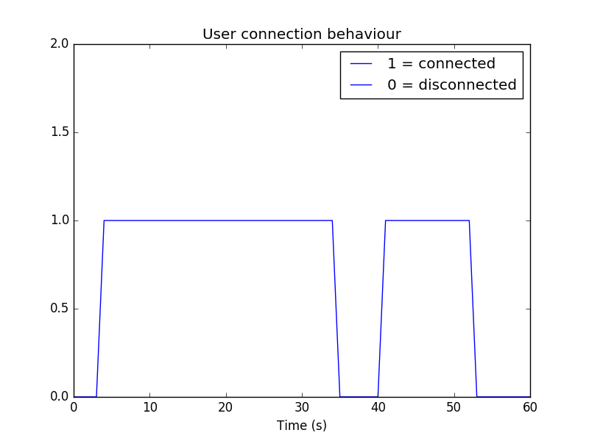
Use Case: Network traffic generator

Slide 13
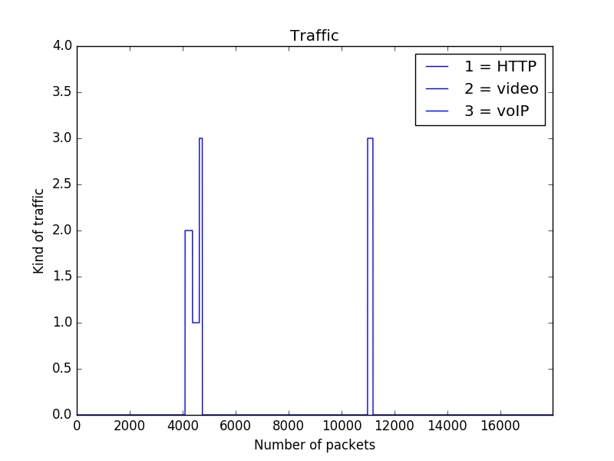
Use Case: Network traffic generator

Slide 14
Use Case: analytics module
User definition
User ID | Contract | Priority demanded | Priority
1 | 1 (Bronze) | 1 (Normal) | 1 (1*1)
2 | 1 (Bronze) | 3 (Video Str.) | 3 (1*3)
3 | 3 (Gold) | 3 (Video Str.) | 9 (3*3)
… | … | … | …

Slide 15

Use Case: analytics module
User definition
User ID | Contract | Priority demanded | Priority
1 | 1 (Bronze) | 1 (Normal) | 1 (1*1)
2 | 1 (Bronze) | 3 (Video Str.) | 3 (1*3)
3 | 3 (Gold) | 3 (Video Str.) | 9 (3*3)
… | … | … | …
Gateway assignation model
New user
?
Threshold & Max numbers of connections
Central GW
Conventional performance
Threshold (1)
Max number of connections
Local GW
Enhanced performance
Threshold (9)
Max number of connections

Slide 16
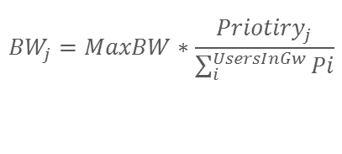
Use Case: analytics module
User definition
User ID | Contract | Priority demanded | Priority
1 | 1 (Bronze) | 1 (Normal) | 1 (1*1)
2 | 1 (Bronze) | 3 (Video Str.) | 3 (1*3)
3 | 3 (Gold) | 3 (Video Str.) | 9 (3*3)
… | … | … | …
Bandwidth assignation model
Assigned GW
Bandwidth assignation for the connected users ?
Assigned bandwidth directly proportional to the users’ priority
$${BW}_{j}=MaxBW∗\frac{{Priotiry}_{j}}{\sum_{i}^{UsersInGw}{Pi}}$$

Slide 17


Use Case: DEMO
SET UP
Random assignation of GWs
Optimized assignation of GWs
time
Users
Gateways
25 users; 12 connected; 3 conn. / discon.
2 Gws
Bronze
Normal & Video streaming
Gold
Video streaming
Central GW
Normal latency
Local GW
Reduced latency
USER SATISFACTION
$$KPI Latency=\frac{Desired latency}{Provided latency}$$
Max value limited to 1
$$KPI Bandwidth=\frac{Desired bandwidth}{Provided bandwidth}$$

Slide 18
Use Case: conclusions
A real-time analytics framework is proposed to assist in the gateway selection process of future 5G networks (policy engine)
The proposed algorithm analyses not only the profile of the users (gold, silver or bronze), but also the kind of traffic generated by them in previous sessions (historic). Both aspects are translated into a factor called “priority”
Based on this priority, the algorithm makes suggestion for the assignation of gateways maximizing the user satisfaction
It is shown that a much more efficient use of the network is achieved when this algorithm is used in comparison with the case when the assignation of gateways is performed randomly

Slide 19
Use Case: future work
(MWC 2017, Master thesis, …)
A new model which takes into account the location of the users, and other technical aspects, is proposed so its efficiency can be proved in a more realistic scenario. A virtual scenario / dynamic interface will be built so the results can be observed in real time
Total delay = processing d. + queuing d. + transmission d. + propagation d. (distance)
Local GW
Local GW
distance
Central GW
Local GW
Local GW

Slide 20
Use Case: future work
(MWC 2017, Master thesis, …)
A new model which takes into account the location of the users, and other technical aspects, is proposed so its efficiency can be proved in a more realistic scenario. A virtual scenario / dynamic interface will be built so the results can be observed in real time
In order to maximize the performance of the network, a dynamic configuration of the gateways (threshold) is proposed based on predictive models which can simulate future states of the network
The combination of this framework together with current designing tools is proposed in order to optimize the design of future 5G networks (number of antennas necessary, location of them, …)

Slide 21
Use Case: future work
(MWC 2017, Master thesis, …)
Build a docker for each module. Setting up all the system in OpenStack
Network traffic simulator
Bandwidth
&
Gateway
Assignation
Kafka
Analytics
Visualization
Database

Slide 22
Use Case: future work
(MWC 2017, Master thesis, …)
Apply the different resources given by GW assignation model to real connections and study the effect on QoE (COM-P-A)
Real connections
Network traffic simulator
Bandwidth
&
Gateway
Assignation
Kafka
Analytics
Visualization
Database

