Slide 1

INTERIM PRESENTATION
Conor Weldon – n00191746

Slide 2
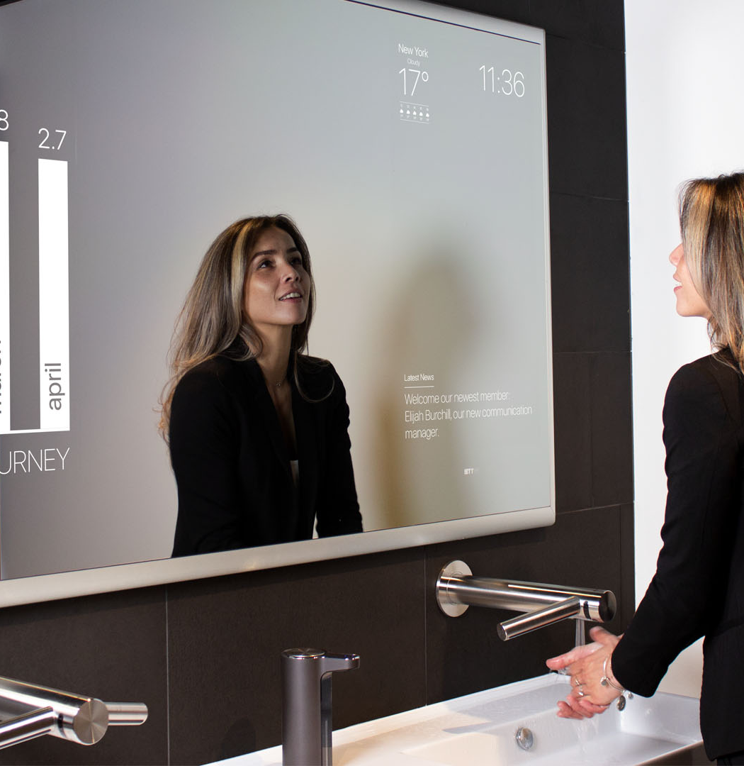
Thesis Overview
Objective: Creating a smart mirror that recognizes emotions and displays tasks
Tools: Raspberry Pi, LED screen, OpenCV and/or Azure Cognitive Services Libraries
Implementation: Use of facial recognition to detect emotions
Data Collection: Creation of a personal database to improve technology and learning
Evolution: Constant adaptation of the technology using OpenCV and Azure Cognitive Services Libraries
Notes:
I plan to create a technical physical object. I wish to create a smart mirror, that can recognize a person’s emotions and based on what it finds, display a list of tasks for you, in aid of either keep you in that emotional state or to change your emotional state to a better one.
The fundamentals for doing this would be, a Raspberry Pie and a LED Screen for the mirror itself, using libraries such as OpenCV (Python Library) and / or the Azure Cognitive Services Libraries to implement my facial recognition. I would then like to implement my own Database and collect my own data each time the “mirror” is used, so that the technology itself is constantly evolving, adapting and most importantly, learning. I would also be looking to use OpenCV and / or the Azure Libraries for this.

Slide 3
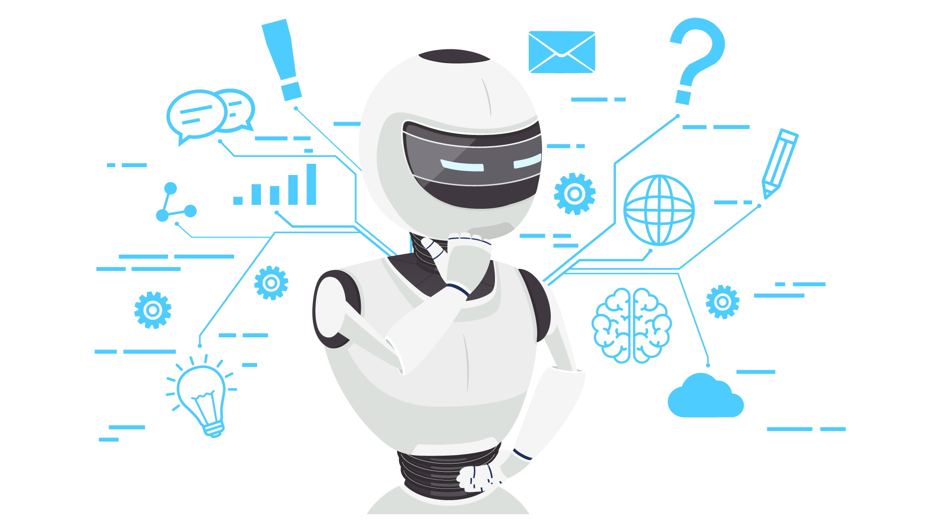
Applications Being Used
Python
OpenCV
Azure Cognitive Services
Raspberry Pi
LED screen
2 Way Glass
Monitor

Slide 4
Applications Being Used
Computer Vision
Deep Learning
IoT
Raspberry Pi & Arduino
Digital Twin

Slide 5

Azure Cognitive Services
Azure Cognitive Services Face API is a facial recognition and analysis service provided by Microsoft.
The Face API is available as a REST-based web service, making it easy to integrate into various platforms including mobile apps, web applications, and desktop software.
The API is highly customizable and provides several parameters that developers can use to fine-tune the recognition process.
The Face API is constantly evolving and improving through updates and feedback from users.
The Face API is a cost-effective and time-saving solution for adding facial recognition capabilities to your projects.
Notes:
Azure Cognitive Services Face API is a powerful tool that can add facial recognition capabilities to your applications and software. It's a cloud-based service provided by Microsoft that uses machine learning algorithms to analyze and recognize human faces in images or videos. With this API, you can identify facial features such as eyes, nose, and mouth, and even detect emotions like anger, happiness, or sadness. The Face API can also perform other tasks like facial verification and grouping.
The best part is that the Face API is easy to integrate into your projects, whether you're developing mobile apps, web applications, or desktop software. It's available as a REST-based web service, which makes it very versatile and flexible. So if you're looking to add facial recognition capabilities to your application, Azure Cognitive Services Face API is definitely worth considering.
A REST-based web service is a type of web service that follows architectural principles for building distributed systems. It uses HTTP protocol for exchanging data between two computer systems and is designed to be simple, lightweight, and scalable. REST-based web services are widely used to build APIs that can be used by different applications and systems, regardless of the platform or programming language used.

Slide 6

OpenCV
OpenCV stands for Open Source Computer Vision and is an open-source library for building computer vision applications.
OpenCV includes features such as filtering, feature detection, object recognition, and tracking.
OpenCV is written in C++, but it also has interfaces for other popular programming languages like Python, Java, and MATLAB.
Its open-source nature enables developers to customize and extend the library to suit their specific needs.
Notes:
Hey, let me tell you about OpenCV! It stands for Open Source Computer Vision and is a widely used open-source library for building computer vision applications. Originally developed by Intel in 1999, OpenCV provides developers with a comprehensive set of functions and algorithms for image and video processing tasks, including filtering, feature detection, object recognition, and tracking.
What's more, OpenCV includes machine learning algorithms for tasks like image classification and segmentation. The library is written in C++ but also has interfaces for other popular programming languages like Python, Java, and MATLAB. This means that developers can use their preferred programming language to build computer vision applications.
OpenCV has numerous applications across a range of industries, including robotics, healthcare, entertainment, and security. Its open-source nature enables developers to customize and extend the library to suit their specific needs. Overall, OpenCV is a powerful and flexible tool for computer vision applications and continues to be a popular choice among developers.

Slide 7
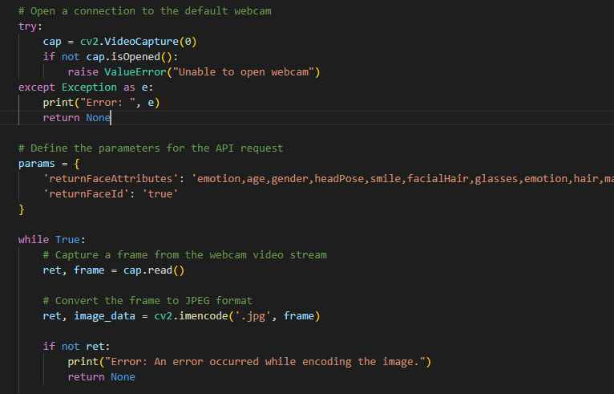
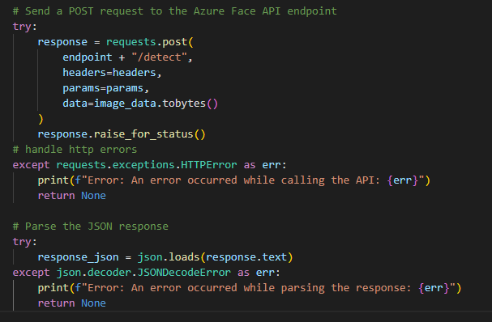
Implementation of the two Codes
OpenCV
Azure Face API

Slide 8
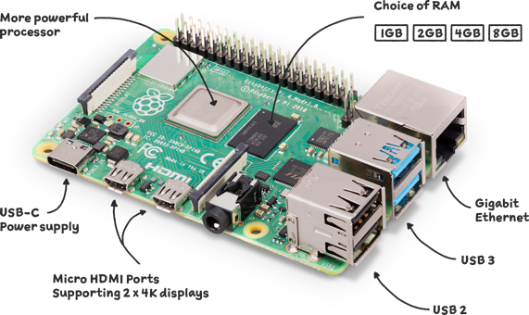
Raspberry PI
Raspberry Pi is a series of low-cost, credit card-sized single-board computers created by the Raspberry Pi Foundation.
Raspberry Pi boards come equipped with a CPU, GPU, RAM, and input/output interfaces like USB, Ethernet, HDMI, and GPIO.
They can run a variety of operating systems, including Linux-based systems, and be programmed with languages like Python, C, and Java.
Notes:
Raspberry Pi is a series of small, low-cost, credit card-sized single-board computers developed by the Raspberry Pi Foundation in the UK. It is designed to promote the teaching of basic computer science in schools and developing countries, as well as to serve as a low-cost platform for hobbyists and makers to build various electronic projects.
The Raspberry Pi boards are equipped with a CPU, GPU, RAM, and various input/output interfaces, such as USB, Ethernet, HDMI, and GPIO (General Purpose Input/Output). They can run a variety of operating systems, including Linux-based operating systems, and can be programmed using various programming languages such as Python, C, and Java.
Raspberry Pi boards have a wide range of applications, such as in home automation, robotics, media centers, game consoles, and even in commercial products. Their low cost, small size, and versatility make them a popular choice for DIY enthusiasts, hobbyists, and educators.

Slide 9
Current Situation
OpenCV being used to take a frame from your webcam and send it off as a jpg to Azure Cognitive Services.
Azure Cognitive Services Face API then scans the image, checks for the emotions in the image and returns then them.
Takes into account the image sent, checks to see if there is another photo with the same person in it, if so it will group the image, if not it’ll create a new group.
Uses this data to test itself continuously.
Raspberry PI acquired and learnt on how to code.
Low Fidelity – Mid Fidelity – High Fidelity Designs made.

Slide 10

How It’s Going
(Or not going)

Slide 11
Work Done
9 Different Versions of Code.
Daily GitHub Updates with 37 Unique Research Documents.
Smart Mirror Applications.

Slide 12
Set Backs
Azure Limited Access Form
Shipping Time
Design & Surveys

Slide 13
Future Plans
Further improver my Code.
Implement the design with the backend.
Testing.
Creation of Physical Product.

Slide 14
Sprints
Sprint 1 – Fix the current Access Issue.
Sprint 2 – Testing to ensure the current code is working.
Sprint 3 – Design the User Interface and Backend of Application
Sprint 4 – Complete the development of Backend
Sprint 5 – Begin Implementation of the Code into the Raspberry PI
Sprint 6 – Testing after the conversion of code to Raspberry PI
Sprint 7 – Building of the Physical Computing Component
Sprint 8 – Implement extra features where possible
Sprint 9 – Implement extra features where possible

Slide 15

Questions?
(Feedback)

Slide 16

Conor Weldon – N00191746

