Slide 1



https://www.dash-app.com/
Home
-- Login --
-- Sign Up --
Item 1: Login button
Item 2: Sign up button

Slide 2
https://www.dash-app.com/sign-up
Sign up
Sign up
First Name
Last Name
Email
Password

Slide 3
https://www.dash-app.com/login
Login
Log in
Email
Password

Slide 4
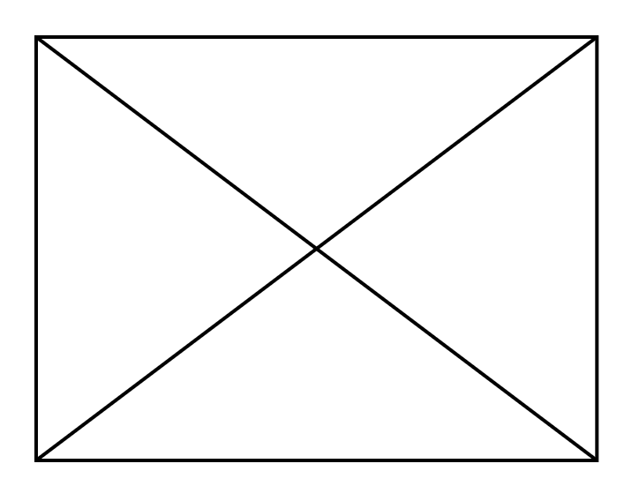
https://www.dash-app.com/price-map
Pollution Graphs​
Joe Smith
Price Map
Contents
Enter Location:
Price Map
Item 2: Location Input for pricing information
Pollution Graphs
Usage Graphs
Item 1: Price Map
Item 3: Pricing Information for Location

Slide 5
https://www.dash-app.com/pollution-graphs
Pollution Graphs​
Joe Smith
Pollution Graphs
Contents
Price Map
Pollution Graphs
Item 2: Drop-down box to choose Location
Usage Graphs
Item 1: Historical Pollution Data for chosen Location
Item 3: Statistical Measures of chosen Data

Slide 6
https://www.dash-app.com/usage-graphs
Pollution Graphs​
Joe Smith
Usage Graphs
Contents
Price Map
Item 1: Drop-down box to choose Location
Item 3: Drop-down box to choose Location
Pollution Graphs
Usage Graphs
Item 1: Monthly Cycle Usage Chart
Item 2: Monthly Cycle Usage Chart
Item 4: Daily Cycle Usage Chart

Slide 7
Start
Home
Login
Signup
Price Map
Pollution Graphs
Usage Graphs

Slide 8
https://www.machine-learning-app.com/
Home
-- Login --
-- Sign Up --
Item 1: Login button
Item 1: Sign up button

Slide 9
https://www.machine-learning-app.com/login
Login
Log in
Email
Password

Slide 10
https://www.machine-learning-app.com/sign-up
Sign up
Sign up
First Name
Last Name
Email
Password

Slide 11
https://www.machine-learning-app.com/prediction-request
Pollution Graphs​
Joe Smith
Predict Pollution Level
Contents
Enter Date (dd/mm/yyyy):
Make Prediction
Item 1: Input Parameters for ML Algorithm
Enter Location:
-- Make Prediction --
Item 2: Predict Button to Submit Parameters

Slide 12
https://www.machine-learning-app.com/prediction-response
Pollution Graphs​
Joe Smith
Pollution Level Prediction
Contents
Value: XXXXXX
Make Prediction
Item 1: Inputted Parameters
Value: XXXXXX
Prediction: XXXXXX
Item 2: Displayed Result from ML Prediction

Slide 13
Start
Home
Login
Signup
Prediction Request
Prediction Response

