Slide 1
Lecture 12 Graph-Based Algorithms
CSE373: Design and Analysis of Algorithms

Slide 2
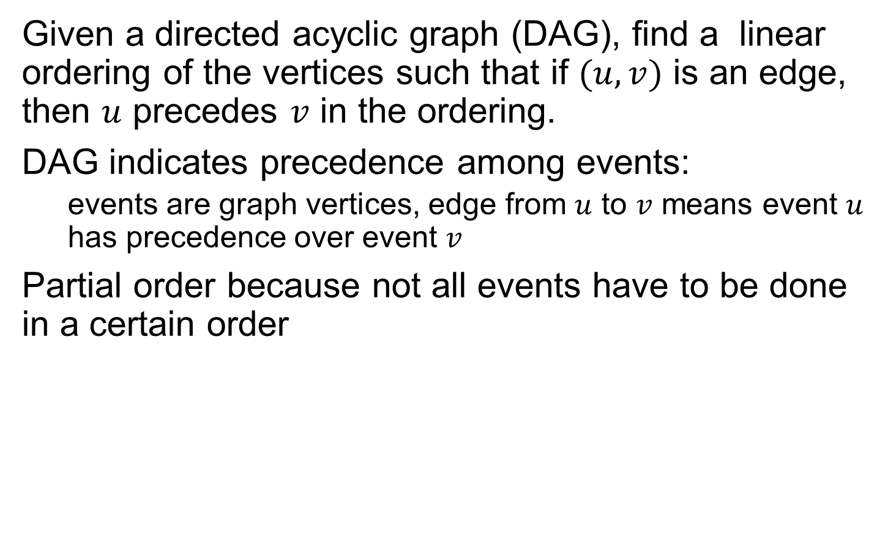
DFS Application: Topological Sort
Given a directed acyclic graph (DAG), find a linear ordering of the vertices such that if $(u,v)$ is an edge, then $u$ precedes $v$ in the ordering.
DAG indicates precedence among events:
events are graph vertices, edge from $u$ to $v$ means event $u$ has precedence over event $v$
Partial order because not all events have to be done in a certain order

Slide 3
DFS Application: Topological Sort
Precedence Example:
Consider how Professor Bumstead gets dressed for his office.
undershorts, pants, shirt, jacket, tie, watch, belt, shoes, socks
Certain garments must before others (e.g., socks before shoes)
For other events, it doesn't matter (e.g., socks and pants)

Slide 4
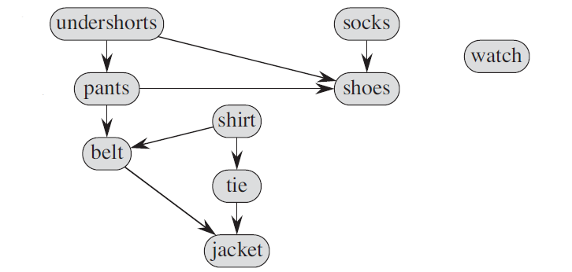

DFS Application: Topological Sort
A directed edge $(u,v)$ in the DAG indicates that garment $u$ must be donned before garment $v$. A topological sort of this DAG therefore gives an order for getting dressed.

Slide 5
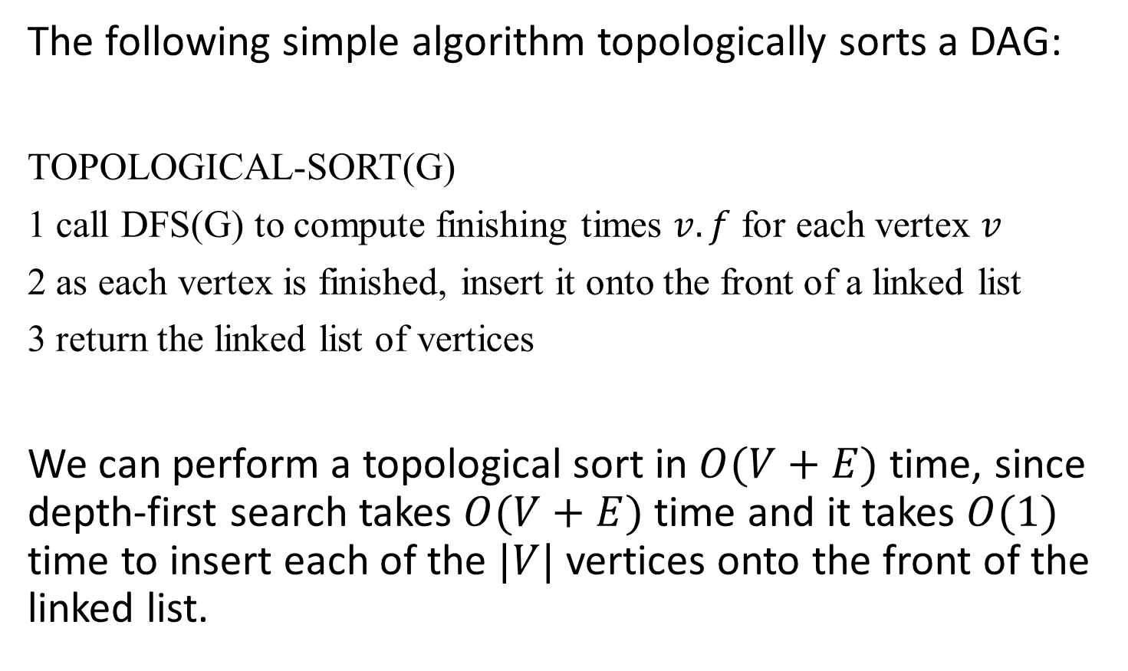
DFS Application: Topological Sort
The following simple algorithm topologically sorts a DAG:
TOPOLOGICAL-SORT(G)
1 call DFS(G) to compute finishing times $v.f$ for each vertex $v$
2 as each vertex is finished, insert it onto the front of a linked list
3 return the linked list of vertices
We can perform a topological sort in $O(V+E)$ time, since depth-first search takes $O(V+E)$ time and it takes $O(1)$ time to insert each of the $|V|$ vertices onto the front of the linked list.

Slide 6
Topological sort
Call DFS(G) to compute the finishing times f[v]
Time = 2
Time = 3
d = ∞
f = ∞
Let’s say we start the DFS from the vertex c
a
d = 1
f = ∞
Next we discover the vertex d
d = ∞
f = ∞
b
c
c
d = ∞
f = ∞
d = ∞
f = ∞
d = 2
f = ∞
d
d
e
d = ∞
f = ∞
f

Slide 7
Topological sort
Call DFS(G) to compute the finishing times f[v]
Time = 3
Time = 4
as each vertex is finished, insert it onto the front of a linked list
d = ∞
f = ∞
Let’s say we start the DFS from the vertex c
a
d = 1
f = ∞
Next we discover the vertex d
d = ∞
f = ∞
b
c
c
Next we discover the vertex f
d = 2
f = ∞
d = ∞
f = ∞
f is done, move back to d
d
d
e
d = 3
f = ∞
d = 3
f = 4
f
f
f

Slide 8
Topological sort
Call DFS(G) to compute the finishing times f[v]
Time = 4
Time = 5
d = ∞
f = ∞
Let’s say we start the DFS from the vertex c
a
d = 1
f = ∞
Next we discover the vertex d
d = ∞
f = ∞
b
c
c
Next we discover the vertex f
d = 2
f = 5
d = ∞
f = ∞
f is done, move back to d
d
d
e
d is done, move back to c
d = 3
f = 4
f
f
d
f

Slide 9
Topological sort
Call DFS(G) to compute the finishing times f[v]
Time = 5
Time = 6
d = ∞
f = ∞
Let’s say we start the DFS from the vertex c
a
d = 1
f = ∞
Next we discover the vertex d
d = ∞
f = ∞
b
c
c
Next we discover the vertex f
d = 2
f = 5
d = ∞
f = ∞
f is done, move back to d
d
d
e
d is done, move back to c
d = 3
f = 4
f
Next we discover the vertex e
f
d
f

Slide 10
Topological sort
Call DFS(G) to compute the finishing times f[v]
Time = 6
Time = 7
d = ∞
f = ∞
Let’s say we start the DFS from the vertex c
a
d = 1
f = ∞
Next we discover the vertex d
d = ∞
f = ∞
b
c
Next we discover the vertex f
d = 2
f = 5
d = 6
f = ∞
f is done, move back to d
d
d
e
e
d is done, move back to c
d = 3
f = 4
f
Next we discover the vertex e
f
e is done, move back to c
e
d
f

Slide 11
Topological sort
Call DFS(G) to compute the finishing times f[v]
Time = 7
Time = 8
d = ∞
f = ∞
Let’s say we start the DFS from the vertex c
a
d = 1
f = ∞
Next we discover the vertex d
d = ∞
f = ∞
b
c
Next we discover the vertex f
d = 2
f = 5
d = 6
f = 7
f is done, move back to d
d
d
e
e
d is done, move back to c
d = 3
f = 4
f
Next we discover the vertex e
f
e is done, move back to c
c
e
d
f
c is done as well

Slide 12
Topological sort
Call DFS(G) to compute the finishing times f[v]
Time = 9
Time = 10
d = ∞
f = ∞
Let’s now call DFS visit from the vertex a
d = 9
f = ∞
a
a
d = 1
f = 8
Next we discover the vertex c,
but c was already processed
d = ∞
f = ∞
b
c
d = 2
f = 5
d = 6
f = 7
Next we discover the vertex b
d
d
e
e
d = 3
f = 4
f
f
c
e
d
f

Slide 13
Topological sort
Call DFS(G) to compute the finishing times f[v]
Time = 10
Time = 11
d = 9
f = ∞
Let’s now call DFS visit from the vertex a
a
a
d = 1
f = 8
Next we discover the vertex c,
but c was already processed
d = 10
f = ∞
d = 10
f = 11
b
b
c
d = 2
f = 5
d = 6
f = 7
Next we discover the vertex b
d
d
e
e
b is done,
now move back to c
d = 3
f = 4
f
f
b
c
e
d
f

Slide 14
Topological sort
Call DFS(G) to compute the finishing times f[v]
Time = 11
Time = 12
d = 9
f = ∞
Let’s now call DFS visit from the vertex a
a
a
d = 1
f = 8
Next we discover the vertex c,
but c was already processed
d = 10
f = 11
b
b
c
d = 2
f = 5
d = 6
f = 7
Next we discover the vertex b
d
d
e
e
b is done,
now move back to c
d = 3
f = 4
f
f
a is done as well
b
c
e
d
f

Slide 15
Topological sort
Call DFS(G) to compute the finishing times f[v]
Time = 11
Time = 13
d = 9
f = 12
Let’s now call DFS visit from the vertex a
WE HAVE THE RESULT!
return the linked list of vertices
a
a
d = 1
f = 8
Next we discover the vertex c,
but c was already processed
d = 10
f = 11
b
b
c
d = 2
f = 5
d = 6
f = 7
Next we discover the vertex b
d
d
e
e
b is done,
now move back to c
d = 3
f = 4
f
f
a is done as well
a
b
c
e
d
f

Slide 16
Topological sort
Time = 11
Time = 13
The linked list is sorted in decreasing order of finishing times f[]
d = 9
f = 12
a
a
d = 10
f = 11
d = 1
f = 8
b
Try yourself with different vertex order for DFS visit
b
c
d = 2
f = 5
d = 6
f = 7
d
d
e
e
Note: If you redraw the graph so that all vertices are in a line ordered by a valid topological sort, then all edges point „from left to right“
d = 3
f = 4
f
f
a
b
c
e
d
f

Slide 17
Strongly Connected Components
G is strongly connected if every pair (u, v) of vertices in G is reachable from one another.
A strongly connected component (SCC) of G is a maximal set of vertices C ⊆ V such that for all u, v ∈ C, both u v and v u exist.

Slide 18
Strongly Connected Components
A
C
E
G
B
D
F
H

Slide 19
Strongly Connected Components
A
C
E
G
B
D
F
H

Slide 20
Strongly Connected Components
G^{SCC} = (V^{SCC}, E^{SCC}).
V^{SCC} has one vertex for each SCC in G.
E^{SCC} has an edge if there’s an edge between the corresponding SCC’s in G.
G^{SCC} is always a DAG
a
b
c
d
e
j
i
h
g
f

Slide 21
Strongly Connected Components
G^{T} = transpose of directed graph G.
G^{T} = (V, E^{T}), E^{T} = {(u, v) : (v, u) ∈ E}.
G^{T} is G with all edges reversed.
We can create G^{T} in Θ(V + E) time if we are using adjacency lists.
G and G^{T} have the same SCC’s. (u and v are reachable from each other in G if and only if reachable from each other in G^{T}).
a
d
G
a
d
G^{T}
b
c
Edges
have reverse
direction!
b
c
a b c d
a b c d
a
b
c
d
1
a
b
c
d
1
1
1
1
1
1
1

Slide 22
Algorithm to Determine SCCs
SCC(G)
call DFS(G) to compute finishing times f [u] for all u
compute G^{T}
call DFS(G^{T}), but in the main loop, consider vertices in order of decreasing f [u] (as computed in first DFS)
output the vertices in each tree of the depth-first forest formed in second DFS as a separate SCC
Time: Θ(V + E).

Slide 23
Example
a
b
c
d
13/
14
11/
16
1/
10
8/
9
DFS on the initial graph G
b
16
e
15
a
14
c
10
d
9
g
7
h
6
f
4
3/
4
2/
7
5/
12/
15
6
e
f
g
h
a
b
c
d
DFS on G^{T:}
start at b: visit a, e
start at c: visit d
start at g: visit f
start at h
2/5
1/6
7/10
8/9
3/4
12/13
11/14
15/16
e
f
g
h
Strongly connected components: C₁ = {a, b, e}, C₂ = {c, d}, C₃ = {f, g}, C₄ = {h}

Slide 24
Exercise: Compute SCCs
Compute SCCs in the following graph using the algorithm described earlier.
a
b
c
d
e
j
i
h
g
f

