Slide 1

Effective Teaching and Its Evaluation
Larry Abele
June 2017

Slide 2
Objectives
  Introduce the course syllabus
  List the eight factors of
  effective teaching
  Brief discussion of assessment of learning
  “Demonstrate” the validity of
  student evaluations of teaching

Slide 3
Before the Course Begins
What should my students be able to do intellectually as a result of this course?
How can I help them to develop the necessary intellectual understanding and capacity?
How can I and the students assess their intellectual progress?
How do I evaluate my own efforts to foster learning as the course progresses?

Slide 4

The Course Syllabus
It is a valuable guide for you and
your students.
It begins with a statement that places the course within the intellectual area of the field.
It provides overall objectives for the course that should be fairly specific.
Includes appropriate references, including primary literature.

Slide 5

The Course Syllabus (continued)
Introduce yourself, perhaps offering a few personal facts; office hours, contact information.
Your approach to teaching.
A student contract for attendance and performance is often a good idea.
Course prerequisites.
Course assignments and due dates.

Slide 6
The Course Syllabus (continued)
How performance will be evaluated, e.g., essay exams, multiple choice, term papers.
Grading policy in considerable detail to avoid misunderstandings in the future.
Policy on attendance/make-up exams/
late papers/other related items..
Other administrative matters.

Slide 7
The Course Syllabus (continued)
Support services, e.g., math help labs or writing labs, library services.
Academic integrity and plagiarism.
Strategies for Success in the course.
Course Calendar: My personal preference is to separate the Course Calendar from the Syllabus and treat the Calendar as a course outline with at least three specific objectives for each class period.

Slide 8

9 Factors Most Important to Students
Subject Matter
  Demonstrates detailed knowledge of
  the subject matter.
  Shows enthusiasm for the subject.

Slide 9
9 Factors Most Important to Students
Presentation/Facilitation
  Is well prepared for class
  (clear syllabus and schedule, organized in class).
  Stimulates interest in the subject.
  Encourages discussion/class interaction.
  Explains information clearly.

Slide 10
9 Factors Most Important to Students
Approach to Students
  Shows concern for students.
  Is readily available to students.
  Allows recovery from a single poor performance.

Slide 11
EDUCATIONAL PRACTICES THAT FACILITATE LEARNING
First-Year Seminar
Learning Communities
Undergraduate Research
Internships in the Discipline
Freshmen Interest Groups
Service Learning

Slide 12
Assessment of Learning
This is much more difficult than it would seem because of the nature and variety of student learners.
How do we distinguish among students who are “procedural=(gamers)” and those who have
“deep understanding?”
There are few, in any, instruments available and real assessment requires prolonged oral interactions.
There are many published examples of students who received an “A” in a course but who did not have deep understanding of the material.

Slide 13

Assessment Instruments
National Survey of Student Engagement
Collegiate Learning Assessment
ETS Proficiency Profile
Collegiate Assessment of
Academic Proficiency
ETS Major Fields
College Senior Survey

Slide 14

How Do We Measure
Effective Teaching?
Student achievement: Performance in
  Current course
  Subsequent courses
  Program of study
  Professional work
  The next level of the student’s education, e.g., graduate or professional school

Slide 15
How Do We Measure
Effective Teaching?
Ratings of teaching based on
  Peer observations
  Expert observations
  Student perceptions
  Self and peer evaluation
  “Video of you teaching”

Slide 16
Holistic Observational Instruments
Reformed Teaching Observation Protocol (RTOP)
UTeach Observation Protocol (UTOP)
Teaching Behaviors Inventory (TBI)
Teaching Dimensions Observation Protocol (TDOP)
And several others

Slide 17
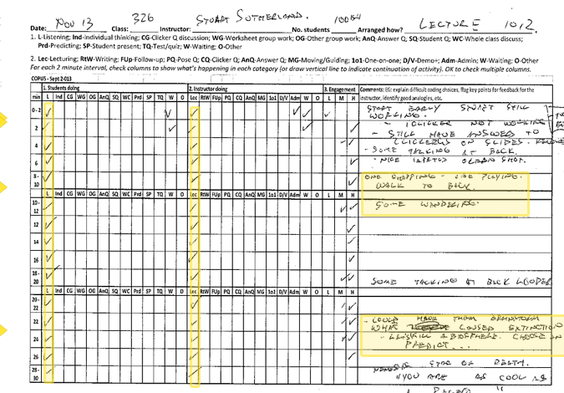
A Typical Observation Scoring Sheet with Codes

Slide 18
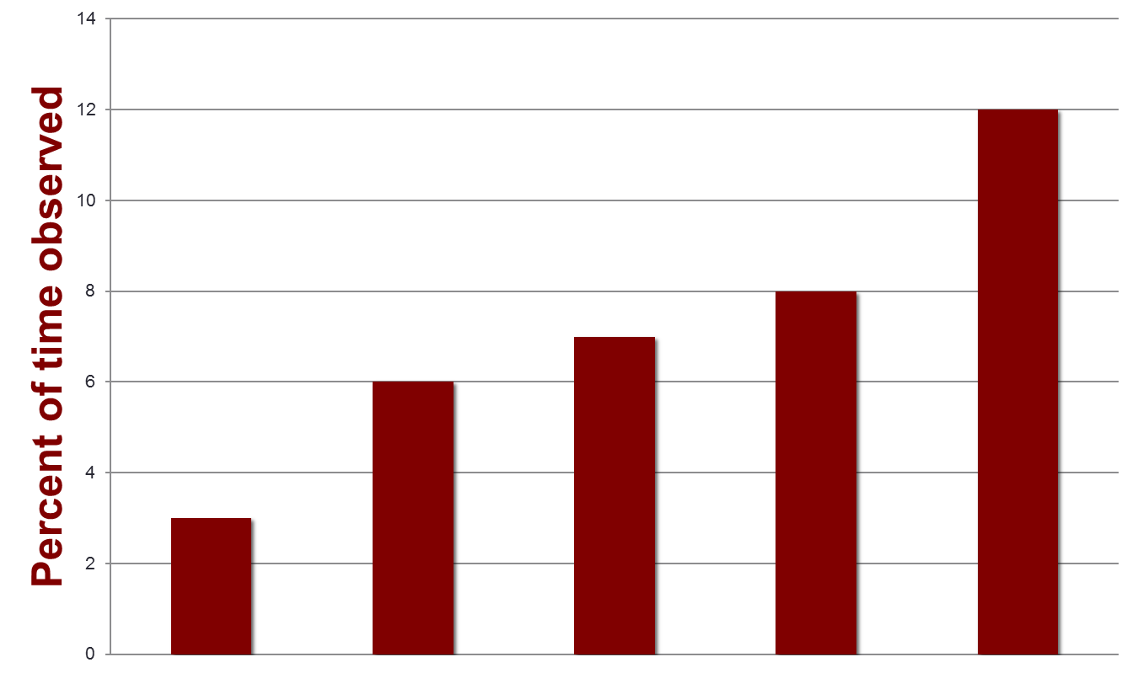
Percent of time humor is used in class: math, biology, chemistry and physics
Findings from classroom observations of 58 math and science faculty
Matthew T. Hora, Joseph J. Ferrare, Amanda Oleson Culture, Cognition, and Evaluation of STEM Higher Education Reform(CCHER) (NSF # DRL-0814724) OCTOBER 2012

Slide 19
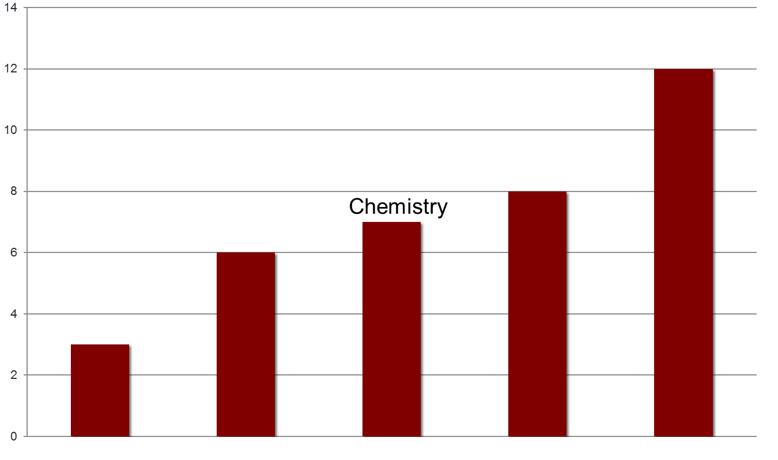
Percent of time humor is used in class: math, biology, chemistry and physics
Biology
Mathematics
Geology
Physics

Slide 20
Pay Attention to
Student Perceptions of Teaching
Read the student evaluations very carefully as research indicates that they are valid and highly correlated with peer assessment and other objective measures.
See: Kulik, J. 2001. Student Ratings: Validity, Utility and Controversy. P.9-25 In: Theall, M., Abrami, P.C., and Mets, L.A. (eds.).
The Student Ratings Debate: Are they valid? How can we best use them? Jossey-Bass, San Francisco.
Aleamoni, L. M. 1999. Student rating myths versus research facts from 1924-1998. J. Personnel Evaluation in Education 13:2 153-166

Slide 21
Responses from All Courses
Section D SUSSAI | E | VG | G | F | P | (N)
Description of course objectives and assignments | 43.8% | 31.4 | 18.9 | 4.6% | 1.2% | 98066
Communication of ideas and information | 45.4% | 29.8 | 17.3 | 5.6% | 2.0% | 97958
Expression of expectations for performance in class | 46.9% | 29.4 | 17.6 | 4.8% | 1.3% | 97692
Availability to assist students in or out of class | 49.3% | 27.3 | 17.7 | 4.4% | 1.2% | 97372
Respect and concern for students | 56.7% | 25.5 | 13.5 | 3.2% | 1.1% | 97450
Stimulation of interest in the course | 48.9% | 26.9 | 16.1 | 5.7% | 2.4% | 97287
Facilitation of learning | 47.4% | 28.7 | 17.1 | 5.0% | 1.8% | 97204
Overall assessment of instructor | 53.6% | 25.3 | 14.1 | 5.1% | 1.8% | 97237

Slide 22
Responses for a Course of Concern
Section D SUSSAI | E | VG | G | F | P | (N)
Description of course objectives and assignments | 3% | 3% | 38% | 29% | 18% | 43
Communication of ideas and information | 3% | 0 | 35% | 41% | 21% | 43
Expression of expectations for performance in class | 3% | 0 | 24% | 32% | 32% | 43
Availability to assist students in or out of class | 0% | 9% | 38% | 32% | 26% | 43
Respect and concern for students | 3% | 3% | 24% | 26% | 41% | 43
Stimulation of interest in the course | 6% | 24% | 24% | 44% | 21% | 43
Facilitation of learning | 3% | 6% | 38% | 26% | 24% | 43
Overall assessment of instructor | 3% | 3% | 18% | 35% | 41% | 43

Slide 23
Correlations
Student ratings and how much they feel they have learned AND the effectiveness of the of the instructor and course elements
  Positive correlation (.48-.64)
Overall teacher effectiveness rating AND the grade expected in the course
  Low correlation (.24) and less than the correlation between teaching effectiveness and time of day (.27)
Moderate but significant correlations between student ratings AND outside observers
  Moderate correlation (.5)

Slide 24
  Send a “Thank you and congratulations” or a complimentary note to anyone who receives 90% or better in Excellent for “overall assessment.”
  Look into anyone who receives 30% or more “Fair+Poor” to the same question.
  Improvement plans are almost always successful.

Slide 25
Concerns about Faculty Teaching
The first poor evaluation should result in a meeting with the department chair to discuss the issues. Anyone can have one poor evaluation for a variety of reasons.
The second poor evaluation should result in a written teaching improvement plan.
If there is a third poor evaluation, the faculty member should only be permitted to teach under supervision.
Failure to improve should result in removal from the program.
Faculty are almost always successful when given some guidance.

Slide 26
Written Teaching Improvement Plan
The plan is prepared with the guidance of a senior colleague or learning specialist and approved by the chair.
It should begin with a detailed list of concerns identified through student perception surveys, peer evaluation and videos of the individual teaching.
The concerns should be listed and a specific, measurable objective listed for each area of concern.
A colleague or learning specialist should be sitting in every class with an instrument that permits assessment of the improvement objectives.
Student surveys should be conducted at least every four weeks during the course.

Slide 27
Percentage of institutions that use various sources of information for evaluation of teaching
Information Source | % used in 2000 (n=506) | % used in 2010 (n=401)
Student Evaluation | 88.1% | 94.2%
Classroom visits | 40.3% | 60.4%
Course Syllabi & exams | 38.6% | 4.5%
Grade distribution | 6.7% | 10.1%
Student exam performance | 5% | 7.2%
http://www.aaup.org/article/changing-practices-faculty-evaluation#.VzigN-crLZt

Slide 28

Questions
& Discussion

Slide 29
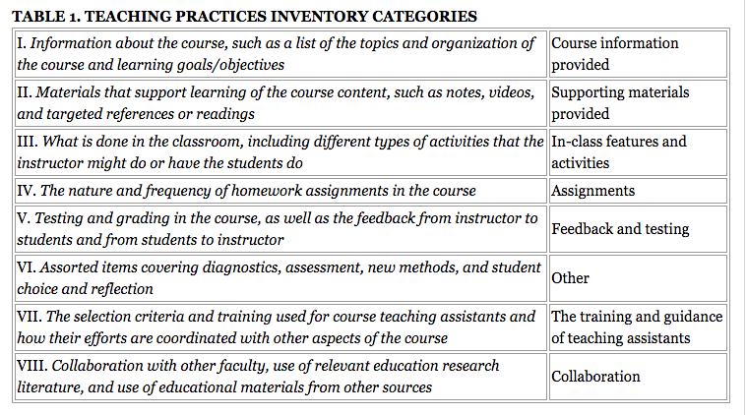
Another Approach from the Chronicle

