Slide 2
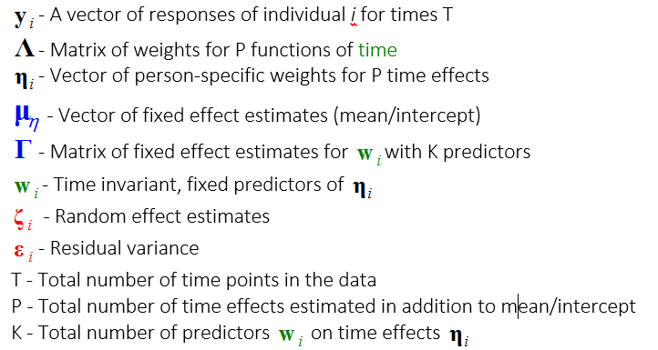
Bollen & Curran (2006)
Snijders & Bosker (2011)

Slide 4
Sequence
What models to estimate?
Model
How to express each result?
Manifestation

