Slide 1
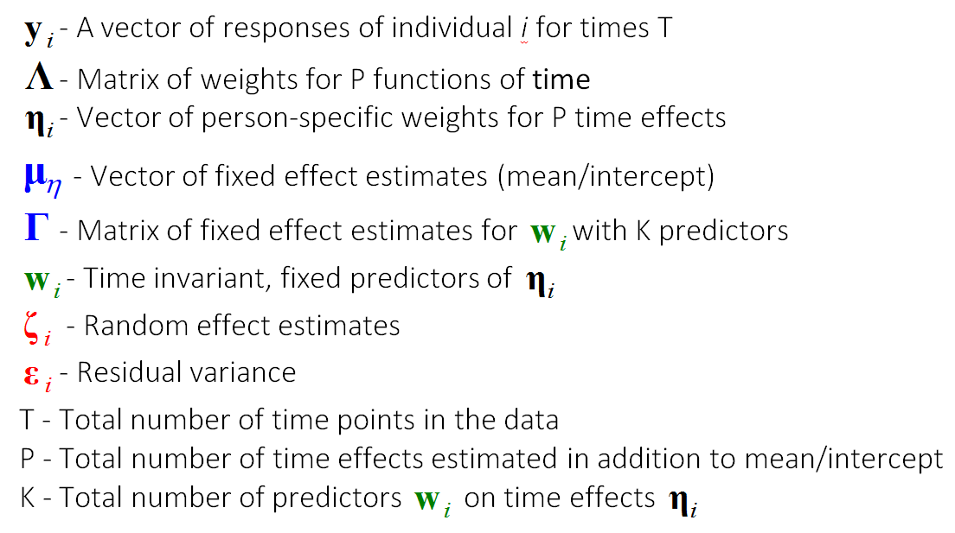
Bollen & Curran (2006)
Snijders & Bosker (2011)

Slide 2
Bollen & Curran (2006)
Snijders & Bosker (2011)

Slide 3
Model Sequence Map
F
0 random terms
m0_F
m1_F
m2_F
m0a_F
m1a_F
m2a_F
m1b_F
m2b_F
m2c_F
Models: 9
Number of time effects
*F
m0_*
m1_*
m2_*
m0a_*
m1a_*
m2a_*
m1b_*
m2b_*
m2c_*

Slide 4
Model Sequence Map
R1
1 random term
m0_R1
m1_R1
m2_R1
m0a_R1
m1a_R1
m2a_R1
m1b_R1
m2b_R1
m2c_R1
Models: 9
*R1
m0_*
m1_*
m2_*
m0a_*
m1a_*
m2a_*
m1b_*
m2b_*
m2c_*

Slide 5
Model Sequence Map
R2
2 random terms
m1_R2
m2_R2
m1a_R2
m2a_R2
m1b_R2
m2b_R2
m2c_R2
Models: 7
*R2
m1_*
m2_*
m1a_*
m2a_*
m1b_*
m2b_*
m2c_*

Slide 6
Model Sequence Map
R3
3 random terms
m2_R2
m2a_R2
m2b_R2
m2c_R2
Models: 4
*R3
m2_*
m2a_*
m2b_*
m2c_*

Slide 7
m0_* | m1_* | m2_*
m0a_* | m1a_* | m2a_*
 | m1b_* | m2b_*
 |  | m2c_*

Slide 8
Model Specification
Estimates
Predicted
Values
Model
Fit

Slide 9
Algebraic
Numeric
Graphic
Graphic/
Numeric

Slide 10
Algebraic
Model Specification
Numeric
Estimates
Graphic
Graphic/
Numeric
Predicted
Values
Model
Fit

Slide 11
Save the size of this box – use it to create pngs

