Slide 1

www.ialsa.org
Big Data, Big Analysis:
A Collaborative Modeling Framework for Multi-study Replication
Andriy V. Koval
University of Victoria
William H. Beasley
University of Oklahoma
Andrea Piccinin
University of Victoria
Graciela Muniz-Terrera
University of Edinburgh
Scott Hofer
University of Victoria
Convention of Canadian Psychological Association | Victoria, BC | June 10, 2016

Slide 2
www.ialsa.org
The IALSA network (NIH/NIA 1P01AG043362) is comprised of over 100 longitudinal studies on aging, health and dementia.
Mix of samples aged from birth to 100 years
Assessed from 1921 to the present.
Monitoring each individual for 4 to 48 years
Time between assessments 6 months to 17 years
Focus on the reproducibility of results (i.e., direction and pattern of effects) across populations, historical periods, measurements, designs, and statistical models.
Research aim: To maintain and enhance cognitive and physical health and well-being throughout the lifespan

Slide 3
www.ialsa.org
IALSA Approach: Coordinated Analysis with Replication (CAR)
Finds common/similar measures among studies (maelstrom-research.org)
Fits same models to many longitudinal studies
Meta-analyzes model solutions
Aim: Maximize value from each study while providing comparable results
Expect similar conclusions regardless of the exact variables used.
Evaluation of sensitivity to statistical model
Meta-Analysis / Meta-Regression
Hofer, S. M., & Piccinin, A. M. (2009). Integrative data analysis through coordination of measurement and analysis protocol across independent longitudinal studies. Psychological Methods, 14(2), 150.

Slide 4
www.ialsa.org
IALSA Portland Workshop Feb 23-25, 2015 (github.com/IALSA/IALSA-2015-Portland)
Primary aim: To examine the associations between changes in
physical functioning (e.g., grip strength, pulmonary function) and
cognitive functioning (e.g., memory, reasoning)
in multiple-study comparative framework.
Research foci: To examine concurrent decline between
Pulmonary function – Cognition
Grip Strength – Cognition
Gait – Cognition
Cognition: Within and across cognitive domains
Physical functioning: Across pulmonary, grip, gait
Bivariate linear growth curve models
Adjustment for age, sex, education, height, health behaviors and outcomes

Slide 5
IALSA Portland Workshop Feb 23-25, 2015 (github.com/IALSA/IALSA-2015-Portland)
Study |  | Driver
Einstein Aging Study | EAS | Andrea Zammit
English Longitudinal Study of Aging | ELSA | Annie Robitaille
Health and Retirement Study | HRS | Chenkai Wu
Interdisciplinary Longitudinal Study of Aging | ILSE | Philipp Handschuh
Normative Aging Study | NAS | Lewina Lee
Quebec Longitudinal Study on Nutrition and Aging | NuAge | Valerie Jarry
Octogenarian Twins | OCTO | Marcus Praetorius
Rush Memory and Aging Project | MAP | Cassandra Brown
Swedish Adoption Twin Study of Aging | SATSA | Deborah Finkel

Slide 6
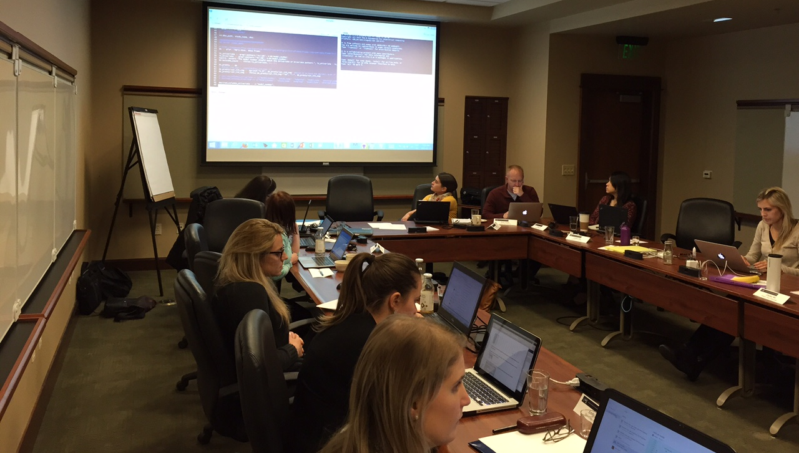
Portland, OR
Feb 23-25, 2015

Slide 7
This is the
WORKFLOW MAP
of the coordinated analysis.

Slide 8
Next,
we will show you
what each element and process
IS and DOES.

Slide 9
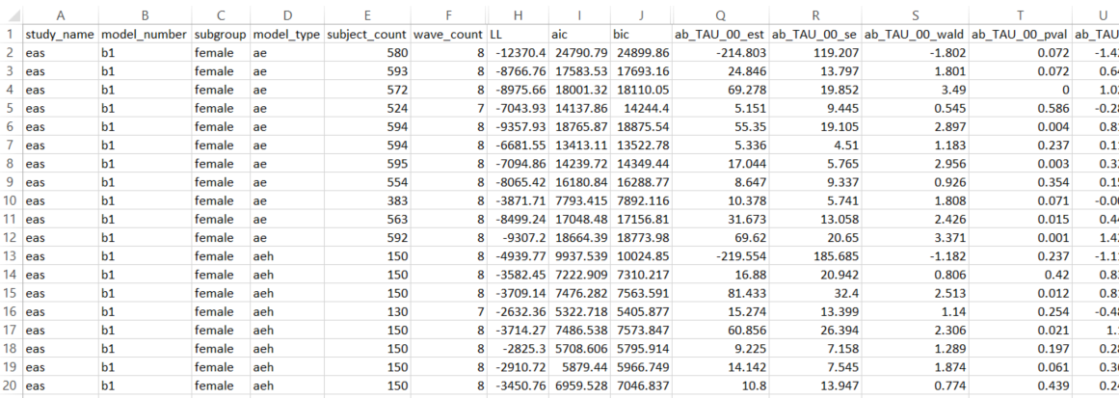
These are
language-agnostic, tabulated DATA FILES.
They can be used by any software (R, SAS, STATA, Mplus, etc)

Slide 10
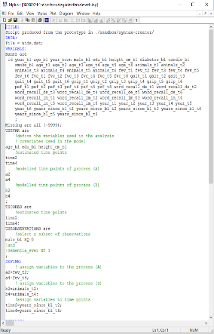

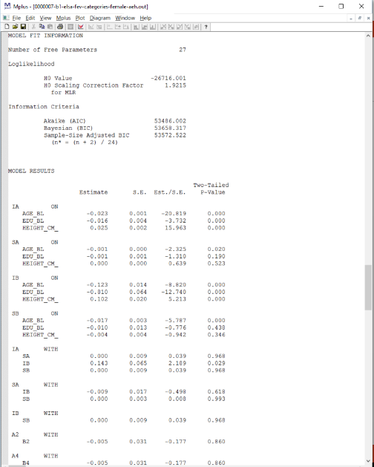
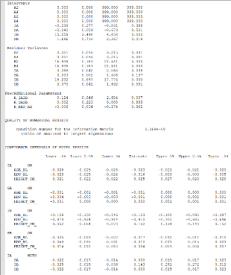
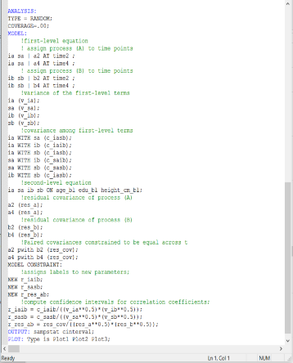
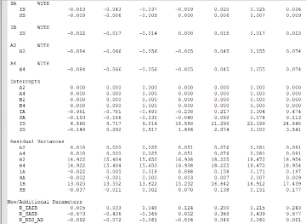
These are
input and output files
consumed and produced by Mplus.

Slide 11

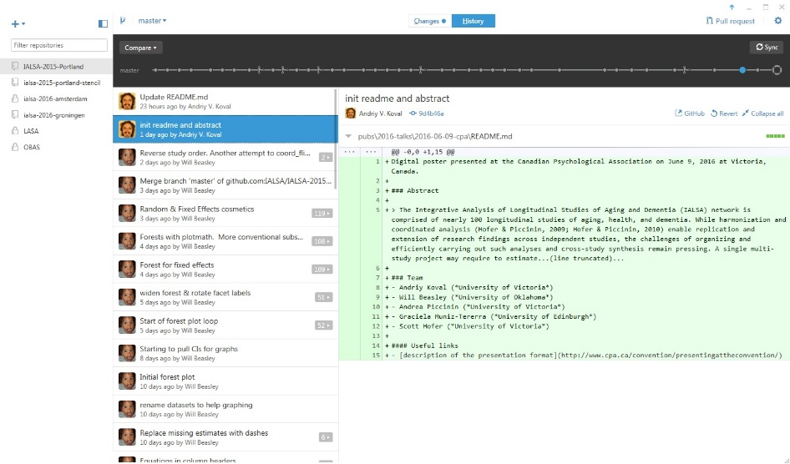
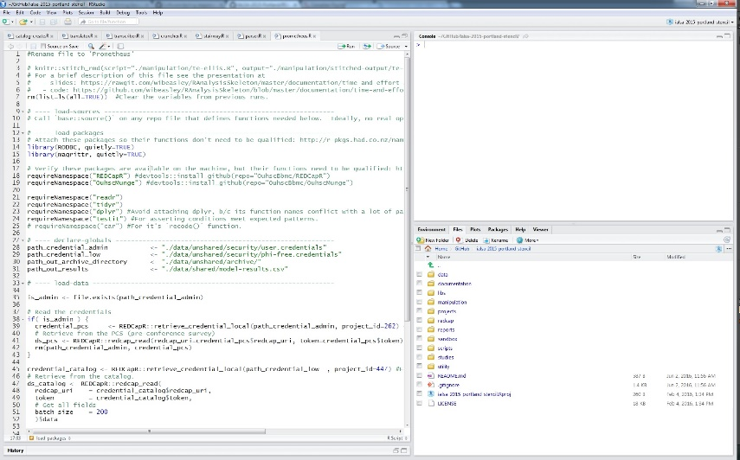
These are R SCRIPTS
Run in RStudio and coordinated in GitHub

Slide 12

This is a
DATASET
each row = one model per study
It is stored on a REDCap server.
Harris, PA, Taylor, R, Thielke, R, Payne, R, Gonzalez, N, Conde, JG (2009). Research electronic data capture (REDCap) - A metadata-driven methodology and workflow process for providing translational research informatics support, J Biomed Inform, 42(2), 377-81.

Slide 13
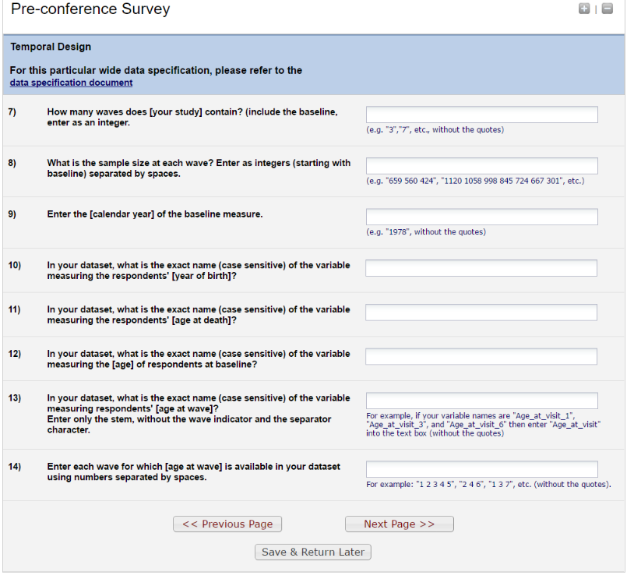
Drivers enter their study’s
METADATA
into this REDCap survey.
Harris, PA, Taylor, R, Thielke, R, Payne, R, Gonzalez, N, Conde, JG (2009). Research electronic data capture (REDCap) - A metadata-driven methodology and workflow process for providing translational research informatics support, J Biomed Inform, 42(2), 377-81.

Slide 14
This is PRIVATE space on local machines.
Sensitive information ALWAYS under control of the driver.
Raw data is not shared with anyone at any point.
-> greater security
-> less IRB paperwork

Slide 15
Now we will walk you through
Coordinated Analysis with Replication
from raw data files to tables and graphs in manuscripts.

Slide 16
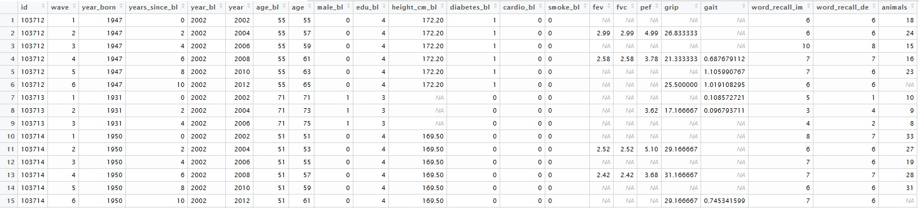
DRIVERS
provide expertise on their longitudinal studies,
bring groomed dataset to CAR, and
need only basic knowledge of R
EAS
Wide
Long

Slide 17

REDCap interacts with the DRIVER
to obtain relevant description
of the study 's DATASET and characteristics.
EAS
Image credit: https://support.novell.com/techcenter/articles/ana19920502.html

Slide 18
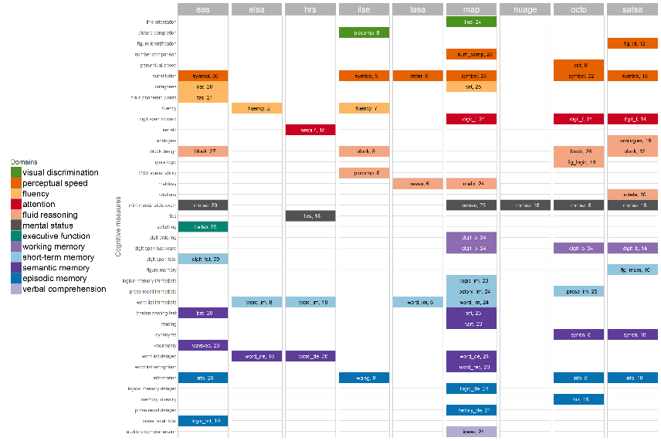
When all drivers fill in the Pre-Conference Survey
we can see which studies have similar
cognitive measures
EAS
ELSA
HRS
ILSE
LASA
MAP
NuAge
OCTO
SATSA

Slide 19

EAS
ELSA
HRS
ILSE
LASA
MAP
NuAge
OCTO
SATSA

Slide 20
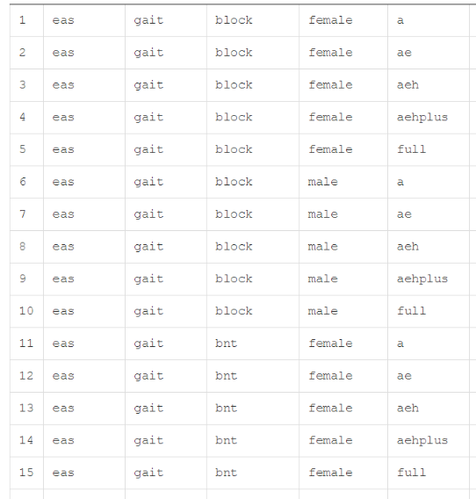
Script run on server.
After drivers enter responses into PCS,
the CREATOR populates/writes
PART I of the Catalog.

Slide 21
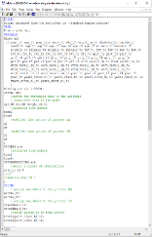
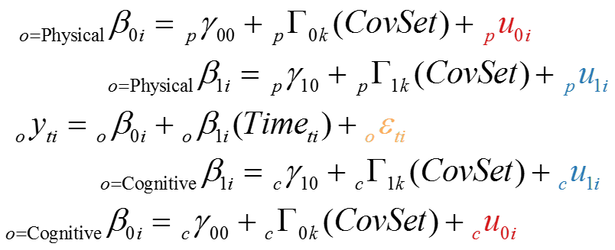
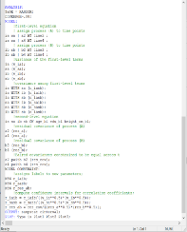
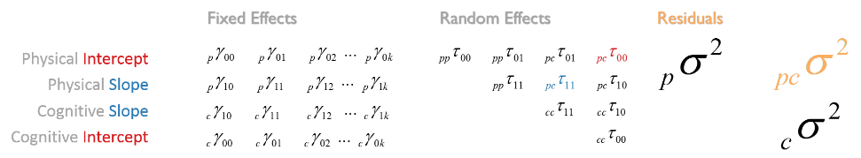
Script run on server.
Using dataset descriptions, the
TRANSLATOR encodes statistical models
Into Mplus estimation language

Slide 22
Script run on driver's local machine.
TRANSCRIBER takes model syntax from Part II,
and saves it as an .inp file on the driver's local machine

Slide 23
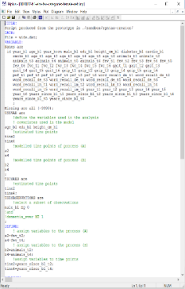

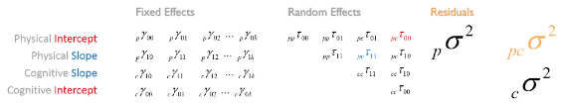
Script run on driver's local machine.
Calls a local installation of Mplus,
which uses the local .dat and .inp files.
Returns an .out file containing the MODEL SOLUTION

Slide 24
Script run on driver's local machine.
Uploads the contents of the .out files
to Part III of the Catalog.

Slide 25
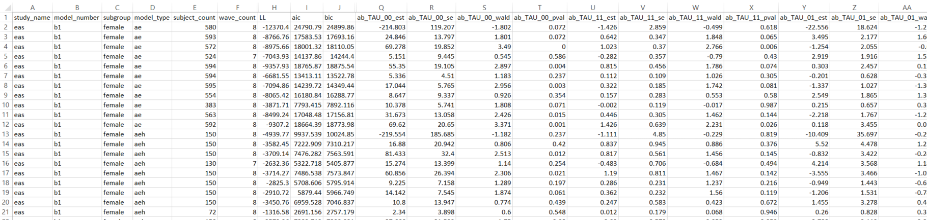
Script run on server.
PARSER extracts elements of model solution from the Mplus output
(e.g. parameter estimates, fit indices, and the convergence status).
For each model, these values are saved as separate columns in a single row of Part IV.

Slide 26
Script run on driver's local machine.
Copies the entire catalog as a .csv on the driver's local machine.
This disconnected CSV allows the drivers to pursue their own analyses after the workshop.

Slide 27
The catalog forms the dataset for META-ANALYSIS,
in which models are the new units.
MANUSCRIPTS reports and interprets the results of meta-analysis.

Slide 28
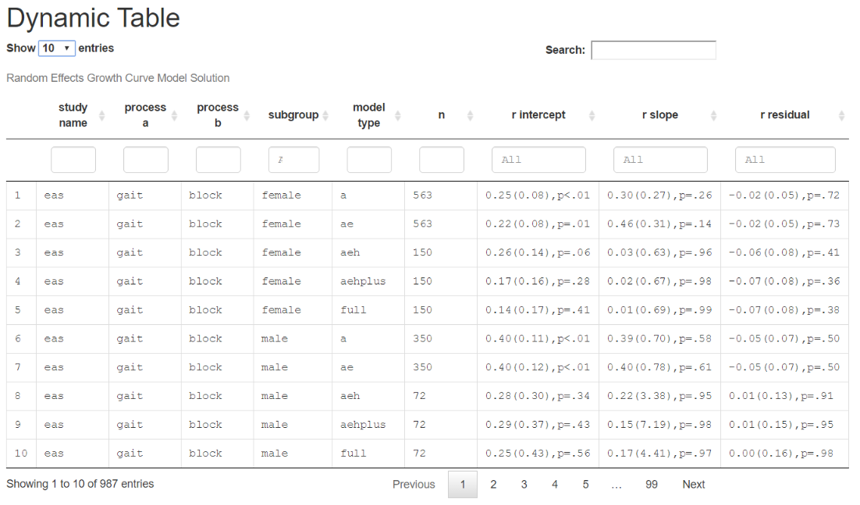
DYNAMIC tables store all extracted model estimates.
These are useful for EXPLORATION.
You can filter and sort to guide your search for patterns.

Slide 29
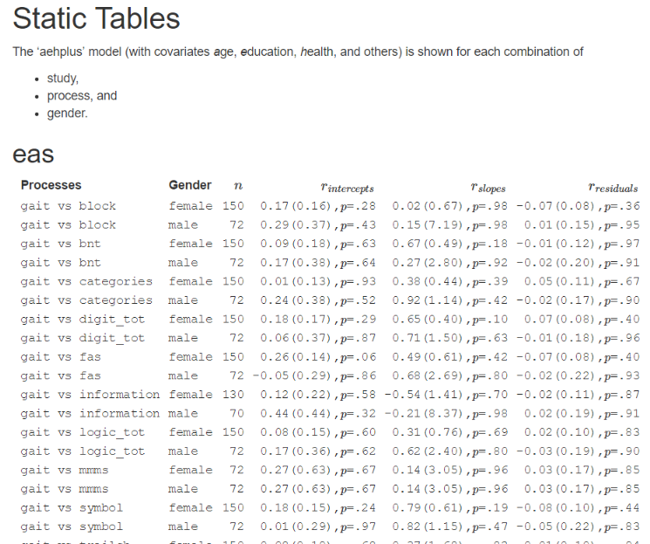
STATIC tables print targeted results.
These are useful to have for
DEMONSTRATION and MANUSCRIPT CONSTRUCTION.

Slide 30
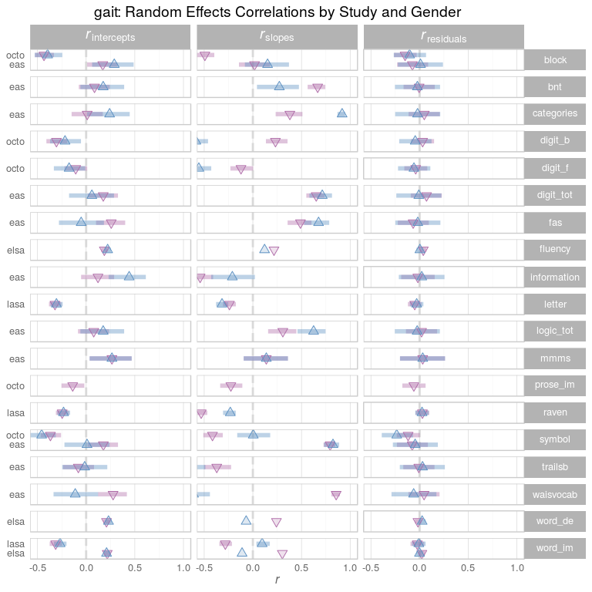
FOREST plots display the values from the tables
To optimize for useful comparisons.

Slide 31
Big Data, Big Analysis:
A Collaborative Modeling Framework for Multi-study Replication
Andriy V. Koval
University of Victoria
William H. Beasley
University of Oklahoma
Andrea Piccinin
University of Victoria
Graciela Muniz-Terrera
University of Edinburgh
Scott Hofer
University of Victoria

Slide 32

www.ialsa.org
IALSA is funded through
an NIH/NIA Program Project Grant (P01AG043362; 2013-2018)
to Oregon Health & Science University
(Program Directors: Scott Hofer, Andrea Piccinin, Jeffrey Kaye, and Diana Kuh)
and previously funded by
NIH/NIA (R01AG026453; 2007-2013) and CIHR (103284; 2010-2013).

Slide 33
Special thanks to the drivers of the Portland 2015 workshop
Portland, OR
Feb 23-25, 2015
Study |  | Driver
Einstein Aging Study | EAS | Andrea Zammit
English Longitudinal Study of Aging | ELSA | Annie Robitaille
Health and Retirement Study | HRS | Chenkai Wu
Interdisciplinary Longitudinal Study of Aging | ILSE | Philipp Handschuh
Normative Aging Study | NAS | Lewina Lee
Quebec Longitudinal Study on Nutrition and Aging | NuAge | Valerie Jarry
Octogenarian Twins | OCTO | Marcus Praetorius
Rush Memory and Aging Project | MAP | Cassandra Brown
Swedish Adoption Twin Study of Aging | SATSA | Deborah Finkel

