Slide 1
Portland : Analytic Strategy
Brainstorming session
2016-08-30

Slide 2
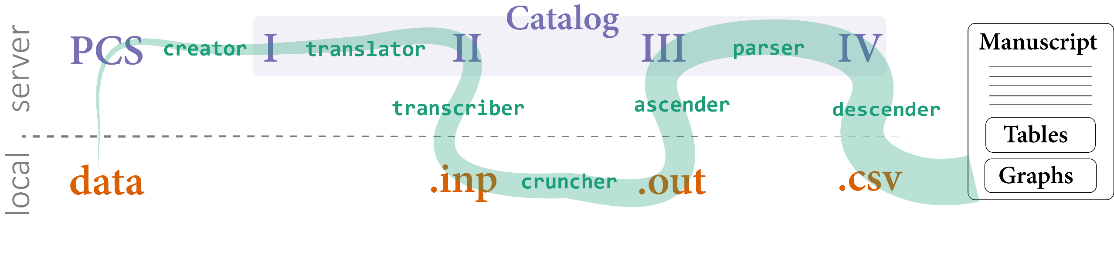
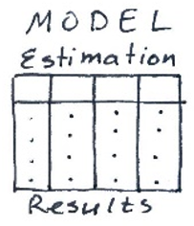

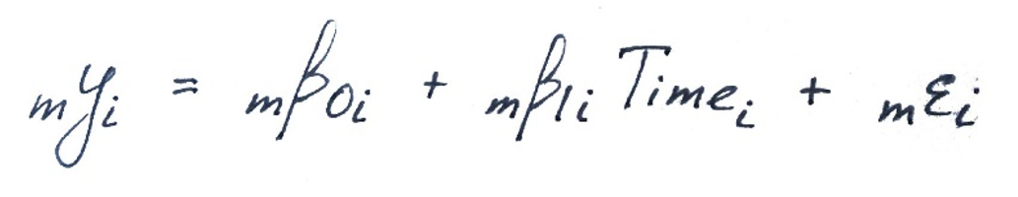
Primary Phase
catalog
ELSA
clean
raw
…
MAP

Slide 3
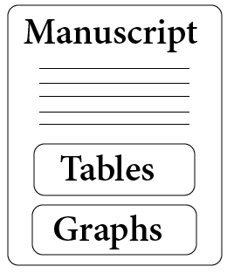
Secondary Phase
catalog

Slide 4
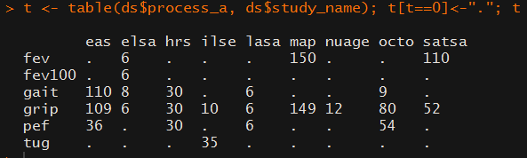
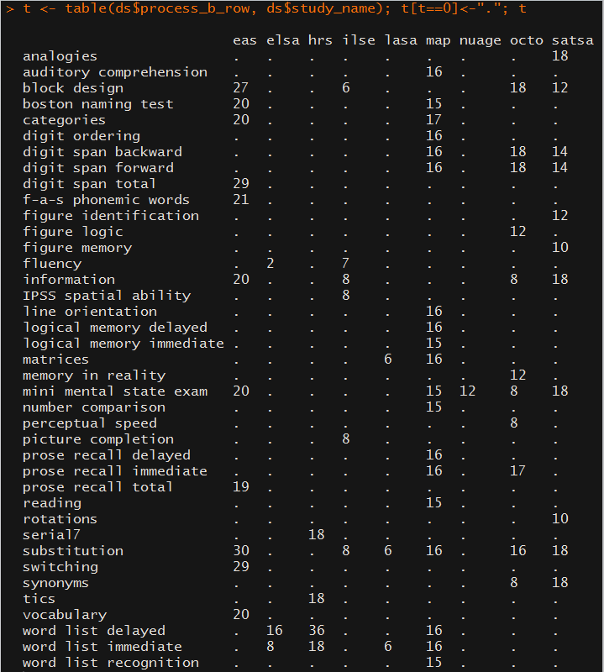
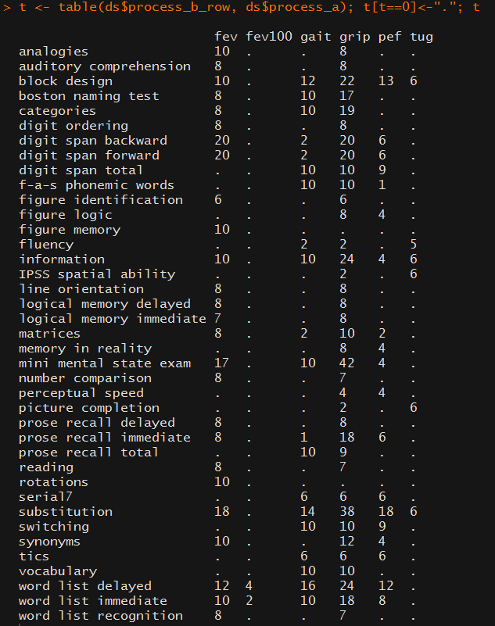
6(3)
35
9 studies

Slide 5
Secondary Phase
Currently available Tools for
Examining the Results
Domain Map
Single Model
Growth Curve
Correlation
catalog

Slide 6
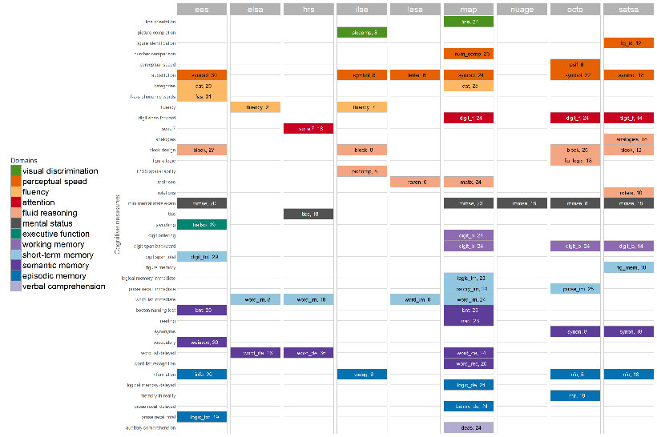
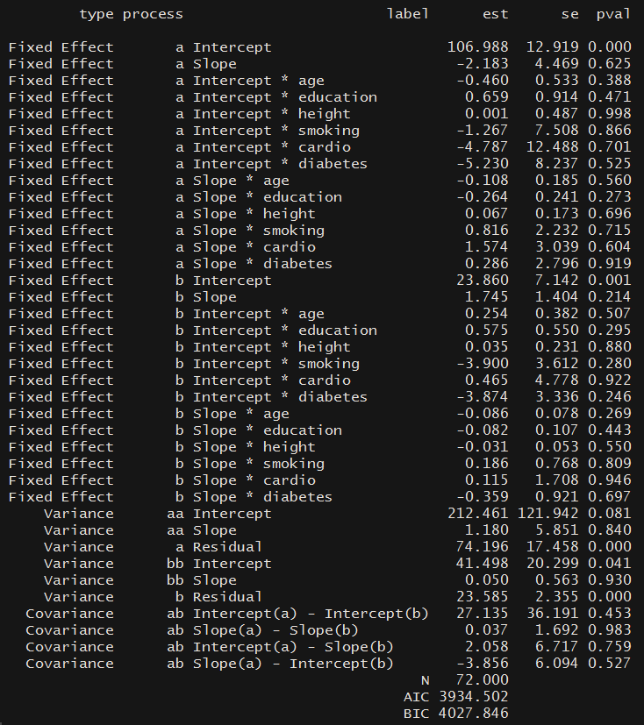

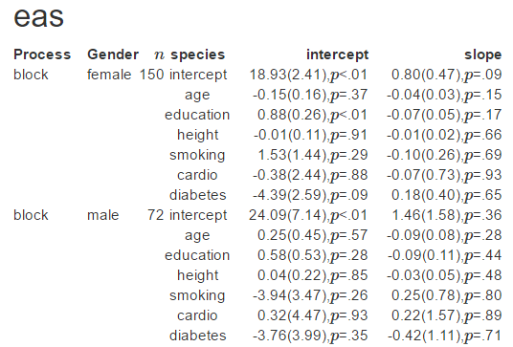
Physical outcome = gait
Model type = aehplus
Domain Map
Single Model
Correlation
Growth Curve

Slide 7
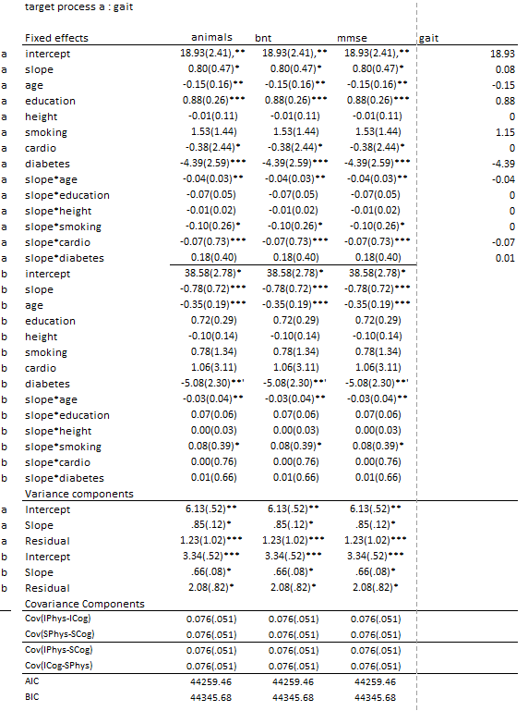
Physical outcome = gait
Model type = aehplus
Domain Map
Correlation
Growth Curve

Slide 8

Modifications to the Domain Map
1) Replace cell values by
Values of target index (R(slopes)
Dense of target index
2) Alternate among physical outcomes
3) Highlight specific domains

Slide 9
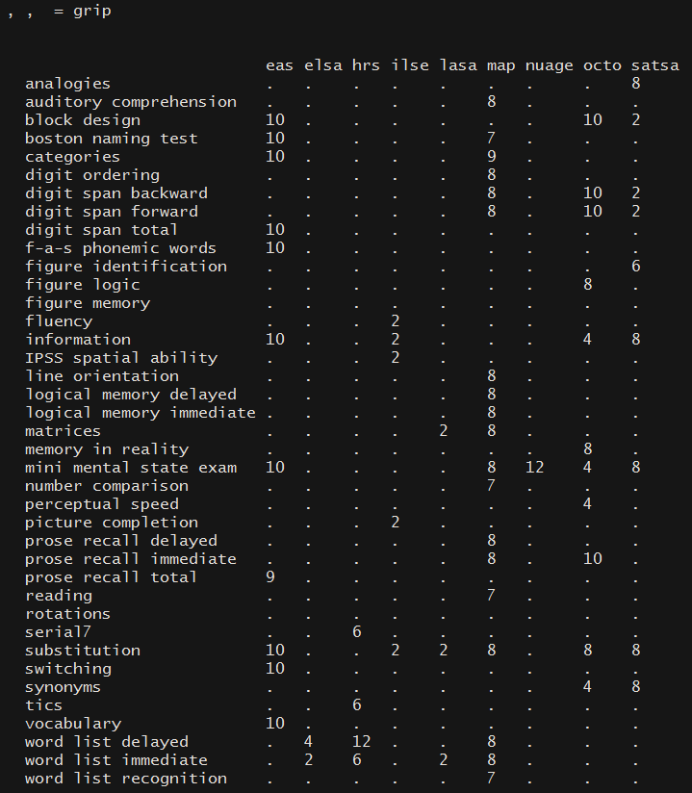

Slide 10
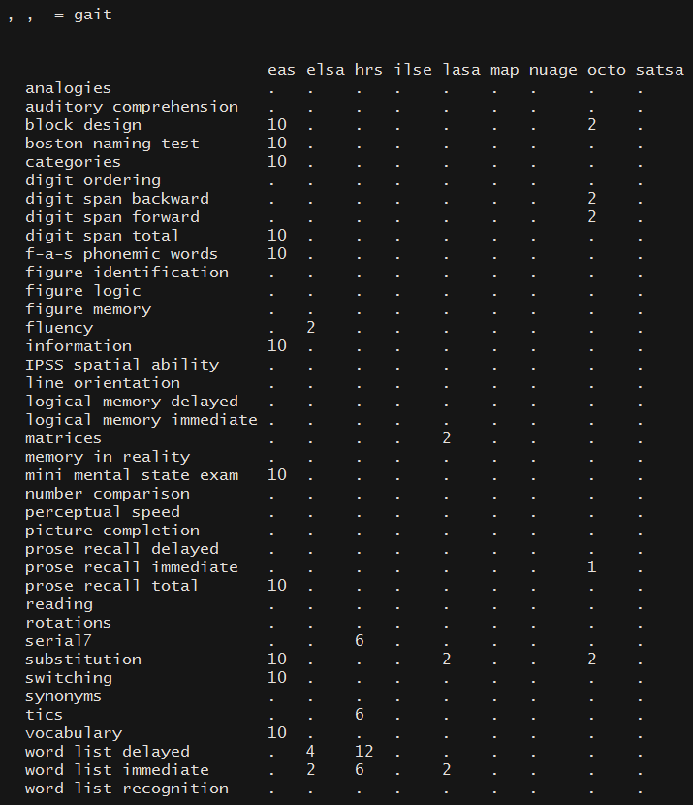

Slide 11
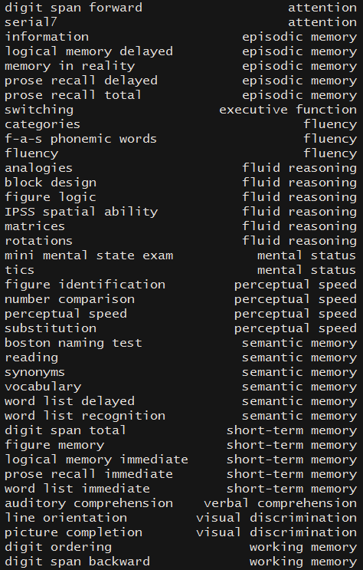
35 x 3 = 105 unique models
pulmonary
OR
gait
OR
grip
Story of class A :
change in a physical outcome (e.g. grip)
is related to
change in a cognitive domain (e.g. short-term memory)
or specific test (e.g. prose recall)

Slide 12
35 x 3 = 105 unique models
pulmonary
OR
gait
OR
grip
Story of class A :
change in a physical outcome (e.g. grip)
is related to
change in a cognitive domain (e.g. short-term memory)
or specific test (e.g. prose recall)

Slide 13
mmse
tics
Story of class B :
performance in a cognitive domain (e.g. fluid reasoning)
is sensitive to
changes in a physical function (e.g. gait)

Slide 14
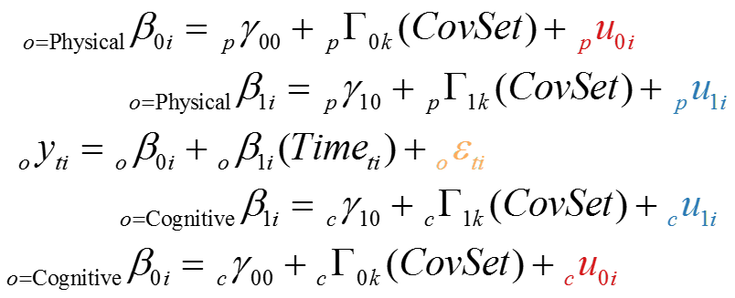
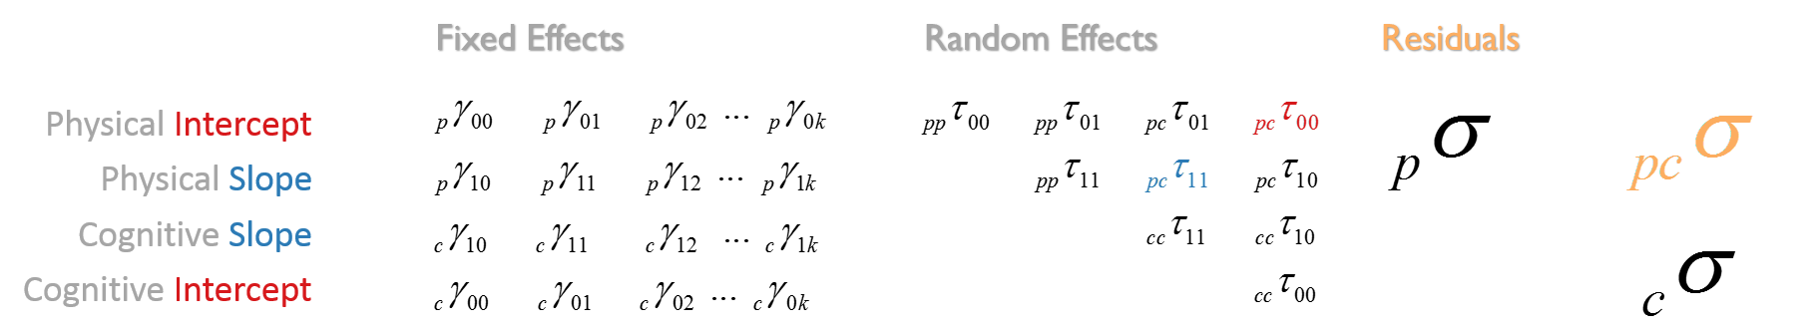
Check points for individual model evaluation
Significant pc TAU 11
Significant pc R 11
Sufficient pp TAU 11
Sample size < threshold
?
?
?

Slide 15
Check points for domain evaluation

