Slide 1

www.ialsa.org
Big Data, Big Analysis:
A Collaborative Modeling Framework for Multi-study Replication
Andriy V. Koval
University of Victoria
William H. Beasley
University of Oklahoma
Andrea Piccinin
University of Victoria
Graciela Muniz-Terrera
University of Edinburgh
Scott Hofer
University of Victoria
Convention of Canadian Psychological Association | Victoria, BC | June 10, 2016

Slide 2
www.ialsa.org
The IALSA network (NIH/NIA 1P01AG043362) is comprised of over 100 longitudinal studies on aging, health and dementia.
Mix of samples aged from birth to 100 years
Assessed from 1921 to the present.
Monitoring each individual for 4 to 48 years
Time between assessments 6 months to 17 years
Focus on the reproducibility of results (i.e., direction and pattern of effects) across populations, historical periods, measurements, designs, and statistical models.
Research aim: To maintain and enhance cognitive and physical health and well-being throughout the lifespan

Slide 3
www.ialsa.org
IALSA Approach: Coordinated Analysis with Replication (CAR)
Finds common measures among studies (maelstrom-research.org)
Fits same models to many longitudinal studies
Meta-analyzes model solutions
Aim: Maximize value from each study while providing comparable results
Expect similar conclusions regardless of the exact variables used.
Evaluation of sensitivity to statistical model
Meta-Analysis / Meta-Regression
Hofer, S. M., & Piccinin, A. M. (2009). Integrative data analysis through coordination of measurement and analysis protocol across independent longitudinal studies. Psychological methods, 14(2), 150.

Slide 4
www.ialsa.org
IALSA Portland Workshop Feb 23-25, 2015 (github.com/IALSA/IALSA-2015-Portland)
Primary aim: To examine the associations between changes in
physical functioning (i.e., grip strength, pulmonary function) and
cognitive functioning (i.e., memory, reasoning)
in multiple-study comparative framework.
Research foci: To examine concurrent decline between
Pulmonary function – Cognition
Grip Strength – Cognition
Gait – Cognition
Cognition: Within and across cognitive domains
Physical functioning: Across pulmonary, grip, gait
Bivariate linear growth curve models
Adjustment for age, sex, education, height, health behaviors and outcomes

Slide 5
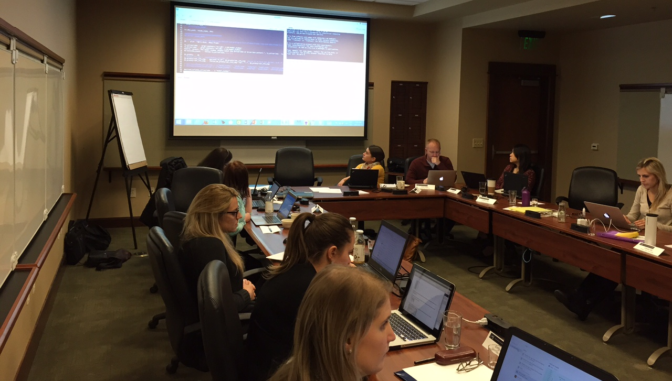
Portland, OR
Feb 23-25, 2015

Slide 6
This is the
WORKFLOW MAP
of the coordinated analysis

Slide 7
Next
We will show you
What each element and process
IS and DOES

Slide 8
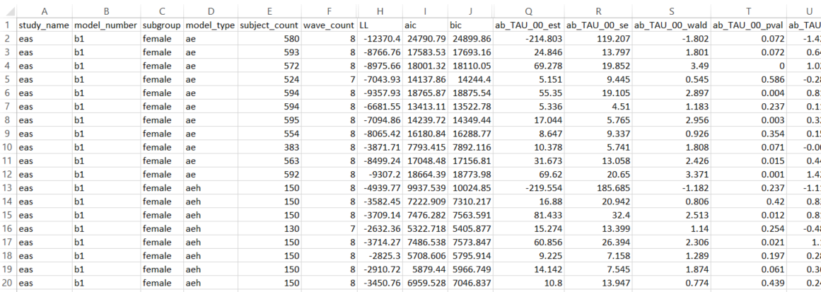
These are
Language-agnostic
Tabulated
DATA FILES

Slide 9
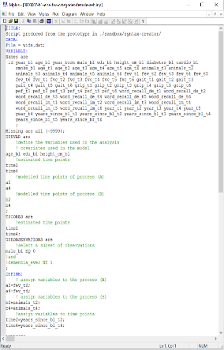
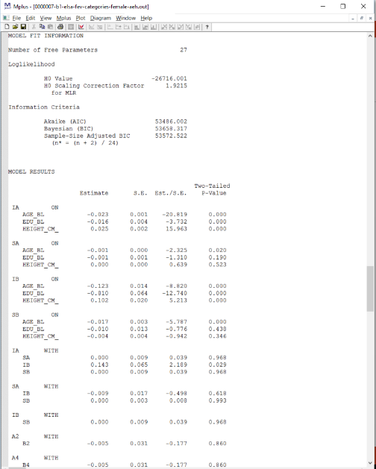
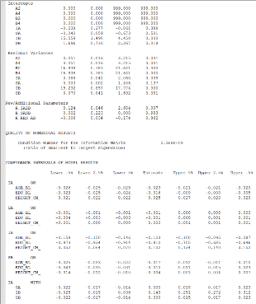
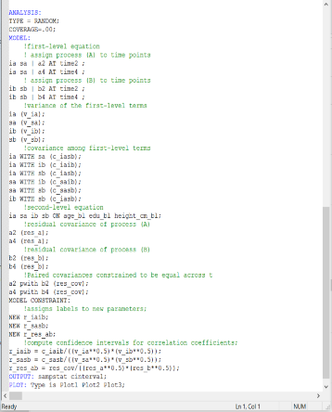
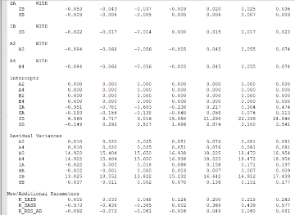
These are
Free-form
Text files/strings
used and produced by Mplus

Slide 10
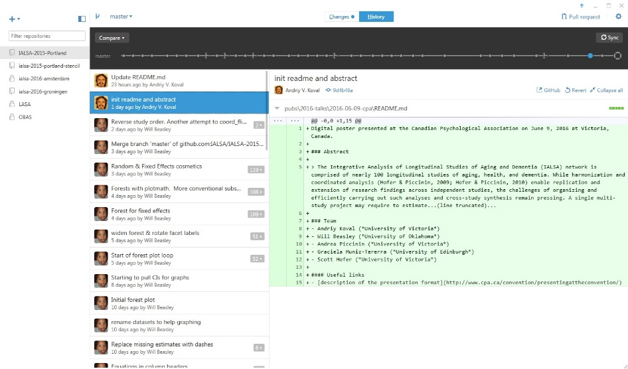
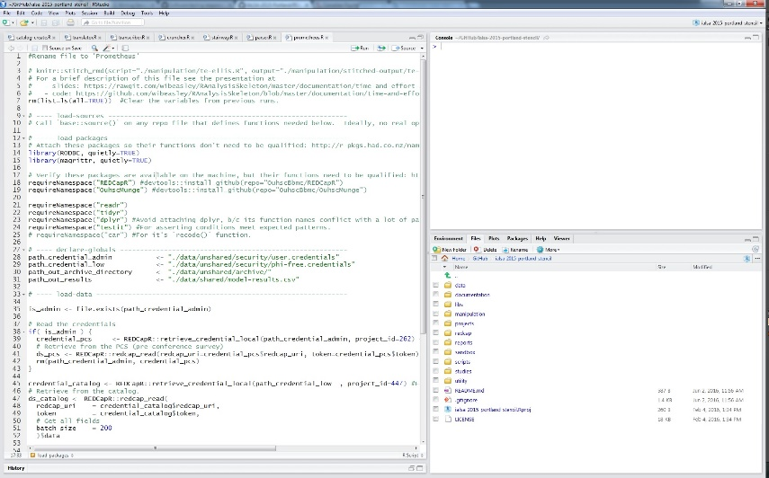
These are R SCRIPTS
Run in RStudio and coordinated in GitHub

Slide 11

This is a
DATASET
each row = one model per study
It is stored on a REDCap server

Slide 12
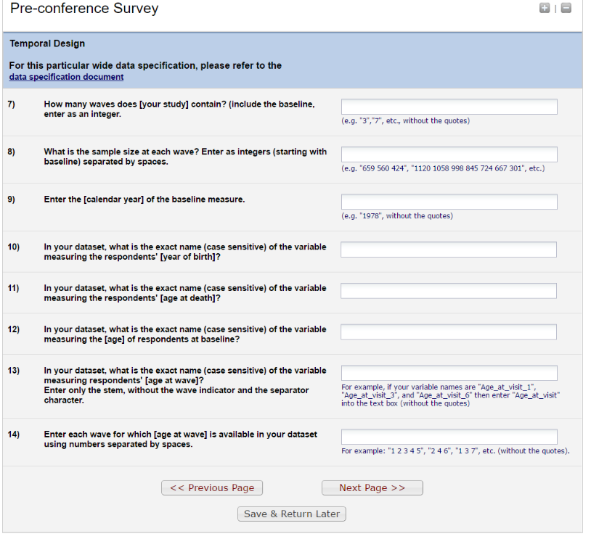
This is a
REDCap survey
Through which participants
Enter information about their studies

Slide 13
This is PRIVATE space
On local machines of drivers
Raw data never leaves this space

Slide 14
Now we will walk you through
Coordinated Analysis with Replication
from raw data files to tables and graphs in manuscripts

Slide 15
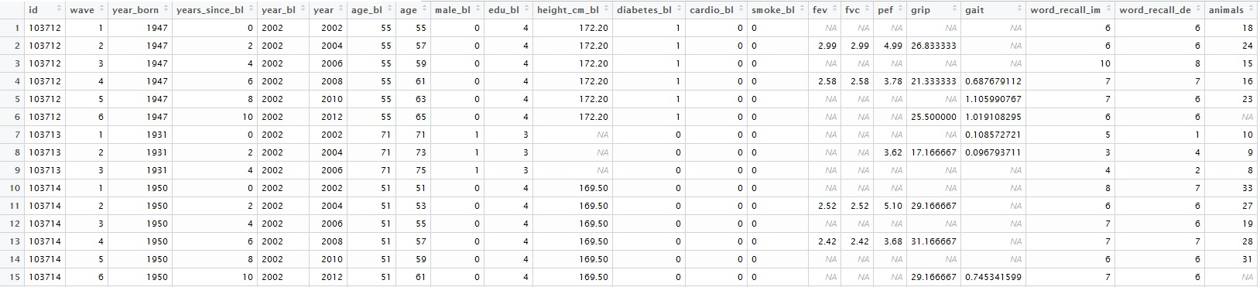
DRIVER
Someone with some expert knowledge
Of a particular longitudinal study
Who brings groomed data to CAR
EAS
Wide
Long

Slide 16
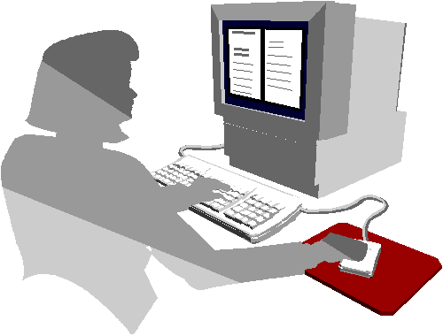
REDCap interacts with the DRIVER
to obtain relevant description
of the study 's DATASET and characteristics.
EAS
Image credit: https://support.novell.com/techcenter/articles/ana19920502.html

Slide 17
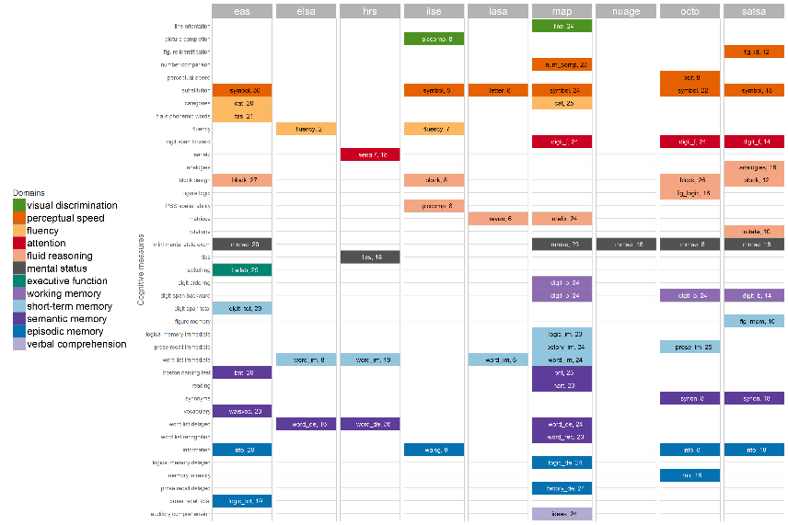
When all drivers Fill in the Pre-Conference Survey
We can see which have similar
cognitive measures
EAS
ELSA
HRS
ILSE
LASA
MAP
NuAge
OCTO
SATSA

Slide 18

EAS
ELSA
HRS
ILSE
LASA
MAP
NuAge
OCTO
SATSA

Slide 19
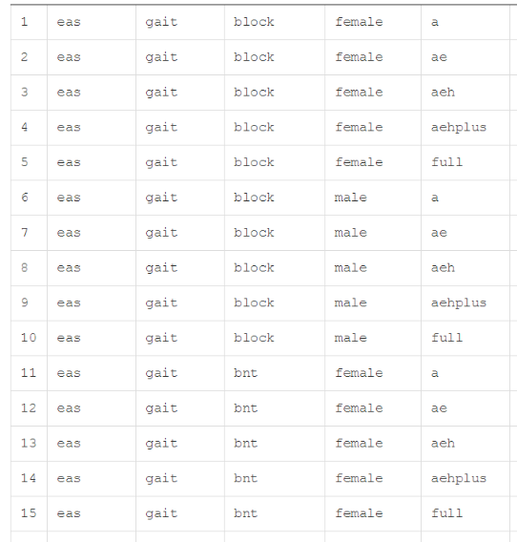
Script run on server.
After drivers enter responses into PCS,
the CREATOR populates/writes
PART I of the Catalog.

Slide 20
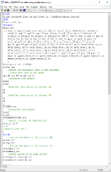
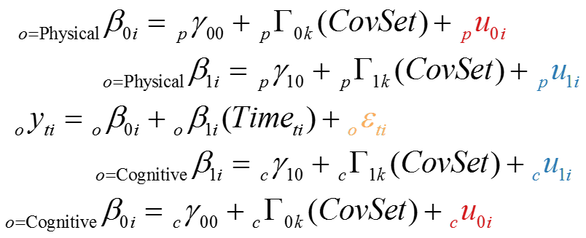
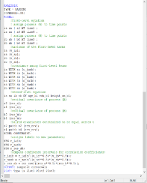
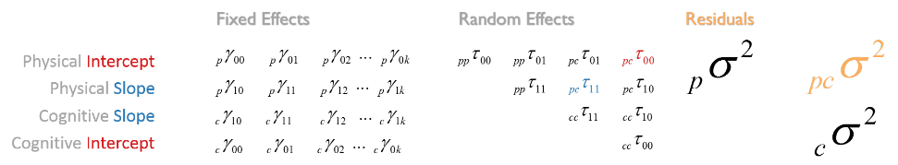
Script run on server.
Using dataset descriptions, the
TRANSLATOR encodes statistical models
Into Mplus estimation language

Slide 21
Script, run on driver's local machine.
TRANSCRIBER takes model syntax from Part II,
and saves it as an .inp file on the driver's local machine

Slide 22
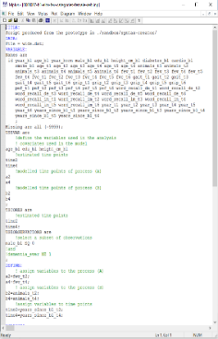

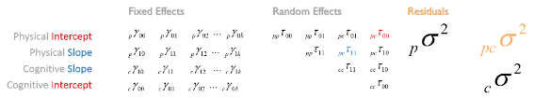
Script, run on driver's local machine.
Calls a local installation of Mplus,
which uses the local .dat and .inp files.
Returns an .out file containing the MODEL SOLUTION

Slide 23
Script, run on driver's local machine.
Uploads the contents of the .out files
to Part III of the Catalog.

Slide 24
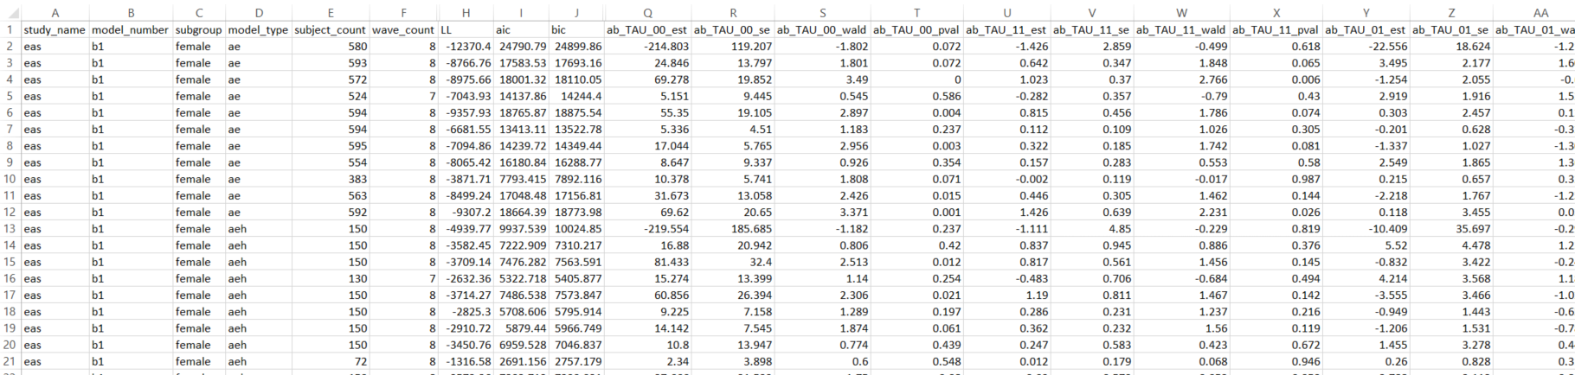
Script run on server.
PARSER extracts model solution from the Mplus output
(e.g. parameter estimates, fit indices, and the convergence status).
For each model, these values are saved as separate columns in a single row of Part IV.

Slide 25
Script run on server.
Copies the entire catalog as a CSV on the driver's local machine.
This disconnected CSV are drivers’ to keep for further analysis.

Slide 26
The Catalog forms the dataset for META-ANALYSIS,
In which models are the new units.
MANUSCRIPTS reports and interprets the results of meta-analysis.

Slide 27
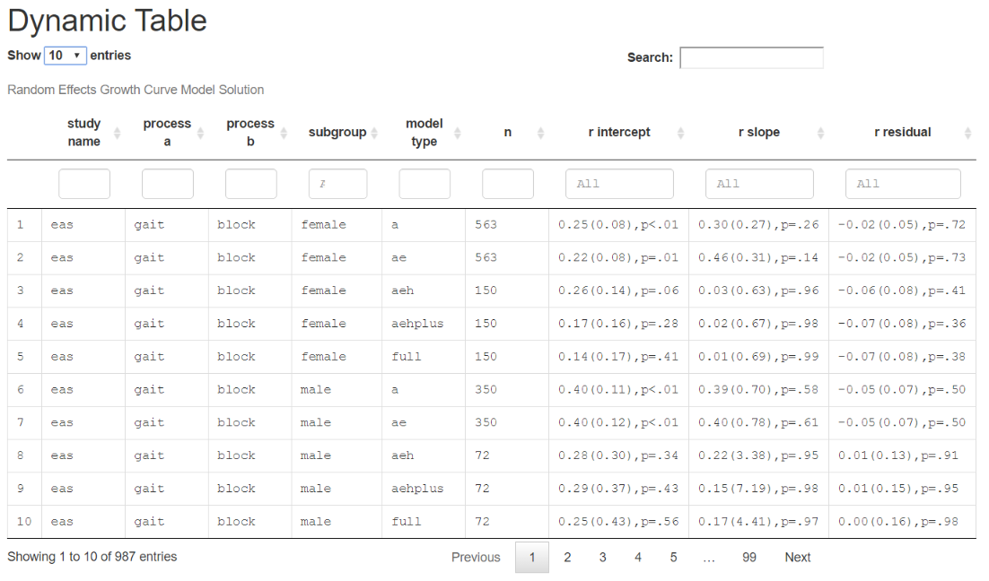
DYNAMIC tables store all possible values.
These are useful to have for EXPLORATION.
You can filter and sort to guide your search for patterns.

Slide 28
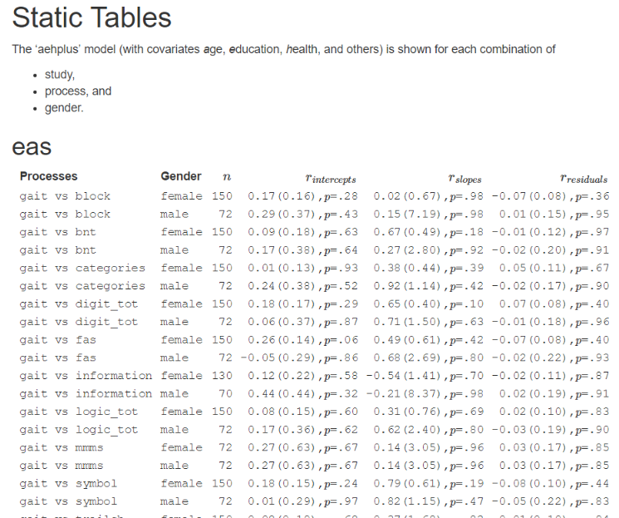
STATIC tables print targeted results.
These are useful to have for DEMONSTRATION.

Slide 29
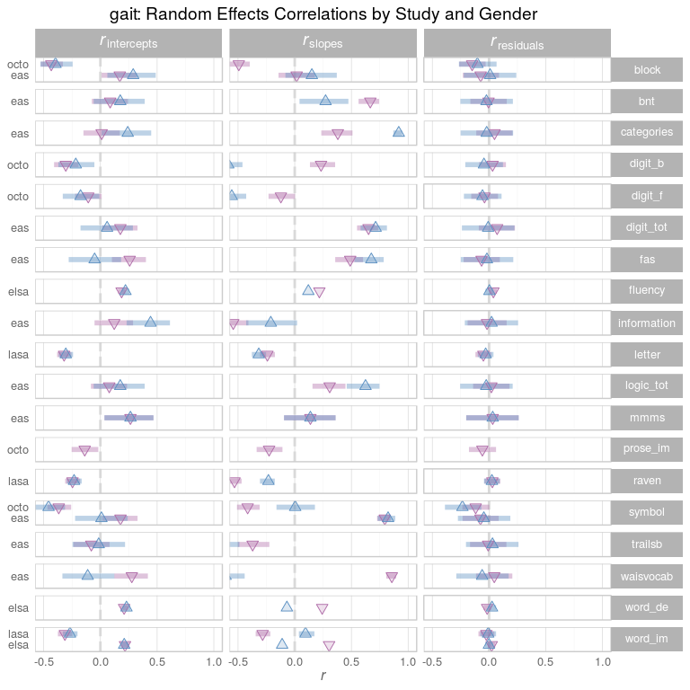
FOREST plots display the values from the tables
To optimize for useful comparisons.

Slide 30
Big Data, Big Analysis:
A Collaborative Modeling Framework for Multi-study Replication
Andriy V. Koval
University of Victoria
William H. Beasley
University of Oklahoma
Andrea Piccinin
University of Victoria
Graciela Muniz-Terrera
University of Edinburgh
Scott Hofer
University of Victoria

Slide 31

www.ialsa.org
IALSA is funded through
an NIH/NIA Program Project Grant (P01AG043362; 2013-2018)
to Oregon Health & Science University
(Program Directors: Scott Hofer, Andrea Piccinin, Jeffrey Kaye, and Diana Kuh)
and previously funded by
NIH/NIA (R01AG026453; 2007-2013) and CIHR (103284; 2010-2013).

Slide 32
Special thanks to the drivers of the Portland 2015 workshop
Portland, OR
Feb 23-25, 2015
Study | Driver
Einstein Aging Study | Andrea Zammit
English Longitudinal Study of Aging | Annie Robitaille
HRS | Chenkai Wu
Interdisciplinary Longitudinal Study | Philipp Handschuh
Normative Aging Study | Lewina Lee
NuAge | Valerie Jarry
OCTO-Twin | Marcus Praetorius
Rush Memory and Aging Project | Cassandra Brown
SATSA | Deborah Finkel

