Slide 1
Portland CAR: next steps
2016-08-05

Slide 2
Contents
Preamble : context so far
CPA poster : Gen2 scripts
Next steps

Slide 3

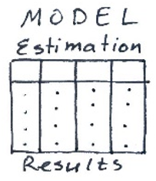
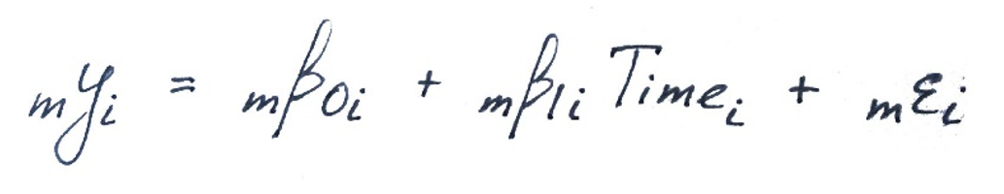
Original vision
Aggregation Phase: Coordinate statistical analysis of the primary data
Analysis Phase: Facilitate the analysis of the secondary data
ELSA
…
MAP
primary
secondary

Slide 4
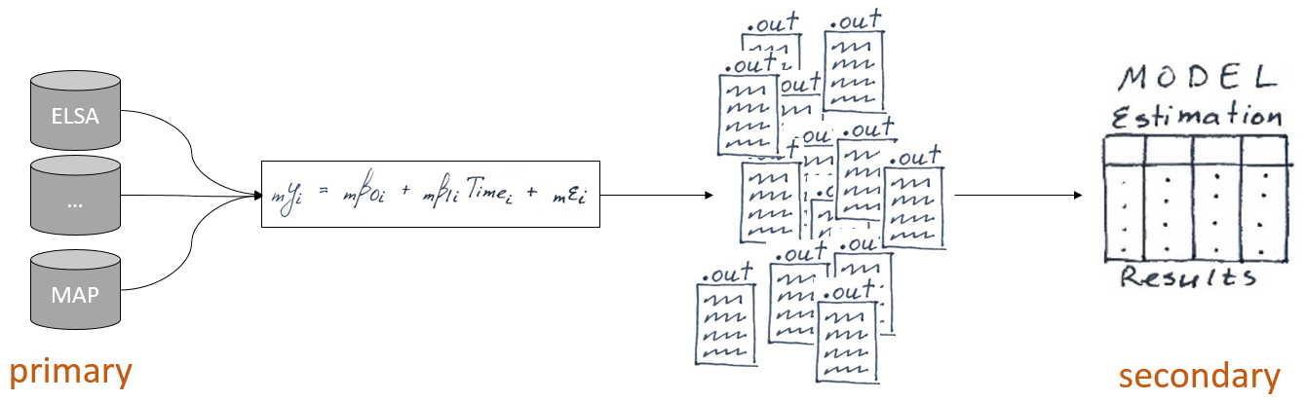
Original vision
Coordinate statistical analysis of the primary data
Standardize input data
Standardize syntax for fitting models
Remove human error during extracting indices from outputs
Facilitate the analysis of the secondary data

Slide 5
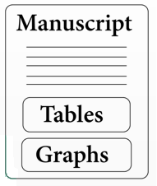
Original vision
Coordinate statistical analysis of the primary data
Facilitate the analysis of the secondary data
Originally we thought a simple BISR correlation will be all we need
But there were many unexpected specifics that threatened the validity of conclusions
Phase 2

Slide 6
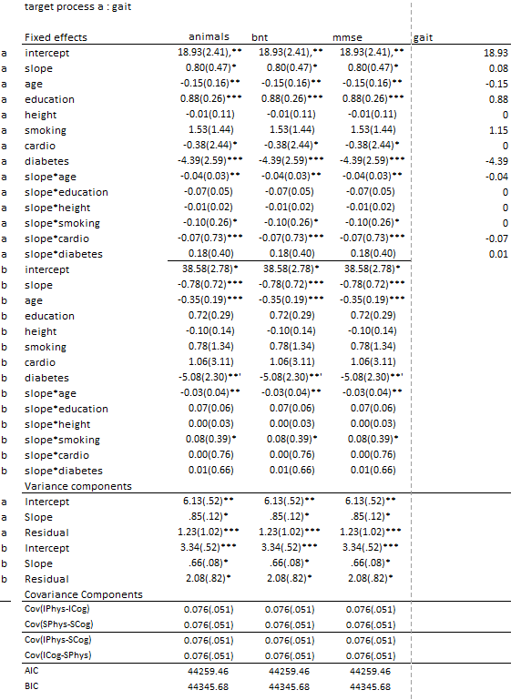
Current progress in the Analysis Phase
Table of BISR correlation
Table of Growth processes
Study-specific tables for manuscript seeds

Slide 7
This presentation is about phase of
mechanical aggregation.
The subjective analysis phase is for another meeting

Slide 8
Two generation of software scripts
2015
2016
Feb
Mar
Apr
May
Jun
Jul
Aug
Sep
Oct
Nov
Dec
Jan
Feb
Mar
Apr
May
Jun
Jul
Aug
Sep
Generation 1
Generation 2
Limitations
Difficult to re-run models
Humans create syntax files
No certainty that data described are data modeled

Slide 9
Two generation of software scripts
2015
2016
Feb
Mar
Apr
May
Jun
Jul
Aug
Sep
Oct
Nov
Dec
Jan
Feb
Mar
Apr
May
Jun
Jul
Aug
Sep
Generation 1
Generation 2
Uncertainty about:
Right subjects? (e.g. wrong subgroup filter)
Misspecified models? ( e.g. relied on filename for model shape)
Violated convention that were suggested to the drivers?

Slide 10
Two generation of software scripts
2015
2016
Feb
Mar
Apr
May
Jun
Jul
Aug
Sep
Oct
Nov
Dec
Jan
Feb
Mar
Apr
May
Jun
Jul
Aug
Sep
Generation 1
Generation 2
Creates Threats to Statistical Conclusion Validity (Analysis Phase):
Many models have not estimated correlations
(instead, computed post hoc)
We cannot rely ONLY on the value of BISR correlations. Here’s why:
Variance of slope
Sample size due to subgroup split
What if we drop models with insufficient sample size? (e.g. N < 100 )
Number of included waves
D. Untraced human errors during estimation

Slide 11
Two generation of software scripts
2015
2016
Feb
Mar
Apr
May
Jun
Jul
Aug
Sep
Oct
Nov
Dec
Jan
Feb
Mar
Apr
May
Jun
Jul
Aug
Sep
Generation 1
Generation 2
Limitations
Difficult to re-run models
Humans create syntax files
No certainty that data described are data modeled
Must improve
Easy to re-run models
Automatic generation of syntax files for each study
Ensure the data described is the data modeled
Greater trust in replication
On May 26, 2016 we have successfully tested aggregation phase or Gen 2 scripts using ELSA data

Slide 12
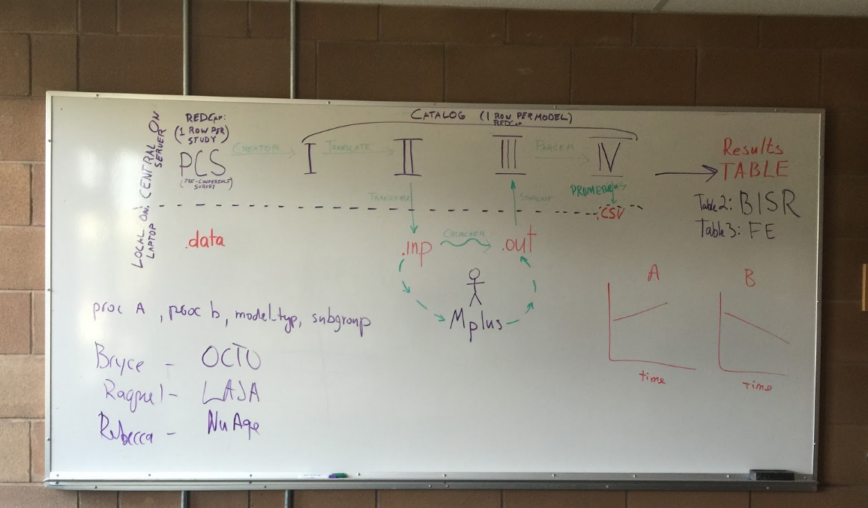
UVic May 26, 2016
We asked three people to use the same dataset (ELSA)
Testing that they would arrive at the same results
Focus on the software ergonomics more than the analysis

Slide 13
POSTER PRESENTATION

Slide 14
(Automated) Chain of Custody
evidence must be documented, otherwise it can’t be used in courtroom
cannot be vouched for
can be contaminated during investigation
Gen 2 has the evidence under control the entire time from the crime scene to the courtroom
Adds transparency and reproducibility to the process
Videotaping the entirety of the investigation
No assurance that the knife found on the crime scene is the murder weapon.
But solid confidence that the knife presented in the courtroom is the knife found at the crime scene

Slide 15
(Automated) Chain of Custody
Start:
Pre-Conference Survey + data
No human intervention after that:
no subjective decision
only click-and-run
oversight of script execution
Without ACC we cannot be certain about:
Right subjects? (e.g. apply subgroup filter)
Misspecified models? (relied on filename for model shape)
Violated convention that were suggested to the drivers?

Slide 16
Bottlenecks
1 generation
generating and aggregating the output ( ~12 months)
comprehending the aggregated output ( ~ 5 months into it)
2 generation
generating and aggregating the output (~ 1 day)
comprehending the aggregated output

Slide 17
Advantages of Gen 2
Lower cost of collaboration during coordinated analysis
Alleviates the disheartening difficulty/length of result extraction
If each workshop takes too long to process then you will be tempted to swing for the fences (become more aggressive to achive results here and now, b/c you don’t want to wait for another 18 months.
greater focus on achievable goals

Slide 18
Advantages of Gen 2
Focus changes
From :How many models can we bring together?
To: How can we organize the results?
To : How many results can we make sense of?
Will take less time
Can do remotely
More frequent
More focused workshop
Greater emphasis on Phase 2

Slide 19
Future directions
iLifeSpan-based:
Groom available studies to fit Portland needs = standard for a “general grooming”
Same model (BISR), new workshop with new studies or/and variables
Keep variables, change studies
change variables, change studies
New statistical model
Old studies
New studies

Slide 20
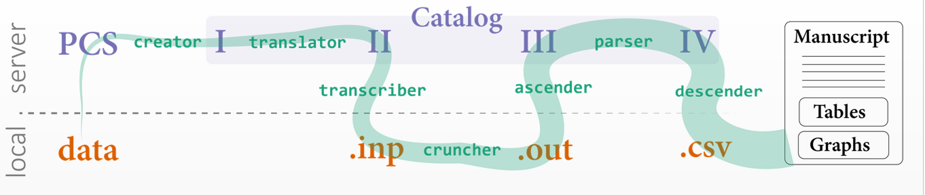

Slide 21
IALSA-study-curator project
Study
Einstein Aging Study | EAS
English Longitudinal Study of Aging | ELSA
Health and Retirement Study | HRS
Interdisciplinary Longitudinal Study of Aging | ILSE
Normative Aging Study | NAS
Quebec Longitudinal Study on Nutrition and Aging | NuAge
Octogenarian Twins | OCTO
Rush Memory and Aging Project | MAP
Swedish Adoption Twin Study of Aging | SATSA
Longitudinal Aging Study Amsterdam | LASA
Whitehall II | WH
100%
100%

Slide 22
New options in Gen 2
Unlike Gen 1 that offered only option 1, Gen 2 offers different types of workshops:
together ( 4 days + travel costs)
remote completely (regular, spaced out meetings online)
hybrid (muscle happens quickly, more time dedicated to the interpretation and writing), happens at the conference workshop ( ~6 hours

